Slide 1


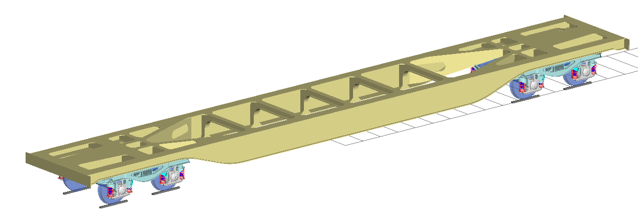
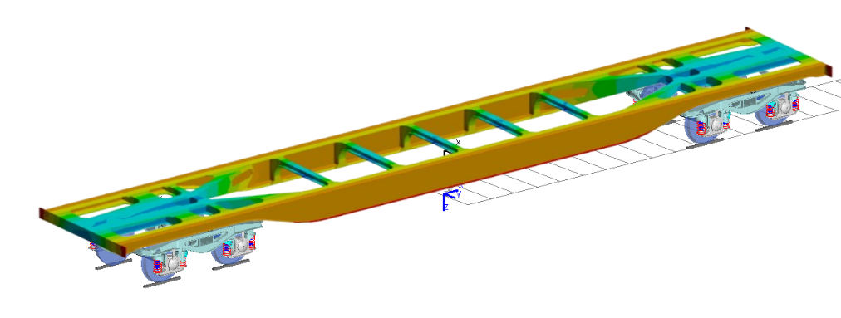
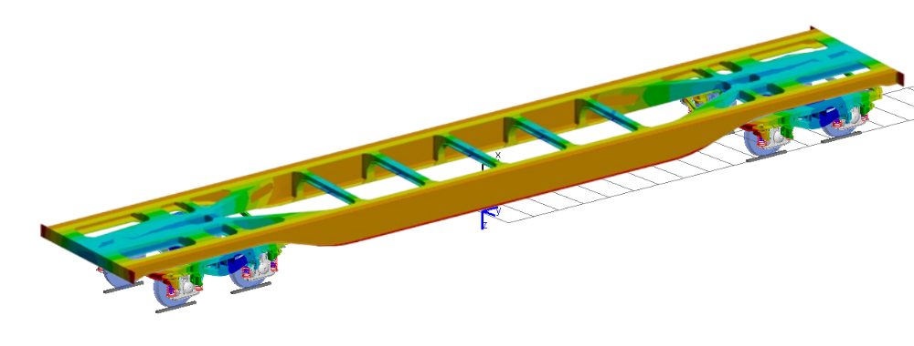
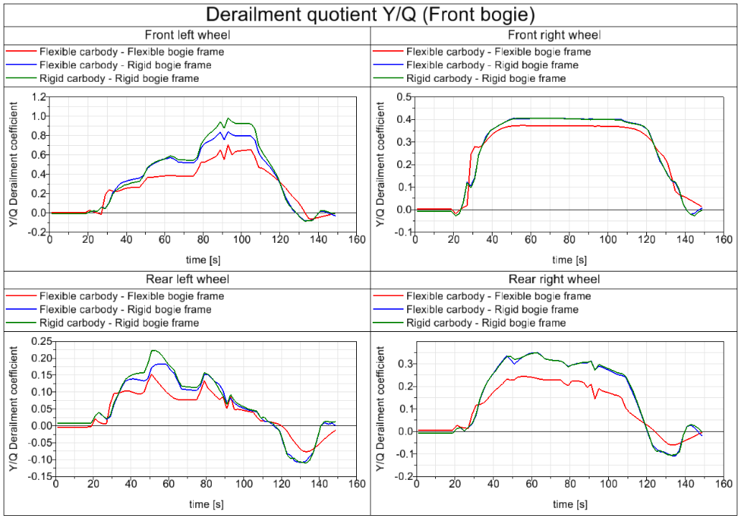
Safety against derailment of a container freight wagon with flexible components according to the EN 14363 standard – the Method 1
TRANSCOM 2025: 16th International Scientific Conference on Sustainable, Modern and Safe Transport
Vadym Ishchuk¹, Ján Dižo¹, Miroslav Blatnický¹, Alyona Lovska¹ , Stanislav Semenov² , Evgeny Mikhailov²
1 University of Žilina, Žilina, Slovak Republic
2 Volodymyr Dahl East Ukrainian National University, Kyiv, Ukraine
introduction
Safety against derailment or derailment quotient Y/Q is one of the main safety indicators of a rail vehicle. According to the EN 14363 standard, there are three methods to evaluate the safety against derailment of a rail vehicle, which can be performed on real track or by means of simulation modelling. | In this work, a simulation test of safety against derailment is carried out using the commercial software Simpack according to the Method 1 of the EN 14363 standard. Three configurations of the rail vehicle model (rigid, hybrid, fully flexible) have been created for simulation modelling. | The first configuration is a basic model with rigid bodies. The second configuration is a hybrid system with a flexible wagon frame and with a rigid bogie frame. The third configuration includes flexible elements for both the wagon frame and the bogie frame simulating more complex mechanical interactions.
materials, methods & implementation
The commercial software Simpack was used for modelling the MBS models of a freight wagon. Three wagon model configurations were made for the simulation modelling, each representing different levels of detail of the rail vehicle's mechanical structure. The first configuration (Fig. 1a) represents a basic model. This model includes only rigid bodies, and it is used as a basic etalon to compare the dynamic properties with two other configurations in which flexible body elements are implemented. The second configuration (Fig. 1b) of the simulation model is a hybrid system in which the container wagon's frame is designed as a flexible body, while the bogie frame remains a rigid body. The third wagon model configuration (Fig. 1c) includes two flexible elements: the wagon frame and the bogie frame. In this case, the availability of flexible components affects load redistribution, vibration amplitudes and wheel-rail contact conditions, especially during movement on the track with irregularities. The model considers longitudinal and transverse deformations, elastic couplings between components, and the effect of flexibility on contact forces and natural frequencies of the structure. This provided a more accurate assessment of the dynamics and safety against derailment.
a)
b)
c)
Fig. 1. The Sgnss 60ft wagon model – a) rigid, b) hybrid, c) flexible
results
As it can be seen in Fig. 2, the largest difference between the derailment quotient values occurs at the front left wheel. For the first model, which is the base model used for comparison with the other two models, the derailment quotient value is Y/Q = 0.98425. The analogous value obtained for the second and third models is Y/Q = 0.843149 and Y/Q = 0.704898. All values of the derailment quotient Y/Q for three wagon models did not exceed the maximum permissible value of Y/Qmax = 1.2 (for the curves with a radius smaller than 250 m). As it can be seen after implementing a flexible wagon body frame, the derailment quotient value decreases by 16.74%.
When both the flexible wagon body frame and the flexible bogie frame are implemented (the third model), the decrease is of 39.62%. Between the second and third models, the difference equals to the value of 19.61%. It can be concluded based on the obtained results that the derailment quotient value decreases significantly with the implementation of a flexible wagon body frame and even more significantly with the combination of a flexible wagon body frame and a flexible bogie frame. Based on the achieved results, the third configuration was the safest from the point of view of safety against derailment, as it most accurately captured structural deformations and their influence on wheel-rail contact forces. Unlike the rigid and hybrid configurations, the fully flexible model allowed for a more realistic assessment of dynamic load redistribution, leading to better prediction of the derailment quotient.
Fig. 2. Waveform of the derailment quotient Y/Q – front bogie.
conclusion & implementation path
The presented study employed simulation modelling using the Simpack software in order to evaluate safety against derailment by the Method 1 of the EN 14363 standard. Three rail vehicle model configurations were developed for the simulation. The first one was a basic rigid-body model intended as a benchmark to assess the impact of incorporating flexible components. The second configuration was a hybrid model with a flexible wagon body frame and a rigid bogie frame allowing the effects of frame flexibility to be analysed. The third configuration introduced flexibility into both the wagon body and bogie frames, capturing more intricate mechanical interactions. Safety against derailment was quantified using the derailment quotient Y/Q, which was presented on waveforms. The analysis reveals that the flexibility of wagon components significantly effects the dynamic behaviour of the wagon as it moves on a railway track.
acknowledgements
This research was also supported by the Slovak Research and Development Agency of the Ministry of Education, Science, Research and Sport of the Slovak Republic VEGA 1/0308/24 “Research of dynamic properties of rail vehicles mechanical systems with flexible components when running on a track. This publication was supported by the Cultural and Educational Grant Agency of the Ministry of Education of the Slovak Republic in the project KEGA 031ŽU-4/2023: Development of key competencies of the graduate of the study program Vehicles and Engines. “Funded by the EU NextGenerationEU through the Recovery and Resilience Plan for Slovakia under the project No. 09I03-03-V01-00131.” This contribution was elaborated within execution of the project “New generation of freight railway wagons” (Project code in ITMS2014+: 313010P922), on the basis of support of the operational program Research and innovation financed from the European Regional Development Fund.

