Slide 1


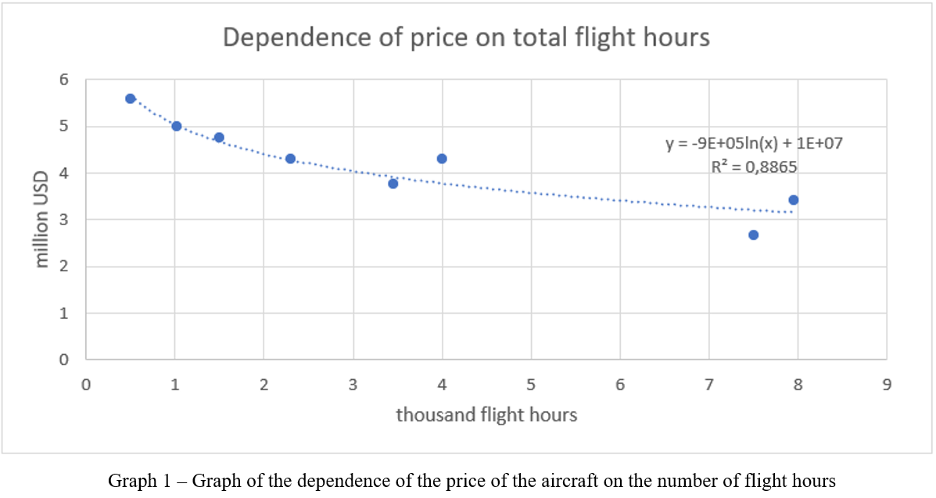
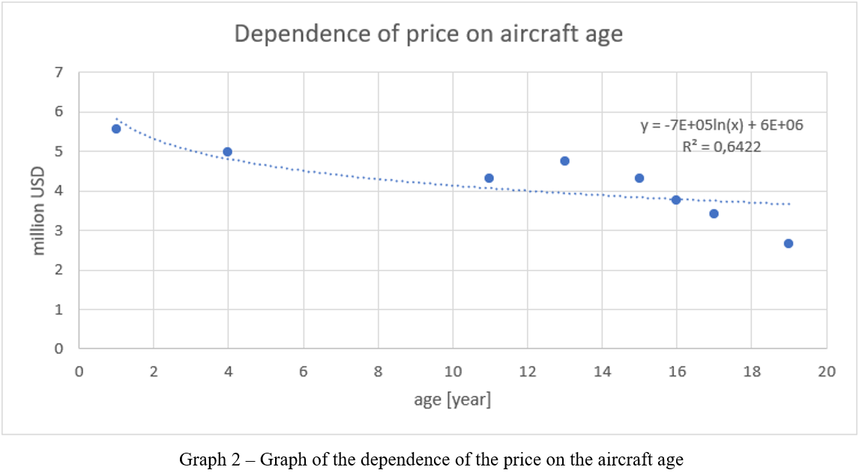
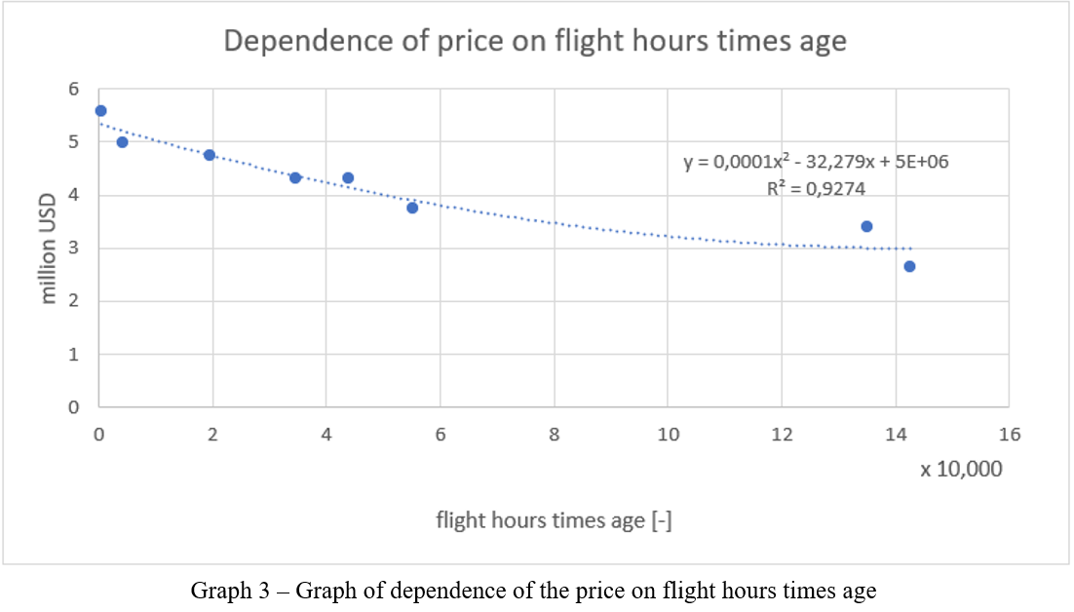
Aircraft Valuation Method
TRANSCOM 2025: 16th International Scientific Conference on Sustainable, Modern and Safe Transport
Němec Vladimír¹, Šantrůček Jaroslav¹, Hůlek David¹, Mrázek Petr¹, Daňko Petr¹
1 Czech Polytechnics Institute Ltd., Pardubice, Czech Republic
introduction
Determining a certain level of aircraft value, or aircraft valuation, is an integral part of aviation and related business. The article describes one of methods for valuing the aircraft. | It was found that such an identical or similar method has not yet been systematically published, not even in other transport sectors or it was possibly published implicitly as part of a broader methodology for valuing machinery and equipment, movable property. | The goal was to create the comparative method of the market valuation of an aircraft that the authors and their colleagues use in their work. It is a Direct Comparison Method, the result of which will therefore be the market value or market value range of the aircraft.
materials, methods & implementation
The first and second steps of the Direct Comparison Method is to determine and to search whether aircraft of the same type with a similar age and number of flight hours is still being sold and to determine their value selling price. If such aircraft cannot be found in a sufficient number of representatives, a price finding of a similar aircraft with corresponding technical and condition parameters with the valued aircraft will serve as a substitute. The absolute minimum number of similar aircraft for comparison should be three samples, only on the condition that they are of the same type and condition of wear and tear and that the prices found will show a relatively small dispersion, i.e. Coefficient of Variation V_{k} maximum in units of percent and these samples will be homogeneous over time. V_{k} = σ/μ; σ is the standard deviation and µ is the average of prices from the sample. The V_{k} should not exceed 30%.
results
To evaluate the numerical data obtained, it will be used mathematical procedures for regression analysis. It is always necessary to check or assess the outputs of mathematical regression results in an economic-technical context, in other words, to ensure that they also have technical logic. From the numerical data, it is calculated, for example, the dependence of the price on the total flight hours and the dependence of the price on the aircraft age by regression. Graph 1 shows the dependence of the price on the total flight hours. Graph 2 shows the dependence of price on the aircraft age. Both basic condition factors, i.e. flight hours and aircraft age, are practically equally important price-forming factors. It is therefore necessary to verify the interaction of both factors. This can be verified in the second regression, by analysing the dependence of the aircraft price on the product of flight hours and age (Graph 3).
For justified validation and refinement of the estimated price of the valued aircraft, in cases where the aircraft is worn out but still commonly traded on the global market, it is necessary to apply a comparison using data obtained from the Aircraft Bluebook database. This global database and its set analyses are able to determine the value of the valued aircraft based on the identified realized prices of comparable types at a given time and the condition of the aircraft.
conclusion & implementation path
The authors believe that the described method is a simple and relatively quick tool for valuing or, if you want, determining the value of an aircraft in cases where similar aircraft are still traded. Its indisputable advantage is the support of another, also comparative, procedure for valuing an aircraft. The result is thus more accurate, or rather better justified, and any objections to the resulting value of the aircraft can be argued more easily. Another advantage is that the described method using the Aircraft Bluebook database is published and regularly updated, which makes it a tool that can also be used for sectors that require it, including, for example, the judiciary. The disadvantage of the described valuation method, disposal and is dependent on their own price investigation, is the limited possibilities of finding relevant data, or rather, the data obtained is incomplete and the price estimate is then based on the professional experience of the appraiser, where they do not have the possibility of checking by confronting the result with the result from the database. Its certain limitations with regard to the impact on prices are only related to the operational and legislative requirements of aircraft registration. In this case or to refine the data, it is possible to use other databases. The second disadvantage is the possibility of an insufficient number of aircraft needed for the described method. In this case, it is possible to use a combination of the databases mentioned above. Currently, the aircraft market is almost globalized and operates practically regardless of national borders. The subjectivity of the appraiser is another factor that can distort the price estimate. Subjectivity is partially removed by the aforementioned databases such as Aircraft Bluebook when determining the final value. Furthermore, the professionalism of the appraisers and their objectivity in using the method are necessary.
acknowledgements
GORJIDOOZ, Javad, et al. Aircraft valuation in dynamic air transport industry. 2010. JUSTIN, Cedric; GARCIA, Elena; MAVRIS, Dimitri. Aircraft valuation: a network approach to the evaluation of aircraft for fleet planning and strategic decision making. 2010. POLIAK, Miloš, et al. Competitiveness of price in international road freight transport. Journal of Competitiveness, 2021. VASIGH, Bijan; AZADIAN, Farshid. The Foundation and Economics of Aircraft Valuation. 2022. YU, David. Aircraft Valuation: Airplane Investments as an Asset Class. 2020.

