Slide 1




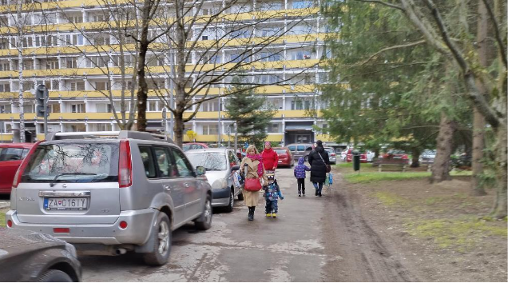
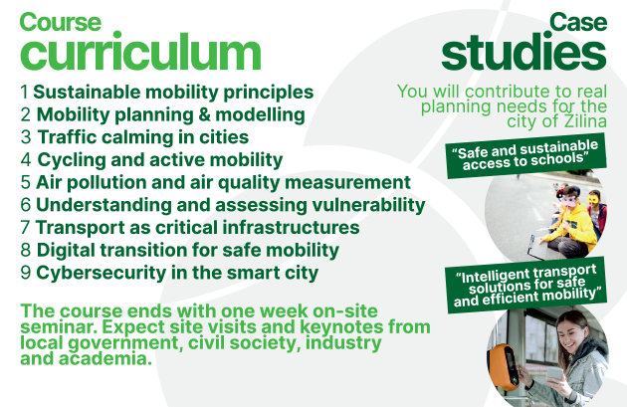
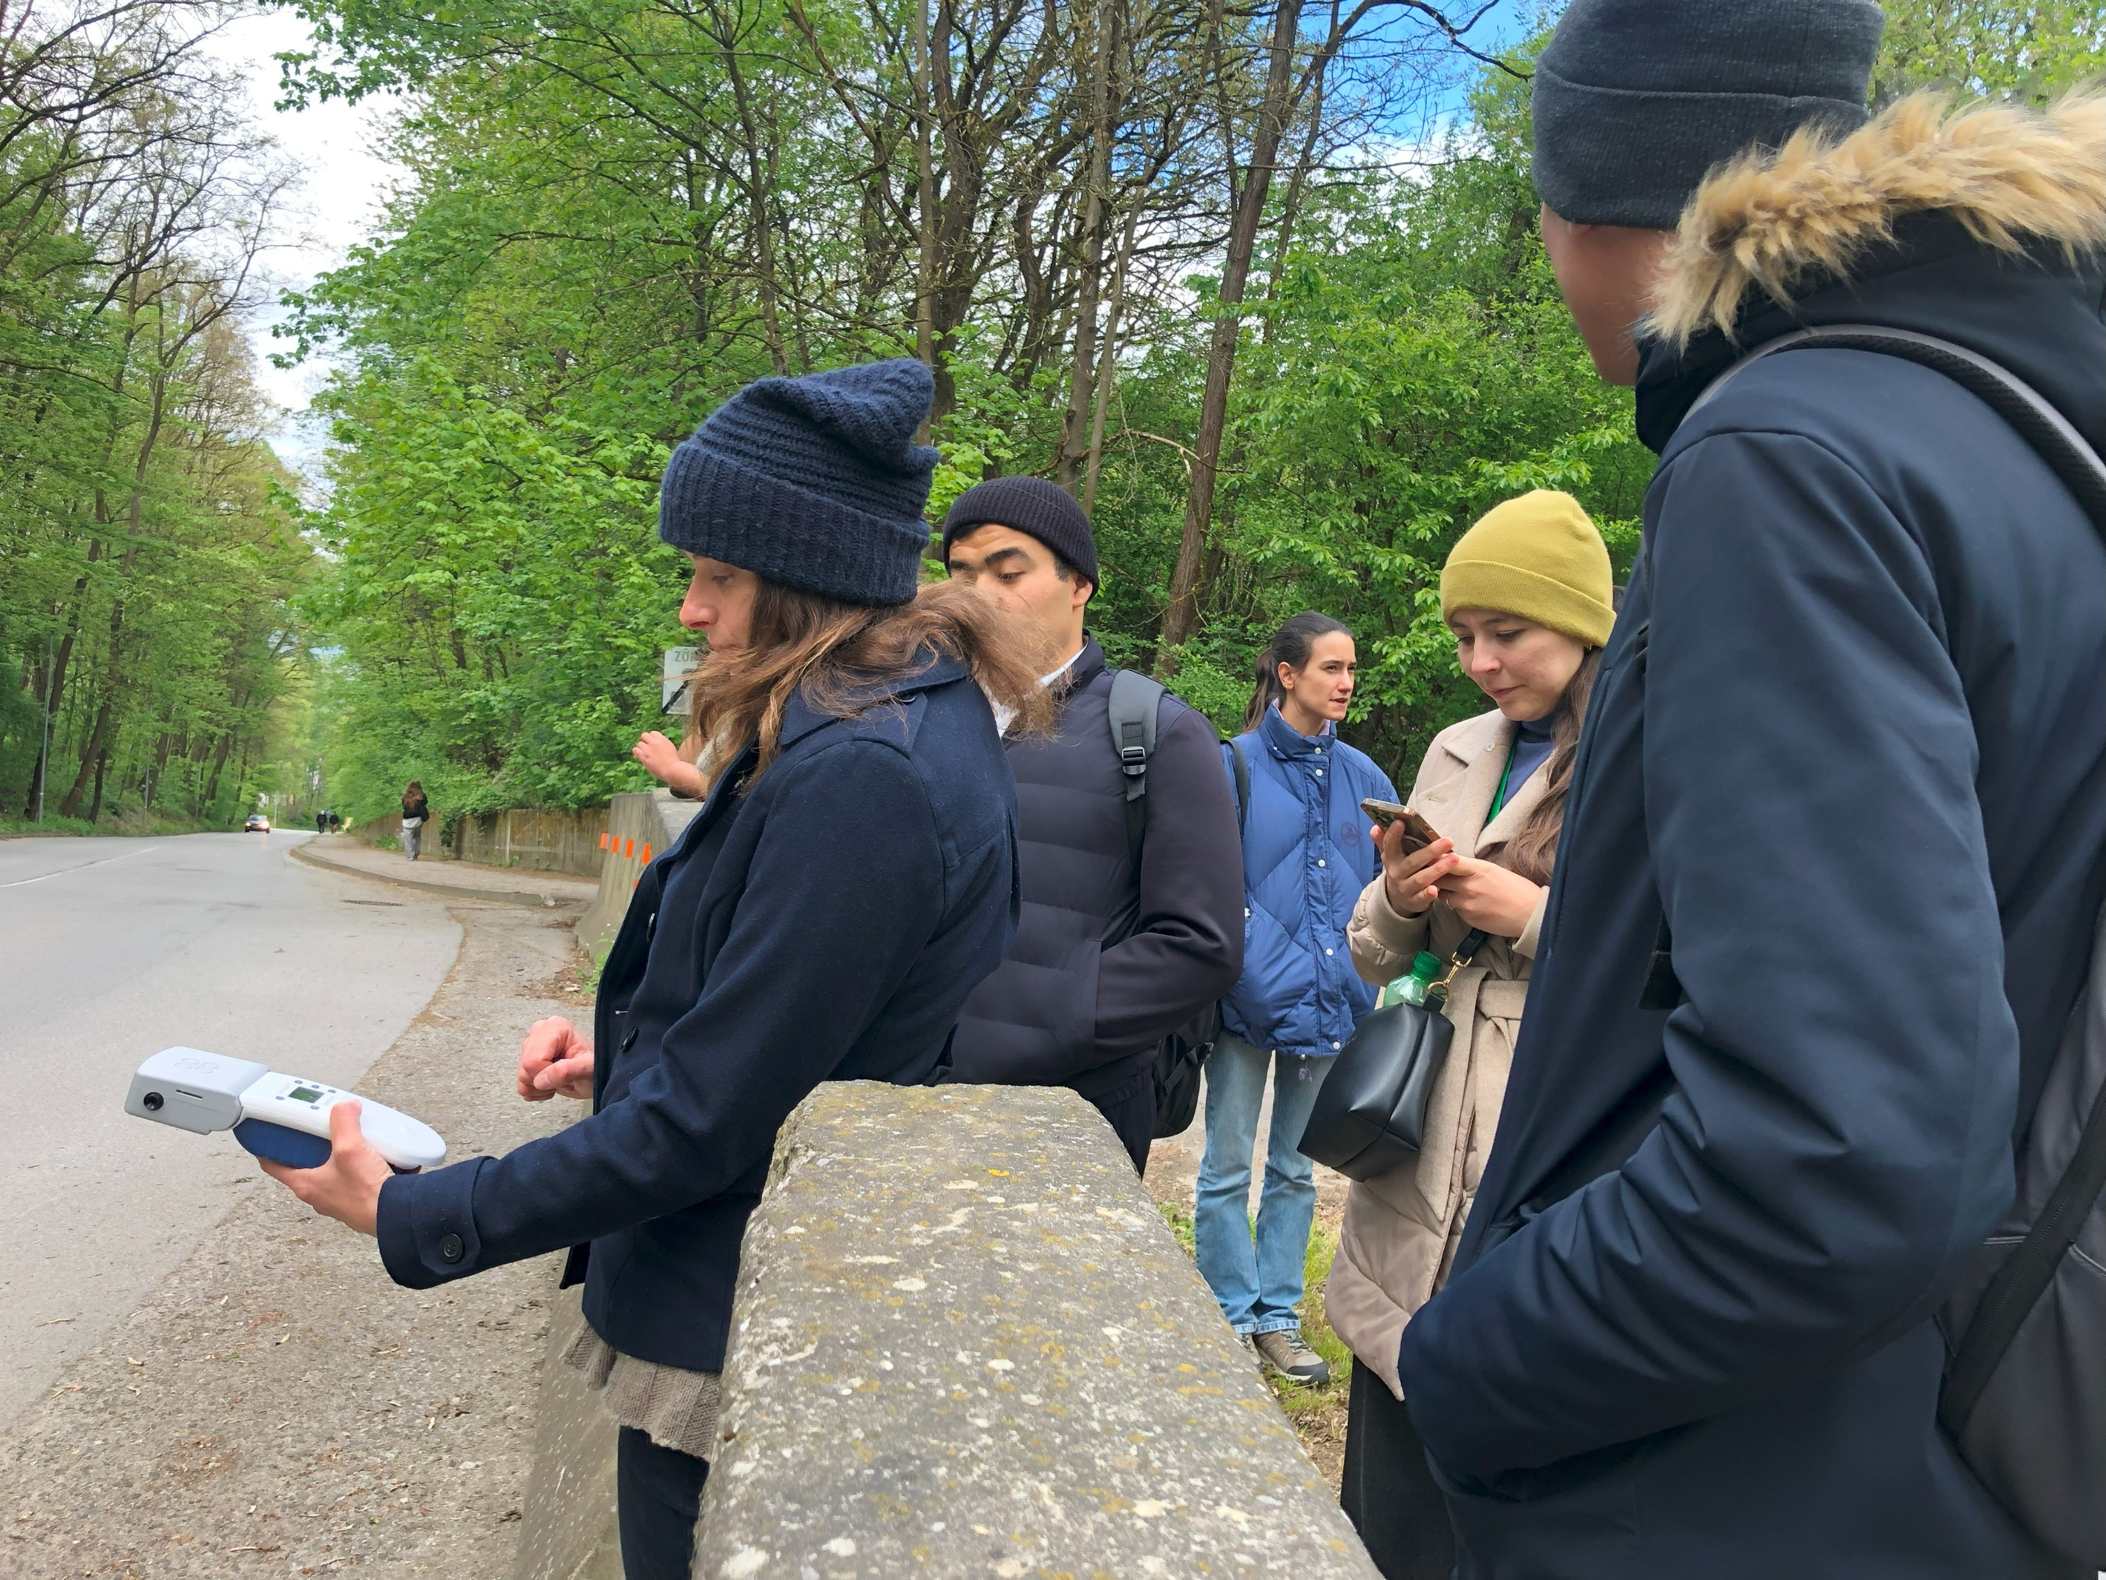
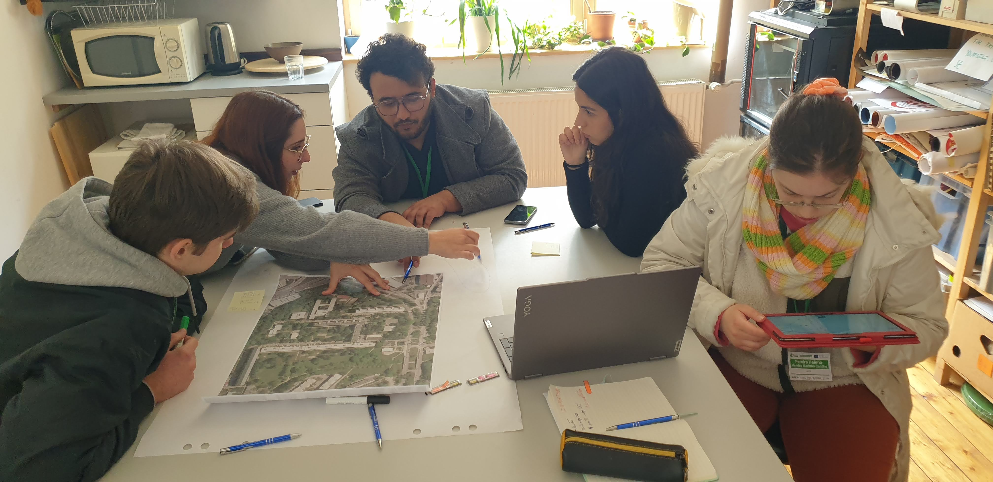
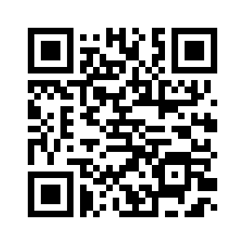
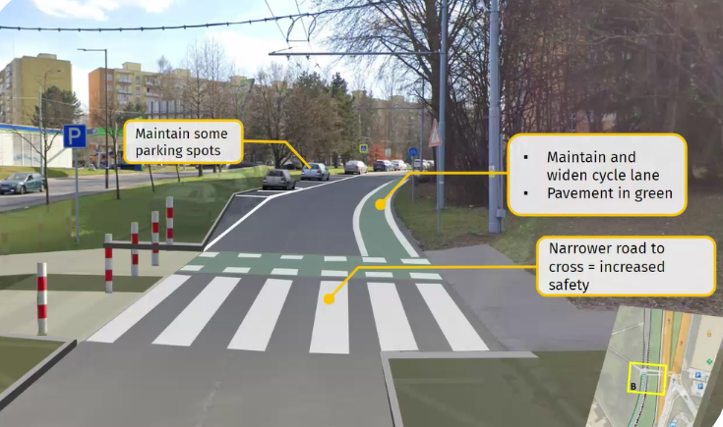

16th International Scientific Conference on Sustainable, Modern and Safe Transport
Advancing Education for Inclusive, Sustainable and Resilient Cities: Insights from the UNIZA Pilot Course on
Learning by Developing (LbD)
Yannick Cornetª, Christina Georgouli^{a,b}, Tibor Petrovª, Tatiana Kováčikováª,
Albert Kulla^{c}, Jozef Bruk^{c}
ªUniversity of Žilina (UNIZA), Department of International Research Projects – ERAdiate+, Slovakia
^{b} University of Žilina (UNIZA), Faculty of Management Science and Informatics, Department of Macro and Microeconomics, Slovakia
^{c}University of Žilina (UNIZA), Faculty of Mechanical Engineering, Institute of Lifelong Learning, Slovakia
1. Introduction & Background
2. Sustainable Mobility Innovations BIP course
3. Students engagement
Urban areas face urgent, interlinked challenges - climate change, inequality, and mobility.
Traditional teaching often lacks the real-world integration needed for addressing these.
The InCITIES project adopts the Learning by Developing (LbD) model to bridge theory and practice.
LbD empowers students to co-create solutions for Inclusive, Sustainable, and Resilient (ISR) cities, aligned with SDGs and IDGs.
Authentic challenge 1: Safe & Sustainable Access to Schools
Focused on traffic calming, child-friendly infrastructure, and stakeholder engagement.
Students conducted air quality tests, traffic counts, and surveys.
Outcome: Proposed pedestrian zones, drop-off redesigns, designated drop-off spaces, active mobility solutions.
Authentic challenge 2: Intelligent transport solutions for safe and efficient mobility
Targeted optimisation of pedestrian access to Žilina’s city centre.
Included proposals for smart access control, multimodal hubs, and improved zoning.
Developed with real city datasets and presented to municipal planners.
Countries of participants
28 students from 9 countries, across BSc, MSc, and PhD levels joined both online and onsite.
Team composition based on personality types: Motivators, Energisers, Teamers, Analysts.
Digital collaboration tools (MS Teams, Slido, Whiteboard) enabled smooth remote teamwork.
Emphasis on interdisciplinary peer learning.
Global Challenges
LbD Approach
SDGs/IDGs
Educational Needs
Authentic challenge 1: Safe children access to Gorazda school
Connection between global challenges, SDGs, and pedagogical models
Air pollution measurements on site
4. Educational Innovations
5. Outcomes & Impact
6. Lessons Learnt
Strengthened students’ technical, analytical, and collaboration skills.
Encouraged a mindset shift—from traditional instruction to co-creation and coaching.
Enabled practical, real-world impact via city-reviewed proposals.
Highlighted institutional learnings: importance of early credit recognition and logistics planning.
Video of BIP course outcomes
LbD is generally perceived as a new, innovative, and more sophisticated approach compared to traditional or project-based learning.
Some misunderstand LbD as too focused on soft skills or impractical with technical education.
Recommendations for LbD implementation
Provide time to transition existing course material
Setup trainings and incentives for educators
Create an ‘authentic challenge’ bank and external stakeholder contacts
Create more flexible accreditation frameworks
Support a trusting and empowering mindset towards students.
Group work of students on site
Authentic challenges: hands-on learning and real-world problems, fieldwork, stakeholder interviews, real data analysis.
Fostered creativity using maps, design tools, and visual presentations.
Embedded STEM and ICT applications in mobility simulations and planning.
Encouraged student autonomy, initiative and critical thinking
Promoted green, inclusive transport through evidence-based proposals.
“I think that group work is the best and having a good chemistry in the group is crucial for happy and successful learning.”
“I really liked being here. I learned a lot that I will definitely use in my future work. I also think this pushed a lot about my critical thinking”
Suggested solution with designated drop-off area near the school
Acknowledgements & transparency statement
The authors thank the European Commission for funding the InCITIES project under the Horizon Europe Programme (Grant No. 101071330). The contributions of all project partners, particularly those involved in the UNIZA pilot, are gratefully acknowledged. An AI copy editing tool was used to assist in the improvement of texts for readability and style, and to ensure that the text is free of errors in grammar, spelling, punctuation and tone. Authors take full accountability for the final version of the text.

