Slide 1

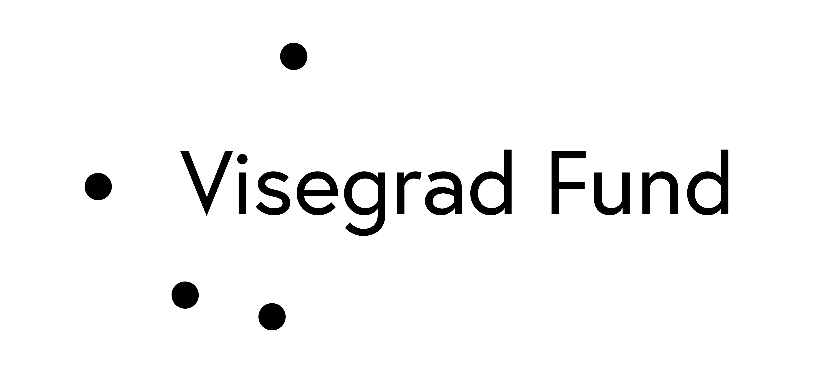
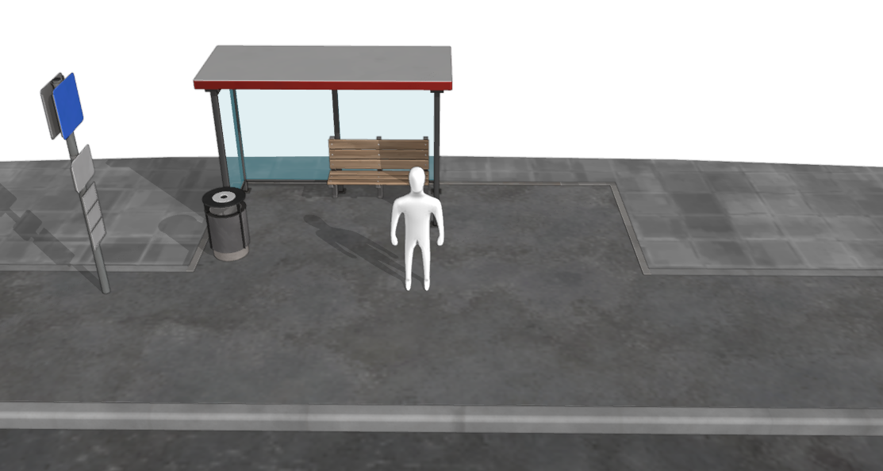
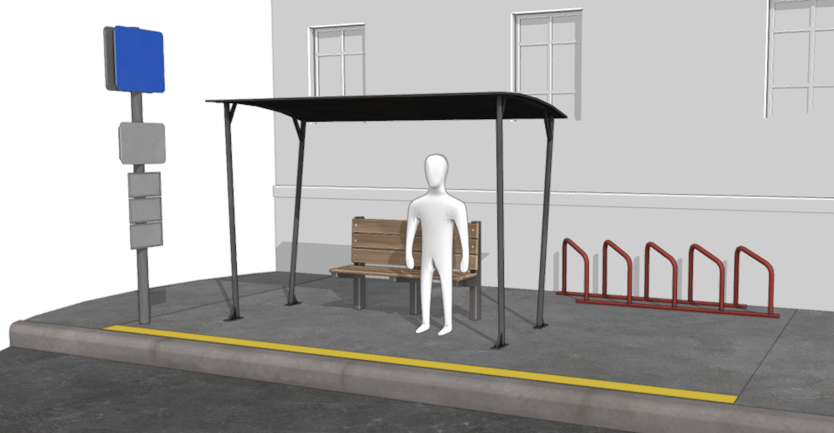
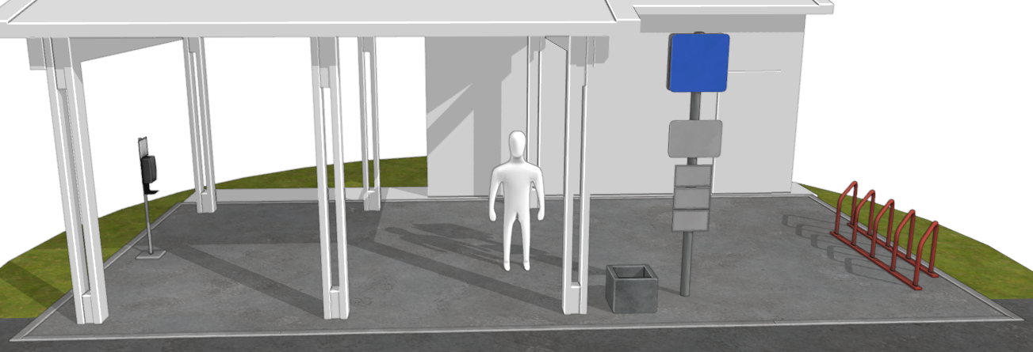
Transforming Urban Mobility - The Role of 3D Modeling in Designing Sustainable and User-Friendly Public Transport Stops
TRANSCOM 2025: 16th International Scientific Conference on Sustainable, Modern and Safe Transport
Antons Patlins¹, Deniss Fadejevs², Pavels Gavrilovs³
1 Riga Technical University (RTU), Institute of Industrial Electronics, Electrical Engineering and Energy, Riga, Latvia
2 Riga Technical University (RTU), Riga, Latvia
3 Riga Technical University (RTU), Riga, Latvia
introduction
Background Information & Market Context. Urbanization is driving increased demand for efficient public transport systems, with transport stops serving as critical interfaces between commuters and networks. Traditional 2D planning methods often fail to address modern accessibility, congestion, and sustainability challenges, necessitating innovative solutions like 3D modeling. | Problem Statement & Stakeholders. The inefficiencies in traditional public transport stop design—such as poor spatial planning and lack of accessibility—hinder user experience and system effectiveness. Key stakeholders include urban planners, transport authorities, policymakers, and commuters who rely on well-optimized stops for a seamless travel experience. | Research Objectives & Expected Impact. This research aims to explore how 3D modeling can enhance public transport stop design by improving spatial planning, accessibility, and sustainability. The expected impact includes better commuter experiences, reduced congestion, and more effective integration of transport infrastructure within urban environments.
materials, methods & implementation
Materials The study utilizes Blender 3D as the primary tool for designing and analyzing public transport stops. Blender was selected for its cost-effectiveness, flexibility, and powerful modeling capabilities, enabling urban planners to create detailed, interactive, and adaptable designs. The designs incorporate key infrastructure elements such as shelters, seating, digital signage, security features, and accessibility enhancements like ramps and tactile paving. Methods The research follows a structured approach to optimize public transport stop designs: Site Analysis – Examining existing urban layouts, commuter flow, and environmental conditions to determine spatial requirements. 3D Model Development – Using Blender to create different stop configurations, ranging from simple to advanced setups, integrating real-world constraints and accessibility considerations. Design Evaluation – Assessing various layout options based on efficiency, comfort, and user experience through real-time simulations. Stakeholder Feedback & Iteration – Refining designs based on feedback from urban planners, transport authorities, and users to ensure practical viability. The study demonstrates three public transport stop models with increasing levels of complexity: Basic Design (Fig. 1) – Includes essential elements like a bench, canopy, waste bin, and an information stand. Intermediate Design (Fig. 2) – Adds features such as bicycle stands and a designated safety lane. Advanced Design (Fig. 3) – Incorporates digital displays, security cameras, and a shelf for hand sanitization, ensuring a modern, user-friendly experience. These models showcase how 3D modeling helps visualize spatial constraints, optimize layouts, and integrate essential infrastructure components effectively. By leveraging Blender’s capabilities, planners can enhance accessibility, efficiency, and overall commuter satisfaction, making public transport stops more adaptable to urban mobility demands.
results
Academic Findings & Innovation The study highlights the transformative role of 3D modeling in optimizing public transport stop design, demonstrating how spatial analysis and real-world simulations improve functionality, accessibility, and sustainability. The research introduces Blender 3D as an innovative, cost-effective tool that enhances urban planning by enabling detailed infrastructure visualization and real-time modifications, bridging the gap between traditional 2D methods and modern urban mobility needs. Practical Applications By implementing 3D modeling in public transport stop design, cities can optimize space usage, enhance user experience, and improve infrastructure integration within urban environments. The ability to simulate various configurations allows planners to identify efficient layouts, reduce congestion, and ensure accessibility for diverse commuter needs. Additionally, integrating digital elements like real-time displays and security features fosters a safer and more user-friendly transit experience, aligning with sustainability and smart city initiatives.
conclusion & implementation path
Summary of Research Conclusions The study confirms that 3D modeling enhances public transport stop design by improving spatial planning, accessibility, and user experience. Using Blender 3D allows for real-time adjustments, stakeholder collaboration, and efficient infrastructure integration, making it a valuable tool for urban planners. Impact 3D modeling optimizes public transport stops, reducing congestion, enhancing commuter experience, and ensuring sustainability. Its application supports smart city initiatives by integrating digital signage, accessibility features, and real-time data. Potential Areas of Further Research Future studies can explore AI-driven simulations, virtual reality (VR) integration, and GIS-BIM synergy for more dynamic transport planning. Additionally, real-world implementation case studies could validate 3D modeling’s effectiveness in diverse urban settings.

