Slide 1


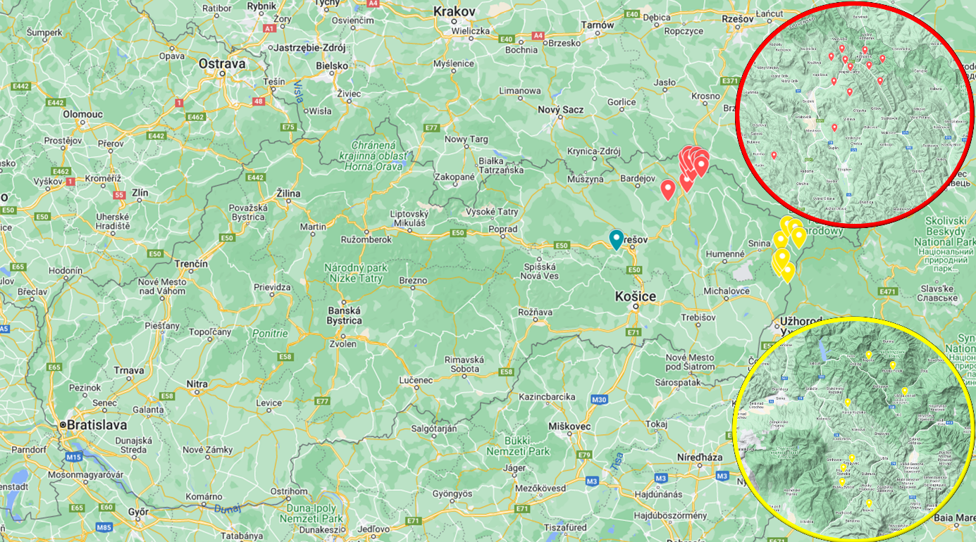
Analysis of access roads, boarding areas and arrival times of firefighting units to selected heritage wooden buildings
TRANSCOM 2025: 16th International Scientific Conference on Sustainable, Modern and Safe Transport
Ing. Michal Huliak¹, prof. RNDr. Iveta Marková PhD.²
1 University of Žilina. 1. Mája 32,. Žilina, 010 01, Slovakia
2 University of Žilina. 1. Mája 32,. Žilina, 010 01, Slovakia.
Introduction
Until the mid-20th century, wood was the most common building material in rural Slovakia. Its widespread availability and low cost made it a preferred choice in these areas. Stone and brick structures were mostly found in urban settings or built by wealthier individuals. As a result, most villages were constructed from wood, which made them highly vulnerable to devastating fires that could destroy entire settlements. With the advent of more advanced building techniques and materials, new religious structures in villages were among the first to be built using these methods, often replacing older ones that were no longer seen, as necessary. Many of these religious buildings had stood for centuries. | Historic wooden churches are invaluable architectural and cultural landmarks, yet they are highly vulnerable to fires. The use of wood as a building material presents specific challenges and risks that can endanger the survival of these unique religious structures. There are twenty-seven wooden Greek-Catholic churches in eastern Slovakia that are designated as national cultural monuments. These churches are highly vulnerable, as any fire damage would make reconstruction impossible due to the nature of the materials used in their construction. These buildings hold exceptional value, both architecturally and artistically, reflecting the cultural achievements of the communities that built them. | Blue marker: Brežany Red marker: Kožany, Potoky, Ladomirová, Krajné Čierno, Šemetkovce, Dobroslava, Korejovce, Nižný Komárnik, Hunkovce, Príkra, Miroľa, Bodružal Yellow marker: Uličské Krivé, Ruský Potok, Topoľa, Kalná Roztoka, Šmigovec, Hrabová Roztoka, Ruská Bystrá, Inovce
materials, methods & implementation
To assess the current condition of roads and the distance of historical wooden sacral buildings in Eastern Slovakia from the nearest fire stations. A checklist was developed to evaluate each site, serving as a qualitative data collection method that helps identify critical points within the system. The travel time for the fire department to reach the building from the nearest fire station was calculated by Instruction of the President of the Fire and Rescue Corps (2003). We compare this calculation time, with Google Maps data. We processed the data in two time periods, namely at night when traffic is low and there is no risk of congestion (from 10:00 p.m. to 6:00 a.m.), and during the day in the densest traffic (dens traffic in the morning between 7:00 and 9:00 and in the afternoon between 14:00 and 16:00).
results
The landing area is located at fourteen objects in the conditions defined by the Decree of the Ministry of Interior of the Slovak Republic 94/2004 § 83. The distance of the boarding areas ranged from 3 meters to 220 meters, six objects had a boarding area in the immediate vicinity of the entrance to the premises of the object - 10 meters. The average distance was 51.29 meters. Of these boarding areas, only one was not permanently vacant. The access roads met required conditions specified. All of them were paved with asphalt, in the immediate vicinity of the building in two cases there was an unpaved road made of earth, in two other cases of gravel. There was permanent access to the objects in fourteen cases, because in the winter period, in case of a snow calamity, it was not possible in seven cases to get to the vicinity of the object with the intervention equipment. This is related to the elevation of the object from the main road and the type of road material. There were ten cases where there were paved paths in the area of the facility. We calculated estimate time according to formula (1). Then we searched in Google Maps for route times from the fire stations to the selected properties.
Building in village | Fire station | Distance (km) | Arrival time by (1) (min:sec) | Arrival time by Google Maps during night (minutes) | Arrival time by Google Maps during high traffic (minutes)
Brežany | FS Prešov | 15,4 | 20:32 | 17 | 21
Kožany | FS Giraltovce | 17,8 | 23:44 | 20 | 21
Potoky | FS Stropkov | 6,4 | 8:32 | 7 | 8
Ladomirová | FS Svidník | 4,8 | 6:24 | 6 | 6
Krajné Čierno | FS Svidník | 8,8 | 11:44 | 10 | 10
Šemetkovce | FS Svidník | 10,2 | 13:36 | 13 | 13
Dobroslava | FS Svidník | 7,5 | 10 | 9 | 9
Korejovce | FS Svidník | 10,6 | 14:08 | 11 | 11
Nižný Komárnik | FS Svidník | 13 | 17:20 | 14 | 14
Hunkovce | FS Svidník | 8,7 | 11:36 | 9 | 9
Príkra | FS Svidník | 16,2 | 21:36 | 17 | 18
Miroľa | FS Svidník | 16,8 | 22:24 | 17 | 17
Bodružal | FS Svidník | 13,6 | 18:08 | 14 | 14
Kalná Roztoka | FS Snina | 14,4 | 19:12 | 16 | 20
Topoľa | FS Snina | 24,9 | 33:12 | 27 | 27
Ruský Potok | FS Snina | 31,5 | 42 | 33 | 33
Uličské Krivé | FS Snina | 35,9 | 47:52 | 36 | 37
Ruská Bystrá | FS Sobrance | 24,8 | 33:04 | 25 | 28
Inovce | FS Sobrance | 19,6 | 26:08 | 23 | 25
Hrabová Roztoka | FS Sobrance | 28,4 | 37:52 | 29 | 29
Šmigovec | FS Sobrance | 26,1 | 34:48 | 25 | 25
conclusion & implementation path
In the paper, we discussed driveways, boarding areas, and the Fire Department's arrival time. From the results we found that 14 buildings had suitable access roads to the building according to the Slovak standards. There were paved roads with asphalt to 17 facilities in the immediate vicinity of the facility, two were made of dirt and two were made of gravel. As the inadequate access roads were located in built-up areas where the space around the roads belonged to private persons, it is not possible to easily resolve the situation in the current situation. The situation is different for buildings that had unpaved roads with asphalt in the immediate vicinity, where it is possible to stretch the asphalt on these access roads. The access area was also permanently accessible to 14 buildings. Its distance proved to be problematic in some cases, and in cases where a driveway was used as a boarding area, the angle of the road did not correspond to Slovak standards. As they were also located in built-up areas, it is not possible to build new boarding areas in the immediate vicinity of the objects. We have devoted ourselves to the time of arrival of the firefighting unit to the objects selected by us. We compared the travel time according to the Instruction of the President of the Fire and Rescue Corps, Formula (1), with the time according to Google maps at night and during high traffic. We found the time according to Google Maps to be lower in all cases at night compared to Formula (1). During high traffic, we came up with a four minute higher commute time in two cases, and a minute higher in four cases compared to Formula (1). Despite these differences, there were still ten objects with a reach time higher than twenty minutes, which represents the critical time, the development of the fire to its full phase. These conclusions force us to reflect on the relevance of Formula (1), which was formulated in 2003. It has been 22 years since the introduction of this Formula, and the nature of traffic has changed, as has the typology of cars on the road.
acknowledgements
We would like to thank the owner of the buildings, which is the Greek-Catholic Archbishopric of Prešov, for allowing us to visit the churches. We would also like to thank the owner of the buildings, which is the Michalovsko-Košická Orthodox Eparchy. The projects were supported by the Early stage grant, project number: 09I03-03-V05-00002 ESG UNIZA.

