Slide 1


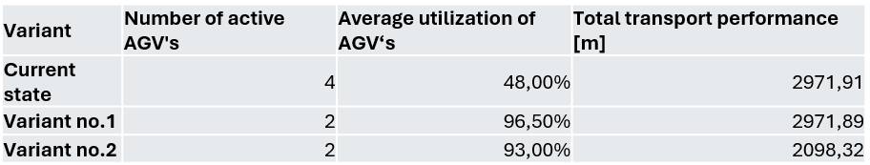
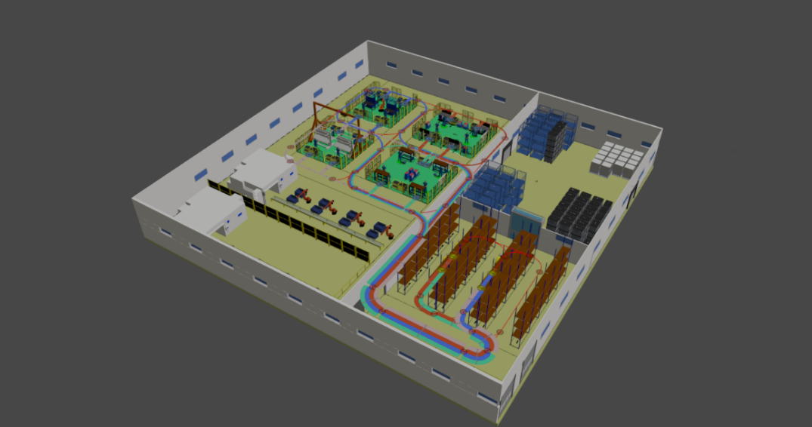
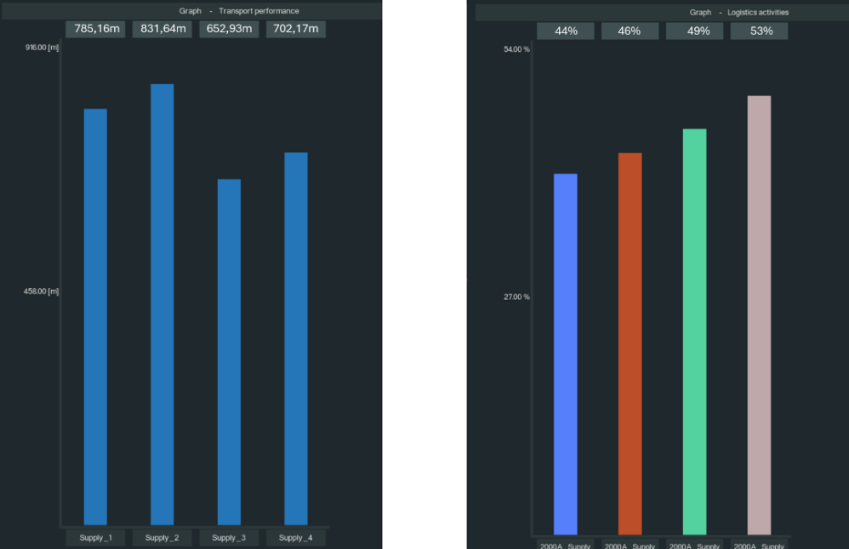
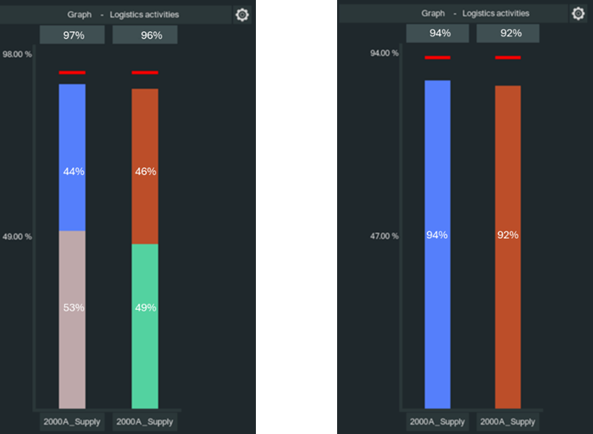
Optimization of in-plant logistics processes in assembly systems using digital simulation tools: A case study using AGV and Twiserion Design Manager
TRANSCOM 2025: 16th International Scientific Conference on Sustainable, Modern and Safe Transport
Dávid Komačka¹, Martin Krajčovič², Marián Matys³, Milan Marčan⁴
1 University of Žilina, Žilina, Slovakia
2 University of Žilina, Žilina, Slovakia
3 University of Žilina, Žilina, Slovakia
4 University of Žilina, Žilina, Slovakia
introduction
The study focuses on optimizing internal logistics processes in assembly systems. It highlights the growing complexity of production planning and the need for digital simulation tools. The research utilizes Twiserion Design Manager, a software tool designed for logistics process optimization. Digital twin and simulation technologies play a crucial role in improving material flow efficiency in intelligent manufacturing systems | Traditional logistics planning is imprecise and inflexible, leading to inefficient AGV use and excess resource consumption. There is a need for data-driven decision-making to enhance logistics efficiency in manufacturing environments. Existing approaches struggle to minimize transport distances and maximize AGV utilization. | This research aims to develop and validate an optimized milk-run logistics model using digital simulation, compare logistics scenarios to identify the most efficient material flow strategy, assess the impact of AGV routing on transport performance and resource utilization, and provide recommendations for implementing digital logistics planning tools in manufacturing.
materials, methods & implementation
Data Collection: Input data was gathered from the company's ERP and MRP systems, containing information about material flow directions, pick up and consumption points, parts delivered. Creation of a parametric model: A model was created in the Twiserion Design Manager software, incorporating four logistics routes for AGVs and importing components via PFEP. Simulation Solutions: Variant 1: Each AGV supplied two workstations while maintaining the need to return to the loading station. Variant 2: Two workstations were supplied directly via a single route without returning to the loading station.
results
Variant 2 proved to be the most efficient, reducing the number of required AGVs from four to two and decreasing total transport performance by 873.59 meters. The average AGV capacity utilization increased to 93%. This approach demonstrated the potential for optimizing internal logistics using digital tools.
conclusion & implementation path
The results of this study underscore the transformative potential of digital simulation tools in optimizing in-plant milk-run logistics systems. By employing tools such as Twiserion Design Manager, it was possible to identify inefficiencies, simulate alternative strategies, and validate improvements in system performance. The study demonstrated that adopting optimized AGV assignment strategies, particularly through Variant 2, led to significant reductions in resource utilization and operational inefficiencies. Specifically, the number of required AGVs decreased by 50%, while average transport performance improved markedly, demonstrating a practical application of lean logistics principles.
acknowledgements
This research was funded by grant number VEGA 1/0633/24: Research and support of the synergistic effect for optimization of assembly processes.

