Slide 1


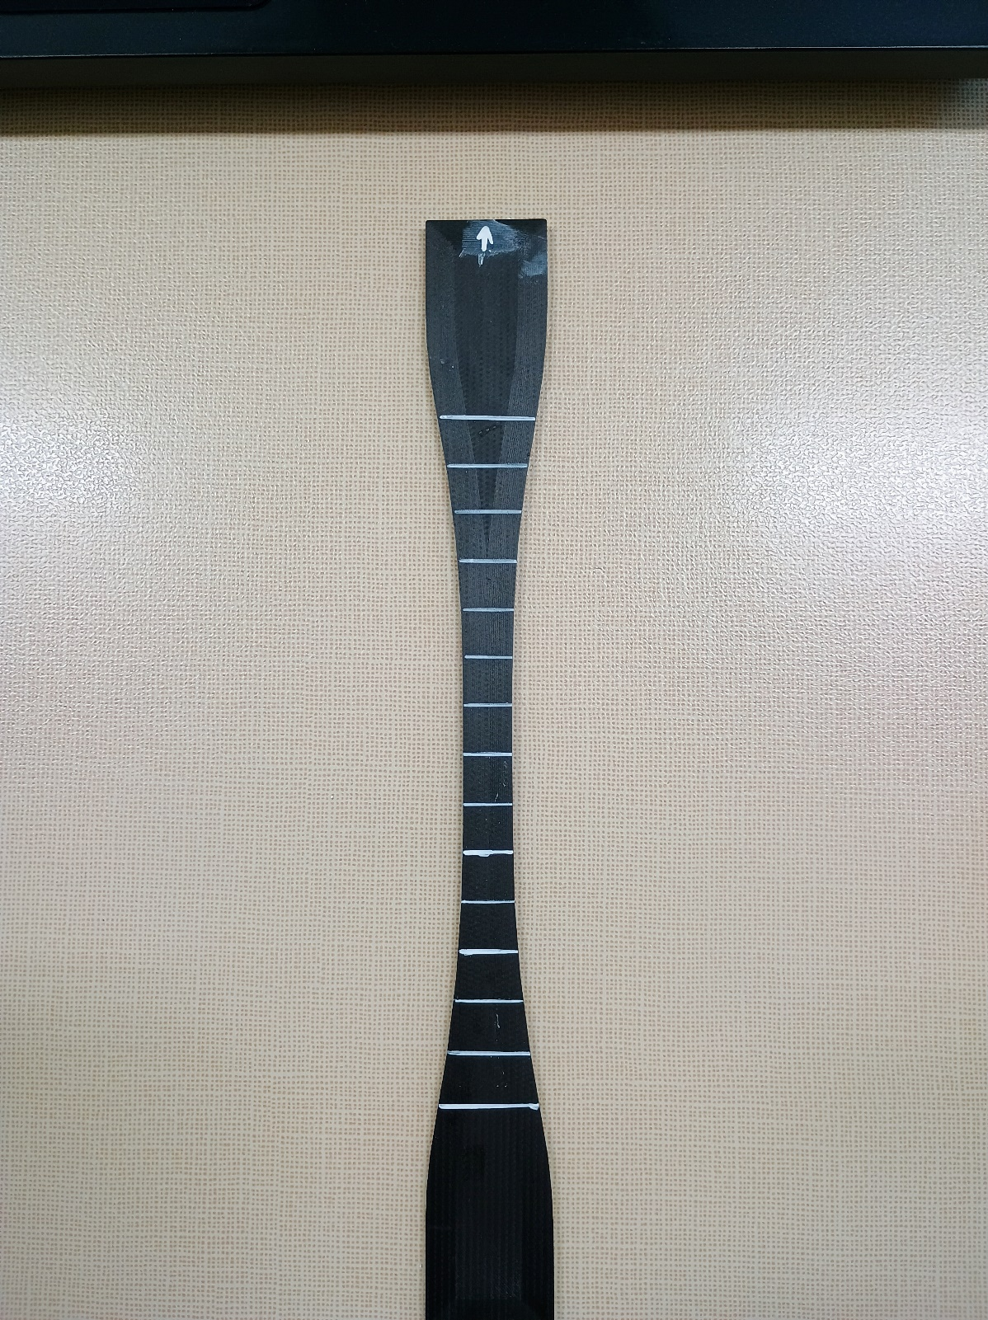
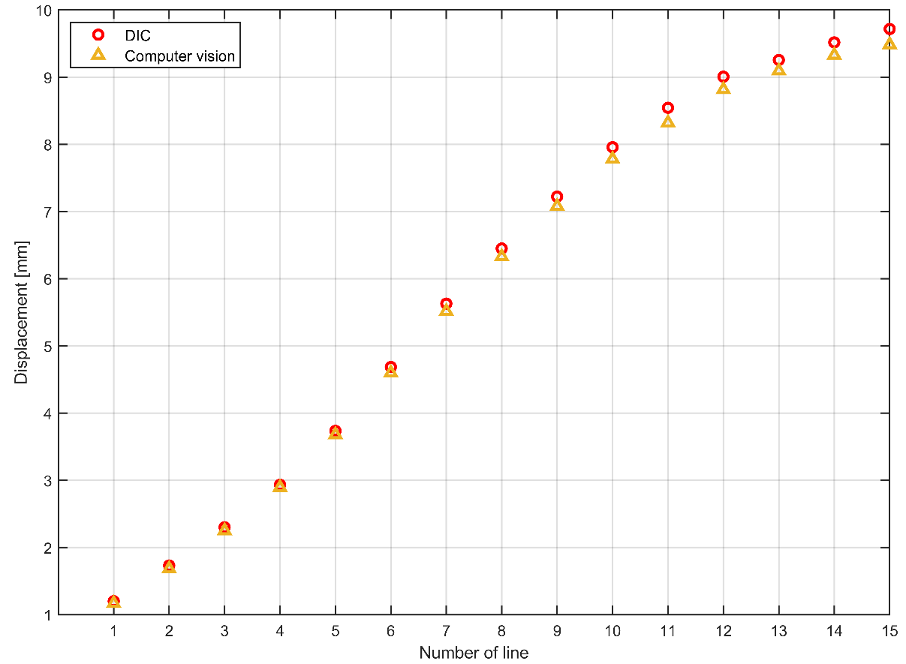
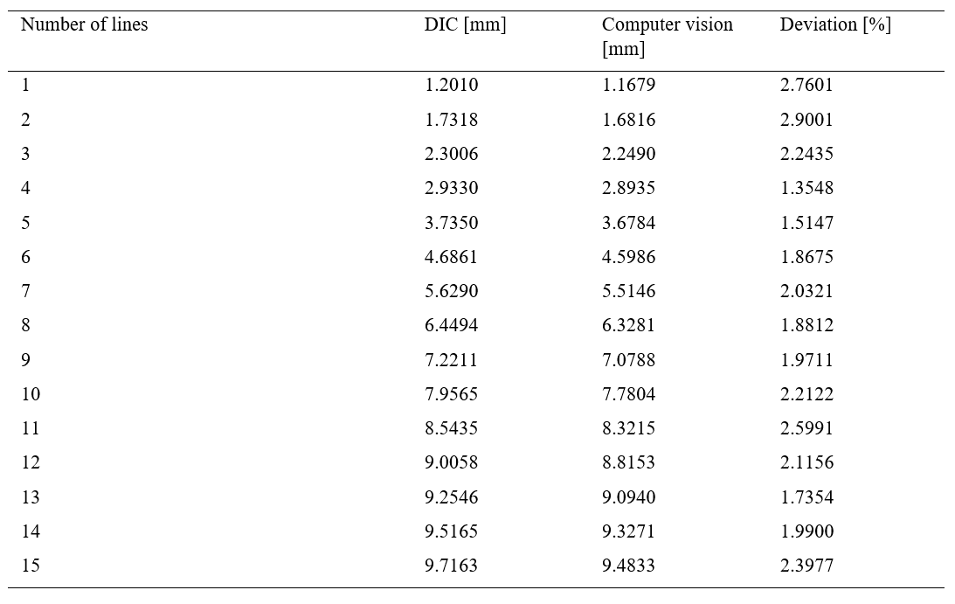
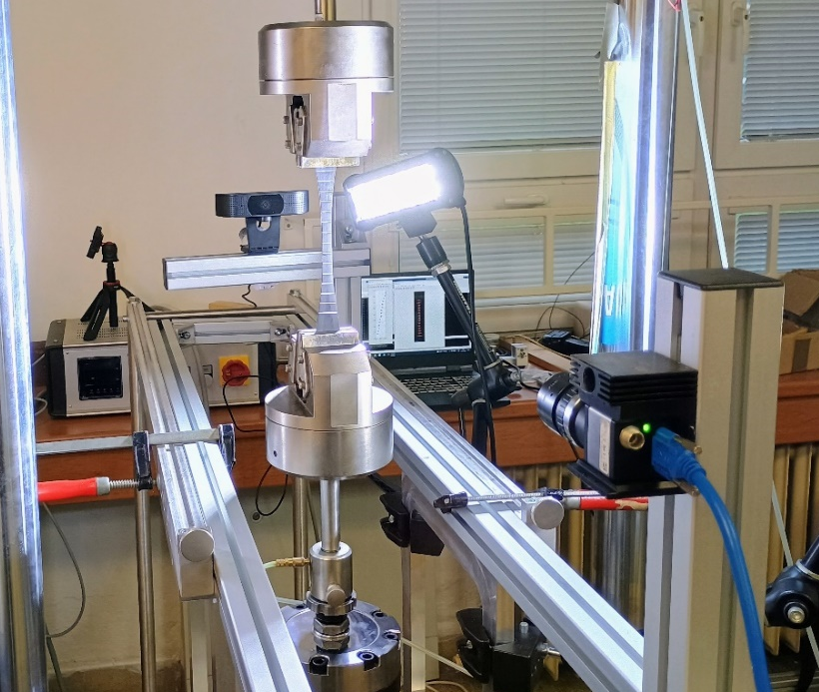
Comparison of non-contact extensometer using image analysis and digital image correlation for non-contact displacement measurement
TRANSCOM 2025: 16th International Scientific Conference on Sustainable, Modern and Safe Transport
Ondrej Piroh¹, Jaroslav Majko¹, Marián Handrik¹, Milan Vaško¹, Martin Fusek², Michal Šofér², Jakub Cienciala², Milan Sága¹
1 University of Zilina, Zilina, Slovakia
2 VŠB – Technical University of Ostrava, Ostrava, Czech Republic
introduction
The application of composite materials, especially 3D-printed ones, is growing in various industries. Measuring their mechanical properties such as displacements is key. Both contact and non-contact extensometers can be used for measurement. Contact extensometers are accurate but expensive, while non-contact extensometers are more flexible but difficult to use. | The authors developed a new method for measuring displacements using computer vision and image analysis. The main challenges were to maintain the advantages of non-contact extensometers while dealing with their disadvantages. The developed system would thus allow measurements to be made with commonly available equipment. | The study aims to verify the accuracy of the image analysis method by comparing the results acquired by digital image correlation during the creep test. To achieve relevant results would indicate the suitability of the developed method as a replacement for conventional non-contact extensometers.
materials, methods & implementation
The creep test was performed with composite flat test specimens made of nylon reinforced with chopped carbon fibers (ONYX) using Fused Filament Fabrication (FFF) 3D printing technology. The specimens used were also modified in shape. The principle of the measurement was to record the creep test as a series of images and then analyze them. Fifteen white lines (regions of interest) were created on the sample as shown in the figure. Evaluation of the series of images then consisted of calculating the displacements in the areas with the created white lines.
results
A comparison of the results was made for the total displacement of the individual lines. The first evaluation method was digital image correlation using the APLHA DIC software with the Line function. The second method was image analysis using computer vision. This analysis was performed in MATLAB software. That process involved the identification of the centers of gravity of each line, specifically through edge and boundary detection. The calculated displacements of the individual lines for the selected measurements are shown in the figure below (each point represents the corresponding line center of gravity). The point marked as line number 1 indicates the line closest to the arrow on the left of the figure in the previous section. This line was close to the non-moving jaw and thus must have had the smallest displacement. On the other hand, line number 15 was close to the moving jaw, which caused the largest displacement values. A comparison of the calculated displacements from the two methods is shown in Table 1. The deviation shown in the last column refers to the difference between the value calculated by the DIC method (considered by the authors as a reference method) and the value using image analysis.
conclusion & implementation path
The non-contact extensometer uses image analysis and computer vision to bring a new approach to experimental mechanics. The developed method is characterized by high accuracy, which has been experimentally verified. Comparison with a reference digital image correlation method has demonstrated: The average deviation of the results was only 2%. The maximum measured deviation did not exceed 3%. The results suggest that the developed method could replace traditional measurement methods in the future. Main advantages of the method: Wide measurement range. Versatility. Simplicity of operation. Low cost of input.
acknowledgements
The work has been supported by the grant project KEGA project number 005ZU-4/2024.

