Slide 1



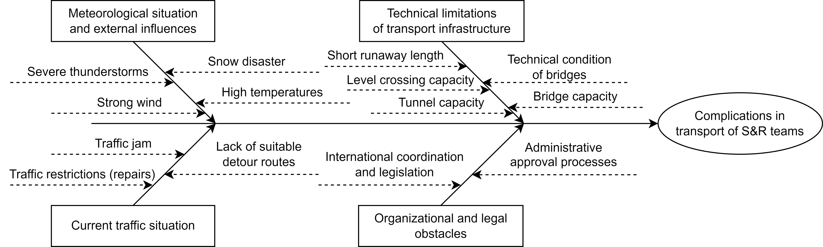
Use of TEN-T for the movement of Search & Rescue teams within the framework of CBRN-E response
TRANSCOM 2025: 16th International Scientific Conference on Sustainable, Modern and Safe Transport
David Rehak¹, Heidi Janeckova¹, Martin Hromada², Vit Stritecky³, Eliska Speldovay⁴, Panagiota Benekou⁵
1 VSB – TUO, Faculty of Safety Engineering, Lumirova 13, 700 30 Ostrava, Czech Republic
2 Tomas Bata University in Zlín, Faculty of Applied Informatics, Nad Stranemi 4511, 760 05 Zlín, Czech Republic
3 Technological Platform Energy Security Czech Republic, V Holesovickach 1443/4, 180 00 Praha, Czech Republic
4 Czech Standardization Agency, Biskupsky dvur 1148/5, 110 00 Praha, Czech Republic
5 Center for Security Studies, P. Kanellopoulou 4, 101 77 Athens, Greece
Introduction
Large-scale disasters which can have fatal impacts not only on the population, but also on the infrastructure or the environment. Therefore, these disasters require the immediate deployment of the necessary Search and Rescue Teams for mitigation, repair, response and recovery. | In the context of High-Impact, Low-Probability Risks, individual states have focused primarily on training their special forces in the event of an incident involving CBRN-E . | The transportation of S&R teams and their equipment thus becomes a significant logistical challenge, in which it is necessary to consider possible complications. Based on these facts, the aim of the article is to draw attention to the issue of transporting forces and resources of S&R teams using the Trans-European Transport Network.
materials, methods & implementation
S&R teams play a key role in saving lives and rebuilding affected areas thanks to their self-sufficiency and multidisciplinary composition. These teams are equipped with advanced technologies to search for people, handle heavy structures and detect hazardous materials, including CBRN-E threats. These operations are among the most challenging because they require high expertise, specialized equipment and precise coordination. However, an effective emergency response also depends on the available transport infrastructure provided by the Trans-European Transport Network (TEN-T), which connects key transport routes in Europe, allowing the movement of rescue teams and their equipment. Thanks to its structure, which includes rail, road, water and air routes, the TEN-T plays a crucial role in crisis management and the recovery of affected areas.
Results
Although the TEN-T has a total of four types of transport infrastructure, road and air transport infrastructure in particular are among the most used modes of transport for S&R teams in the European Union due to their speed and flexibility. However, the full use of road and air infrastructure for S&R team transport presents a number of logistical challenges, which can be identified using the diagram illustrated.
The diagram illustrated above is used to systematically identify and analyse the key factors affecting the effectiveness of S&R operations. It helps to visually illustrate the root causes of problems and their interrelationships, facilitating their understanding and finding optimal solutions. It is intended primarily for crisis managers, emergency services and security professionals involved in the planning and implementation of rescue operations.
conclusion & implementation path
The response to incidents that have a large-scale impact on the population, infrastructure or environment is handled in the European Union not only by emergency services and other agencies, but also by specialized teams known as Search and Rescue Teams. Based on the nature of the incident (e.g. earthquake or terrorist attack using CBRN-E), these specialized teams are sent to various international rescue operations. Although the resolution of each incident represents a considerable logistical challenge, insufficient attention is paid to the transportation of S&R teams and their equipment. In the context of the transport of S&R teams, air and road transport can be considered the most important within the Trans-European Transport Network (TEN-T). Since it is necessary to transport a significant amount of equipment in a short time for incident resolution, possible elements of the given infrastructures and their limiting factors were identified in this regard, which are mainly the meteorological situation, technical limitations of transport infrastructures, current traffic situations and organizational and legal obstacles.
acknowledgements
This work was supported by Horizon Europe [grant number 101121167] and by Technology Agency of the Czech Republic [grant number CK03000182].

