Slide 1


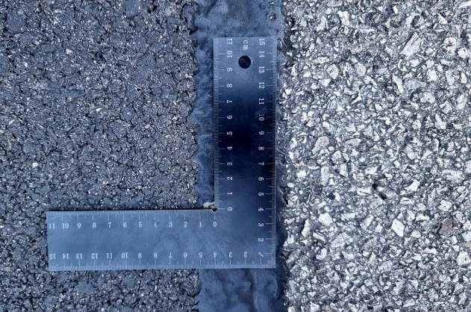
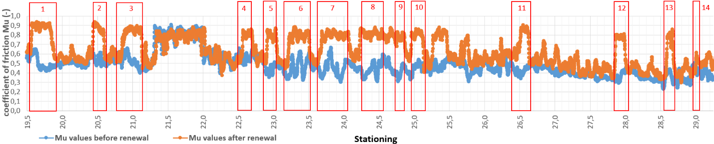
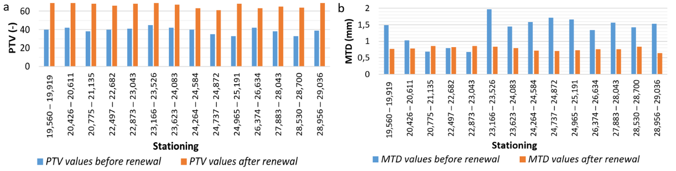
Assessment of road surface roughness before and after surface renewal on road II/584 in the Huty area
TRANSCOM 2025: 16th International Scientific Conference on Sustainable, Modern and Safe Transport
Matej Brna¹, Matúš Kováč¹, Peter Pisca¹
1 Department of Highway and Environmental Engineering, Faculty of Civil Engineering, University of Zilina, 010 26 Žilina, Slovakia
introduction
The article evaluates road surface roughness before and after surface renewal on road II/584 in the Huty area, located in Slovakia’s mountainous region. This area is prone to traffic accidents due to insufficient skid resistance and unfavorable alignment, with a history of accidents occurring even at low speeds safety risks. | The primary issue addressed is the insufficient skid resistance of road II/584, contributing to accidents despite the lack of severe surface defects. The research involves highway engineers, road maintenance authorities, and public safety stakeholders, including the public. | The study aims to quantify the surface texture and friction properties of road II/584, assessing the effectiveness of a new asphalt layer in improving skid resistance and road safety. Research provides insights into surface texture interactions that could help optimize future road designs and surface materials for better safety.
materials, methods & implementation
Measurements were taken before and after the road surface was renewed with an asphalt mixture (AC 11 O PMB 45/80) of 50 mm thickness. The primary methods for assessing road surface roughness included: Macrotexture depth (MTD): measured using the volumetric sand patch test (STN EN 13036-1). Skid resistance: evaluated with two main devices: Pendulum tester: used to measure the Pendulum Test Value (PTV) to assess the friction between the tire and road surface (STN EN 13036-4). Skiddometer BV11: employed for continuous friction measurements at multiple points across the road section (TP 025). The measurements were performed at 14 predetermined stations before and after the surface renewal, aiming to evaluate the impact of the new asphalt layer on surface roughness and skid resistance.
results
Results before surface renewal: macrotexture depth (MTD) met the minimum requirement, but skid resistance Was inadequate (PTV ranged from 33 to 45, below the required 53). Friction coefficient (Mu) was also below the standard, confirming a high skidding risk on the road. Results after surface renewal: the new surface significantly improved MTD, with values between 0.64 mm and 0.86 mm, showing better aggregate contact. PTV values increased to 61-70, well above the required 53, indicating better skid resistance. The friction coefficient improved across most sections, meeting standards after traffic wear. Academic Findings & Innovations: despite reduced macrotexture after renewal, increased microtexture and aggregate properties led to better skid resistance. The study underscores the importance of both macrotexture and microtexture for road safety, even with a decrease in macrotexture. Practical Applications: Surface renewal with high-quality materials is crucial for improving skid resistance and road safety, particularly in accident-prone areas. The findings are applicable for future road rehabilitation projects to optimize design and enhance safety performance.
conclusion & implementation path
Summary of Research Conclusions The study demonstrated that the application of a new surface layer significantly improved road surface roughness, macrotexture, and skid resistance, thus enhancing road safety. Despite a reduction in macrotexture depth after the renewal, friction resistance increased due to improved microtexture and aggregate properties, showing the importance of aggregate properties in surface safety. The road now meets the standard requirements for both skid resistance (PTV ≥ 53) and friction coefficient (Mu ≥ 0.53), reducing the risk of accidents in the evaluated section. Impact and potential areas of further research in this field The results highlight the effectiveness of surface renewal in improving road safety in areas prone to accidents, particularly in mountainous regions where traffic is influenced by elevation and environmental conditions. This approach can be widely applied to other roads with similar topographic challenges to ensure safer driving conditions and reduce accident rates.
acknowledgements
The paper is a result of the research supported by the research project VEGA 1/0337/22 „Analysis of the influence of road surface texture on skid resistance, driving safety and the potential of particulate matter resuspension“.

