Slide 1

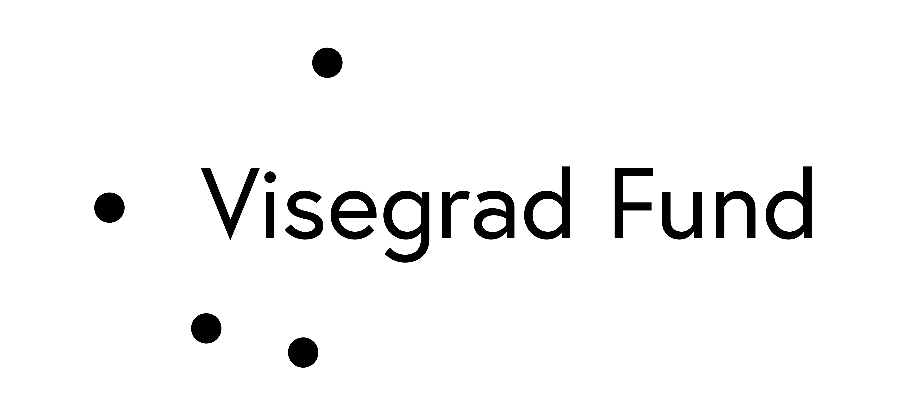
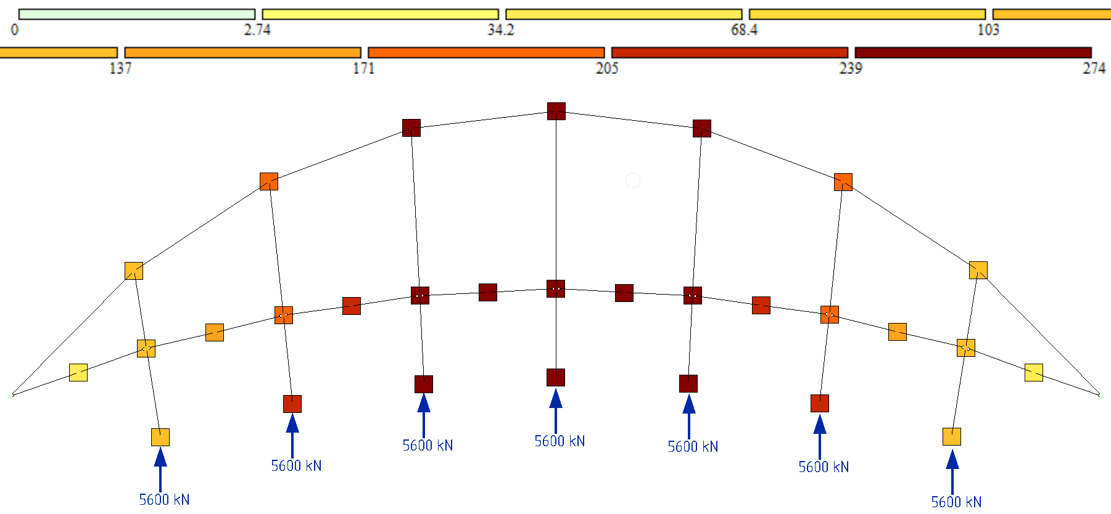
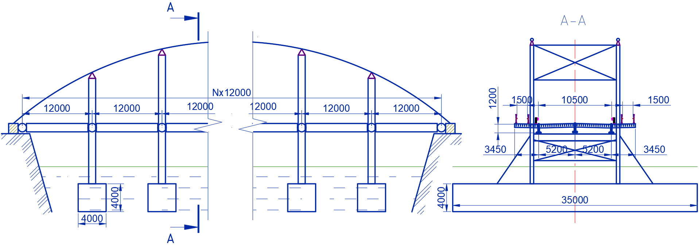
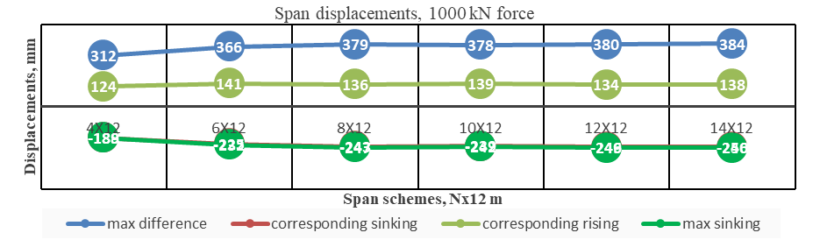
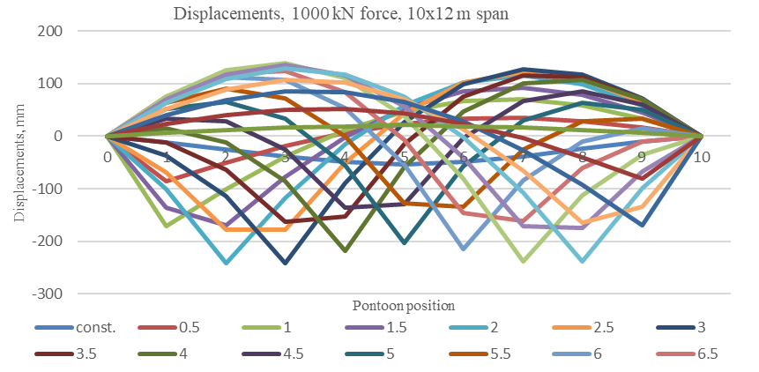
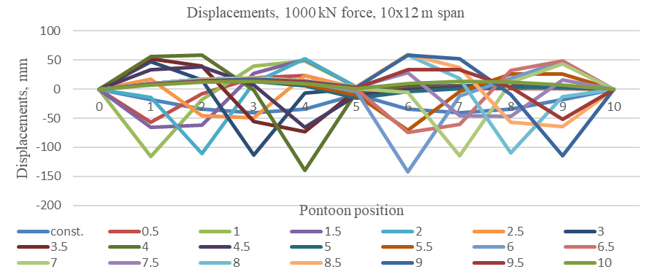
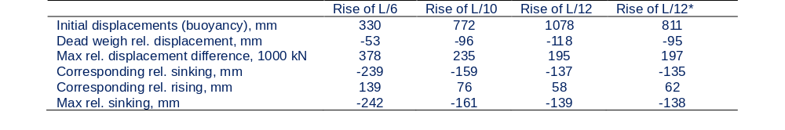
Rationale for New Pontoon-Cable Bridge Structure Parameters for Providing Uninterrupted Transportation
TRANSCOM 2025: 16th International Scientific Conference on Sustainable, Modern and Safe Transport
Pavlo Ovchynnykov¹, Oleksii Tiutkin², Vaidas Lukoševičius³, Larysa Neduzha⁴
1 Ukrainian State University of Science and Technologies, Dnipro, Ukraine
2 Ukrainian State University of Science and Technologies, Dnipro, Ukraine
3 Kaunas University of Technology, Kaunas, Lithuania
4 Ukrainian State University of Science and Technologies, Dnipro, Ukraine
introduction
The fusion of ancient pontoon (floating) bridge designs with modern tensegrity principles holds great potential for innovative engineering solutions. The structure of pontoon-cable bridge was proposed, that implements fully submerged pontoons that are held in place by the cable arch, to counter several disadvantages of classic floating bridges. | Since the proposed bridge structure has no direct analogues, or prior examples to reference, it requires a detailed study from initial data and application conditions to calculation methods, structural optimization, and more. This would provide data for its further design and implementation. | The aim of this research is to substantiate the parameters of a novel pontoon-cable bridge design, representing a significant advancement in the evolution of traditional floating bridge concepts. This stage involves defining the project's applicability, focusing on total length and the number of intermediate spans, alongside a comparison with traditional structures
materials, methods & implementation
To obtain an answer to set tasks, a series of numerical calculations has been performed using finite element method for planar problem using LIRA-CAD R16 software. The model consists of simple beams with fixed span length of 12 m between the pontoons, that are assembled into general structure of 4 to 14 hinged spans for calculation. The only bounding conditions for the model are cable anchors at the span endpoints, as the vertical stability is derived from pontoons that are set to yield buoyancy force larger than combined loads of possible permanent and transient loads. Since pontoons are fully submerged, it’s possible to represent them as constant forces only. For reference values, a control scheme was calculated, that uses only spans and traditional floating pontoons.
The cable was selected iteratively for each span so as to ensure adequate displacements after initial loading from buoyant forces. As an increment value, a rigidity of 180 mm wire rope was taken with added multiplier (4 times for 96 m, 8 – for 144 m etc.
Frontal and side views of proposed bridge with dimensions (mm) set for calculation
Computational model with initial loading and displacements after applying permanent loads
results
Calculation of the proposed design demonstrated, that the displacements are dependent on the total span length. Notably, the sinking of the loaded pontoon also causes a rise in some other ones. Moreover, the observed displacement differences between these pontoons demonstrate a nearly linear relationship across the load range. Although displacements per se are almost three times smaller, than those of control scheme (242 mm and 715 mm), the rising pontoons create displacement differential less than half of those on control scheme (378 mm and 715 mm). However, local force movements, such as shifting the load from the middle of the span to a pontoon, result in significantly less change in cable scheme. Analysis of displacements also shows, that displacement differences do not increase significantly with the total span length increase. This negligible increase, coupled with the smooth deformed curve suggests improved passenger comfort for longer spans.
Due to bridges’ lack of rigidity, implementing standard techniques used to increase the rigidity of suspension bridges for application in calculated bridge designs may be proposed. To illustrate the concept, a simple two-cable (or additional strand) scheme was used in the analysis. These measures nearly halve both maximum sinking and displacement differences.
Maximum displacements for calculated span configurations
Pontoon displacements depending on the 1000 kN force position
conclusion & implementation path
The proposed pontoon-cable new bridge structure, described in this study, represents an advancement over traditional floating bridge designs. This approach significantly improves the overall behaviour of the bridge, particularly its stiffness in the vertical plane, which translates into improved passenger comfort and overall usability. Calculations conducted for various scheme configurations have demonstrated that the full scope of applications for this bridge type remains to be determined. At the same time, it was proven that for spans up to 170 meters, both rigidity and possible comfort of movement improve significantly.
In addition to proposed pure scheme, alternatives may be explored further; particularly, those, that further increase overall rigidity, like proposed two-cable options. Further application scope should be determined by continuing the calculations for other lengths, span configurations and other parameters. Those also will provide for possible optimization due to material economy or bettering the bridges behaviour (like varying cable rise, pontoon size, materials etc.).
Span behaviour for various cable rises
Pontoon displacements depending on the 1000 kN force position for 2-cable scheme

