Slide 1


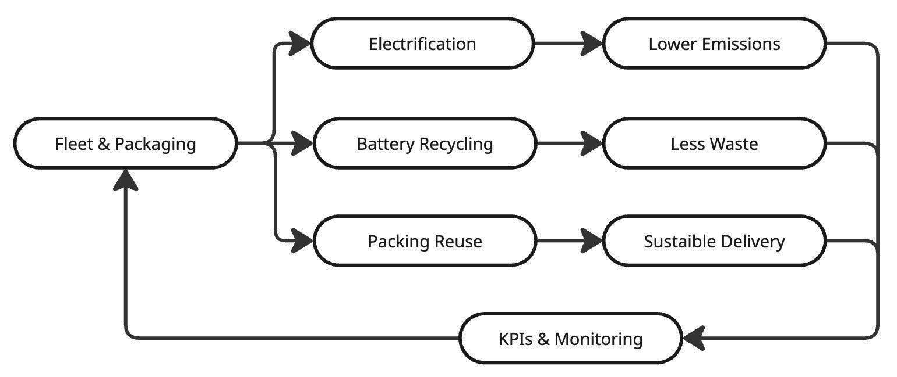
Sustainability and the Circular Economy in the Postal Sector
TRANSCOM 2025: 16th International Scientific Conference on Sustainable, Modern and Safe Transport
Ivona Chupaň Kunertová¹, Mariana Strenitzerová¹
1 Department of Communications, Faculty of Operation and Economics of Transport and Communications, University of Žilina, Žilina, Slovakia
introduction
Postal companies are under increasing pressure to operate more sustainably. Their transport and delivery systems produce high emissions and waste, making circular economy approaches—such as electrification, reuse, and smart packaging—essential to meeting climate and policy goals. | Despite declared commitments, postal companies differ in their sustainability and circular economy performance. Barriers include regulation, cost, and data transparency. This inconsistency limits comparability and slows progress, impacting policymakers, industry partners, and environmental stakeholders alike. | This study compares five postal operators’ circular economy practices, focusing on fleet electrification, carbon neutrality, and waste reduction. It aims to identify best practices and lay the groundwork for the future creation of KPIs to support measurable, scalable sustainability in postal logistics.
materials, methods & implementation
This study applies a comparative case analysis of five postal operators: Swiss Post, USPS, La Poste, Deutsche Post DHL, and PostNL. The selection reflects geographic diversity and availability of sustainability data. Data were gathered from public sources—sustainability reports, official websites, and documents from key industry bodies such as the UPU, PostEurop, and IPC. The research focused on three areas: fleet electrification, carbon neutrality goals, and circular practices in packaging and waste. Strategies were compared to identify best practices and common challenges. Differences in ambition, implementation, and reporting revealed both progress and gaps across the sector. Notably, Slovenská pošta lacked sufficient data for comparison, highlighting the need for more consistent sustainability reporting. These outcomes will serve as a foundation for the future development of KPIs that will support transparent evaluation and benchmarking of environmental performance in the postal industry. These findings can help postal operators adopt more effective and measurable sustainability strategies.
results
The analysis revealed clear differences in how postal operators implement circular economy strategies. Swiss Post operates over 7,200 electric vehicles, aims for carbon neutrality by 2040, and reduced plastic waste by 30% using reusable packaging. La Poste, carbon neutral since 2012, runs a fleet of 37,000 eco-vehicles and applies 70% recycled materials in its packaging. Deutsche Post DHL is expanding to 80,000 EVs by 2030 and applies closed-loop battery reuse, targeting neutrality by 2050. PostNL focuses on emission-free urban delivery and reduces packaging volume by 10% with collapsible pallet systems. USPS, while planning to deploy 66,000 EVs, lacks a defined carbon goal and remains in pilot stages with sustainable packaging. These variations highlight both innovation and gaps, revealing the need for standardized measurement. The results highlight the importance of developing key performance indicators (KPIs) in future research—covering emissions, EV adoption, reuse, and waste diversion—to enable more objective evaluation. The findings underscore the need for KPIs to guide practices such as early EV adoption, battery recycling partnerships, reusable packaging, and route optimization.
Circular Route to Postal Sustainability Early adoption of electric vehicles (EVs) Reusable and recyclable packaging systems Battery recycling and closed-loop initiatives Smart parcel logistics and route optimization Unified KPIs for tracking of circular economy and sustainability performance | Circular Economy Flow In Postal Services | This infographic shows how postal services implement circular economy principles. It highlights key processes like fleet electrification, battery recycling, and packaging reuse, leading to lower emissions and less waste. KPIs & Monitoring ensure continuous improvement, closing the loop for more sustainable logistics.
conclusion & implementation path
This study reveals significant differences in how postal operators implement circular economy strategies. Swiss Post and La Poste lead with integrated approaches—combining large electric fleets, clear carbon neutrality targets, and innovative packaging. In contrast, USPS, DHL, and PostNL show partial progress, often lacking measurable climate goals or transparent data. These differences highlight the need for a unified framework to guide sustainability efforts in the sector. A central finding is the absence of standardized sustainability reporting, which limits comparability and slows sector-wide learning. Without consistent metrics, it is difficult to assess impact or share proven solutions. This study emphasizes the need for the development of key performance indicators (KPIs) in future research—focused on emissions, fleet electrification, packaging reuse, and waste reduction. These KPIs will lay the groundwork for comparative assessments and help align operational practices with long-term sustainability targets. Future research should refine these indicators, apply them to broader datasets, and explore their integration into regulatory frameworks. Such an approach will ensure that the sector is equipped to meet environmental goals. Implementing standardized metrics at the sector level could improve transparency, foster collaboration, and support policy alignment. To achieve meaningful progress, postal services must not only invest in green technologies but also adopt shared evaluation tools. A unified approach will enhance data-driven decision-making, improve accountability, and enable the sector to scale sustainable practices effectively. Only with consistent reporting and industry-wide cooperation can postal services build truly sustainable logistics systems.
acknowledgements
This publication was created thanks to support under the project VEGA 1/0333/24 Innovative business models in the urban circular economy.

