Slide 1


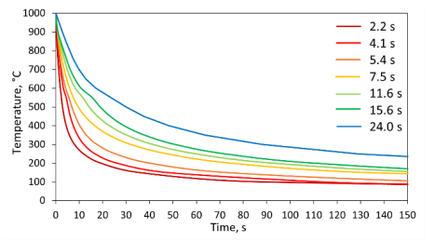
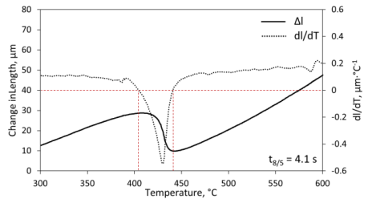
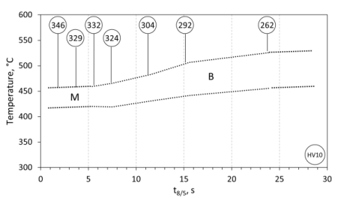
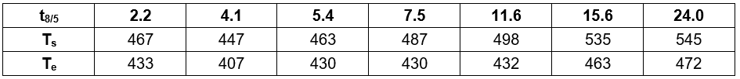
Creation of In-Situ Continuous Cooling Transformation
Welding Diagrams of S960 High Strength Steel
TRANSCOM 2025: 16th International Scientific Conference on Sustainable, Modern and Safe Transport
J.Harvanec¹, J.Moravec ², M.Mičian¹, M.Frátrik¹
1 University of Žilina, Žilina, Slovakia
2 Technical University of Liberec, Liberec, Czech republic
introduction
Background information & Market Context In an effort to reduce carbon emission, manufacturers are trying to make the construction of vehicles and equipment as light as possible. For fulfilment of this need, ne, stronger materials, like HSLA steels, are being used. These steels use multiple strengthening mechanisms as grain boundary strengthening, dislocation strengthening and precipitation strengthening. High grades of HSLA steels, like S960MC use microstructure of martensite and bainite as strengthening mechanism. | Problem Statement & Stakeholders Common welding methods like gas metal arc welding often results to longer cooling times as there is high amount of heat brought into the welding material. Transformation of the base martensitic-bainitic microstructure to softer structures happens as result of longer cooling times. Final microstructure can be predicted based on continuous cooling transformation (CCT) diagrams. For better prediction of microstructure after welding, in-situ CCT diagrams are often used. | Research Objectives & Expected Impact Determination of thermal cycles for construction of in-situ CCT diagram Evaluating of the transformation curves, using first derivate of the length change method Hardness measurement of the microstructure after thermal cycles were applied, for confirmation of microstructural changes Determination of in-situ welding CCT diagram for S960MC steel.
materials, methods & implementation
As first the control program for dilatometer was constructed, with use of the determined thermal cycles. Studied material was HSLA S960 steel.
After that, thermal cycles were applied to samples, using dilatometer. As the result, dilatometric transformation curves were obtained. As the next step the curves were evaluated by the first derivation of the length change method. Based on the results in-situ welding diagram was constructed. Hardness of the microstructure of the samples was measured and added into the diagram. Values of the hardness correspond with the microstructural changes.
results
In situ diagrams are specific in that they are based on real temperature cycles occurring during welding and are defined by the parameter t8/5, that is, the cooling time in the temperature range of 800–500°C. The biggest problem in creating in-situ diagrams is the lack of suitable temperature cycles for dilatometric measurements. It is necessary to realize that the heat-affected zone of welds is very narrow (1 to 2 mm), and in this small area, there are partial places with temperature cycles with maximum temperature in the interval of approximately 750–1500 °C.
In addition, there is another limitation regarding the minimum temperature of the cycle so that the sample is completely austenitized before the application of the cooling cycle. Therefore, only cycles with maximum temperatures exceeding 1000°C were used in this study. The used range of t8/5 values and the intervals between them sufficiently cover the area of application of S960MC steel in welding processes. Based on the hardness values, it can be stated that the phase transformations lead to the formation of martensitic and bainitic microstructures, which corresponds to the chemical composition of the steel (despite the low carbon content).
conclusion & implementation path
This article focuses on the determination of an in-situ diagram for high-strength S960MC steel with a thickness of 3 mm, as that is a valuable tool for predicting the microstructure of the HAZ, with also hardness, after the process of MAG and laser beam welding. This helps to make the most of the mechanical properties of this high-strength steel, as the HAZ zone is the most critical part of the welded components. From this research, the main conclusions are as follows: • The thermal cycles were established based on the parameters t8/5, which were based on real welding cycles and computer simulations. • Start and end of the transformations were determined based on the first derivative of the length change. • Microhardness of the structure of each sample was measured, and it confirmed the phase transformations. Hardness was also plotted into the in-situ diagram. • When comparing the transformation temperatures with the classic CCT diagram published in Moravec et al. study, these deviations are in the range of ± 5 °C. It is important to note that this is valid only for the type of steel under investigation, i.e. S960MC and for the chemical composition according to this study.
acknowledgements
This work was supported by the Slovak Research and Development Agency [grant number APVV-20-0427; KEGA agency [grant number KEGA 008ŽU-4/2022]; VEGA agency [grant number VEGA 1/0044/22]; International Visegrad Fund [grant number 62410209] and by the EU NextGenerationEU through the Recovery and Resilience Plan for Slovakia under the project No. 09I03-03-V05-00002.

