Slide 1



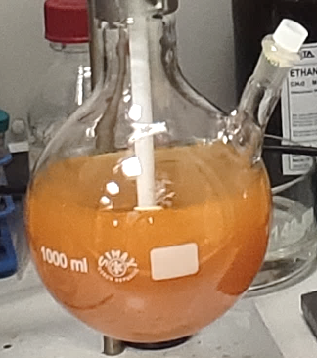
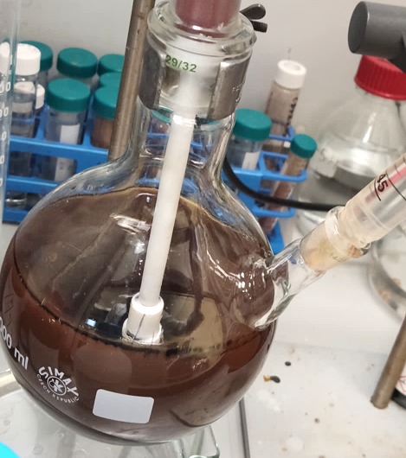
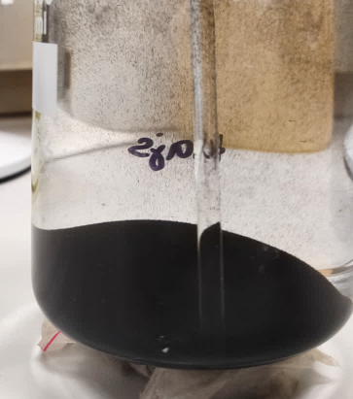
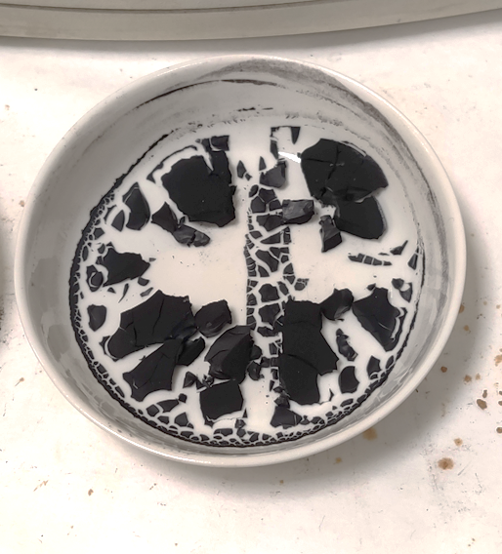
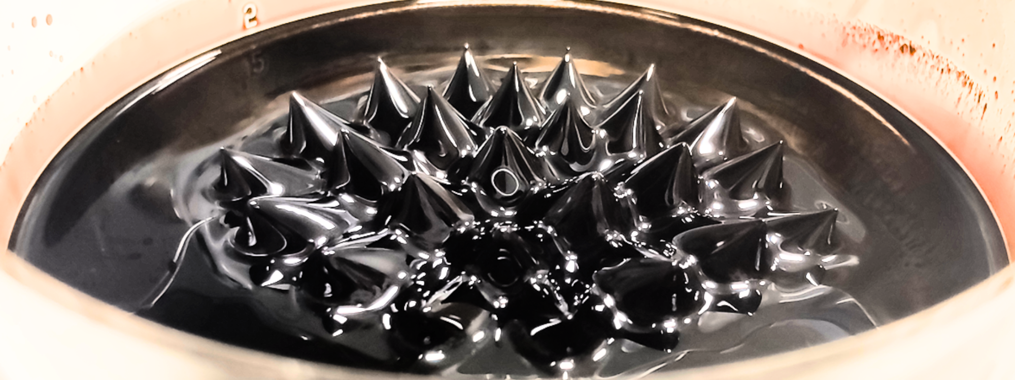
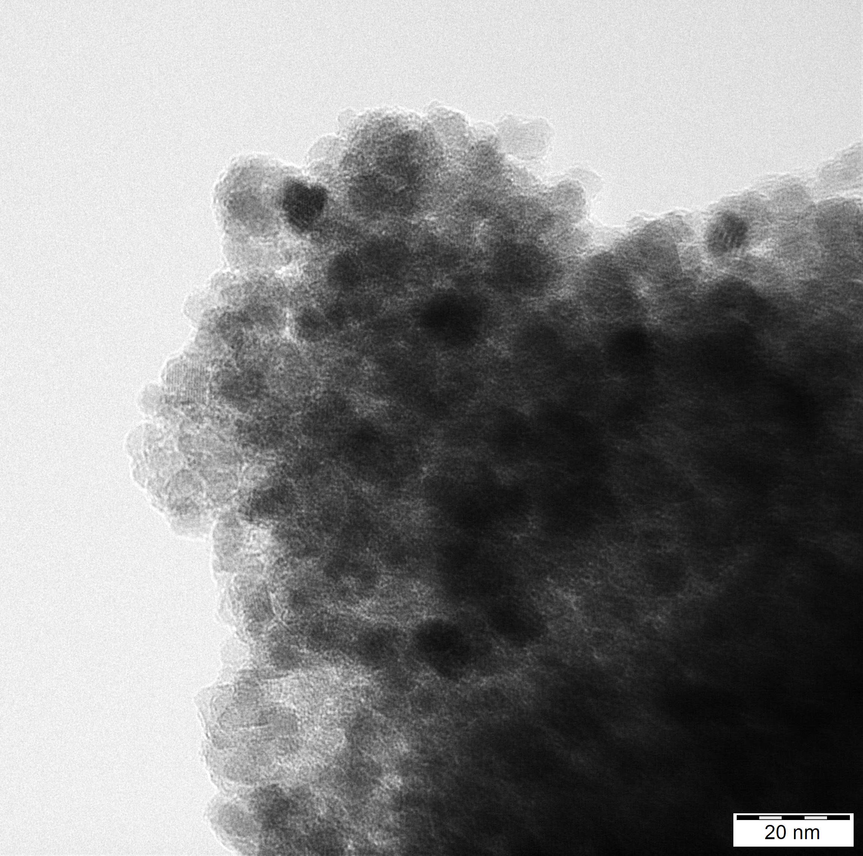
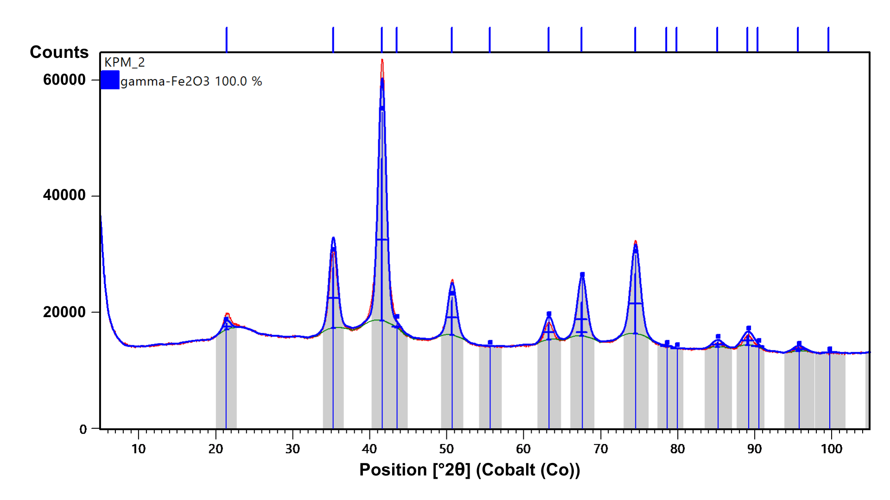
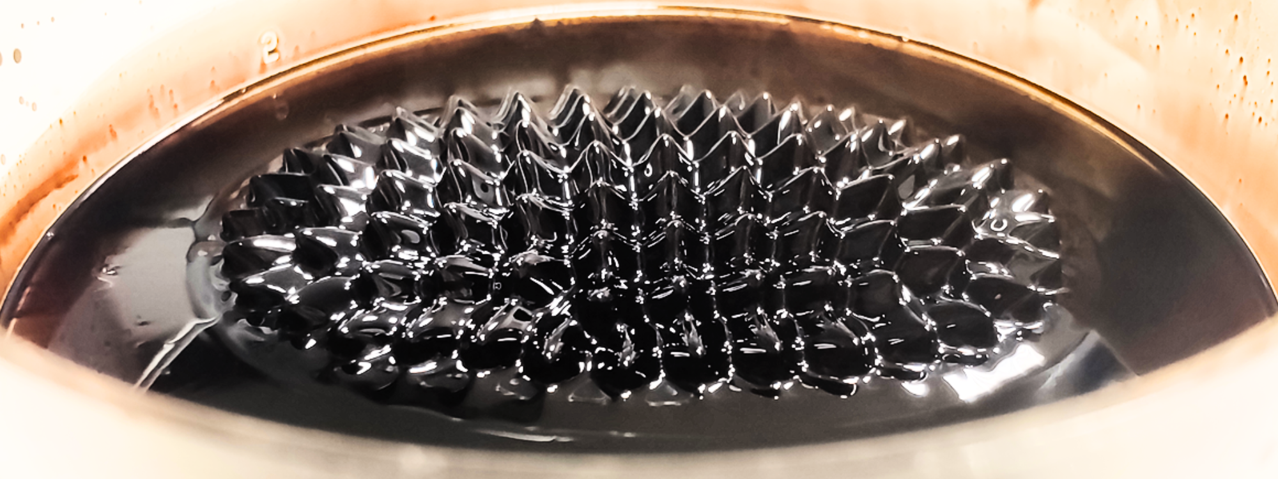
Ferrofluids: properties, preparation and their transport engineering applications
TRANSCOM 2025: 16th International Scientific Conference on Sustainable, Modern and Safe Transport
Karolína Pradeniakováª, Peter Hockickoª
ªDepartment of Physics, Faculty of Electrical Engineering and Information Technology, University of Žilina
introduction
Backround information & Market Context Ferrofluids, consisting of magnetic nanoparticles suspended in carrier liquid, have key applications in multiple fields, such as medicine, sensing, engineering or transport. Their unique mixture of magnetic and fluid properties is used in seals, dampers or mechanical sensing. | Problem Statement & Stakeholders Many of the existing published synthesis methods lack crucial details, making it difficult to reproduce results. This leads to challenges in producing reliable materials in fields such as nanotechnology, while making the process scalable and standardisable. | Research Objectives & Expected Impact The main goal of our research was development of a reproducible synthesis protocol for magnetic nanoparticles used in ferrofluids, while providing detailed and transparent steps. We therefore expect improved reproducibility with possibility of commercial scaling.
materials & methods
drop wise addition of NH₃ (aq)
and oleic acid
magnetic decantation of precipitated NPs
multiple water and ethanol washings and drying the NPs
dispersing the NPs in kerosene to obtain a ferrofluid
FeCl₂ & FeCl₃ (aq)
precipitation of NPs
washed & surfacted NPs
final dry product
results
Behaviour of our ferrofluid in the presence of an external magnetic field, magnet distance increasing from top to bottom. We observe typical sharp peaks, additionally confirming both the synthesis of magnetic nanoparticles and their surfactation were successful
TEM micrograph of our sample, confirming spherical symmetry of prepared nanoparticles and their size as roughly 10 nm. A degree of aggregation is also evident, which becomes inevitable in such small nanosystems
pXRD diffractogram of the sample, displaying peaks characteristic for a crystalline solid in a powder form with visible peak broadening due to small crystallite size. The spectral analysis confirms presence of one phase only with no apparent contamination. Using Scherrer equation, the mean coherent domain size was determined to be 9 nm, while the lattice parameter was calculated to be 8,368 Å.
conclusion
In our paper, we have successfully synthesized iron oxide nanoparticles suitable for preparing ferrofluids using a rapid and simple coprecipitation method from cheap precursors, such as ferrous and ferric chlorides, aqueous ammonia and oleic acid. Both transmission electron microscope (TEM) and powder X-ray diffraction (pXRD) analyses confirmed presence of small nanoparticles with diameter of roughly 10 – 20 nm. The lattice parameter determined from the diffraction data confirms presence of a non-stoichometric maghemite, which is to be expected. By dispersing these surfacted nanoparticles in kerosene, we have successfully prepared a stable ferrofluid displaying all desired characteristics with high stability. The final ferrofluid exhibits sets of sharp peaks in the presence of an external magnetic field, while the viscosity of the fluid is unchanged. This confirms strong magnetic response of our nanoparticles together with their successful surfactation. These findings suggest that our nanoparticles possess complex structural and magnetic characteristics, most likely caused by partial oxidation from magnetite to maghemite. However, despite this issue our final ferrofluid sample behaved as intended. Future studies in this field could benefit from focusing on oxidation control of the nanoparticles during their synthesis and their subsequent surfactation. Additionally, to assess their suitability for transport applications, further mechanical testing should be conducted, including rheological analysis to evaluate viscosity and shear behaviour, as well as tribological testing to examine friction, wear resistance, and lubrication performance.
acknowledgements
This work was supported by the Slovak Grant Agency KEGA through projects No. 006ŽU-4/2024 and No. 003TU Z-4/2024. The author would additionally like to express gratitude to Palacký University in Olomouc for providing them with the opportunity and resources to conduct this research.

