Slide 1

Economic Growth and Transport Emissions: Testing the Environmental Kuznets Curve in Austria and the Netherlands
Ammar Al-lami ª Ádám Török ^{a,b}
ª Department of Transport Technology and Economics, Faculty of Transportation Engineering and Vehicle Engineering, Budapest University of Technology and Economics, Műegyetem rkp. 3., H-1111 Budapest, Hungary
torok.adam@kjk.bme.hu
^{b} KTI - Institute for Transport Sciences, Directorate for Strategic Research and Development Hungary, Budapest, H-1119 Than Karoly str 3-5.
torok.adam@kti.hu
1

Slide 2
Introduction to the Environmental Kuznets Curve and Its Relevance
EKC Hypothesis Overview
Significance for EU Climate Policy
The EKC posits that environmental degradation initially worsens with rising income, but improves as economic development matures beyond a threshold. This study applies EKC to transport CO₂ emissions in Austria and the Netherlands, important contributors to EU climate goals.
Transport is a major source of greenhouse gases, and understanding emission trends linked to GDP helps design targeted policies. Austria and the Netherlands display differing growth-emissions dynamics reflecting their energy policies and economic structures.
2

Slide 3
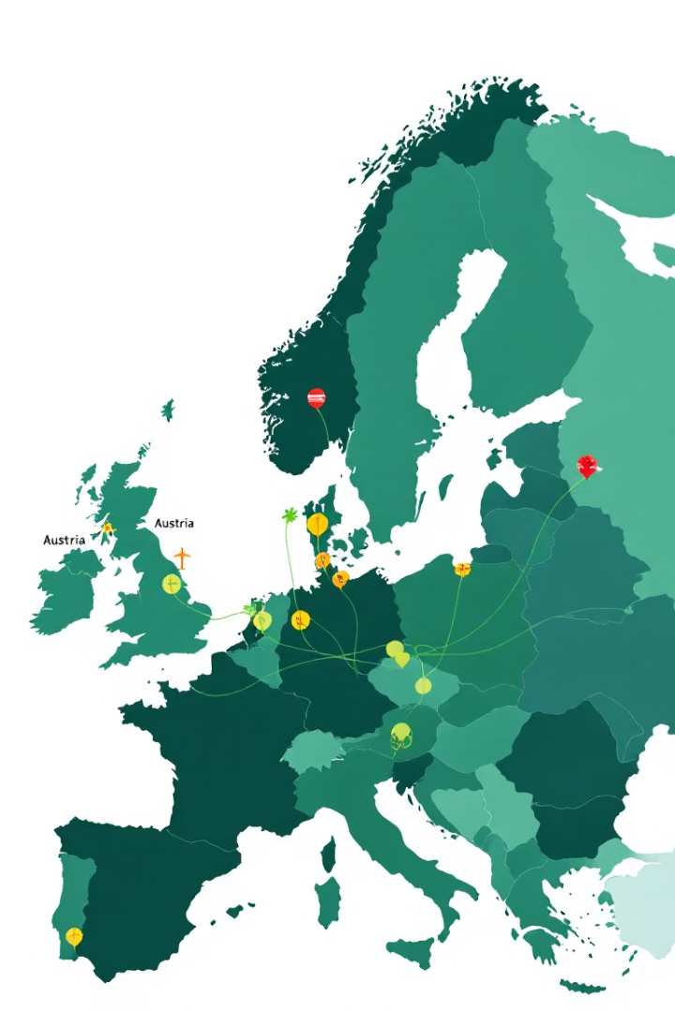
Literature Review: EKC in Transport Emissions and Economic Growth
Global and European Insights
Country-specific Evidence
Transport accounts for about 23% of global CO₂ emissions. EKC findings vary by sector; while energy and industry often confirm EKC patterns, transport emissions tend to resist decline due to urbanization and freight demands.
Austria shows emission reductions supported by renewable energy use, while the Netherlands faces transport emission challenges linked to dense urbanization and freight transport's fossil fuel reliance.
Research Gaps
Previous studies often overlook transport-specific EKC trends and fail to address policy and infrastructural nuances affecting emissions, especially in European contexts with diverse economic and environmental conditions.
3

Slide 4
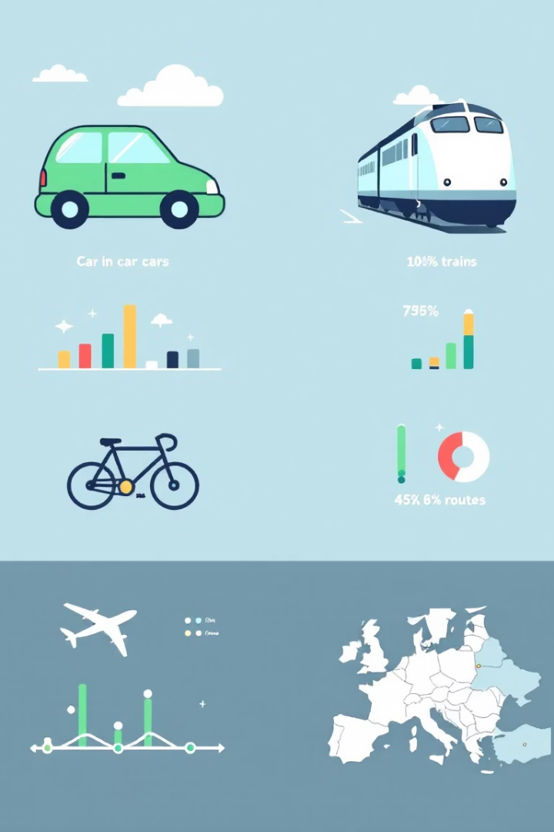
Methodology: Data Sources and Scope
1
Data Collection
2
Variables
Used secondary data (1990-2021) from IEA, World Bank, Eurostat for CO₂ transport emissions and GDP (PPP) in Austria and the Netherlands.
Transport-related CO₂ emissions (million tons) and GDP in purchasing power parity, ensuring comparable economic output assessment.
3
Analytical Focus
Examined transport sector emissions to tease out sector-specific EKC patterns, crucial for policy relevance within the EU climate framework.
4

Slide 5
Model Specification: Quadratic Regression for EKC Testing
EKC Model Description
Statistical Validation
Quadratic regression models are used to capture the inverted U-shaped EKC curve, with GDP as the independent variable and CO₂ emissions as the dependent variable.
Model fitted with non-linear least squares; coefficients β1 and β2 showed statistical significance (p < 0.01) for both countries, validating the inverted U relationship.
Positive linear coefficient and negative quadratic coefficient indicate expected EKC shape.
R² statistic used to assess adequacy of the model in explaining variance in transport emissions.
5

Slide 6
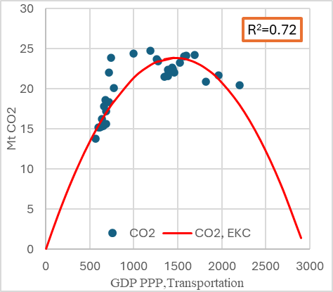
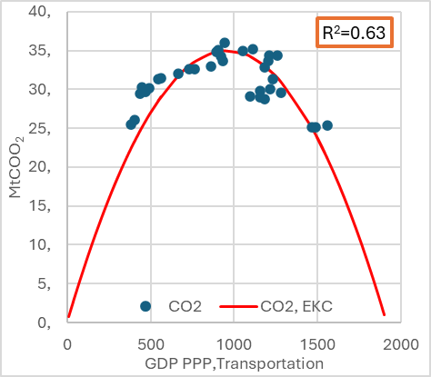
Results: EKC Patterns in Austria and the Netherlands
Austria
Austria
EKC model fits well (R²=0.71), indicating emissions rise slowly with GDP then decline gently, possibly due to renewable energy integration in transport and energy sectors.
Netherlands
Model fit somewhat lower (R²=0.62) but still indicative of EKC shape; sharper initial emissions increase followed by steeper decline, reflecting urban density challenges and fossil-fuel reliance for freight transport.
Netherlands
6

Slide 7




Discussion: Interpretation of EKC Findings and Policy Context
Growth-Increase Phase
Turning Point
Decline Phase
Initial economic growth stimulates transport demand, increasing emissions due to fossil-fuel dependence and expanding freight movement.
GDP threshold reached, leading to policy and technological shifts favoring cleaner transport options and infrastructure investments.
Emissions reduce as sustainable technologies, renewable energy use, and public transit expansion mitigate environmental impacts.
7

Slide 8
Policy Implications and Drivers Beyond GDP
Austrian Context
Dutch Challenges
Renewable energy infrastructure and public transport policies contribute to gradual emissions reduction, emphasizing the importance of green energy integration.
Urban density and freight transport reliance on fossil fuels require targeted policies on electric vehicles, freight modal shifts, and infrastructure upgrades to accelerate emission declines.
8

Slide 9

Conclusions and Limitations
Key Insights
Limitations
Future research should incorporate multi-factor models and explore sub-national variations to better inform sustainable transport strategies aligned with EU climate goals.
The EKC hypothesis holds for transport CO₂ emissions in Austria and the Netherlands, with emissions increasing with GDP initially, then declining past a threshold that reflects cleaner technologies and infrastructure investments.
The quadratic EKC model oversimplifies complex dynamics, ignoring other factors like fuel costs, urban planning, and technology. National aggregates may hide regional heterogeneity. Findings are limited to two countries and may not generalize across Europe.
9

Slide 10
References
Al-lami, A., Török, Á., 2025. Regional forecasting of driving forces of CO2 emissions of transportation in Central Europe: An ARIMA-based approach. Energy Rep. 13, 1215–1224. https://doi.org/10.1016/j.egyr.2025.01.004
Apergis, N., 2015. Environmental Kuznets curves: New evidence on both panel and country-level CO2 emissions. Energy Econ. 54 (2016) 263–271, 9. http://dx.doi.org/10.1016/j.eneco.2015.12.007
Apergis, N., Ozturk, I., 2015. Testing Environmental Kuznets Curve hypothesis in Asian countries. Ecol. Indic. 52, 16–22. https://doi.org/10.1016/j.ecolind.2014.11.026
Bagdi, Z., Csámer, L., & Bakó, G. (2023). The green light for air transport: sustainable aviation at present. Cognitive Sustainability, 2(2).
Boldizsár, A., Mészáros, F., & Torok, E. (2022). Social and economic analysis of the EU road freight transport fleet. Cognitive Sustainability, 1(2).
Bok, M.D., Tavasszy, L., Thoen, S., 2020. Application of an empirical multi-agent model for urban goods transport to analyze impacts of zero emission zones in The Netherlands. Transp. Policy. https://doi.org/10.1016/j.tranpol.2020.07.010
Cautisanu, C., Hatmanu, M., 2023. A Study of the Decoupling of Economic Growth from CO2 and HFCs Emissions in the EU27 Countries. Energies 16, 5546. https://doi.org/10.3390/en16145546
EEA, 2020. Austria [WWW Document]. URL https://www.eea.europa.eu/en/countries/eea-member-countries/austria (accessed 10.31.24).
Grossman, G.M., Krueger, A., 1995. Economic Growth and the Environment. Q. J. Econ. 110, 353–377.
IEA, 2022. Transport - Energy System [WWW Document]. IEA. URL https://www.iea.org/energy-system/transport (accessed 10.31.24).
IPCC, 2015. Climate Change 2014: Mitigation of Climate Change: Working Group III Contribution to the IPCC Fifth Assessment Report. Cambridge University Press, Cambridge. https://doi.org/10.1017/CBO9781107415416
Kampf, R., Gašparík, J., & Kudláčková, N. (2012). Application of different forms of transport in relation to the process of transport user value creation. Periodica Polytechnica Transportation Engineering, 40(2), 71-75.
Kuznets S, 1955. Economic growth and income inequality. American Economic Review [WWW Document]. URL https://www.jstor.org/stable/i304619 (accessed 10.31.24).
Martínez-Zarzoso, I., Maruotti, A., 2011. The impact of urbanization on CO2 emissions: Evidence from developing countries. Ecol. Econ., Special Section: Ecological Economics and Environmental History 70, 1344–1353. https://doi.org/10.1016/j.ecolecon.2011.02.009
Panayotou, T., 1993. Empirical tests and policy analysis of environmental degradation at different stages of economic development. ILO Work. Pap., ILO Working Papers.
Schäfer et al, 2009. Transportation in a Climate-Constrained World [WWW Document]. MIT Press. URL https://mitpress.mit.edu/9780262512343/transportation-in-a-climate-constrained-world/ (accessed 10.31.24).
ShafiK, N., 1994. Economic Development and Environmental Quality: An Econometric Analysis | Oxford Economic Papers | Oxford Academic [WWW Document]. URL https://academic.oup.com/oep/article-abstract/46/Supplement_1/757/2568539?redirectedFrom=fulltext (accessed 10.31.24).
Škorupa, M., Bulková, Z., Gašparík, J., & Kendra, M. (2024). Methodology for designing a system of Public Passenger transport in a functional region. Periodica Polytechnica Transportation Engineering, 52(1), 24-32.
10

