Slide 1


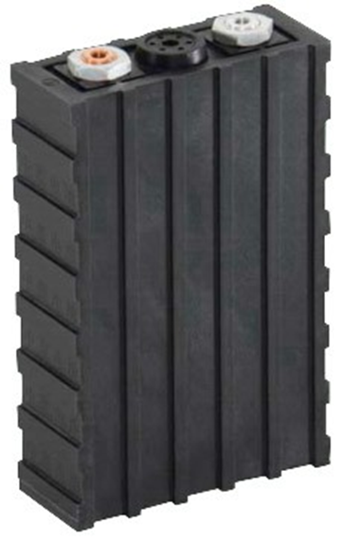
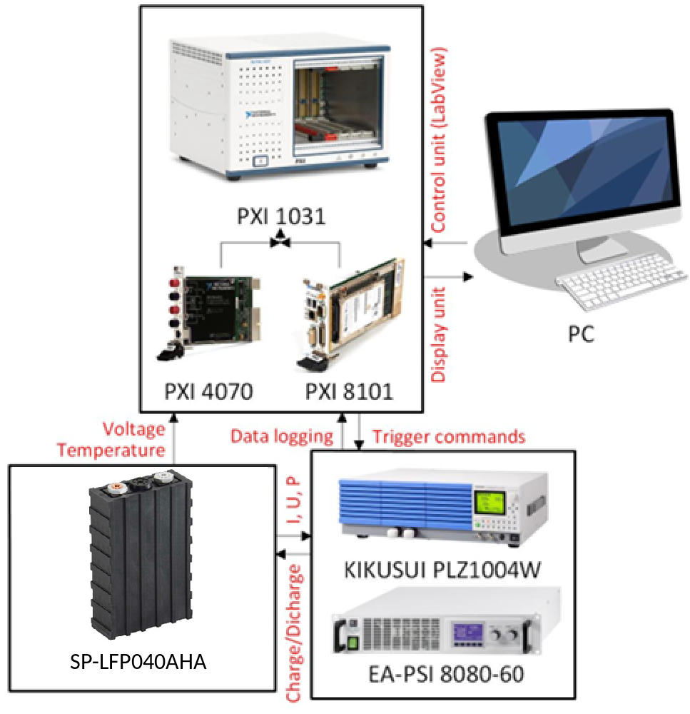
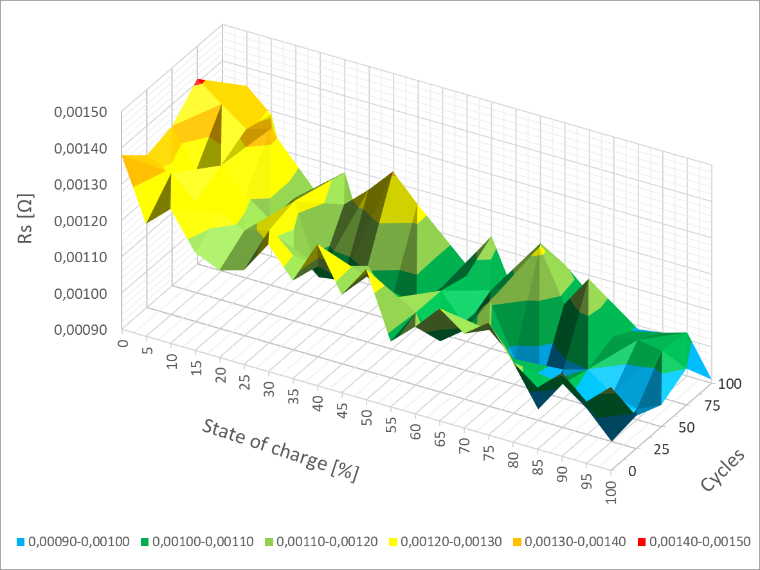
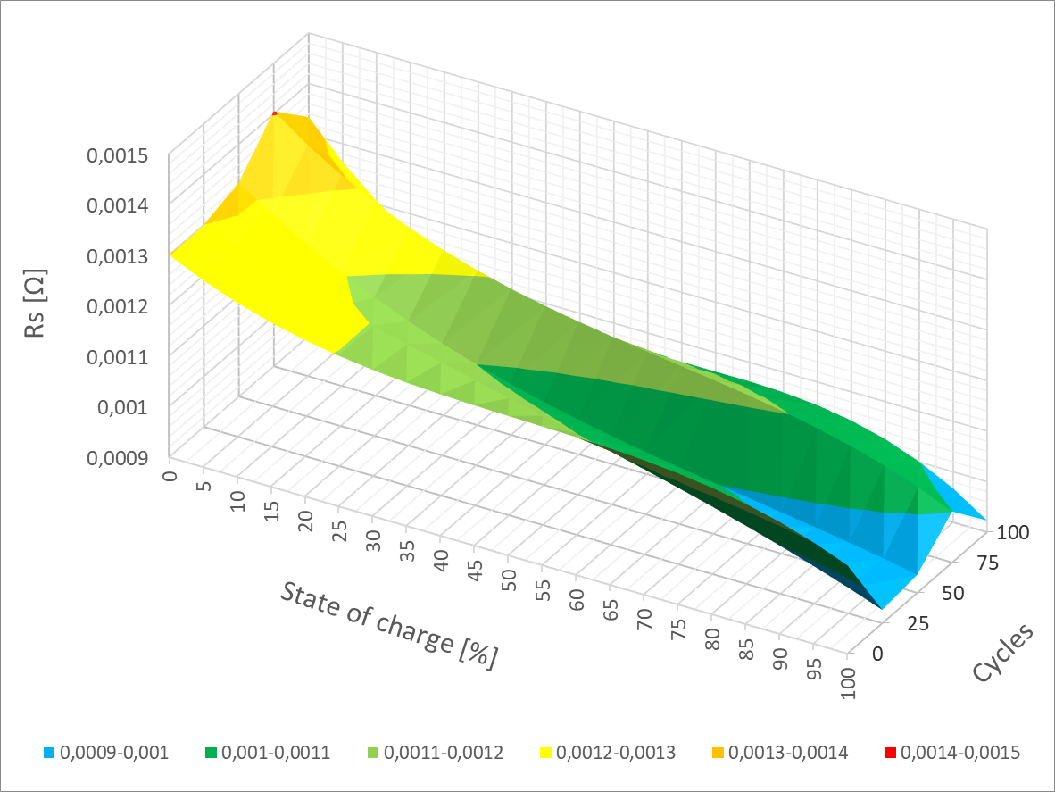
Changes in internal resistance R_{S} after LiFePO4 cell cycling
TRANSCOM 2025: 16th International Scientific Conference on Sustainable, Modern and Safe Transport
Marek Simcak¹, Michal Frivaldsky¹
1 Faculty of electrical engineering and information technology, University of Zilina, Zilina 010 01, Slovakia
INTRODUCTION
In modern battery development, prioritizing safety, capacity, longevity, and cost-effectiveness is essential. These elements are closely related to the battery's electrical characteristics and internal structure, which are crucial in determining overall performance. A battery's operating lifespan is directly and significantly impacted by changes made to its internal structure and electrical properties. Internal resistance is a crucial factor that affects battery performance and usually rises with cycling. This increase in internal resistance has a number of negative consequences that hasten battery deterioration. An increase in resistance leads to less battery capacity and elevated heat generation, both of which shorten the lifespan. For lithium-based batteries, elevated temperatures are especially problematic since they can worsen deterioration processes and jeopardize safety. Therefore, it is crucial to comprehend how internal resistance and cycling interact in order to increase battery longevity and efficiency. This study's main focus is to investigate how cycling affects LiFePO4 cells' internal resistance in order to clarify how these modifications affect battery performance over time.
TESTED BATTERY
INFRASTRUCTURE
Parameters | Values
Nominal voltage | 3.2 V
Capacity | 40 Ah
Deep discharge voltage | 2.65 V
Maximum charge voltage | 3.65 V
Optimal charging current | 13 A (0,3 C)
Maximum discharge current | 120A (3 C)
Maximum charge current | 80 A (3 C)
Longevity | Approx. 1000-1500
Working temperature range | From -20℃ to 55℃
SP-LFP040AHA
The system concept for battery equivalent electrical circuits (EECs).
results
Effect of cycling on the RS parameter change. (Graph on the left) Polynomial representation of the cycling effect on the RS parameter change. (Graph on the right)
conclusion
The RS parameter is a critical component of the battery’s equivalent electrical circuit (EEC), as it directly correlates with the internal resistance of the LiFePO4 cell under investigation. Internal resistance is a fundamental metric for understanding the aging and degradation of a battery, making its accurate characterization vital for assessing the long-term performance and reliability of the cell. In this study, the variation of the RS parameter with cycling was carefully analyzed, revealing that the internal resistance undergoes only a slight increase after 100 charge-discharge cycles. This minor rise in RS indicates that, while some degree of internal degradation occurs, the LiFePO4 cell exhibits a high level of resilience to cycling. The results suggest that 100 cycles are insufficient to induce significant degradation in the RS parameter, reaffirming the well-known durability of LiFePO4 chemistry. Furthermore, the study provides a mathematical representation of the RS parameter's change, enabling more precise modeling of the internal resistance behavior. This mathematical model serves as a crucial tool for developing simulation frameworks that can predict the cell’s future performance, particularly in terms of internal resistance variation. By incorporating the mathematical model into a neural network, it is possible to establish a predictive system capable of forecasting how the RS parameter will evolve over extended cycling. This predictive capacity is particularly valuable for applications that require long-term battery performance forecasting and monitoring, as it allows for the anticipation of changes in internal resistance before they become significant. The combination of empirical measurements and predictive modeling presented in this research provides a comprehensive understanding of the LiFePO4 cell’s behavior over multiple cycles. The slight increase in internal resistance observed after 100 cycles suggests that the cell remains highly robust in the early stages of its lifecycle. This insight not only contributes to a deeper understanding of the degradation mechanisms within LiFePO4 cells but also offers practical value for optimizing battery management systems. By predicting internal resistance changes, one can better manage the cell's state of health and ensure optimal operation over extended periods. Ultimately, this research offers significant contributions to both the theoretical understanding and practical applications of LiFePO4 battery technology, particularly in the areas of longevity and predictive maintenance.
acknowledgements
The authors would like to thank to national grant agency APVV for project funding APVV-21-0462 and to national grant agency VEGA for project funding 1/0274/24.

