Slide 1





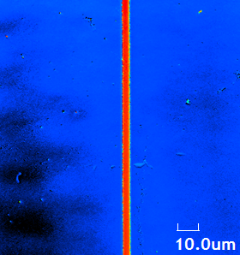
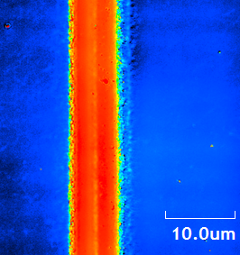
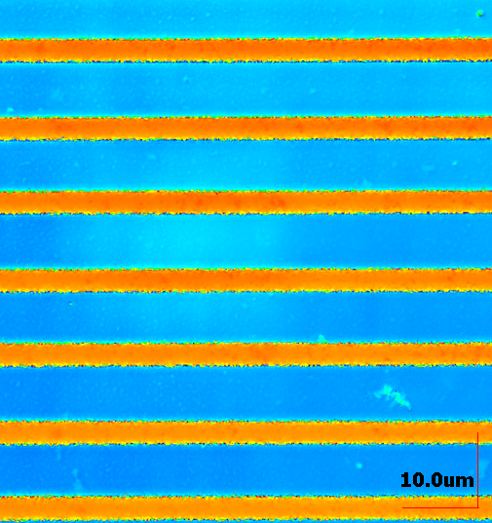
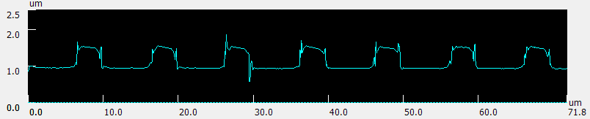
Preparation of microstructures for Gallium oxide photonic devices
TRANSCOM 2025: 16th International Scientific Conference on Sustainable, Modern and Safe Transport
Marek Zdurienčík^{1*}, Dušan Pudiš¹, Filip Gucmann²
1 Department of Physics, Faculty of Electrical Engineering and Information Technologies, University of Žilina, Univerzitná 8215/1, 010 26, Žilina, Slovak Republic
2 Institute of Electrical Engineering, Slovak Academy of Sciences, Dúbravská cesta 9, 841 04, Bratislava, Slovak Republic
Email: zduriencik@fyzika.uniza.sk
Introduction
Gallium oxide (Ga₂O₃) attracted attention of researchers because of its ultra-wide bandgap and transparency in visible spectrum. Recent research shown other interesting properties for photonics and electrical engineering. |  | Research on photonic structures on Ga₂O₃ is focused on manufacturing high-precision components like waveguides and gratings, which offers new applications in the field of modern transportation. |  | Goal is to achieve submicrometer resolution of components based on gallium oxide and investigate optical properties of new this material. Expected results should bring new technologies and high-performance photonic circuits.
Methods
Ga₂O₃ was grown with MOCVD on monocrystalline and polycrystalline sapphire substrate (Al₂O₃). Layes thicknesses are 60 nm for α-Ga₂O₃, 150 nm for β-Ga₂O₃ , 80 nm for κ-Ga₂O₃. Patterning of waveguides and gratings to photoresist layer was made by grayscale laser lithography (GLL) device modified for this application. According to used negative photoresist mrt-DWL, we use 405nm/50mW laser diode. Sample was positioned during patterning with high-precision piezo stages with 50 nm resolution. Both control units were synchronized to achieved desired structures. Thin layer (⁓500 nm) of photoresist was applied on Ga₂O₃ samples. To examine Ga₂O₃ optical properties and their potential use in integrated photonics, we designed set of gratings and waveguides with different parameters. After lithography, samples were developed in developer mrt-DEV600 and rinsed in isopropyl alcohol. Resulting structures were analyzed with confocal laser scanning microscope (CLSM). | Schematic diagram of GLL system with 405 nm laser diode
CCD camera
Semi-transparent mirror
Red LED
Beam splitter 50:50
Pair of lenses
Laser diode
Control unit
40x Objective
PC
Y- linear piezo stage
Control unit
X- linear piezo stage
Sample
results
Presented structures, made by GLL system, show great uniformity, resolution and precision. Waveguide structures 4 mm long, maintain constant width along entire length. We confirmed the measured widths of waveguides as designed: 2.5 μm, 7.5 μm, 10.5 μm. Grating structures, with 10 μm period also shows well uniformity. Profile scan from CLSM demonstrate structures height of 500 nm. | CLSM height image of waveguide: width - 2.5 μm length - 4 mm height - 500 nm | CLSM height image of waveguide: width - 7.5 μm length - 4 mm height - 500 nm | CLSM height image of grating: period - 2.5 μm area – 100x100 μm² height - 500 nm
conclusion
Presented work shows preparation of photonic structures to negative photoresist for future photonic structures based on Ga₂O₃. Results were analyzed with CLSM. Quality of waveguide and grating structures proves capabilities of GLL system. Prepared samples are ready for process reactive ion etching (RIE) and to achieve the real Ga₂O₃ photonic devices. | CLSM profile scan of grating-like structure with period of 10 μm
acknowledgements
This work was supported by grant agency of Ministry of Education, Science, Research and Sport of the Slovak Republic projects VEGA 1/0363/22, and APVV 20-0264.

