Slide 1


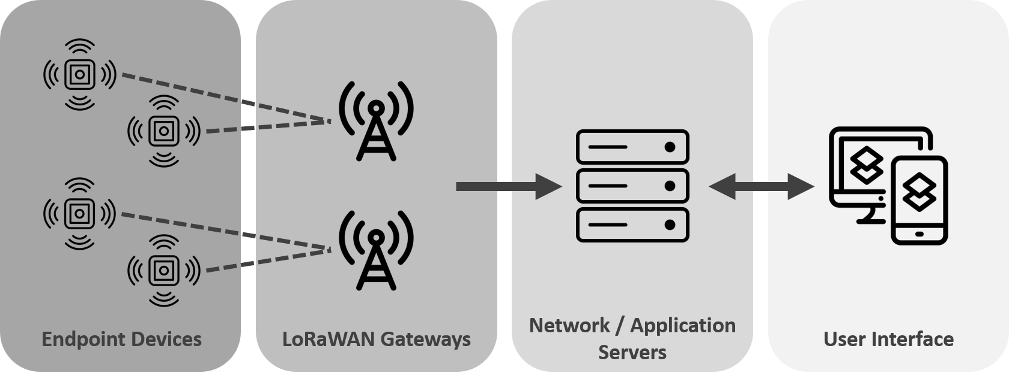
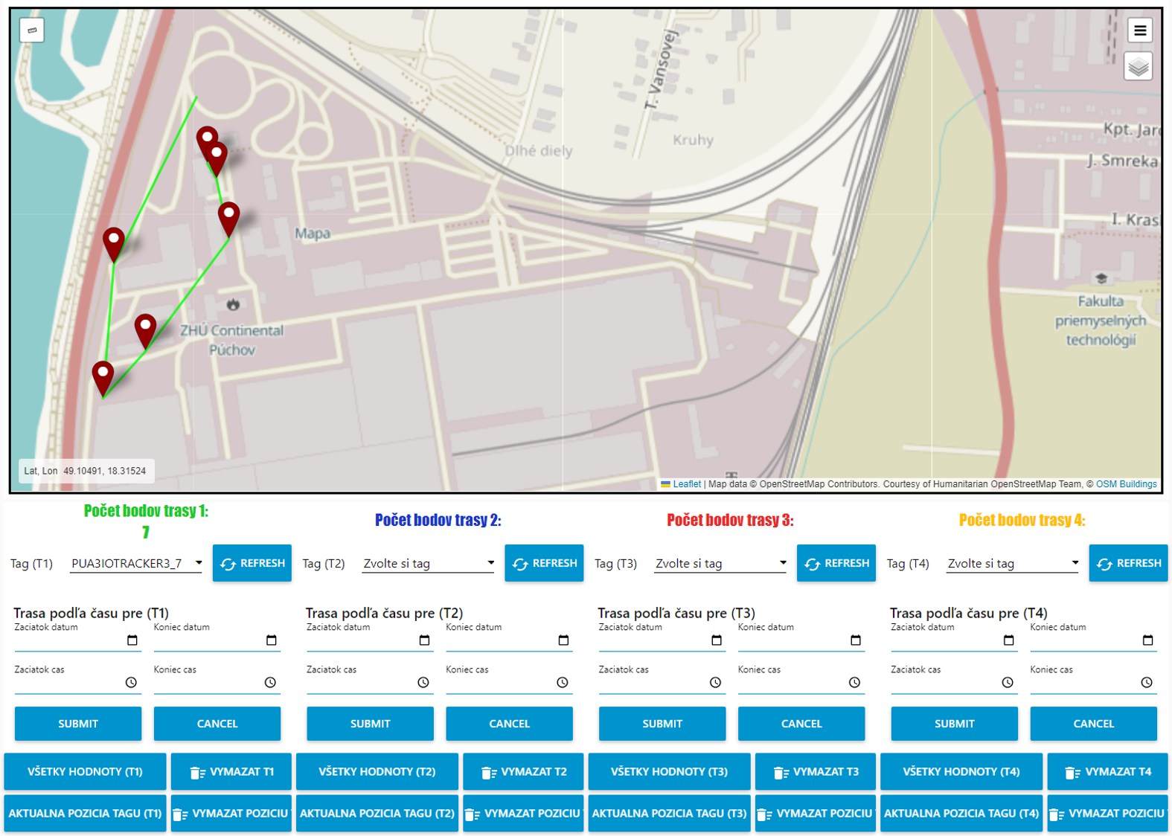
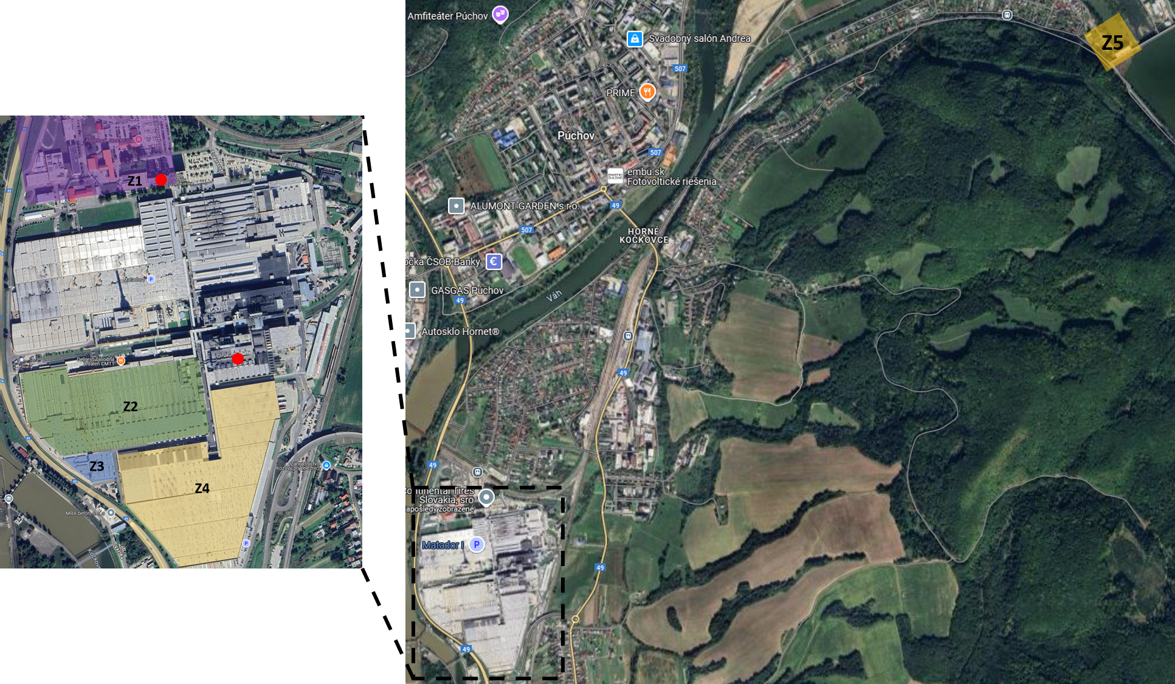
Tracking Object and Personnel Positions in Outdoor Industrial Environments Using LoRaWAN Technology
TRANSCOM 2025: 16th International Scientific Conference on Sustainable, Modern and Safe Transport
Juraj Kekelák¹, Marek Motýľ¹, Dušan Nemec¹, Peter Peniak¹
1 Department of Control and Information Systems, FEIT, University of Zilina, Univerzitna 8215/1, 01026 Zilina, Slovakia
Introduction
Modern industrial manufacturing is driven by cus-tomization, rapid market dynamics, and the inte-gration of production with logistics through auto-mation and monitoring. Despite a research focus on production, logistics operations represents up to 95% of total execution time. | Despite technological progress, real-time logistic monitoring in outdoor environments remains limi-ted by unstable connectivity, energy constraints, and inefficient data transmission, reducing the scalability and effectiveness of current solutions. | This paper proposes a scalable monitoring sys-tem for logistics assets in large outdoor industrial areas, addressing connectivity, energy, and data transmission challenges through LPWAN techno-logies. The system is designed for future exten-sion to indoor environments objects tracking.
materials, methods & implementation
The system’s multilayered architecture includes endpoint devices, communication protocols, and data processing components, ensuring scalability and reliability. The IoTracker3 device uses a combination of GPS, Wi-Fi, and BLE to provide accurate location tracking in both indoor and outdoor environments. Data transmission via LoRaWAN ensures minimal power usage while supporting long-range communication. Cisco LoRaWAN IXM gateways securely forward the data to a server, which processes and stores it in a Microsoft SQL database. The server authenticates, decrypts, and organizes data for efficient analysis. A web-based interface visualizes object positions on a map, enabling the analysis of movement patterns and historical data for optimized decision-making and resource allocation. The system is designed for industrial applications, providing real-time insights and supporting data-driven operational management.
results
The proposed multilayered architecture was successfully deployed, enabling end-to-end data flow from the tracking device to a web-based visualization platform. The system utilized a LoRaWAN-based LPWAN network to transmit real-time location data from the IoTracker3 device to a central server, where the data was processed and displayed through a custom web application (Fig. 1 and Fig. 2). Following deployment, the performance of the system was evaluated through a series of measurements. LoRaWAN network coverage was assessed using the ADEUNIS ARF8124AA device to record signal strength across various indoor and outdoor environments (Fig. 3). Measurements were conducted at multiple locations, including warehouses, production halls, and open spaces. The strongest signal was recorded in Zone 1 (office buildings), while the weakest signal was detected in Zone 5, approximately 6 km from the main industrial site. Within the main campus area, RSSI values ranged from -76 to -64 dBm, and SNR values varied between 9 and 18 dB. Signal attenuation observed in Zones 2 through 4 was primarily due to the presence of reinforced concrete structures and other industrial interference. In addition to coverage evaluation, the localization precision of the IoTracker3 device was tested. The device was attached to a security guard and configured to transmit GPS data every 10 seconds over a 45-minute period, resulting in 263 data points per trial. The positioning accuracy, assessed using the Mean Absolute Error (MAE) based on GPS and HDOP values, remained consistently between 6 and 7 meters. To validate reliability, this experiment was repeated over three consecutive days under varying environmental conditions.
Fig.1 Schematic of the multilayered monitoring architecture.
conclusion & implementation path
This research confirms the viability of a multilayered LoRaWAN-based system for real-time monitoring of objects and personnel in industrial settings. The system integrates IoT devices, long-range communication, and a web-based application for effective data visualization and analysis. Field tests demonstrated reliable network coverage across diverse environments, with RSSI values ranging from -76 to -64 dBm and consistent GPS based localization accuracy of 6-7 meters. While the current level of accuracy is sufficient for general tracking of logistics equipment or specific personnel, more precise location data is needed for detailed analysis and effective optimization of logistics flows. Relying only on GPS also limits the system to outdoor use, as GPS signals are not available indoors. To overcome this, alternative localization methods such as BLE or Wi-Fi should be considered to improve tracking in indoor environments. Future work will focus on refining position estimates within facility and applying machine learning techniques to improve data interpretation and support the optimization of key logistics operations.
Fig.2 Web-based application interface for tracking and analyzing object positions.
Fig.3 Map of the measurement locations with color-coded zones (zone Z5 is depicted in the top-right corner)
acknowledgements
This research has been supported by the project APVV SK-IL-RD-23-0002: Advanced Localization Sensors and Techniques for Autonomous Vehicles and Robots.

