Slide 1


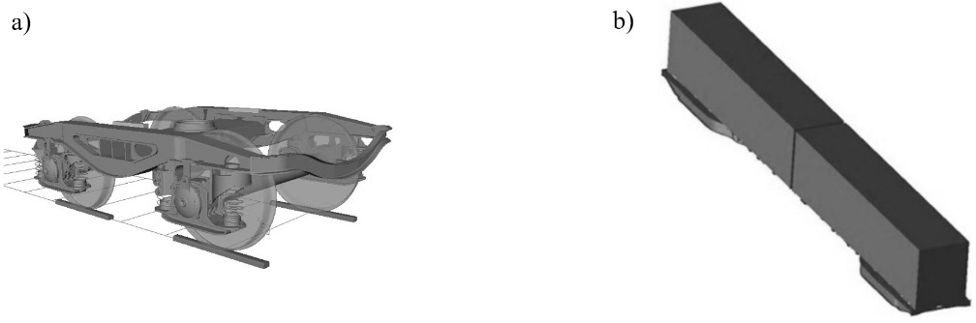
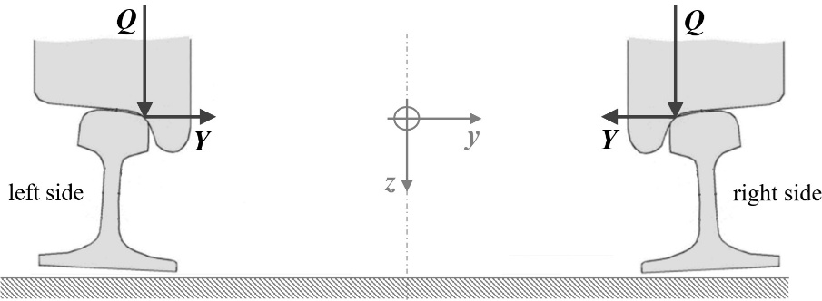
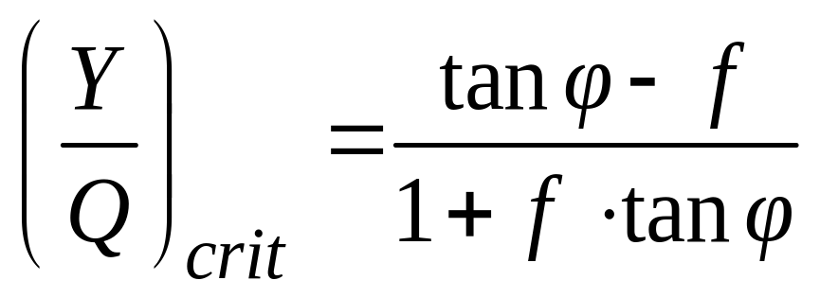
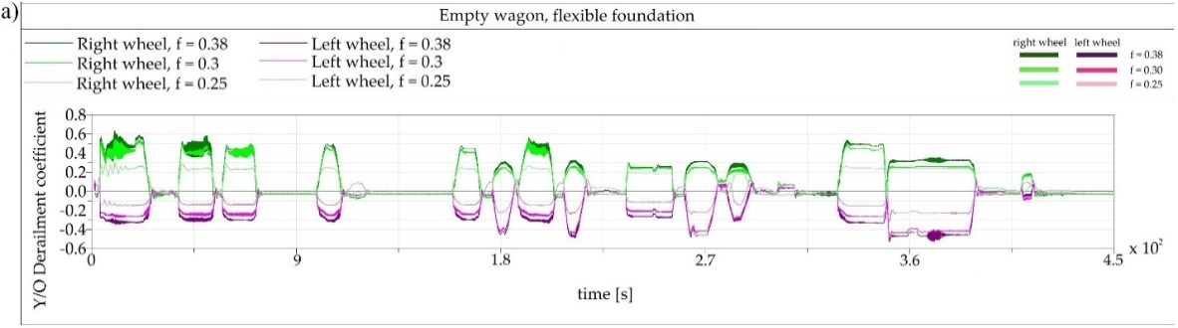
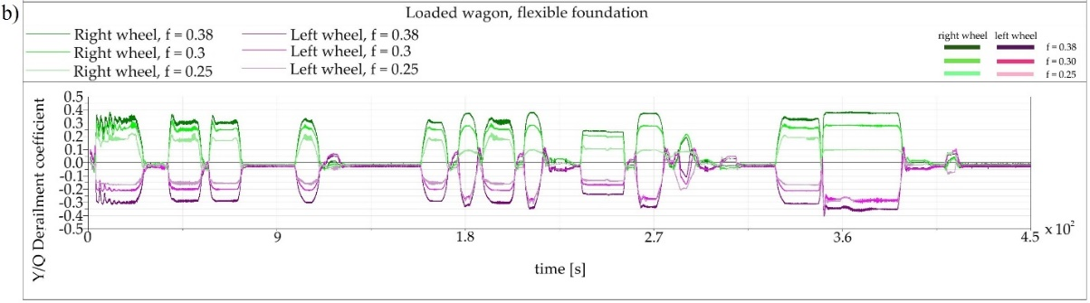
Analysis of long freight wagon running safety depending on wheel/rail contact friction coefficient
TRANSCOM 2025: 16th International Scientific Conference on Sustainable, Modern and Safe Transport
Ján Dižo¹, Alyona Lovska¹, Miroslav Blatnický¹, Vadym Ishchuk¹, Rafał Melnik², Seweryn Koziak³
1 University of Žilina, Žilina, Slovak Republic
2 University of Lomza, Łomża, Poland
3 Warsaw University of Technology, Warszawa, Poland
Introduction
Research and scientific activities in the design of rail vehicles and analysis of their running properties are inseparable part of the field of transportation engineering. There are still stricter and stricter requirements regarding to smooth motion of rail vehicles on a track, high level of safety. | Running safety of wagons depends on ratios and tribological matters in the wheel/rail contact. The problem of the wheel/rail contact is approved by many scientific works around the world. Scientists and researches investigate this issue by means of experiments as well as by simula-tion computations. | It is the research, three different wheel/rail contact friction coefficients were defined, i.e. f = 0.38, f = 0.30, f = 0.20, simulation analyses of long freight wagon running on the track were performed, running safety based on the values of derailment quotient was evaluated.
materials, methods & implementation
A commercial multibody software Simpack was used for this research. The created multibody model of the freight wagon includes three substructures, i.e. two Y25 bogie models and the wagon body. The Y25 bogie model includes seven rigid bodies (a bogie frame, four axleboxes and two wheelsets), which are connected by massless springs and dampers. The main indicator of safety wagon running is the derailment quotient. The derailment quotient expresses a mutual relation between vertical wheel forces Q and lateral wheel forces Y and it comes from the formulation written in UIC 518:
Fig. 1. (a) The Y25 bogie model, (b) the loaded long freight wagon model
where φ is the wheel flange angle and f is the friction coefficient. This formulation is also included in the UIC standard, where the maximal permissible values of the derailment quotient Y/Q are prescribed. An illustration of the wheel/rail contact interaction is shown in Figure 2.
Fig. 2. A scheme of wheel/rail contact of a wheelset.
results
The results are shown in Figure 3. These figures include waveforms of the derailment quotient for the right wheel (shades of green) and for the left wheel (shades of magenta). the empty wagon (Figure 3a) shows worse safety level while running on the track in comparison with the loaded wagon (Figure 3b) for all three frictions coefficient f. In the case of the chosen railway track geometry, the right wheel has higher values of the Y/Q ratio at the beginning of the running (0 s to 35 s), i.e. the values over 0.6. Farer on the track, after 19 s, the left wheel also reaches higher values of 0.5. The lower values of the friction coefficient, i.e. 0.3 and 0.25 lead to significantly lower values of the Y/Q ratio. For the empty wagon, the smallest values are obvious for the right wheel at the beginning of the wagon movement and for the left wheel, these values are also at the beginning of the movement. In the case of a loaded wagon, the derailment quotient Y/Q is smaller than in case of the empty wagon. This is the same tendency as was investigated for the other running conditions presented in previous sections.
Fig. 3. Derailment quotient for: (a) the empty wagon, b) the loaded wagon.
The smallest values are for the f = 0.25 and highest values are for the f = 0.38. In comparison with the empty wagon running, the loaded wagon shows a higher level of the running safety for all three friction coefficients. The derailment quotient Y/Q is the most important output quantity from the safety point of view. It expresses a ratio of the safe operation of the wagon on the track under the given conditions.
conclusion & implementation path
The article presented the research focused on investigation of the friction coefficient in the wheel/rail contact to the derailment safety of the long freight wagon when running on a regional railway track section. The research was carried out by means of simulation computations. The multibody model of the wagon together with the track was created. Simulation computations were conducted for the empty as well as for the fully loaded state of the wagon. The wheel/rail contact friction coefficient f was chosen to the value of 0.38, 0.30 and 0.25. It was found out, that the lower friction coefficient in the wheel/rail contact leads to lower values of the safety factor - the derailment quotient. It means, that the risk of the wagon derailment is lower for value of the lower friction coefficient.
acknowledgements
This research was also supported by the project VEGA 1/0308/24 and the project KEGA 031ŽU-4/2023. “Funded by the EU NextGenerationEU through the Recovery and Resilience Plan for Slovakia under the project No. 09I03-03-V01-00131.”

