Slide 1


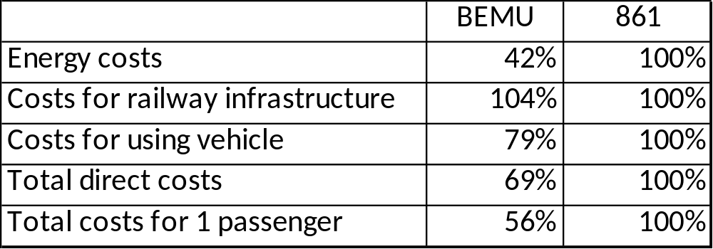
Possibilities of using alternative energy sources in rail transport: a case study in the Slovak Republic
TRANSCOM 2025: 16th International Scientific Conference on Sustainable, Modern and Safe Transport
Anna Dolinayová¹, Peter Morihladko²
1 University of Žilina, Žilina, Slovakia
2 University of Žilina, Žilina, Slovakia
introduction
By using battery vehicles, it is possible to increase the attractiveness of railway transport and contribute to reducing greenhouse gas emissions. However, the run of battery trains doesn't have to be economically and technically acceptable for every considered railway line. | In the transport sector, there is a problem with the producing greenhouse gas emissions. Transport is one of the biggest producers of greenhouse gas emissions. The main producer of emissions is diesel vehicles. This fact applies not only to road transport, but also to rail transport. | The change of vehicle drive has an influence on the costs of operators. Using battery trains doesn't have to be economically acceptable. At the same time, by using battery vehicles, it is possible to reduce greenhouse gas emissions.
materials, methods & implementation
For the case study, the method used was life cycle cost (LCC). The LCC is an economic method where all kinds of costs are calculated on a timescale. In the methodology of LCC, there is consideration of costs from production through operation and maintenance to liquidation of the vehicles. It is therefore about a view focused on all kinds of costs related to monitored vehicles. By LCC, it is possible to know cases where the lowest price is not the best offer for the customer. For making an LCC analysis, selected data is needed. It is necessary to have investment costs, maintenance costs, costs for repairing, costs for periodic changes, and finance indicators like discount rate, rate of price growth, and time scale. To calculate the LCC, data was used from the manager of infrastructure, the data from the operators, and other studies with similar thesis or papers. The results from this case study are possible to implement after the small change of data to a real study.
results
In our case study we compared nowadays using the diesel unit class 861 and using the battery-electric multiple unit (BEMU) on selected railway line. The case study was carried out on the railway line between Banská Bystrica and Brezno. The length of the railway line is 42 km with small slope ratios. At the same time, the railway line suits the requests of BEMU regarding the higher weight of BEMU. The region has a suburban and rural character. The train service is quite often traditional for regional or suburban transport service. A considered BEMU vehicle is slightly more capacious than nowadays using diesel multiple units. The monitored railway line is single-track and non-electrified. Electrified is only the station Banská Bystrica. The total length of the railway line suits the range of BEMU, which is approximately 80-100 km. For the BEMU was created the LCC analysis from available data. In the LCC analysis was considered with using at monitored railway line. The comparison of the BEMU and diesel vehicles was also created by results from the LCC analysis. Selected rates were modelled with regard to missed data or not available data regarding secret operators' data.
How follows from the table, running the BEMU is in many cost items cheaper than running the diesel vehicle. However, regarding the higher weight of the BEMU, costs for using the railway infrastructure are higher than nowadays using vehicles. Despite that, the total costs from monitored cost items are lower during use of the BEMU than nowadays used diesel vehicles. To correctly compare monitored vehicles, the monitored cost was calculated on one passenger.
conclusion & implementation path
To achieve eco-friendly railway transport, there are a need to make some measures. One of the measures can be electrifying the railway lines. Other measures can be using battery-electric vehicles (BEMU). Electrifying the railway lines requires a high investment in the railway infrastructure. Using BEMU trains also needs to have charging stations, or the charging can take place during the run under the catenary. The charging stations can be at electrified stations or need to build the charging place on non-electrified stations. At the same time, there is a need to have some time to charge the trains. In our case study the total costs are not possible to calculate with regard to trade secret data. At the same time, the usability is restricted by the range of BEMU. The range can be different in summer or winter. From our case study follows that operating the BEMU is cheaper than operating diesel trains, but to achieve better results, there is a need to make larger calculations. By these reason there is needed next research in this field of reseach. In future research, there is a need to calculate externality costs which were not included in our case study. Nowadays, there is not some kind of data available about BEMU needed to calculate total costs and needed to compare with diesel multiple units in many parameters. This paper has scientific benefits and is applicable in practice.
acknowledgements
The paper was supported by the VEGA Agency, Grant No. 1/0340/24 "Research on alternatives to decarbonization in rail transport from the point of view of social costs", at Faculty of Operations and Economics of Transport and Communication, University of Žilina, Slovakia.

