Slide 1


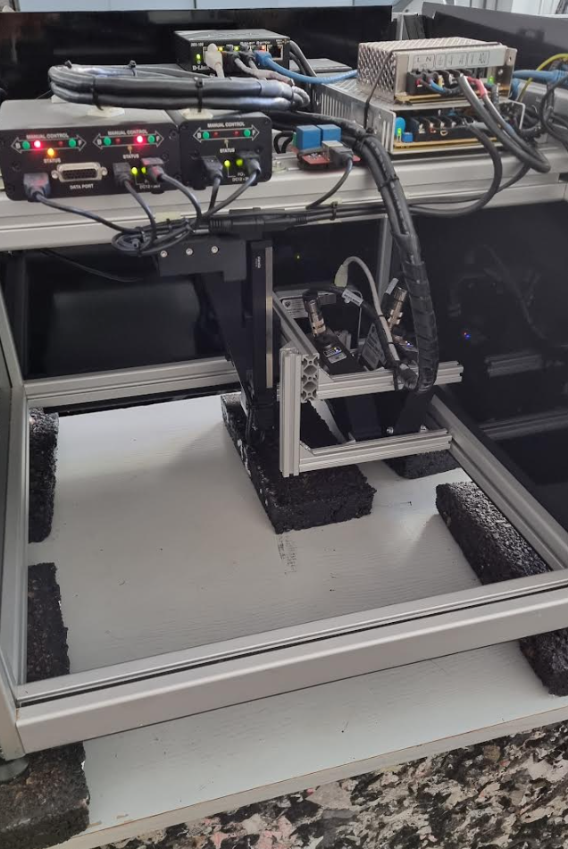
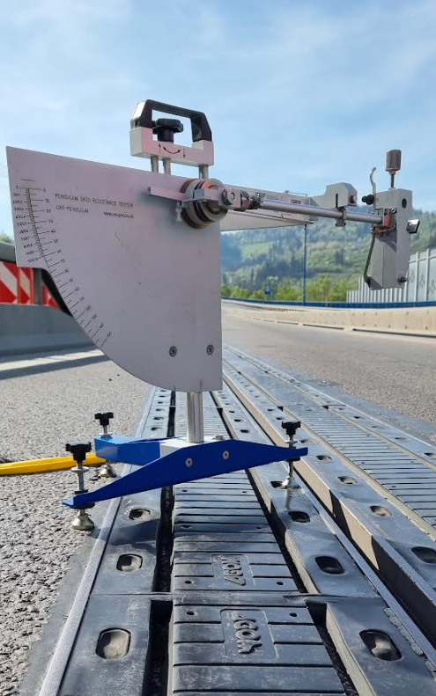
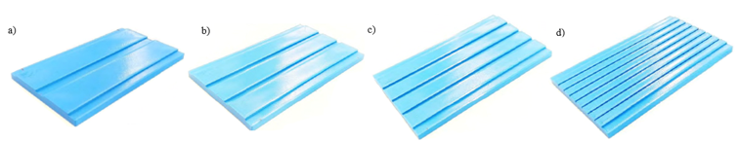
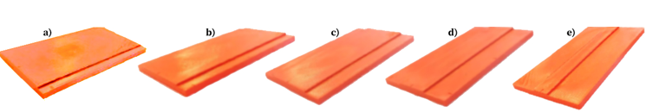
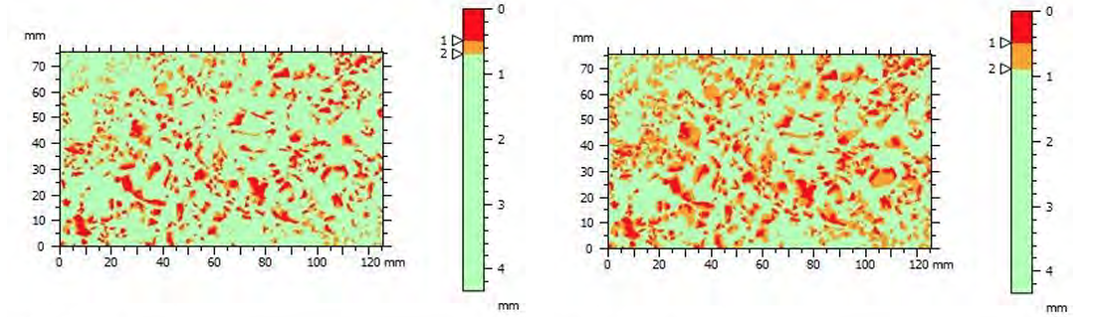
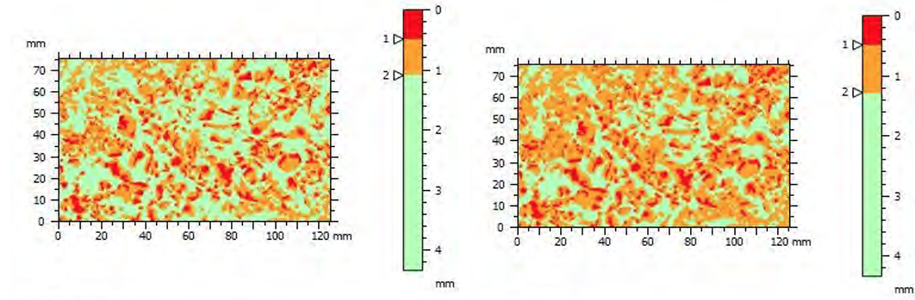
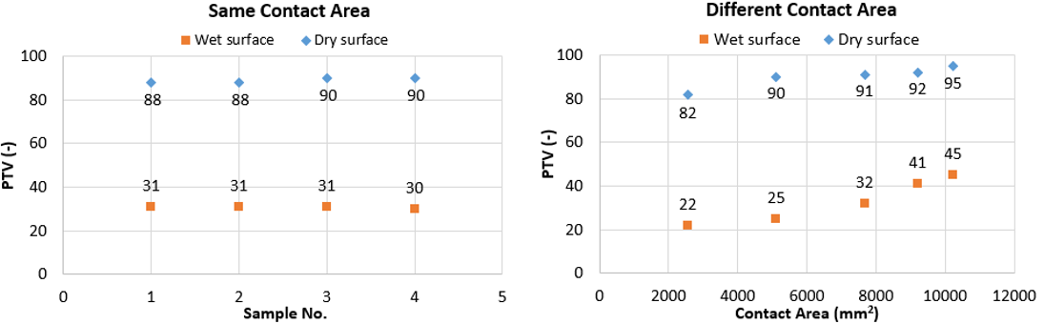
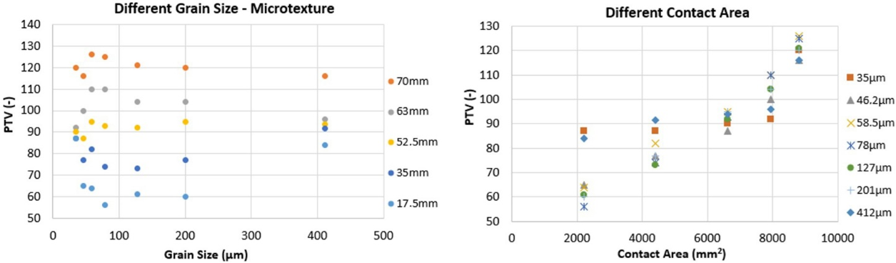
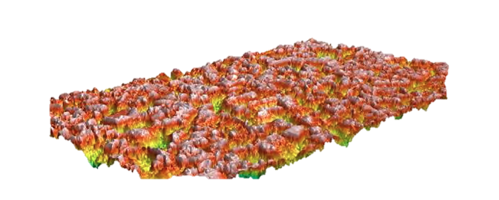
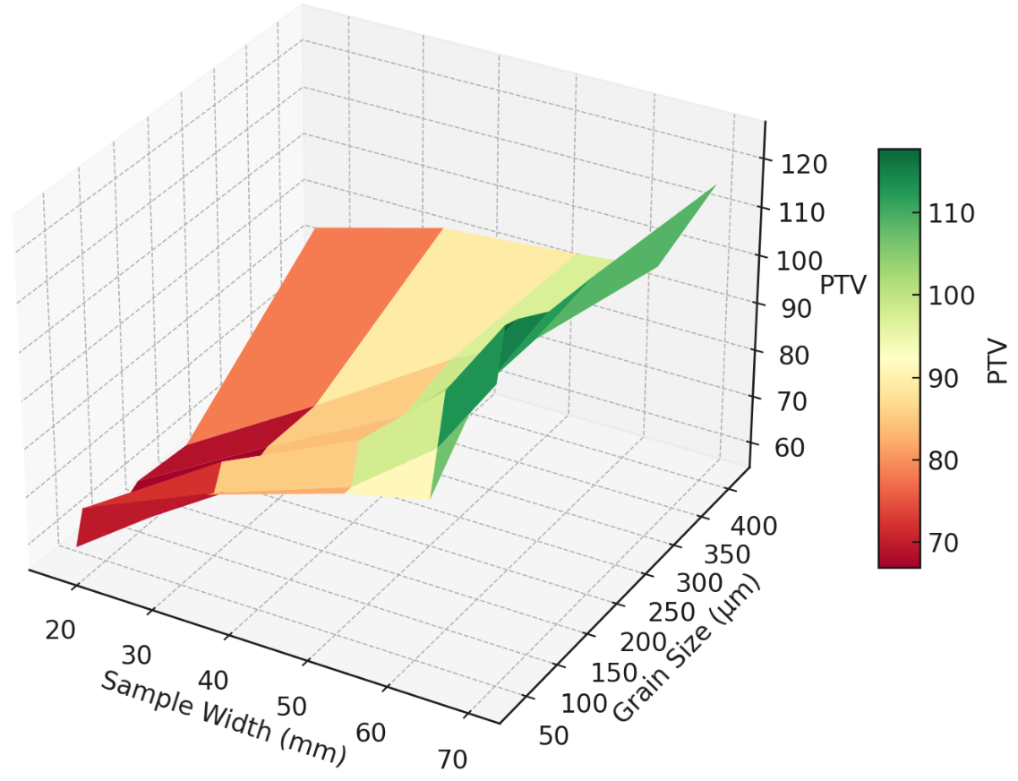
Friction and Texture Analysis of 3D-Printed Samples
TRANSCOM 2025: 16th International Scientific Conference on Sustainable, Modern and Safe Transport
Matúš Kováč¹, Matej Brna¹, Peter Pisca¹, Adam Jahn¹
1 Department of Highway and Environmental Engineering, Faculty of Civil Engineering, University of Zilina, 010 26 Žilina , Slovakia
introduction
Backround information & Market Context Skid resistance is key to road safety. Texture analysis via 3D-printed and real samples supports objective evaluation of road pavement quality in terms of road safety. | Problem Statement & Stakeholders Lack of accurate skid resistance prediction limits road safety. Stakeholders include road authorities, road engineers, safety experts, designers,and policymakers. | Research Objectives & Expected Impact To investigate how texture and contact area affect friction, aiming to improve friction prediction and skid resistance evaluation methods, enhance road safety and reduce maintenance costs.
materials, methods & implementation
British Pendulum Tester (BPT): measures skid resistance in dry and wet conditions Static Road Scanner (SRS): captures micro- and macrotexture,15 μm resolution 3D printer: used to produce texture-defined samples for controlled testing All samples were evaluated using friction measurements and 3D scanning. Samples with the Same Contact Area Three sample groups were tested under lab conditions: Group 1: 3D-printed samples with varying textures and contact areas Group 2: Sandpaper-based surfaces with defined grain sizes Group 3: Real asphalt mixtures with different aggregate compositions Samples with the Different Contact Area
results
Contact area size significantly affects friction – smaller areas result in lower PTV values. Surface pattern arrangement has minimal impact on friction for same contact areas. Intermediate grain sizes (58.5–78 µm) on sandpaper showed highest friction – contrary to the assumption: coarser = better. No strong correlation found between average roughness (Sa) or projected contact area and PTV in asphalt samples. Depths used in 3D analysis may be too large; future tests: shallower depths (<0.2 mm). Innovations Use of 3D-printed samples with controlled texture and geometry for precise lab evaluation. Integration of 3D scanning and friction testing in a unified methodology. Development of a flexible experimental setup suitable for both artificial and real-world surfaces. Practical Applications Better understanding of texture–friction relationship supports optimized pavement diagnostics. Results help improve predictive models for skid resistance under varying conditions. Can guide cost-effective road maintenance, identifying critical surfaces before deterioration escalates. Useful for regulatory bodies and road authorities when assessing quality of the surface in terms of traffic safety.
conclusion & implementation path
The study confirmed that contact area size has a dominant effect on friction, while surface arrangement and grain size play a lesser role. The highest PTV values were recorded for intermediate grain sizes, and conventional roughness metrics like Sa failed to correlate with friction performance. Impact These insights can significantly improve pavement diagnostics, enhance road safety, and optimize maintenance planning by allowing better prediction of skid resistance using measurable texture parameters. Implementation Path Integration of 3D texture analysis into routine pavement evaluation Use in road safety audits and infrastructure planning tools Supports data-driven maintenance decisions by road authorities Future Research Explore advanced texture parameters and machine learning for friction prediction. Focus on finer indentation depths (<0.2 mm) for contact area analysis. Validate findings on real road sections under traffic and weather exposure.
acknowledgements
The paper is a result of the research supported by the research project VEGA 1/0337/22 “Analysis of the influence of road surface texture on skid resistance, driving safety and the potential of particulate matter resuspension”.

