Slide 1


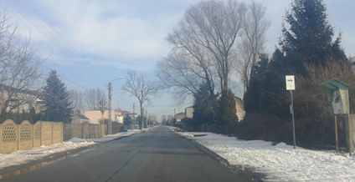
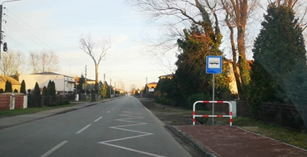
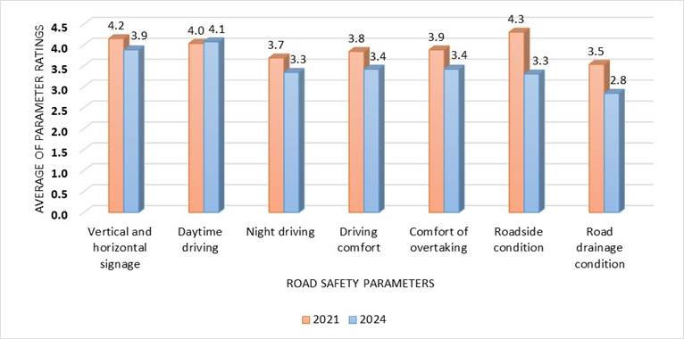
Comparative analysis of the quality of local road repairs in the context of road traffic safety
TRANSCOM 2025: 16th International Scientific Conference on Sustainable, Modern and Safe Transport
Natalia Brycht¹
1 Czestochowa University of Technology, Czestochowa, Poland
introduction
Backround information & Market Context Road traffic safety is influenced by many factors, including the technical condition of roads. In Poland, statistical data indicate an upward trend in the number of accidents caused by improper road maintenance and the lack of road repair activities. | Problem Statement & Stakeholders Currently, many sections of Polish roads, mainly in rural areas, require immediate repairs. Unfortunately, due to insufficient financial resources in road authorities, it is not possible to carry out the necessary actions or these actions are not adapted to the actual conditions. | Research Objectives & Expected Impact The aim of this study was to conduct a comparative analysis of rural road sections undergoing renovation over the last dozen or so years in order to assess the quality of renovation works performed in the context of maintaining performance parameters during the period of operation. The obtained results will serve as a database for further research.
materials, methods & implementation
Description of research methods and materials The data needed to perform the comparative analysis were collected in January and February 2021 and in December 2024. The results obtained in 2021 are the starting point for assessing the quality level of road repairs in the context of comparing the current state with the previous state. The research was carried out in the field in real road traffic conditions. It consisted in identifying 26 sections of local roads from the area of ​​2 selected counties of the Czestochowa region. The data was obtained using a camera recording the current technical condition of road sections undergoing repairs over the last 18 years. The parameters that have a particular impact on the level of road traffic safety were examined: vertical and horizontal markings, driving comfort, overtaking comfort, condition of roadsides, road drainage, daytime driving, night driving. Then, each of the above parameters was assessed using the scale used in the assessment of technical condition from 0 to 5, where "0" means that renovation activities are necessary, and "5" means that the condition does not require renovation. The next step was to compare the obtained results with the assessments from previous studies.
results
Academic Findings & Innovation Practical Applications Among the assessed road sections, only two were subject to renovation works in the period from 2021 to 2024. In the first case, the scope of renovation included replacing the top layer of the road surface, building a sidewalk, building a new drainage system, installing horizontal markings in the form of a line separating traffic lanes and vertical markings and protective barriers above drainage ditches (Fig. 1b). Thanks to the solutions applied, the following parameters improved: horizontal and vertical markings, driving and overtaking comfort, condition of roadsides and road drainage. The remaining parameters did not deteriorate. The renovation of the second section included replacing the top layer of the road pavement, but did not significantly affect the quality level of the analyzed parameters due to the simultaneous organization of a detour leading through this section of the road. The increase in traffic intensity caused degradation of the pavement structure, creating a real risk of accidents. Single cracks and grid cracks and potholes are still visible on the roadway. Based on the assessment of RTS parameters in 2021 and 2024, their average was calculated (Fig. 2). Only the "daytime driving" parameter noted an increase in the quality level by 0.1, while the remaining parameters noted a decrease of up to 1.0. The smallest difference (0.3) was noted for the "vertical and horizontal markings" parameter. A downward trend in the quality of repairs is visible.
a) b)
Fig. 1. (a) Technical condition of the road on section no. 6 before renovation in 2021; (b) after renovation in 2024.
Fig. 2. Average road traffic safety parameter ratings in 2021 and 2024.
conclusion & implementation path
Summary of research conclusions, impact and potential areas of further research in this field Research shows that the overall quality level of the analysed local road repairs is satisfactory, however, a worrying trend was observed, to a decrease in the level in the context of 6 out of 7 analysed parameters. Only one of them ("daytime driving") recorded a slight increase (by 0.1) and this is the only parameter whose average exceeded 4.0. Five parameters obtained values in the range from 3.3 to 3.9, and the lowest average value refers to the "drainage status" (2.8). From 2021 to 2024, two renovation investments were carried out, only one of which significantly improved the quality of road safety, through the renewal of signage, the use of road traffic safety devices and the construction of a sidewalk. In most of the analysed cases, the errors identified during the first studies (in 2021) have still not been eliminated. Comparing the parameter assessments obtained in 2021 and 2024, it can be stated that most of them have deteriorated due to the use by moving vehicles, the lack of periodic maintenance and repair activities and the failure to adapt transport to the appropriate traffic category, the main source of which are the financial shortages of road managers.

