Slide 1


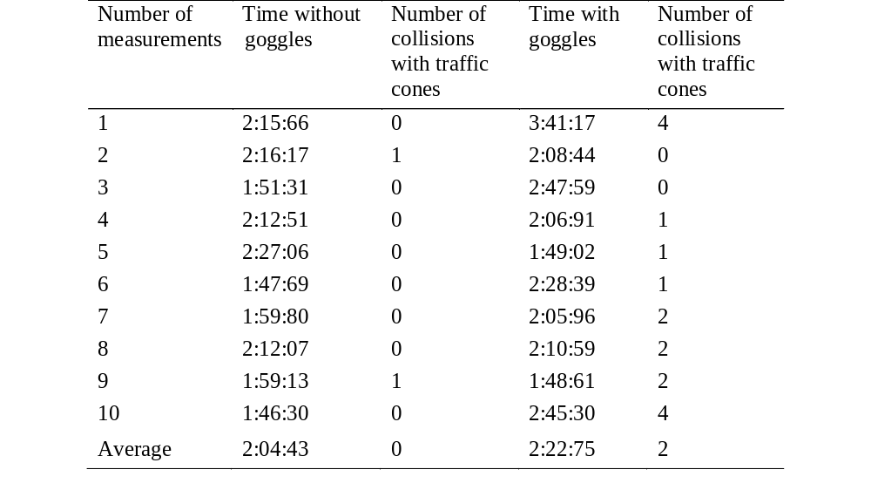
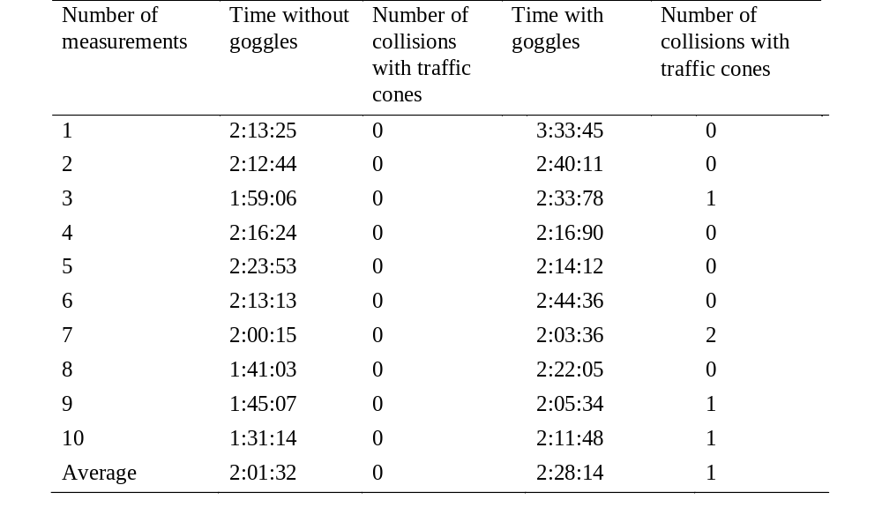
Possible Effects of MDMA on Vehicle Driving Competencies
TRANSCOM 2025: 16th International Scientific Conference on Sustainable, Modern and Safe Transport
Samuel Hubočan¹, Matúš Madleňák¹,
1 University of Zilina, Faculty of Security Engineering, Department of Security Management, 1. Mája 32, Žilina 01026, Slovak Republic
introduction
Traffic safety and security is a fundamental need for all road users. Among the factors influencing safety and security, substance abuse poses significant threat. MDMA impairs visual perception, spatial orientation, and decision-making, increasing the likelihood of traffic accidents. | Although alcohol-related traffic accidents are more prevalent, drug-related accidents also represent a growing concern. Understanding the effects of substances like MDMA on driving competencies is essential for improving road security and designing preventive measures. | This paper aims to simulate the effects of MDMA on driving abilities using specialized goggles that mimic visual impairments caused by the drug. By analyzing driving performance under controlled conditions, the research seeks to highlight the potential dangers of MDMA use and contribute to evidence-based crime prevention strategies.
materials, methods & implementation
To simulate MDMA's visual impairment effects, specialized goggles (developed by Drunk Busters of America) were used to replicate blurred vision, distorted color perception, and impaired spatial awareness. A male driver completed a standardized driving cone course under both normal conditions (in daylight and nighttime) and while wearing the goggles. The course consisted of eight tasks: exit from the garage and entry to the start of the traffic cone slalom, crossing the first, second and third cone of the slalom, passing the fourth slalom cone and preparing to start reversing, reversing and perpendicular back parking, exiting the perpendicular back parking and levelling the car, parallel parking, exiting a parallel parking and reversing into a garage, parking into the garage and thereby ending the journey.
The experiment was conducted in both daylight and nighttime conditions, with ten repetitions per scenario. Performance metrics included completion time (measured in minutes:seconds:milliseconds) and the number of collisions with cones.
results
The experiment demonstrated that simulated MDMA-induced visual impairment significantly affects driving performance: Daylight Conditions: Without goggles: Average time = 2:04:43; Collisions = 0. With goggles: Average time = 2:22:75; Collisions = 2 (average).
Nighttime Conditions:
Without goggles: Average time = 2:01:32; Collisions = 0.
  With goggles: Average time = 2:28:14; Collisions = 1 (average)
conclusion & implementation path
The conducted experiment highlights the significant negative impact of MDMA-induced visual impairment on driving competencies. Simulated effects using specialized goggles demonstrated increased susceptibility to collisions and extended completion times during controlled driving scenarios. These findings underscore the importance of addressing psychoactive substance abuse as a critical factor in traffic security. While the study focused solely on visual distortion, other effects of MDMA—such as heightened risk-taking behavior—could have further impact on driving impairments, increasing the likelihood of traffic accidents. It is recommended for crime prevention specialists to conduct broader studies involving multiple participants to analyze additional effects of MDMA (e.g., cognitive and behavioral impairments) on driving performance. It is also recommended to design an effective strategy to prevent usage of MDMA or other psychoactive substances, since the usage of MDMA might have a rising trend in the upcoming years.
acknowledgements
The article was supported by The Ministry of Education, Research, Development and Youth of the Slovak Republic grant number VEGA1/0257/23 Cyber risk assessment as an essential tool for increasing cyber security in public administration and within the framework of the project KEGA 031ŽU-4/2022. Funded by the EU NextGenerationEU through the Recovery and Resilience Plan for Slovakia under the project No.17R05-04-V01-00005.

