Slide 1


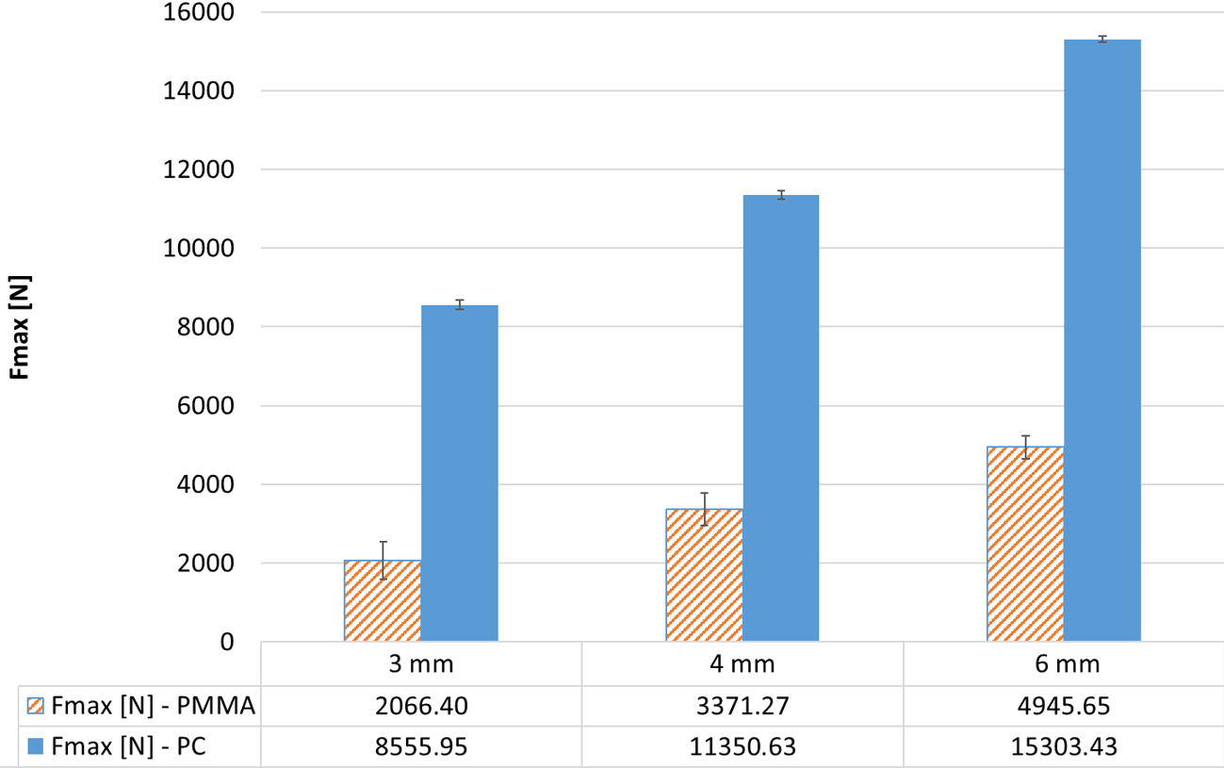
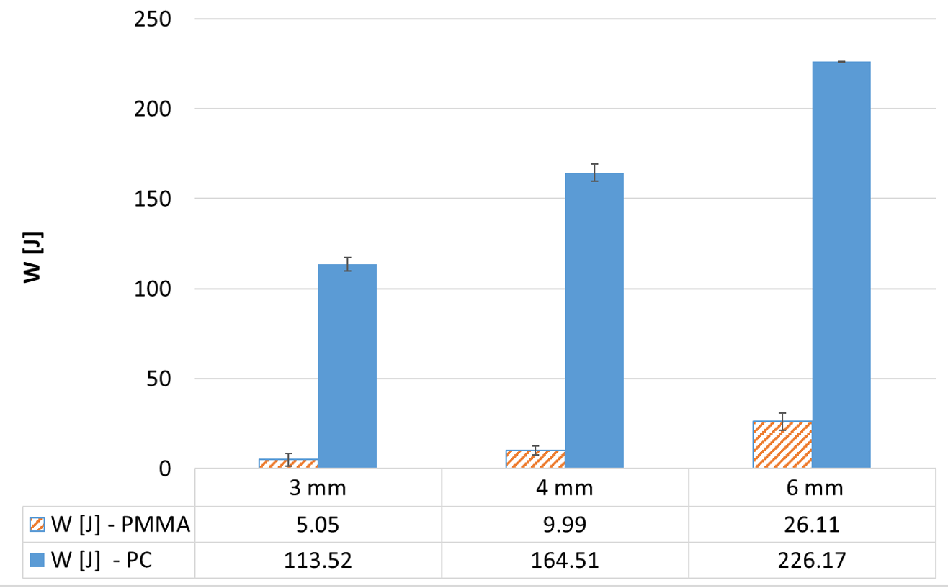
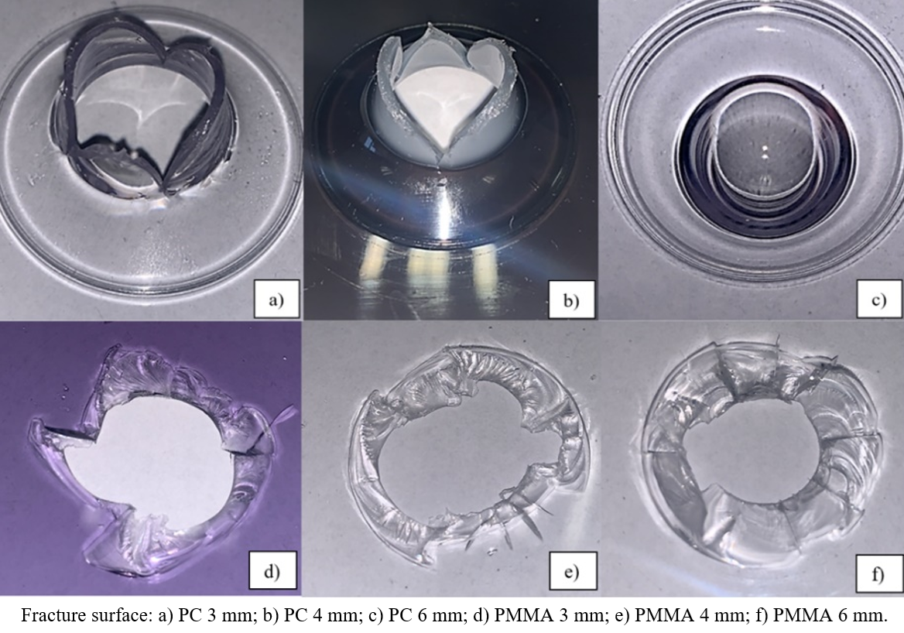
Mechanical Resistance of PC and PMMA Safety Components in Transportation
TRANSCOM 2025: 16th International Scientific Conference on Sustainable, Modern and Safe Transport
Michaela Karhankova^{1*}, Jan Turek¹, Milan Adamek¹, Lucie Svacinova¹, Lukas Miskarik¹, Ales Mizera¹
¹ Faculty of Applied Informatics, Tomas Bata University in Zlin, Czech Republic
introduction
Polycarbonate (PC) and PMMA are widely used thermoplastics in transport, especially for optically clear and impact-resistant components. Increasing demand for lightweight, durable, and safe materials in automotive and aerospace industries drives research into their mechanical performance. | Lack of comparative data on impact resistance of PC vs. PMMA under dynamic loading, which limits optimal material selection for safety-critical parts. Stakeholders include materials scientists, automotive engineers, OEMs, and safety regulators who require reliable data for design optimization and cost-effectiveness. | The study aims to experimentally compare puncture resistance of PC and PMMA through drop-weight impact testing across various thicknesses. The outcomes are expected to guide material selection strategies by balancing mechanical performance, safety requirements, and cost, contributing to efficient and safer transport design.
materials, methods & implementation
Tested Materials: Polycarbonate (PC) and polymethyl methacrylate (PMMA) in three thicknesses: 3 mm, 4 mm and 6 mm. Test Setup: Instrumented drop-weight impact tests conducted using ZWICK HIT 230F system at constant energy of 230 J, following ISO 6603-2. All samples were preconditioned at 23 °C and 50% RH per ISO 10350-1 before testing. Specimen Details: Square plates (80 × 80 mm) cut by band saw for consistent dimensions. A hemispherical striker (radius 10 mm) was used to simulate real-world impact.
results
Academic Findings & Innovation Drop-weight impact testing was used to systematically evaluate puncture resistance of PC and PMMA in transportation safety components. PC demonstrated significantly higher maximum impact force (Fmax up to 15,303 N) and energy absorption (up to 226.17 J for 6 mm) than PMMA.PMMA showed brittle fracture behavior, while PC exhibited ductile deformation, confirming superior mechanical resilience of PC. PC is highly suitable for safety-critical transportation parts like headlight covers, protective shields, and impact-resistant glazing. PMMA, while less impact-resistant, remains valuable for applications prioritizing optical clarity and weather resistance (e.g. decorative or low-load components). Findings are applicable in automotive, aerospace, and civil transport systems, especially where impact performance is critical.
conclusion & implementation path
Polycarbonate (PC) significantly outperforms PMMA in terms of impact resistance, energy absorption, and mechanical reliability under dynamic loading.
PC demonstrates ductile deformation, maintaining structural integrity even at high impact energy (230 J).PMMA, although exhibiting brittle failure, offers advantages in optical clarity and weather resistance for less impact-demanding applications.
The study confirmed a strong correlation between material thickness and mechanical resistance in both polymers.
Impact and Practical Relevance
PC is a preferred material for safety-critical transport applications (e.g. headlamp covers, shields, transparent barriers) where high mechanical resilience is essential.
PMMA remains relevant in aesthetic or lightweight components where visual properties and UV resistance are prioritized.
The results support efficient material selection strategies balancing durability, weight, and cost—key in automotive, aerospace, and public transport design.
acknowledgements
This research was funded by the Internal Grant Agency of Tomas Bata University (Project No. IGA/CebiaTech/2024/002). Language proofreading partly supported by AI tools.

