Slide 1


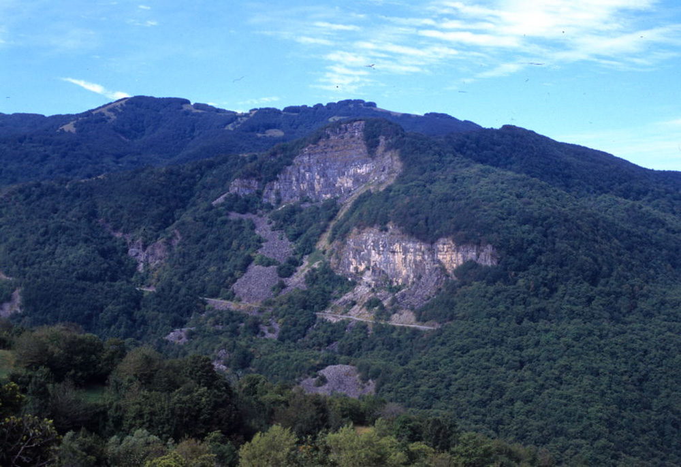
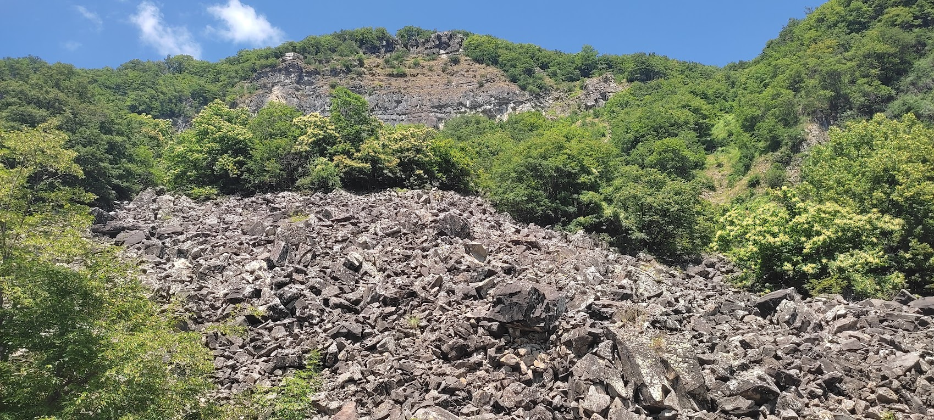
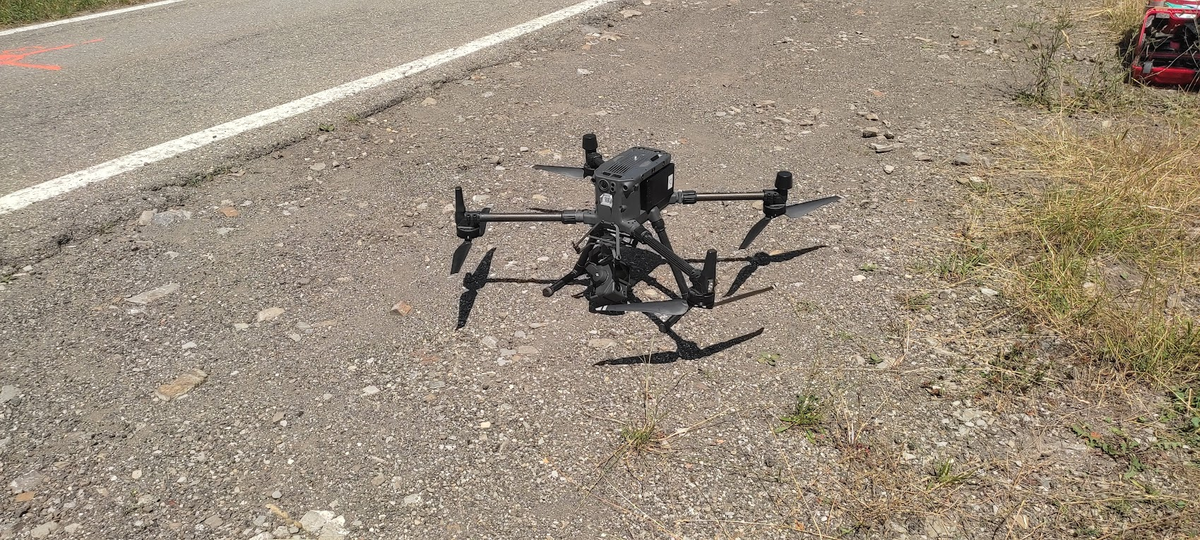
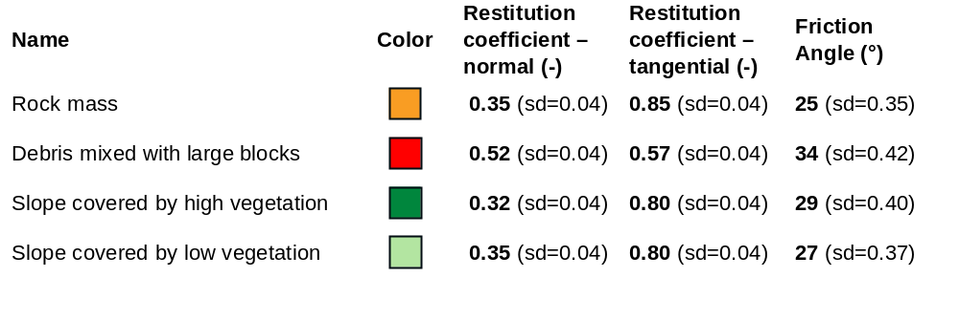
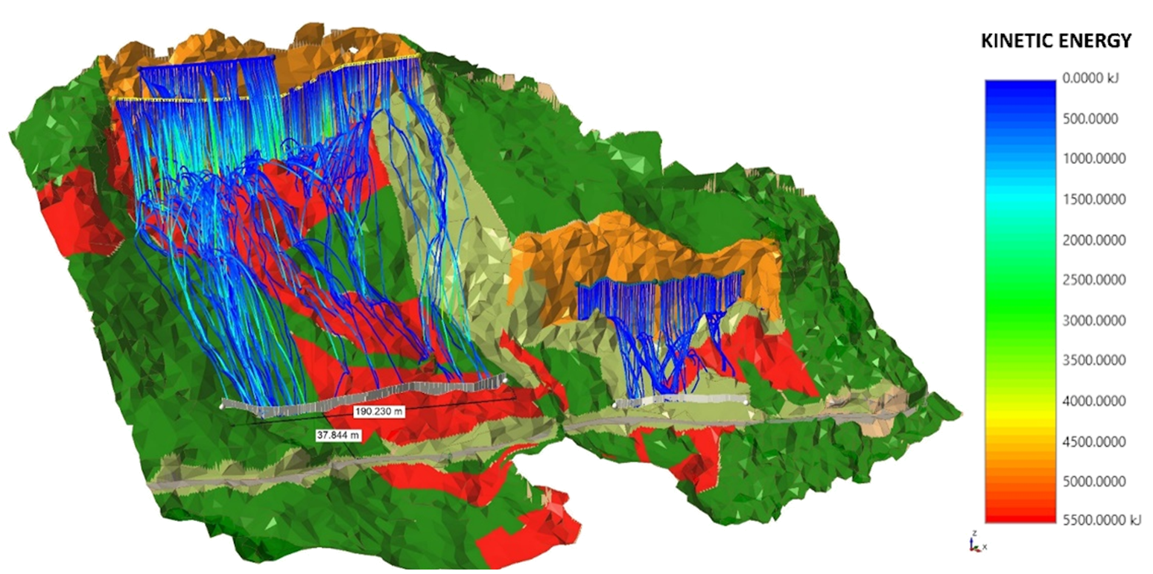
Risk assessment of the Groppo Sovrano rock wall: interaction between rockfall dynamics and a Provincial Road through 3D analysis
TRANSCOM 2025: 16th International Scientific Conference on Sustainable, Modern and Safe Transport
Alessandro Valletta¹, Andrea Segalini¹
1 University of Parma, Department of Engineering and Architecture, Parco Area delle Scienze 181/a, 43124 Parma, Italy
introduction
Among landslide phenomena in mountainous environments, rockfalls are undoubtedly one of the most impactful, due to their widespread occurrence and the potentially catastrophic consequences they can have on human lives and infrastructure. | One of the most effective approaches for evaluating and mitigating rockfall hazards relies on numerical modeling techniques, allowing for the simulation of the complex dynamics of rock block detachment, propagation, and impact, providing valuable insights into the potential risk to infrastructures and the effectiveness of different mitigation strategies. | In this study, the authors present a comprehensive risk assessment of a rock wall located along a provincial road in northern Italy, exploiting 3D numerical modeling techniques to gain a deeper understanding of the interaction between rockfall dynamics and a critical transportation infrastructure.
materials, methods & implementation
CASE STUDY DESCRIPTION
Name: Groppo Sovrano rock wall
Region: Emilia-Romagna, Italy
Issues: Recurrent rockfall events involving the Provincial Road SP75, which connects the municipalities of Monchio and Corniglio, hindering its usability and leading to road closures.
SURVEY ACTIVITIES
Aerial nadiral photogrammetry using UAS across the entire area of interest
Oblique photogrammetry using UAS for the two rock faces affecting the section of the provincial road under analysis
High-precision GNSS satellite surveying for the topographic alignment of all outputs
LiDAR surveying using UAS to generate a Digital Terrain Model for areas with dense vegetation coverage
A geomechanical survey was conducted with the aim of carrying out a series of activities focused on describing and analyzing rockfall phenomena in the area of interest.
results
PRELIMINARY STAGE
Analysis of the DTM to identify discontinuities characterizing the rock mass
Definition of the materials constituting the slope
Assessment and calibration of the restitution coefficients modelling the materials behavior when interacting with a falling block
3D ROCKFALL ANALYSIS
Identification of detachment points (seeders) on the rock wall and estimation of rock blocks dimension
Calculation of the trajectory followed by each boulder from the seeder to the endpoint → 4% of the blocks detaching from the main wall may affect the SP75, reaching a maximum kinetic energy value of 1004.9 kJ
Introduction of a flexible rockfall barrier, designed according to the analysis results and available geomorphological information, as a potential safety measure to protect the SP75 → barrier height 5 m; total length 190 m; maximum kinetic energy 2000 KJ
The blocks hit the barrier with a maximum total kinetic energy of approximately 1380 KJ and maximum impact height of 4.6 m, with no blocks exceeding the height of the barrier
conclusion & implementation path
The 3D analysis defined the trajectories of the blocks, their end points, the maximum total kinetic energy with which the blocks could reach the road, and the percentage of blocks that reached it. All data collected during the analysis allowed to suggest a potential intervention to control the phenomenon and safeguard the transport infrastructure, represented by a series of flexible barriers appropriately designed. The proposed solution is currently under evaluation by the authorities in order to plan the most appropriate actions to mitigate the risk related to rockfall events in the area.
acknowledgements
This research was conducted within the framework of the agreement "Rilievo geomeccanico, analisi di stabilità e valutazione della pericolosità del tratto di strada provinciale prospicente l’abitato di Groppo Sovrano", between the University of Parma and the Province of Parma, Italy.

