Slide 1


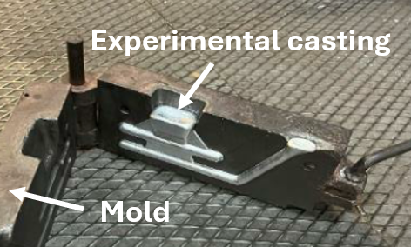
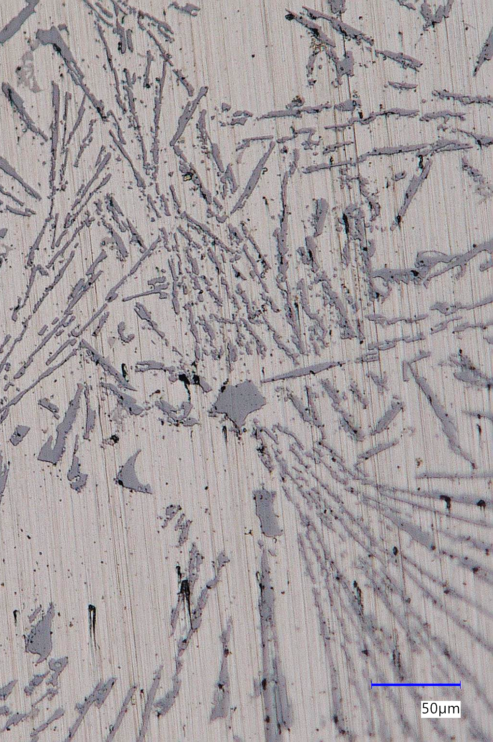
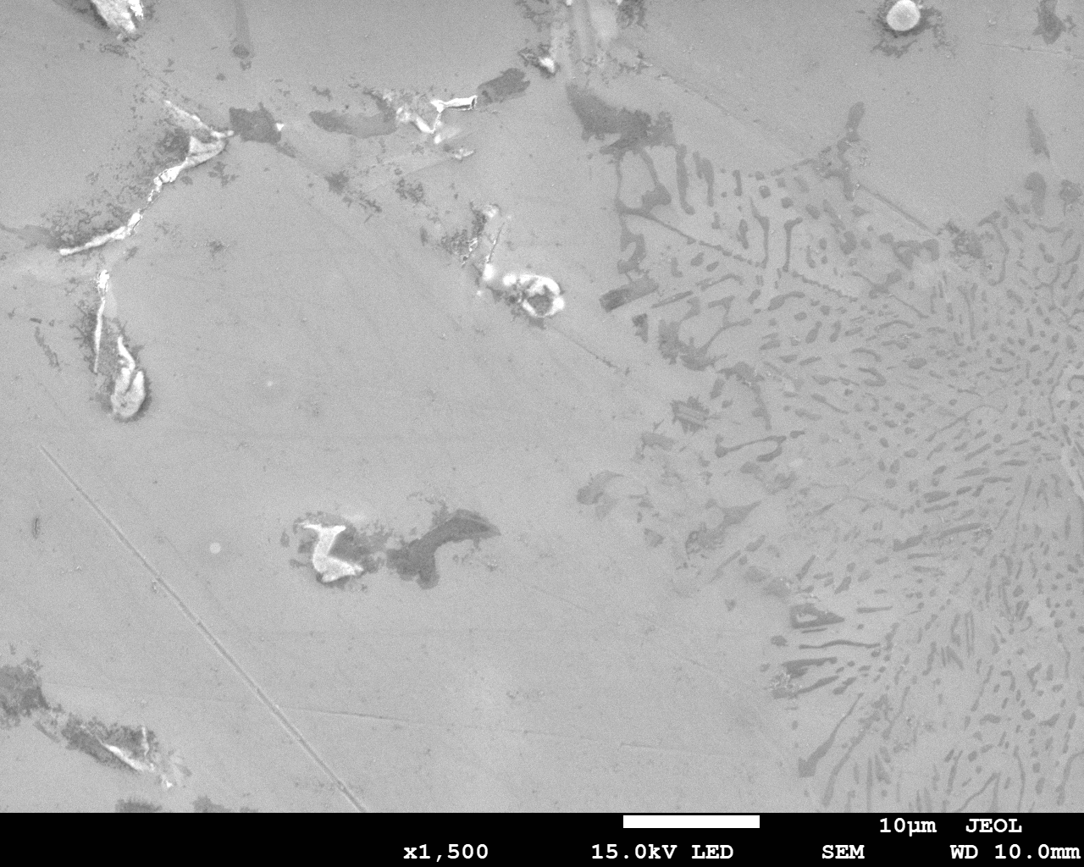
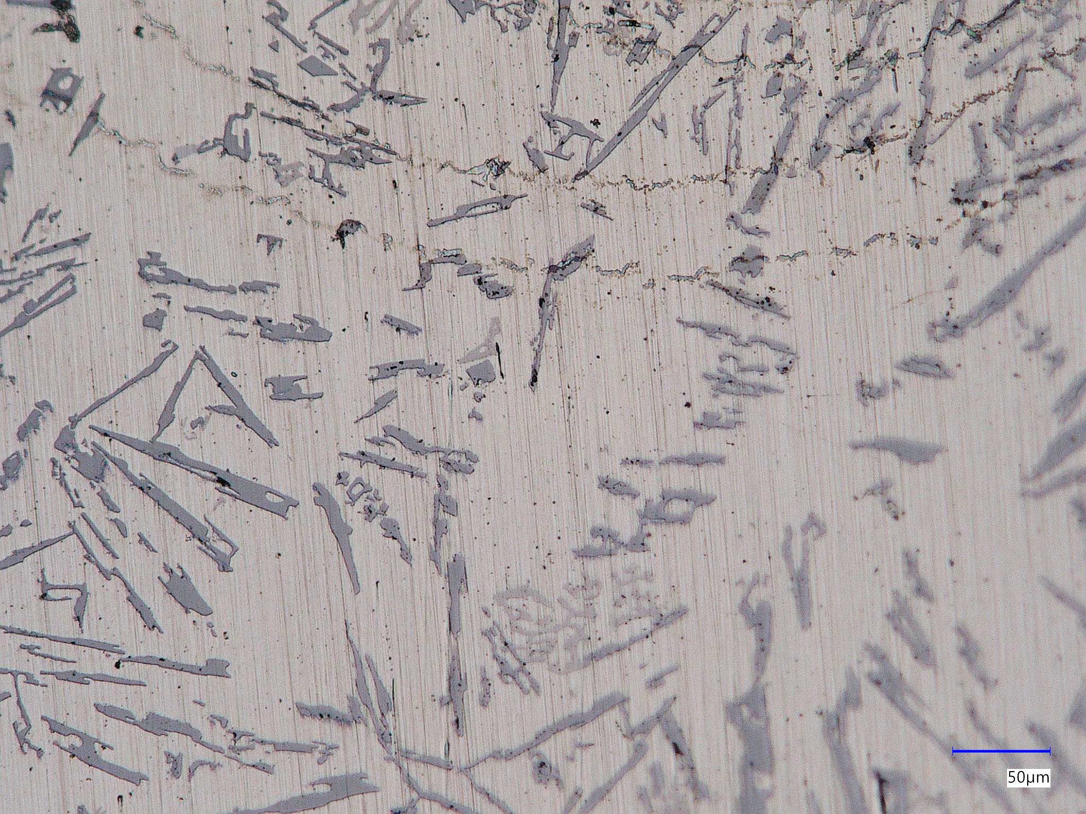
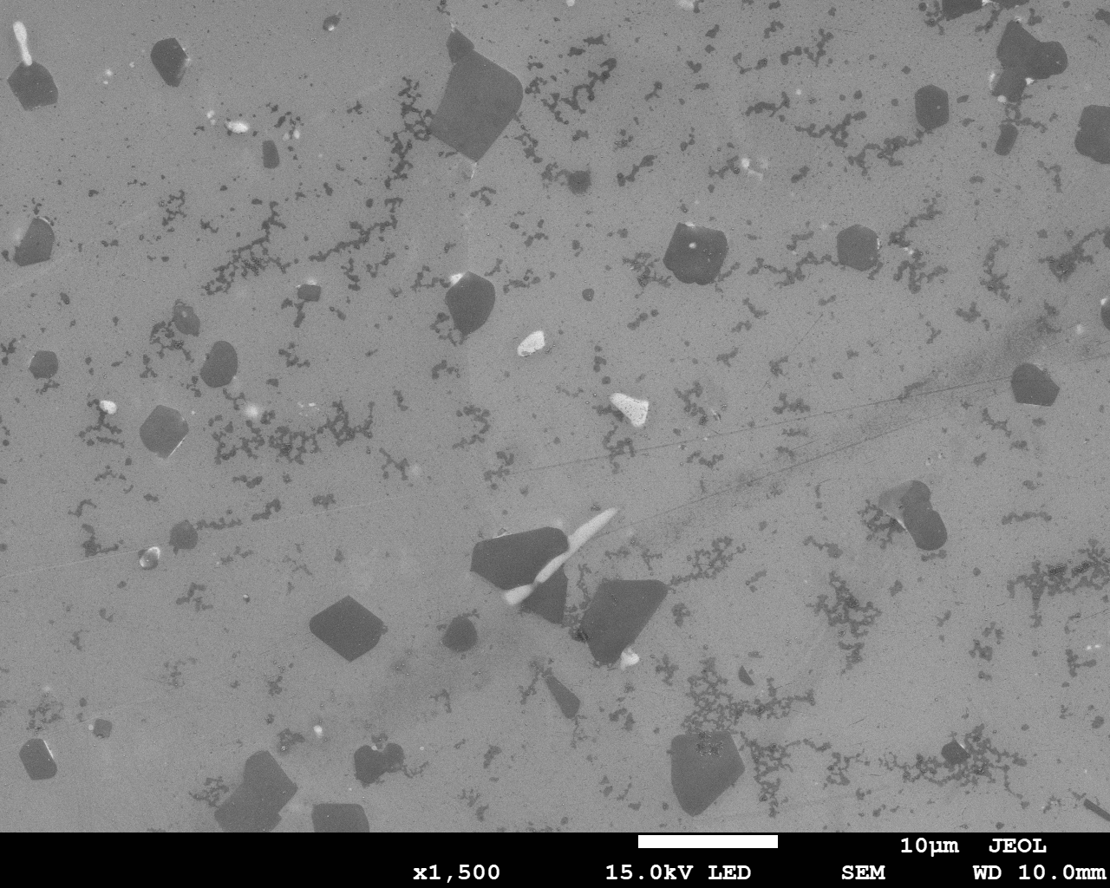
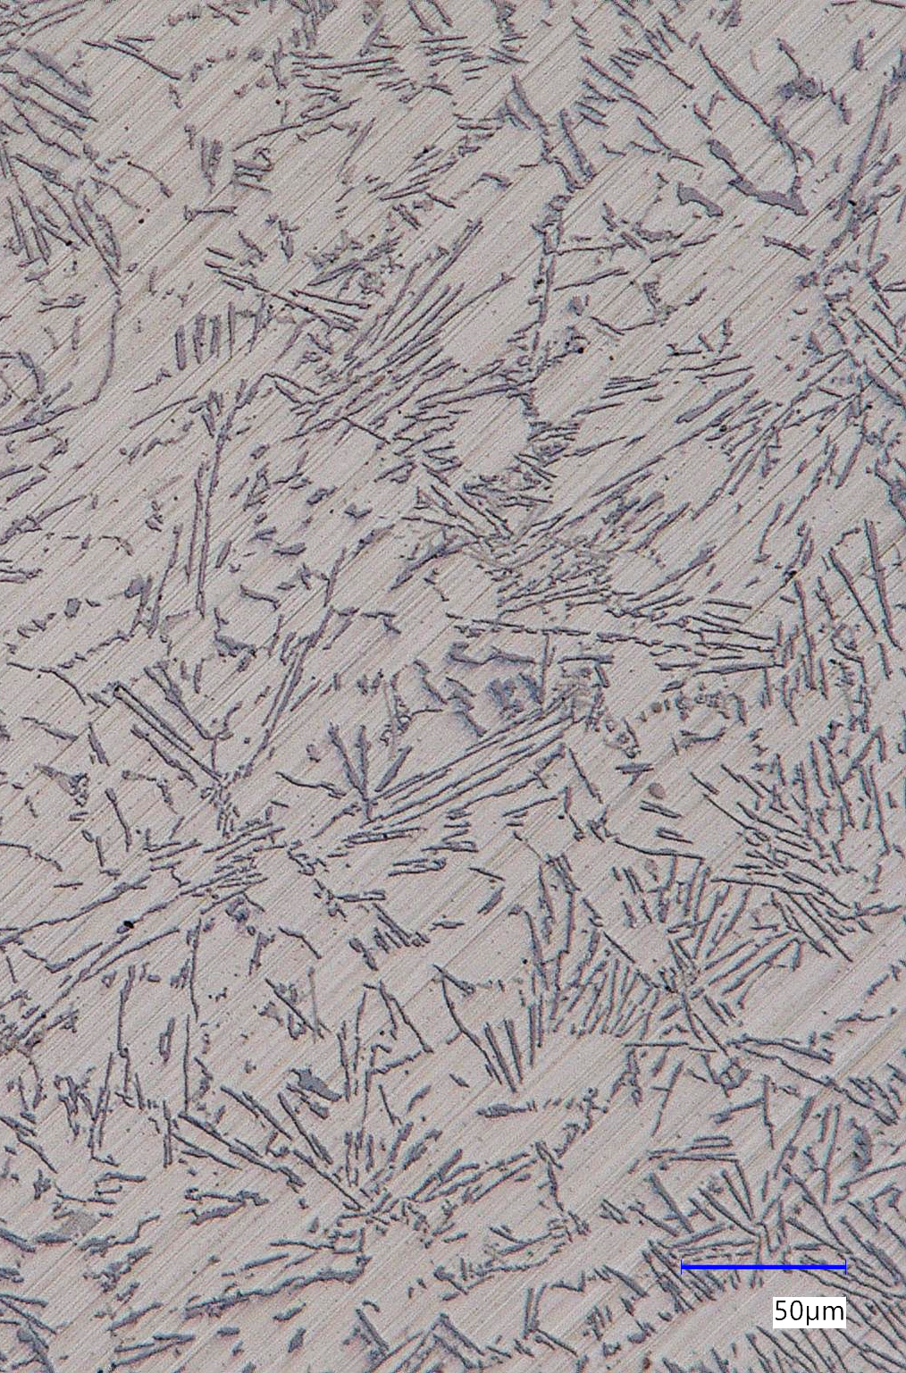
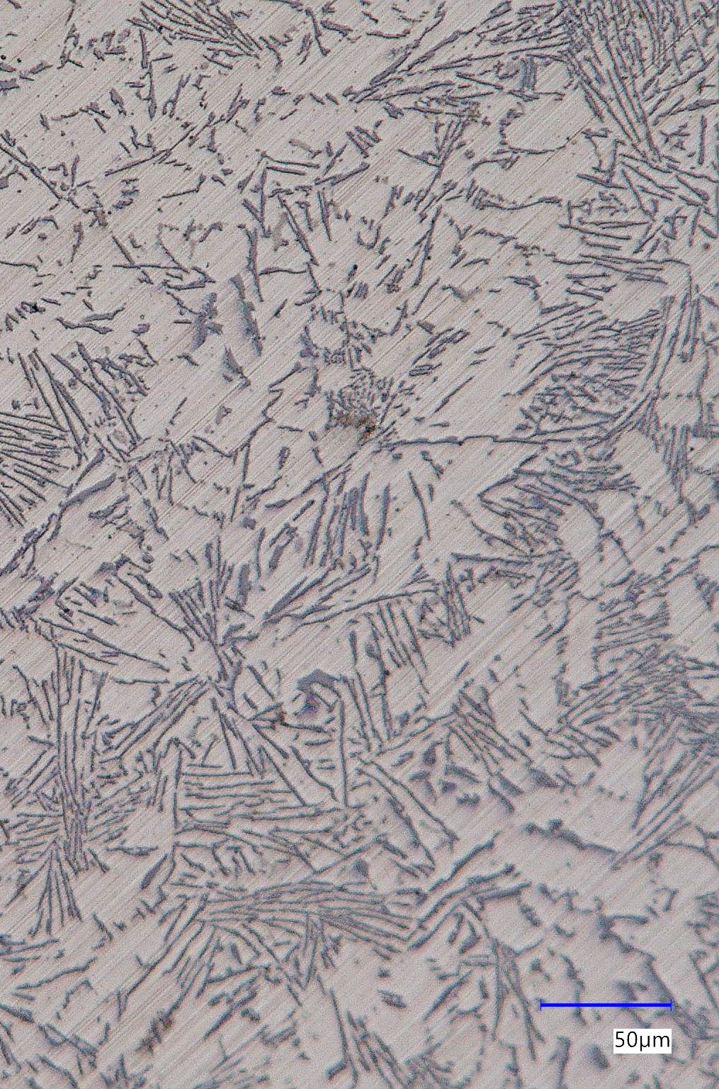
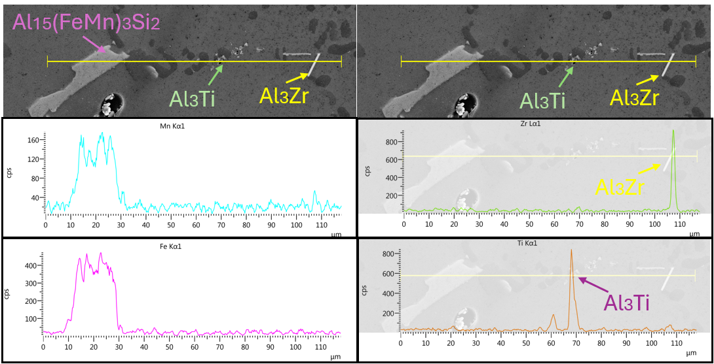
Effect of Ti and Zr on the Microstructure of Al-Si-Cu-Based Casting Alloys
TRANSCOM 2025: 16th International Scientific Conference on Sustainable, Modern and Safe Transport
Elena Kantoríková¹, Marek Matejka¹, Joanna Borowiecka-Jamrozek², Justyna Kasińska²
1 Univertity of Žilina, Žilina, Slovak Republic
2 Kielce University of Technology , Kielce, Poland
introduction
The foundry industry is a key component of industrial production, and therefore, it is essential to focus on its more efficient functioning while maintaining competitiveness in global markets. Nowadays, there are several approaches to improving this sector, including enhancing metal material recycling, modernizing manufacturing processes, and developing new materials that provide significant improvements. | The elements zirconium and titanium have the ability to significantly influence the formation and behavior of various structural components in the alloy, thereby improving its overall performance. Zirconium and titanium affect the microstructure of aluminum alloys by refining the grain structure, resulting in a finer and more homogeneous texture. In addition, both elements form intermetallic phases that can improve the mechanical properties, fatigue resistance and corrosion resistance of the alloy. | This study aims to investigate the effect of zirconium and titanium additions on the structure of Al-Si-Cu aluminum alloys. Special attention is given to their influence on the refinement of the primary α phase, as well as the synergistic effect induced by the presence of these elements. The results of this study will provide new insights into optimizing the properties of aluminum alloys for demanding industrial applications and offer valuable information for the development of new materials with improved properties.
materials, methods & implementation
For experimental purposes, the hypoeutectic AlSi9Cu1 alloy was used. For the purpose of evaluating the changes in the chemical composition of the alloy, five variants of the AlSi9Cu1 alloy were cast: reference alloy AlSi9Cu1 addition of 0.1 wt.% Zr. addition of 0.1 wt.% Zr + 0.05 wt.% Ti addition of 0.1 wt.% Zr + 0.10 wt.% Ti addition of 0.1 wt.% Zr + 0.15 wt.% Ti | The metallographic analysis was conducted using a Keyence VHX-7000 digital microscope. For a detailed examination of structural components, a VEGA LMU II scanning electron microscope (SEM) was used, equipped with an energy-dispersive X-ray spectroscopy (EDX) analyzer, Brucker Quantax.
Alloy | Si [wt. %] | Fe [wt. %] | Cu [wt. %] | Mn [wt. %] | Ti [wt. %] | Zr [wt. %]
Reference | 8.904 | 0.507 | 0.937 | 0.278 | 0.034 | 0,001
Zr 0,10 | 8.911 | 0.498 | 0.932 | 0.274 | 0.033 | 0,087
Zr 0,1 + Ti 0,05 | 8.867 | 0.512 | 0.924 | 0.267 | 0.053 | 0,091
Zr 0,1 + Ti 0,10 | 8.853 | 0.504 | 0.929 | 0.281 | 0.094 | 0,096
Zr 0,0 + Ti 0,15 | 8.887 | 0.501 | 0.925 | 0.276 | 0.143 | 0,102
results
The microstructure of the AlSi9Cu1 reference alloy is composed of the primary α phase (light color). Eutectic silicon occurs mainly in the form of thick rods, long narrow needles and grains in interdendritic regions.Due to the addition of 0.10 wt. % Zr results in a finer morphology of the primary α phase and a shortening of the rods and needles of eutectic silicon compared to the variant without Zr addition.
Addition of 0.05 wt. % Ti increases the number of crystallization nuclei of the primary α-Al phase, which contributes to the homogenization of the microstructure of the AlSi9Cu1 alloy. The combined addition of Ti and Zr positively affects the morphology of eutectic silicon, which occurs in the form of smaller, rounded rods. Further additions of Ti (0.10 and 0.15 wt. %) did not show significant changes compared to 0.05 wt. % Ti, while the microstructure remains fine with eutectic silicon in the form of smaller rod-like structures.
a
2
1
b
2
3
3
1
Spec. | Al | Si | Mn | Fe | Cu | Total
1 | 47.89 | 1.69 |  |  | 50.42 | 100.0
2 | 54.10 | 23.07 | 1.88 | 8.13 | 0.66 | 100.0
3 | 98.47 | 1.53 |  |  |  | 100.0
Spec. l | Al | Si | Cr | Mn | Fe | Cu | Zr | Total
1 | 64.86 | 7.27 | 0.90 | 1.50 | 19.69 | 5.66 | 0.11 | 100.0
2 | 2.41 | 97.51 |  |  |  |  | 0.08 | 100.0
3 | 96.04 | 1.35 |  |  |  | 2.44 | 0.17 | 100.0
Fig. 1 Microstructure of AlSi9Cu1 alloy, light microscope (a) reference alloy; (b) AlSi9Cu1 + Zr 0.10
a
b
c
Fig. 2 Microstructure of AlSi9Cu1 alloy (a) AlSi9Cu1 + Zr 0.10 + Ti 0.05; (b) AlSi9Cu1 + Zr 0.10 + Ti 0.10; (c) AlSi9Cu1 + Zr 0.10 + Ti 0.15
conclusion & implementation path
The article focuses on determining the effect of the addition of Zr and Ti and their combined effect on the structural components in the AlSi9Cu1 alloy. Based on the results, the following conclusions can be drawn: The addition of titanium and zirconium to the AlSi9Cu1 alloy significantly influenced the refinement of the primary aluminum grain and modified the morphology of the eutectic silicon. The formation of interphase particles based on Al3Ti and Al3Zr supported heterogeneous nucleation of α-phase grains, preventing the growth of large grains and dendritic structures, and eutectic silicon achieved a finer and more uniform morphology. The addition of 0.10 wt.% Zr led to the refinement of the primary α-phase grain and a partial change in the morphology of eutectic silicon, transitioning from predominantly long needles and sharp-edged rods to shorter rods with rounded shapes. The addition of 10 wt. % Zr also led to the presence of small amounts in the Fe- and Mn-rich phases. The addition of Ti resulted in significant refinement of the primary α-phase, which also caused a considerable change in the morphology of eutectic Si. The amount of Ti addition itself no longer had a significant effect on the size of the refined α-phase and, consequently, on the morphology of the eutectic Si.
acknowledgements
This work was supported by VEGA grant number 1/0241/23 and International Visegrad Fund [grant number 62410230].

