Slide 1

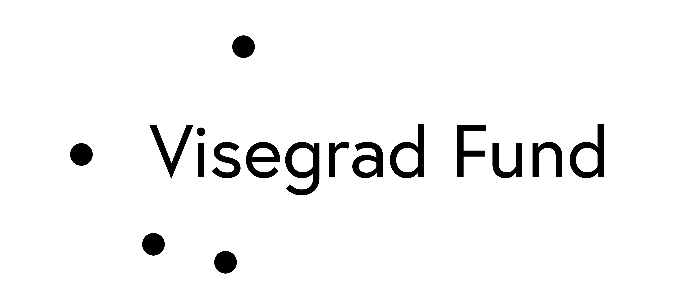
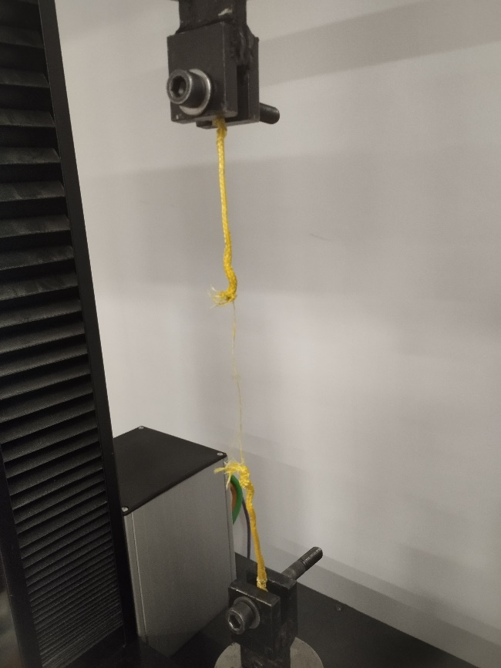
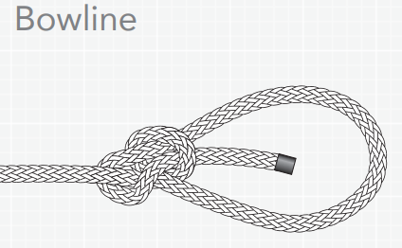
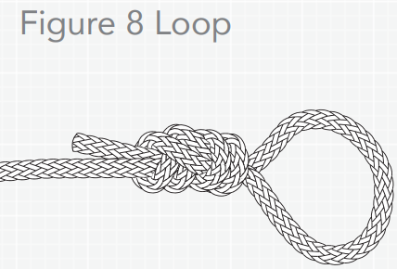
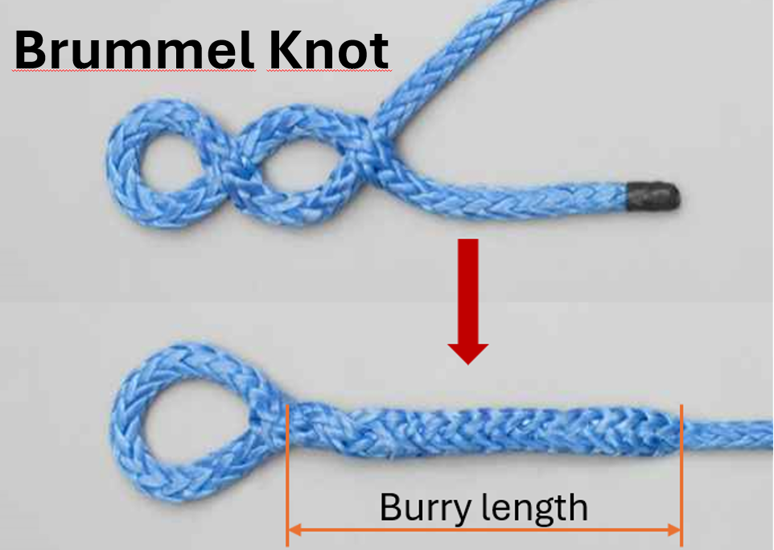
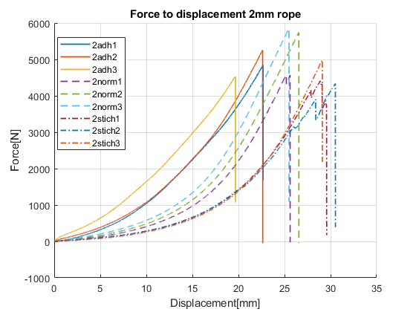
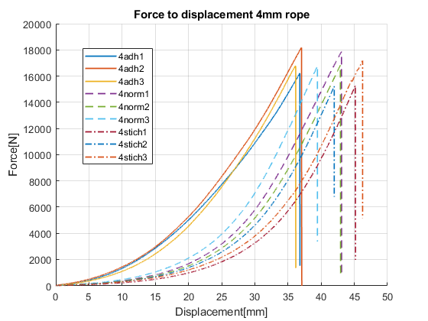
Analysis of Knot Variants and Their Impact on the Mechanical Performance of Dyneema Composite Ropes
TRANSCOM 2025: 16th International Scientific Conference on Sustainable, Modern and Safe Transport
Daniel Kozárik¹, Ronald Bašťovanský ¹, Slavomír Hrček ¹, Matúš Vereš ¹
1 Department of Design and Mechanical Elements, Faculty of Mechanical Engineering, University of Žilina, Univerzitná 8215/1, Žilina 010 26, Slovakia
introduction
Dyneema (UHMWPE) composite ropes are essential in transportation and automotive industries due to their strength-to-weight ratio, UV resistance, and low elongation. Demand for lightweight, durable materials is rising, but challenges like creep and low melting points require further optimization. | Knots weaken Dyneema ropes by creating stress concentrations and increasing slippage risks. Sharp bends accelerate wear, reducing reliability in load-bearing applications. This affects industries where rope failure impacts safety, requiring manufacturers, engineers, and end-users to develop better knotting solutions. | This study assesses three Brummel knot variants—standard, stitched, and glued—to determine their impact on Dyneema rope strength and elongation. The goal is to identify the best configuration for industrial use, improving safety and durability in transportation and automotive sectors.
materials, methods & implementation
Dyneema SK-75 composite ropes (2 mm and 4 mm) were used due to their high strength and low elongation. Tested knots included the Bowline, Figure Eight, and Brummel knot, with reinforced Brummel variants incorporating stitching or adhesive for improved load retention. Knots were tested using a tensile strength machine to determine actual strength retention. The Brummel knot was evaluated with bury lengths of 20 and 47 times the rope diameter to enhance friction and prevent slippage. The study analyzed knot performance under tensile stress to optimize load-securing applications, particularly in transportation and automotive industries requiring high reliability.
results
The tensile strength tests demonstrated clear distinctions in the performance of the various knot configurations, revealing significant insights into the impact of knot modifications on rope efficiency. The glued Brummel knot, which exhibited the smallest elongation and highest tensile strength, presented the most effective performance, aligning with theoretical expectations. This variant shows the potential for optimizing knot performance through minimal displacement, which is crucial for applications demanding high load retention and reduced elongation. The standard Brummel knot, while slightly less efficient in terms of elongation, still displayed strong performance in tensile strength. Conversely, the stitched variant exhibited the largest elongation and the lowest tensile strength, underscoring the trade-offs associated with such modifications.
The findings have important implications for real-world applications, particularly in industries such as transportation and automotive, where rope reliability and load retention are critical. The glued Brummel knot offers a promising solution for applications requiring minimal elongation and consistent load-bearing capacity over time. The standard and stitched Brummel variants, though showing higher elongation, may still be suitable for situations where a higher degree of flexibility is needed without compromising too much on strength. These insights contribute to improving safety and performance in systems involving rope load securing, ensuring that the most suitable knot is selected based on specific operational needs.
conclusion & implementation path
This study highlights the critical influence of knot configurations on Dyneema composite rope performance. The glued variant demonstrated superior efficiency and minimal elongation, making it ideal for applications requiring precise load control, while the stitched variant exhibited the lowest tensile strength and greatest elongation, emphasizing inherent trade-offs. To optimize performance, industries should prioritize glued knots in applications demanding stability and efficiency. Future research should focus on long-term durability under cyclic loading and explore alternative reinforcements. Collaboration among manufacturers, engineers, and material scientists will be key to advancing Dyneema rope applications in high-performance industries.
acknowledgements
This work was supported by the Scientific Grant Agency of the Ministry of Education, Science, Research and Sport of the Slovak Republic (VEGA), project no. 1/0568/24, Research in the field of loading and stress-deformation states of rolling bearing cages. The authors gratefully acknowledge this support.

