Slide 1


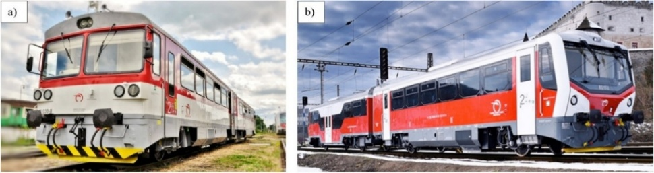
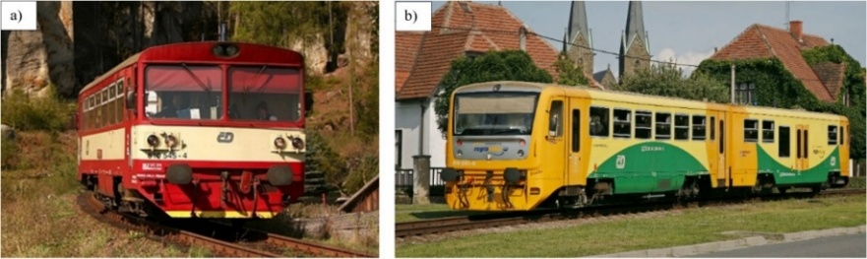
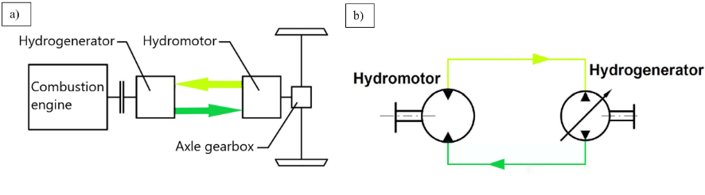
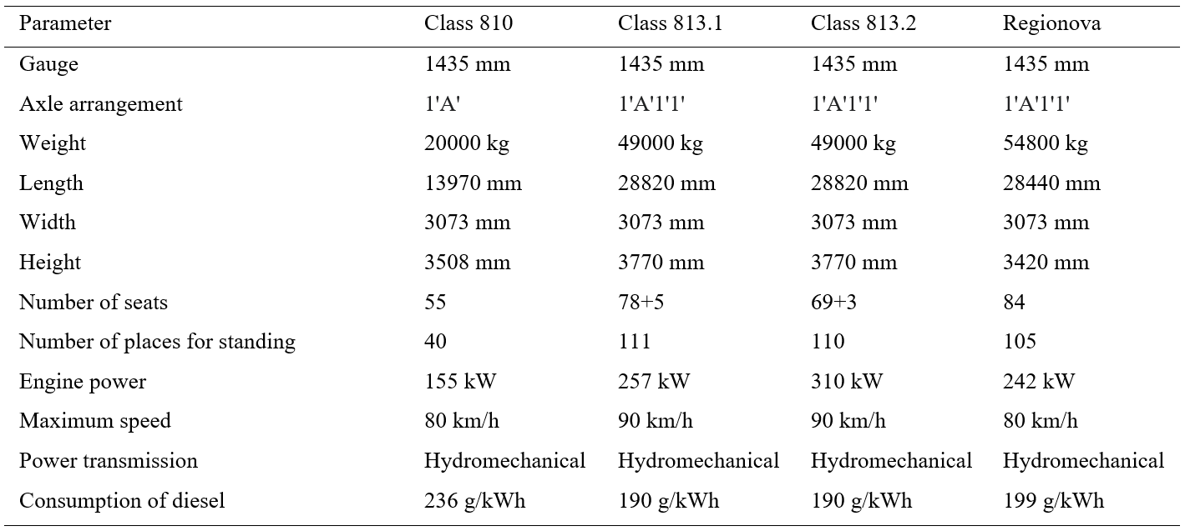
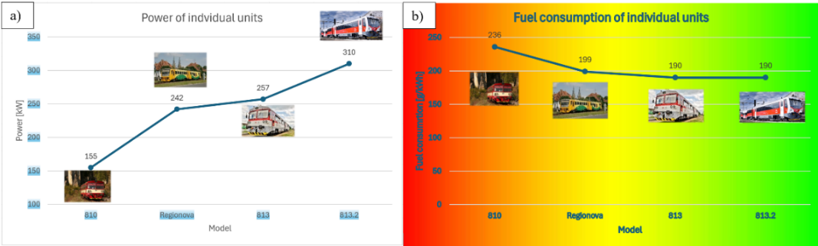
Analysis of the current state of motor units with single-axle bogies
TRANSCOM 2025: 16th International Scientific Conference on Sustainable, Modern and Safe Transport
Martin Bučko¹, Dalibor Barta¹, Ján Dižo¹, Miroslav Blatnický¹, Alyona Lovska¹, Slavomir Kowalski²
1 University of Žilina, Žilina, Slovak Republic
2 State University of Applied Sciences in Nowy Sacz, Nowy Sacz, Poland
Introduction
Rail transport is widely regarded as a leader in sustainable mobility, and its to enjoy significant popularity among passengers, largely attributed to its comfort, safety and speed and ecology of its operation. This study aims to analyze a regional railway vehicle equipped with independent traction and single- axle bogies. | The rail vehicles being compared is based on the original Class 810 motor wagon, which has been improved by various upgrades. Also compared are the power transmission of these rail vehicles, which are of the same type, but each with certain modifications for the most economical operation. | The analysis of the current state of rail units with independent traction and single-axle bogies can serve as a basis for the future development of these vehicles, which will offer greater passenger comfort and safety, more economical and environmentally friendly operation on lines where electrification will not be feasible.
materials, methods & implementation
The individual technical data of each railcar were compared and are shown in The Tab.1 below. The railcars are derived from the original Class 810 railcar, which has undergone various modernisations in Slovakia and abroad. The main propulsion elements are described, which are different for each vehicle, but the concept of propulsion is fundamentally the same for each of the above-mentioned railcars. The hydrostatic drive is described in more detail, where simple graphical representations of the principle of operation of this type of drive in Fig.3, which is usually implemented in vehicles with independent traction and single-axle chassis, are provided for ease of understanding.
Fig. 3. An illustration of the Motor unit 813.1 (a) and the Motor unit 813.2 (b)
Fig. 2. An illustration of the Motor unit 810 (a) and the Motor unit 814 Regionova (b)
Fig. 3. An illustration of the hydrostatic drive (a) and the closed hydrostatic circuit (b)
results
As can be seen in Tab. 1, the original Class 810 railcar consists of only one wagon, while it can be seen from the passenger capacity and length that the other railcars consist of two wagons.
Fig.4(a) shows a curve with an increasing character, which indicates the power of the combustion engine of individual units, which are divided according to the year of commissioning. Fig.4(b) graphically compares the diesel consumption of individual railcars.
Class 813.2 and Regionova vehicles contain a carriage with a low-floor section, which facilitates boarding and alighting for persons with limited mobility or persons with a carriage. Class 810 and Class 813.1 do not have this feature.
Hydrostatic power transmission in motor vehicles offers several advantages, including low component weight, cost efficiency, compact installation requirements, the ability to perform intensive braking through the drive system, flexibility in design configurations, and ease of direction reversal. Although efficient, these technologies have limitations in terms of efficiency, emissions and adaptability to new transport requirements. The growing emphasis on sustainability and reducing operating costs has prompted significant progress in alternative propulsion systems that could be implemented in this type of rolling stock in the near future, for example hybrid drive, battery drive. A promising alternative are hydrogen-powered trains, but disadvantage is the cost of this alternative technology.
Tab. 1. Parameters of individual units
Fig. 4. Comparison of engines power (a) and fuel consumption of individual units (b)
conclusion & implementation path
The overview study compares power units with single-axle bogie, which are primarily intended for non-electrified regional lines. A detailed analysis and comparison of the technical characteristics of these units, including their advantages, disadvantages and retrofitting, has been carried out. In addition, the type of drive, its advantages and disadvantages and its further applicability in rolling stock were examined. Despite several modernisation efforts, these vehicles are obsolete and no longer meet current emission standards. In addition, the electrification of regional lines is reducing the demand for diesel-powered units, leading to their replacement by units with dependent traction systems. However, on lines where electrification is technically impossible or economically disadvantageous, it is advisable to have rolling stock with independent traction using a modern propulsion concept. By integrating modern drive concepts, this research offers a new perspective on rail vehicle propulsion. The emphasis on modern propulsion technologies further reinforces its importance for further progress in the sustainable and efficient development of railway vehicles. The findings have potential applications for next-generation rail transport that enhances performance in a variety of operating conditions.
acknowledgements
This research was supported by the project KEGA 031ŽU-4/2023. This publication was realized with support of Operational Program Integrated Infrastructure 2014 - 2020 of the project: Concept, safety and related industrial research for the replacement of diesel traction by hydrogen fuel cell traction in the railway vehicles series 861 (code ITMS2014+: 313011BVC2), co-financed by the European Regional Development Fund. “Funded by the EU NextGenerationEU through the Recovery and Resilience Plan for Slovakia under the project No. 09I03-03-V01-00131.”

