Slide 1


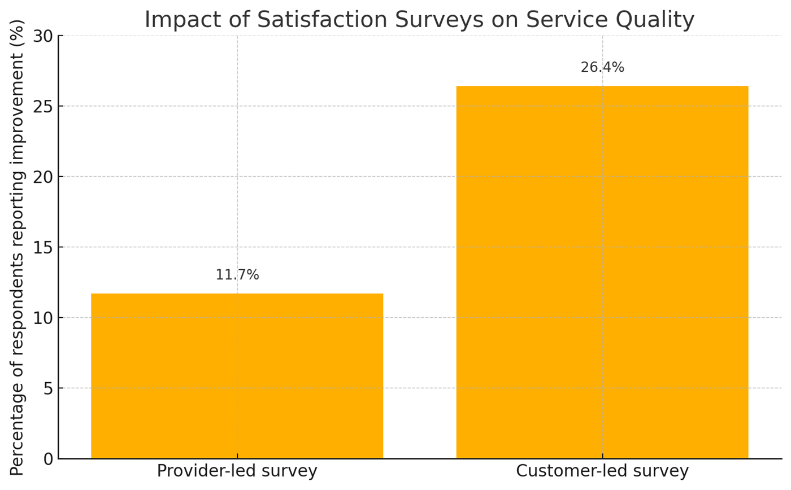
Analysis of the determinants of the quality of outsourcing services in B2B relations in the automotive industry
TRANSCOM 2025: 16th International Scientific Conference on Sustainable, Modern and Safe Transport
Jakub Cieśla¹, Jakub Cieśla²
1 Czestochowa University of Technology, Czestochowa, Poland
2 Czestochowa University of Technology, Czestochowa, Poland
introduction
Backround information & Market Context Outsourcing in the automotive sector is a strategic tool to boost efficiency and stay competitive. As digitalization and sustainability reshape the industry, service providers must deliver more than just cost savings—they need to offer reliability, flexibility, and innovation. | Problem Statement & Stakeholders Despite unified quality standards, companies assess service and material suppliers differently. Stakeholders across departments apply inconsistent criteria, creating gaps in how outsourcing quality is measured and improved. | Research Objectives & Expected Impact The study aimed to identify key factors influencing outsourcing service quality in B2B automotive contexts. Findings can support better evaluation systems and foster performance-driven supplier relationships.
materials, methods & implementation
Description of research methods and materials A structured pilot survey was conducted among 48 professionals representing various functions within or supplying to the automotive industry. The survey included three main parts: respondent profiling within the value chain, evaluation of service management elements, and rating of quality determinants based on a modified SERVQUAL model using a five-point Likert scale. Service attributes were categorized into six thematic groups: general performance (e.g. professionalism, timeliness), operational flexibility, communication effectiveness, equipment/tools, innovation & sustainability, and financial/compliance aspects. The study compared the impact of satisfaction surveys run by service providers versus those initiated by clients, revealing that customer-led assessments were more likely to result in service improvements.
results
Academic Findings & Innovation Practical Applications The study confirms that outsourcing service quality in the automotive sector hinges on factors like responsiveness, transparency, and alignment with customer needs. Key attributes such as timely execution, adaptability, and professionalism consistently received top scores from respondents. More importantly, the data reveals that service providers rarely respond to their own satisfaction surveys with significant improvements—only 11.7% of respondents noticed any real benefit. In contrast, when the customer initiates a satisfaction assessment, the rate of perceived improvement more than doubles to 26.4%. The accompanying chart starkly visualizes this gap and suggests that pressure from clients is a far more effective catalyst for change than internal feedback mechanisms. This insight highlights a practical innovation opportunity: automotive firms should embed structured, client-driven feedback loops into their supplier management systems to drive measurable service improvements. In parallel, leveraging cloud-based quality tools and integrating Industry 4.0 technologies can reinforce these improvements by enhancing transparency and performance monitoring in real time.
conclusion & implementation path
Summary of research conclusions, impact and potential areas of further research in this field The research underscores the complex, multi-layered nature of B2B service outsourcing in the automotive industry. While industry standards provide general guidance, companies need more refined tools and strategies to assess and improve service quality effectively. The clear asymmetry in survey impact—where client evaluations outperform provider self-assessments—points to the importance of customer empowerment in quality control processes. These findings advocate for more structured and differentiated approaches to evaluating service suppliers versus material providers. Further research could explore how specific digital tools—such as AI-driven service analytics, blockchain-based audit trails, or automated feedback mechanisms—might enhance the efficiency and accountability of outsourcing partnerships. There's also strong potential to integrate ESG (environmental, social, governance) criteria into service quality metrics to align with broader industry transformation goals.
acknowledgements
Identify applicable funding agency here, put sponsor acknowledgments and references. This research received no direct funding. Potential funding bodies for related research include Horizon Europe, the Polish National Centre for Research and Development (NCBR), and automotive associations such as CLEPA or ACEA.

