Slide 1


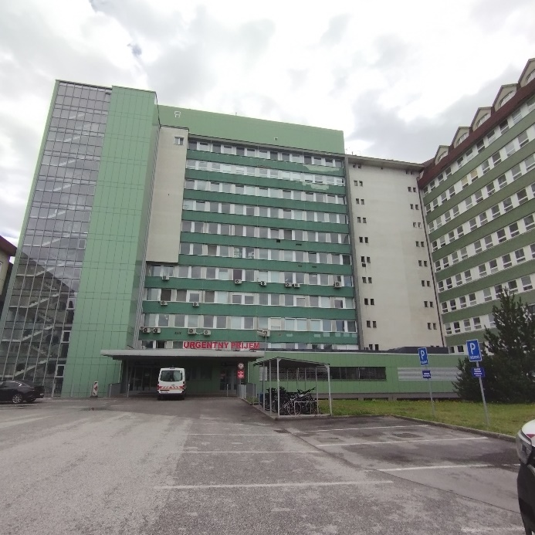
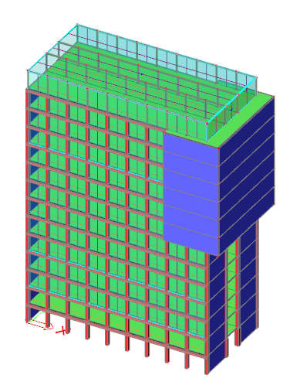
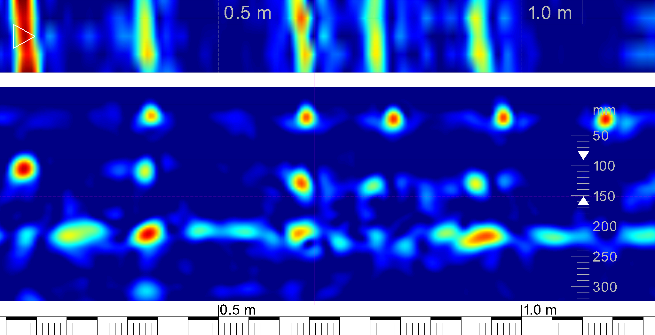
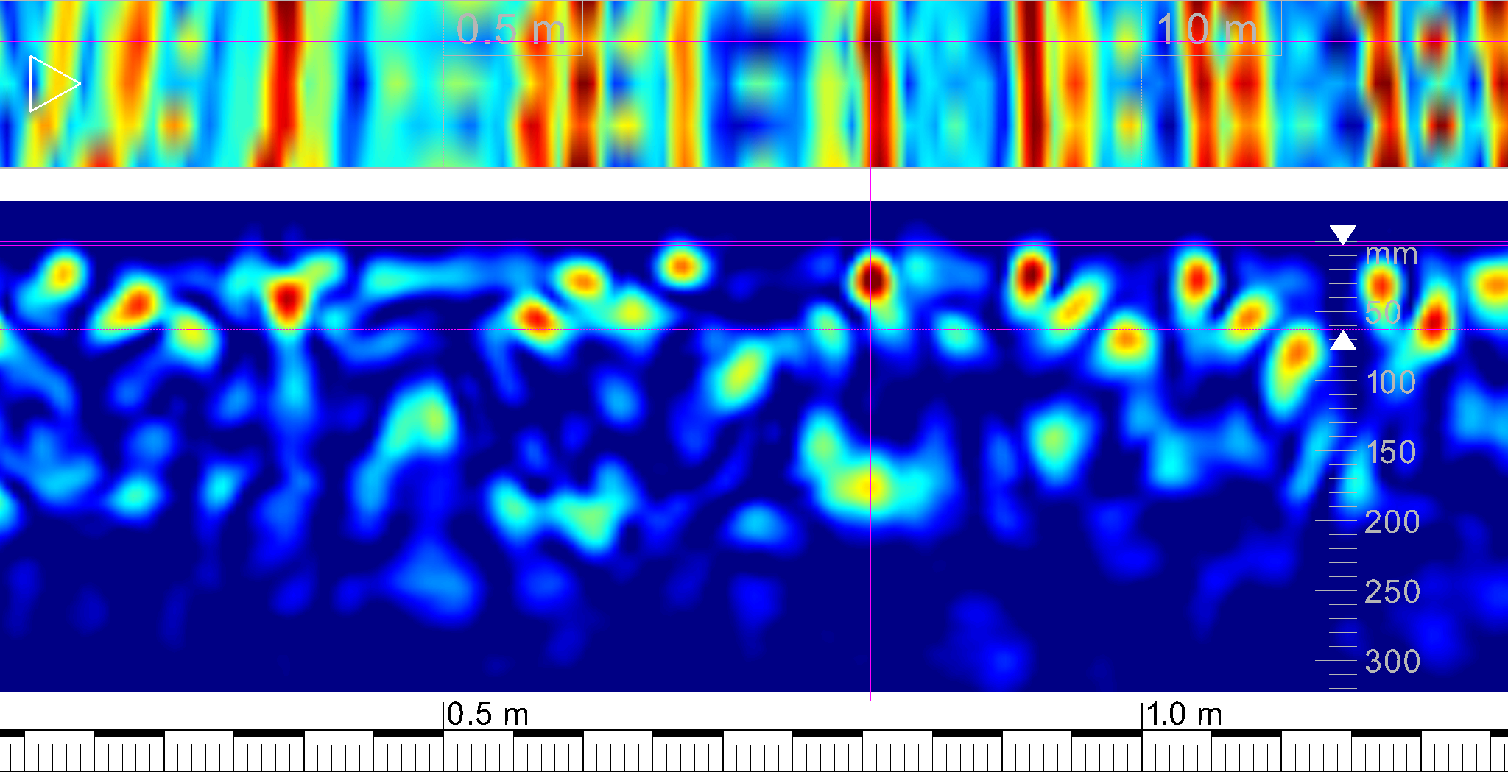
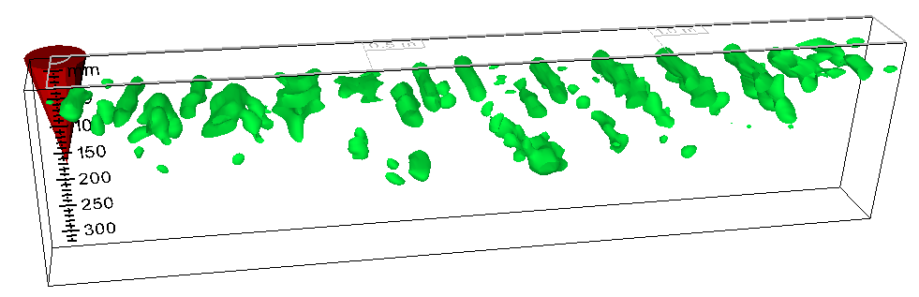
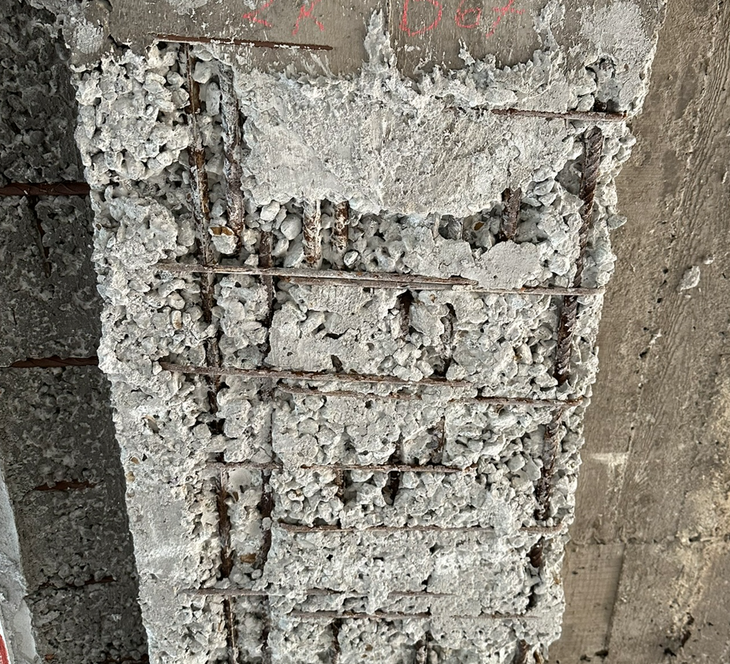
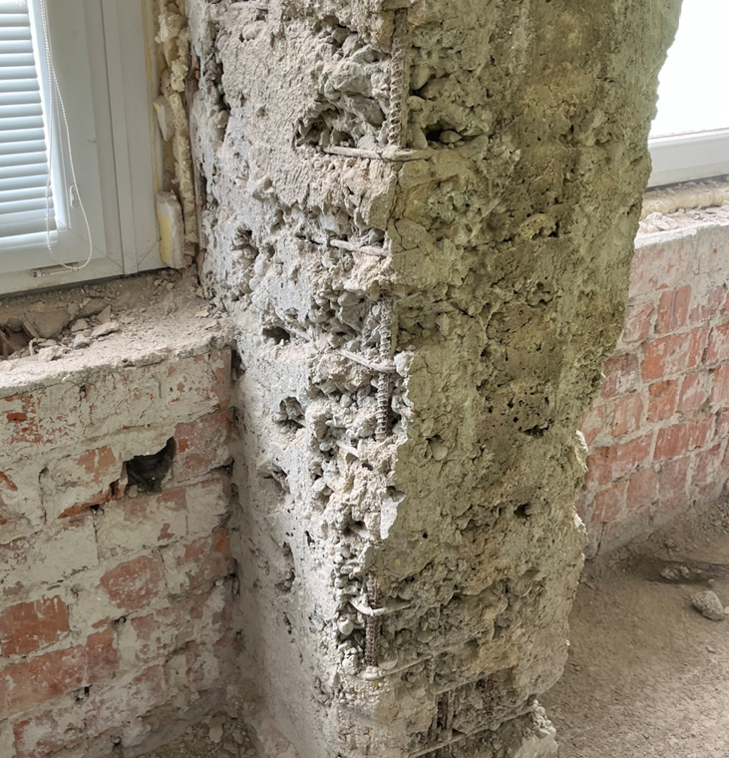
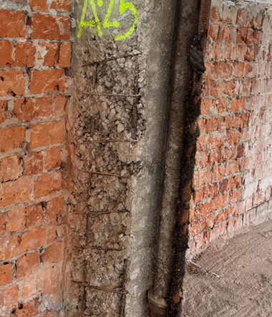
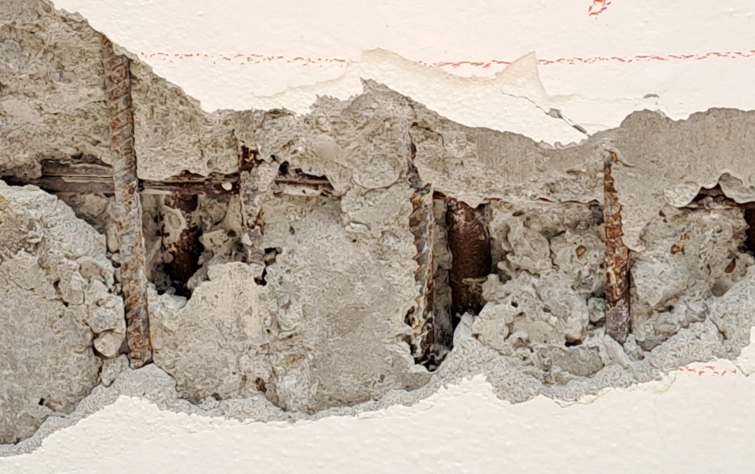
The effect of low quality of surface treatment of reinforced concrete layers and the consequent impact on non-destructive measurements and localization of concrete reinforcement
TRANSCOM 2025: 16th International Scientific Conference on Sustainable, Modern and Safe Transport
Michal Zahuranec¹, Martin Vavruš²
Department of Structures and Bridges, Faculty of Civil Engineering, University of Žilina, Univerzitná 8215/1, 010 26 Žilina, Slovakia
introduction
The aim of this paper is presentation of a diagnostic assessment of a major multi-storey building, whose plan is to modernise and reduce energy consumption. The main purpose of the diagnostic was to find out the dimensions of the main load-bearing elements and their material properties, whether it is the class of concrete or the type and number of concrete reinforcement used. The paper focuses on the non-destructive and semi-destructive measurements of the reinforcement location, and significant problems of the structure were revealed.
DIAGNOSTICS USING NON-DESTRUCTIVE MEASUREMENTS
Hilti PS1000 GPR was used to diagnose the reinforced concrete slab structure, providing real-time insight into the concrete structures and generating accurate images for on-site condition assessment or later documentation.
Large caverns and voids were discovered when locating the reinforcement due to imperfect compaction. These caverns caused the instrument to become dysfunctional as the instrument could not distinguish between the cavity and the reinforcement. Another problem was the hot water heating and electrical wiring in the structure. In the pictures we can see the location of a number of caverns in the structure and also the hot water heating ducted in the centre of the slab.
DIAGNOSTICS USING SEMI-DESTRUCTIVE MEASUREMENTS
Semi-destructive tests were carried out to determine the type and measure the diameter of the reinforcement. After removal of the plaster, the assumptions of the non-destructive tests were confirmed, namely that the elements of the reinforced concrete skeleton have a significantly low quality of surface treatment (insufficient compaction, content of minor but also major cavities). At the floor slabs, the caverns were so large that the steel pipes used as hot-water heating were visible.
conclusion & implementation path
On the basis of the diagnostic measurements made, these conclusions can be drawn from the study conducted: 1. Non-destructive diagnostic measurements aimed at locating and positioning the axial distance of reinforcement in building structures need to use instruments with short range area capability, since structural elements in building structures have a significantly smaller cross-section than in bridge structures. 2. If the elements of reinforced concrete skeleton contain poor quality surface layers or smaller or larger caverns, or heating pipes or electrical wiring is routed directly in the elements, the equipment may become dysfunctional. If the equipment is able to scan the area of the element under investigation, it may be very difficult to determine the location and position of the axial distance of the reinforcement with so many interfering elements. 3. This type of structure, which has reached a service life of 50 years, has confirmed the necessity to perform diagnostic measurements. This is especially the case when the plaster is removed entirely from the load-bearing structural elements, whereby we can detect significant imperfections and, by subsequent reprofiling, prolong the lifetime of the elements and also increase its reliability.
acknowledgements
This research is supported by Funded by the EU NextGenerationEU through the Recovery and Resilience Plan for Slovakia under the project No. 09I03-03-V05-00002.

