Slide 1


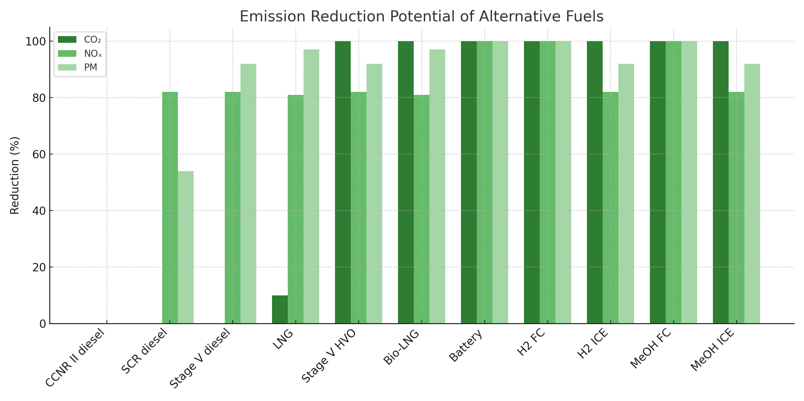
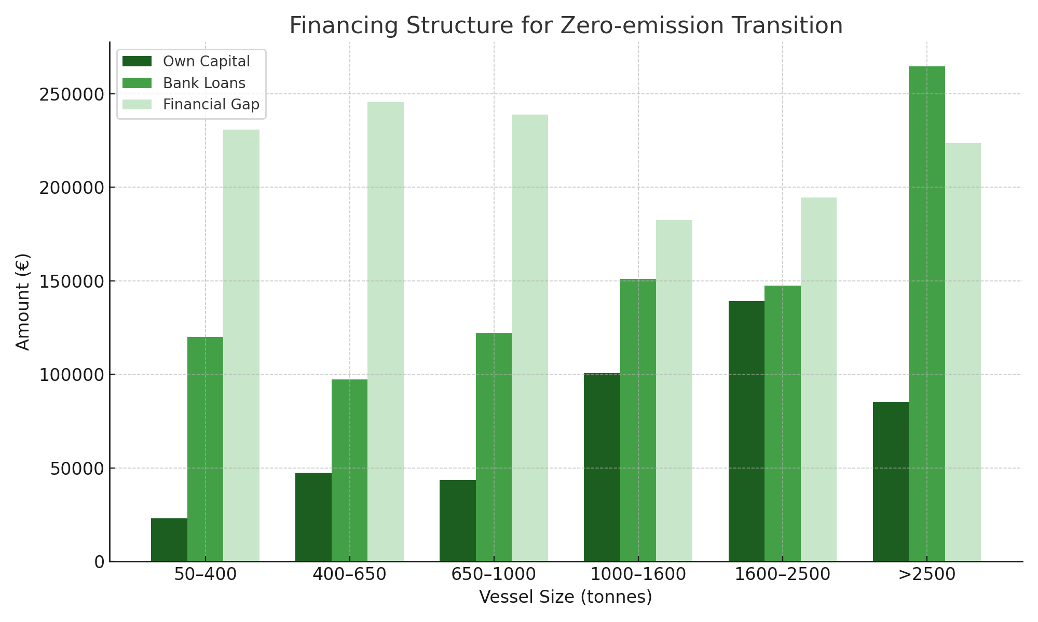
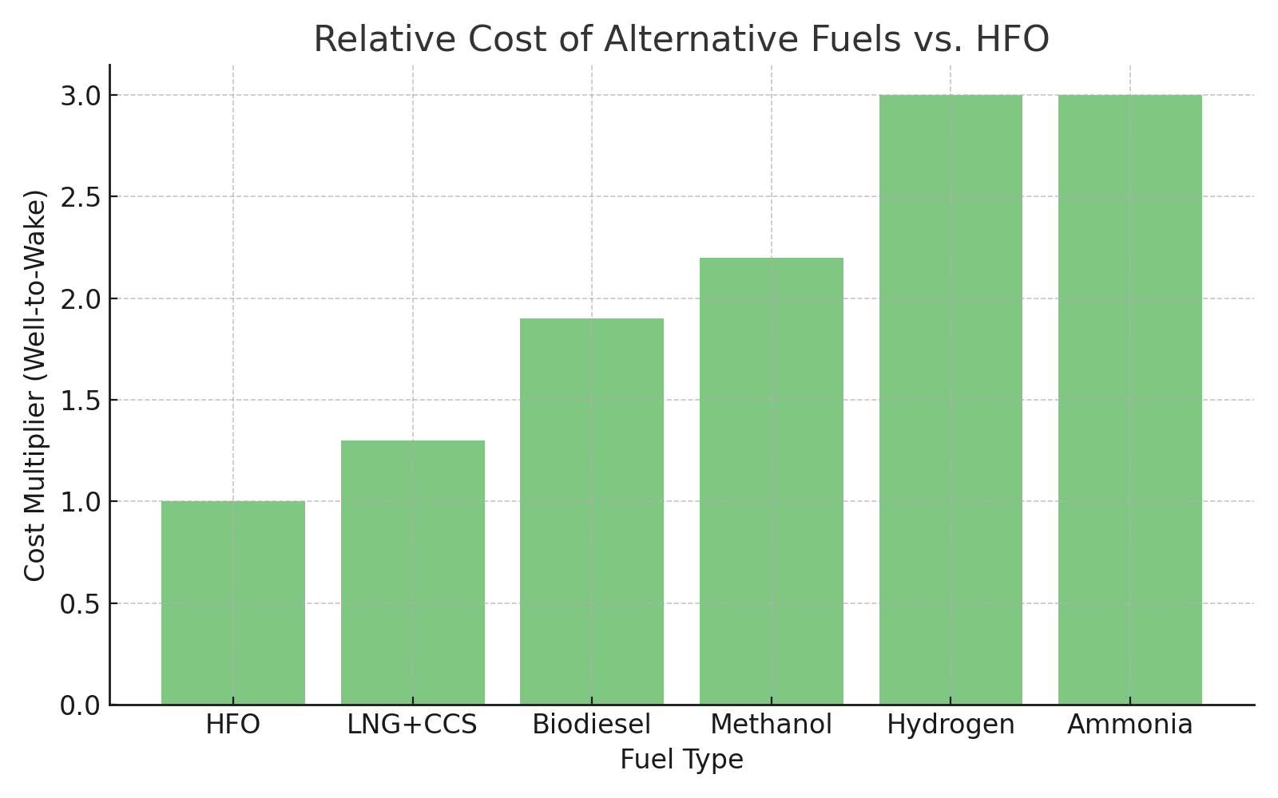

Decarbonizing Inland Waterway Transport: Transition to Low and Zero Carbon Fuels
TRANSCOM 2025: 16th International Scientific Conference on Sustainable, Modern and Safe Transport
Martin Jurkovič¹, Róbert Kadnár¹, Jarmila Sosedová¹, Tomáš Kalina¹, Aditya Rio Prabowo², Oleksiy Melnyk³ , S M Rashidul Hasan⁴
1 University of Zilina, Zilina, Slovakia
2 Universitas Sebelas Maret, Surakarta, Indonesia
3 Odesa National Maritime University, Odesa, Ukraine
4 Bangabandhu Sheikh Mujibur Rahman Maritime University, Bangladesh, Dhaka
Introduction
The decarbonization of inland waterway transport (IWT) is a crucial component of Europe’s strategy for achieving climate neutrality by 2050. | The NAIADES III action plan and Repower EU emphasize the shift to low and zero-emission vessels through innovation, regulation, and investment. | This paper identifies the technological, regulatory, and economic challenges in transitioning to clean fuels within the Danube region, focusing on alternative fuel readiness and infrastructure gaps.
materials, methods & implementation
The analysis is based on international roadmaps (CCNR, CESNI), EU policy frameworks (NAIADES III, REGULATION 2023/1804), and feasibility studies on green fuels. Fuel technologies were evaluated in terms of: Technology Readiness Level (TRL), Emission reduction potential (CO₂, NOₓ, PM), Applicability to long-distance navigation (e.g. 600–1880 km voyages), Compatibility with Danube convoy systems, Economic feasibility (CAPEX, OPEX, grant requirements). Drop-in fuels such as HVO and Bio-LNG emerged as strong near-term solutions, while hydrogen and methanol offer longer-term benefits under certain constraints.
results
Battery and hydrogen propulsion systems were found impractical for Danube conditions due to long voyage durations and high energy demand. Conversely, internal combustion engines fuelled by HVO or Bio-LNG demonstrated full compatibility and immediate applicability. Cost analysis indicates: CCS is the most affordable zero-emission option, Hydrogen and ammonia remain costly (3x vs. HFO), Financial gaps up to 60% exist for smaller vessels. The policy shift towards accepting LNG, hydrogen, and methanol under ES-TRIN 2025/1 marks a significant regulatory milestone.
.
conclusion & implementation path
A successful energy transition in Danube IWT depends on a hybrid approach: regulatory support, infrastructure deployment, and scalable clean fuel technologies. Biofuels stand out for their maturity, emission performance, and availability. Coordinated EU and national actions are essential, including: TEN-T port refueling infrastructure, financial aid schemes for retrofitting, standardization of safety and performance protocols. Strategic investments today will determine whether inland navigation can truly become a zero-emission mode of transport.
acknowledgements
This work is the result of the Project VEGA No.1/0312/25: Research on the economic efficiency of inland water transport, 2025-2027.

