Slide 1


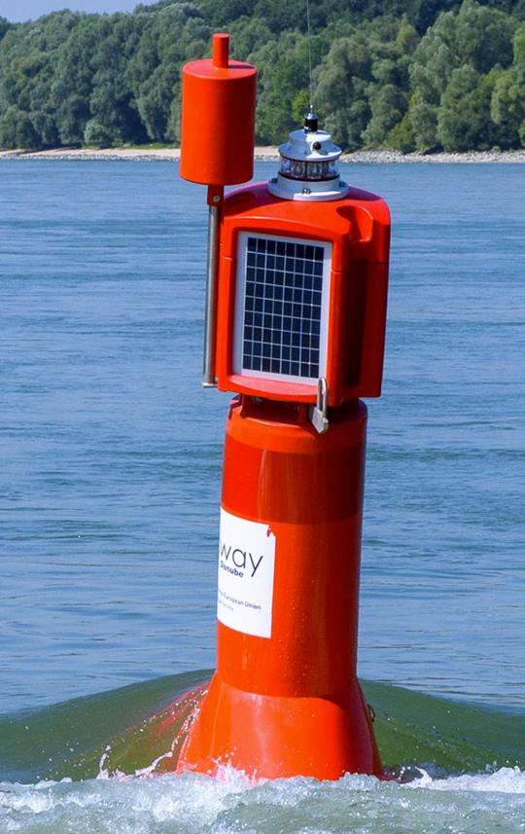
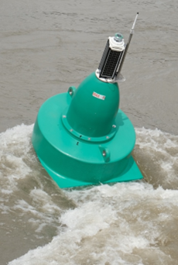
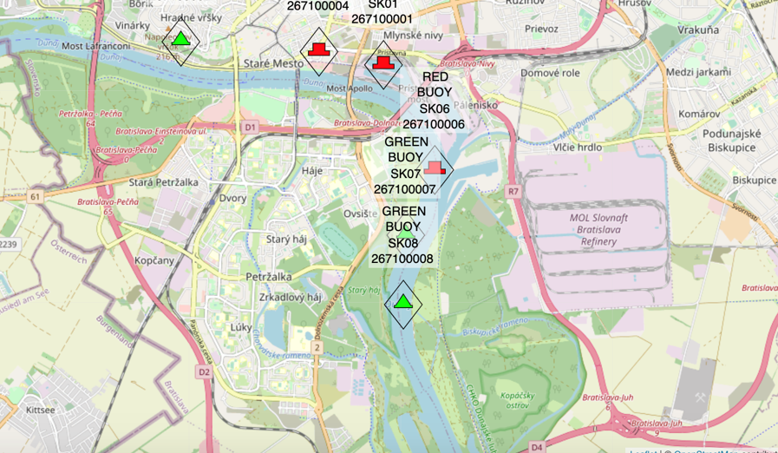
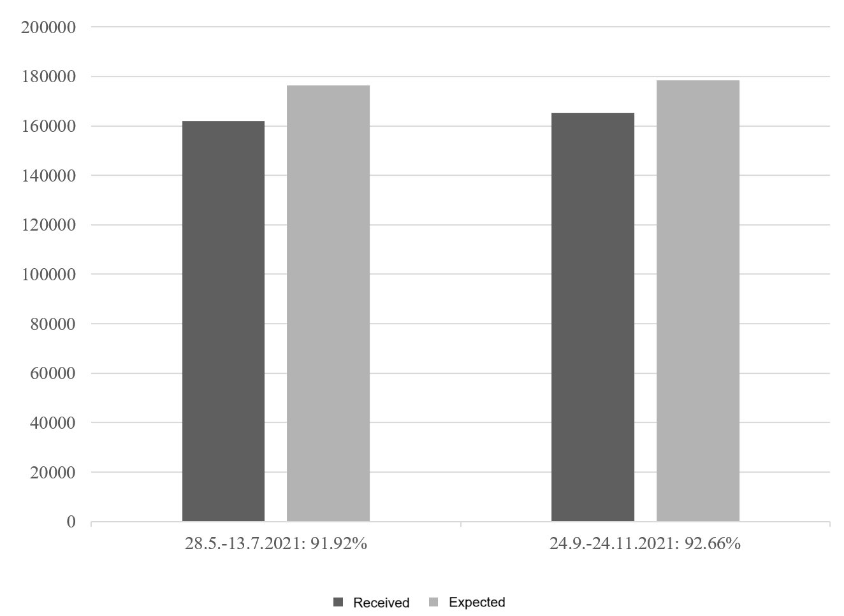
Transformative Technology for Inland Waterway Navigation: AIS AtoN
TRANSCOM 2025: 16th International Scientific Conference on Sustainable, Modern and Safe Transport
Martin Jurkovič¹, Alena Molnárová Baracková¹, Aditya Rio Prabowo² Piotr Gorzelanczyk³, Oleksiy Melnyk⁴
1 University of Zilina, Zilina, Slovakia
2 Universitas Sebelas Maret, Surakarta, Indonesia
3 Stanislaw Staszic State University of Applied Sciences in Pila, Pila, Poland
4 Odesa National Maritime University, Odesa, Ukraine
introduction
The Automatic Identification System (AIS) Aids to Navigation (AtoNs) represent a groundbreaking advancement in inland waterway transport. By providing real-time data on vessel movements, AIS AtoNs significantly enhance navigational safety and operational efficiency. | The implementation of AIS AtoNs along the Danube River has demonstrated reductions in operational delays and collisions, highlighting their value in improving situational awareness. They also support sustainability through reduced emissions and optimized route management. | This research aims to evaluate the performance and limitations of AIS AtoNs in inland waterway navigation, with the expected impact of enhancing safety, operational efficiency, and sustainability through smarter navigation technologies.
materials, methods & implementation
A pilot study was conducted with the installation of eight AIS AtoNs along the Slovak section of the Danube River (rkm 1871–1862). The AtoNs were categorized into Type 1 (transmitting AIS messages) and Type 3 (equipped with sensors for environmental monitoring). The deployment involved staged testing from controlled port environments to full-scale deployment, with performance evaluated based on signal visibility, energy consumption, and positional stability. Monitoring used the SlovRIS AIS platform.
AIS AtoNs testing
results
The AtoNs achieved over 90% success in AIS message transmission. Type 1 units demonstrated consistent energy performance, while Type 3 units with sensors and repeater mode experienced battery depletion during low sunlight periods. Positional stability was affected by strong currents, particularly near bridges. The communication network showed minimal VHF Data Link (VDL) load. Adjustments to positional radius improved deviation detection. A hybrid model combining physical and synthetic AtoNs proved effective.
Verification of receiving and sending messages from AIS AtoN
Evaluation of energy-independent operation of AtoNs during test operation
Impact on VDL Load (VHF Data Link Load)
conclusion & implementation path
Key challenges include buoy instability in strong currents, energy limitations during winter, and exposure to environmental damage. Standardized anchoring systems and advanced energy storage technologies are essential for improving resilience. Cybersecurity threats must also be addressed through encryption, monitoring, and operator training. International design standards are needed for interoperability and efficient deployment of AIS AtoNs. The pilot deployment demonstrated that AIS AtoNs can significantly enhance inland waterway navigation. AIS AtoNs offer promising advancements toward safer, more efficient, and sustainable waterway systems.
acknowledgements
This work is the result of the Project VEGA No.1/0312/25: Research on the economic efficiency of inland water transport, 2025-2027.

