Slide 1


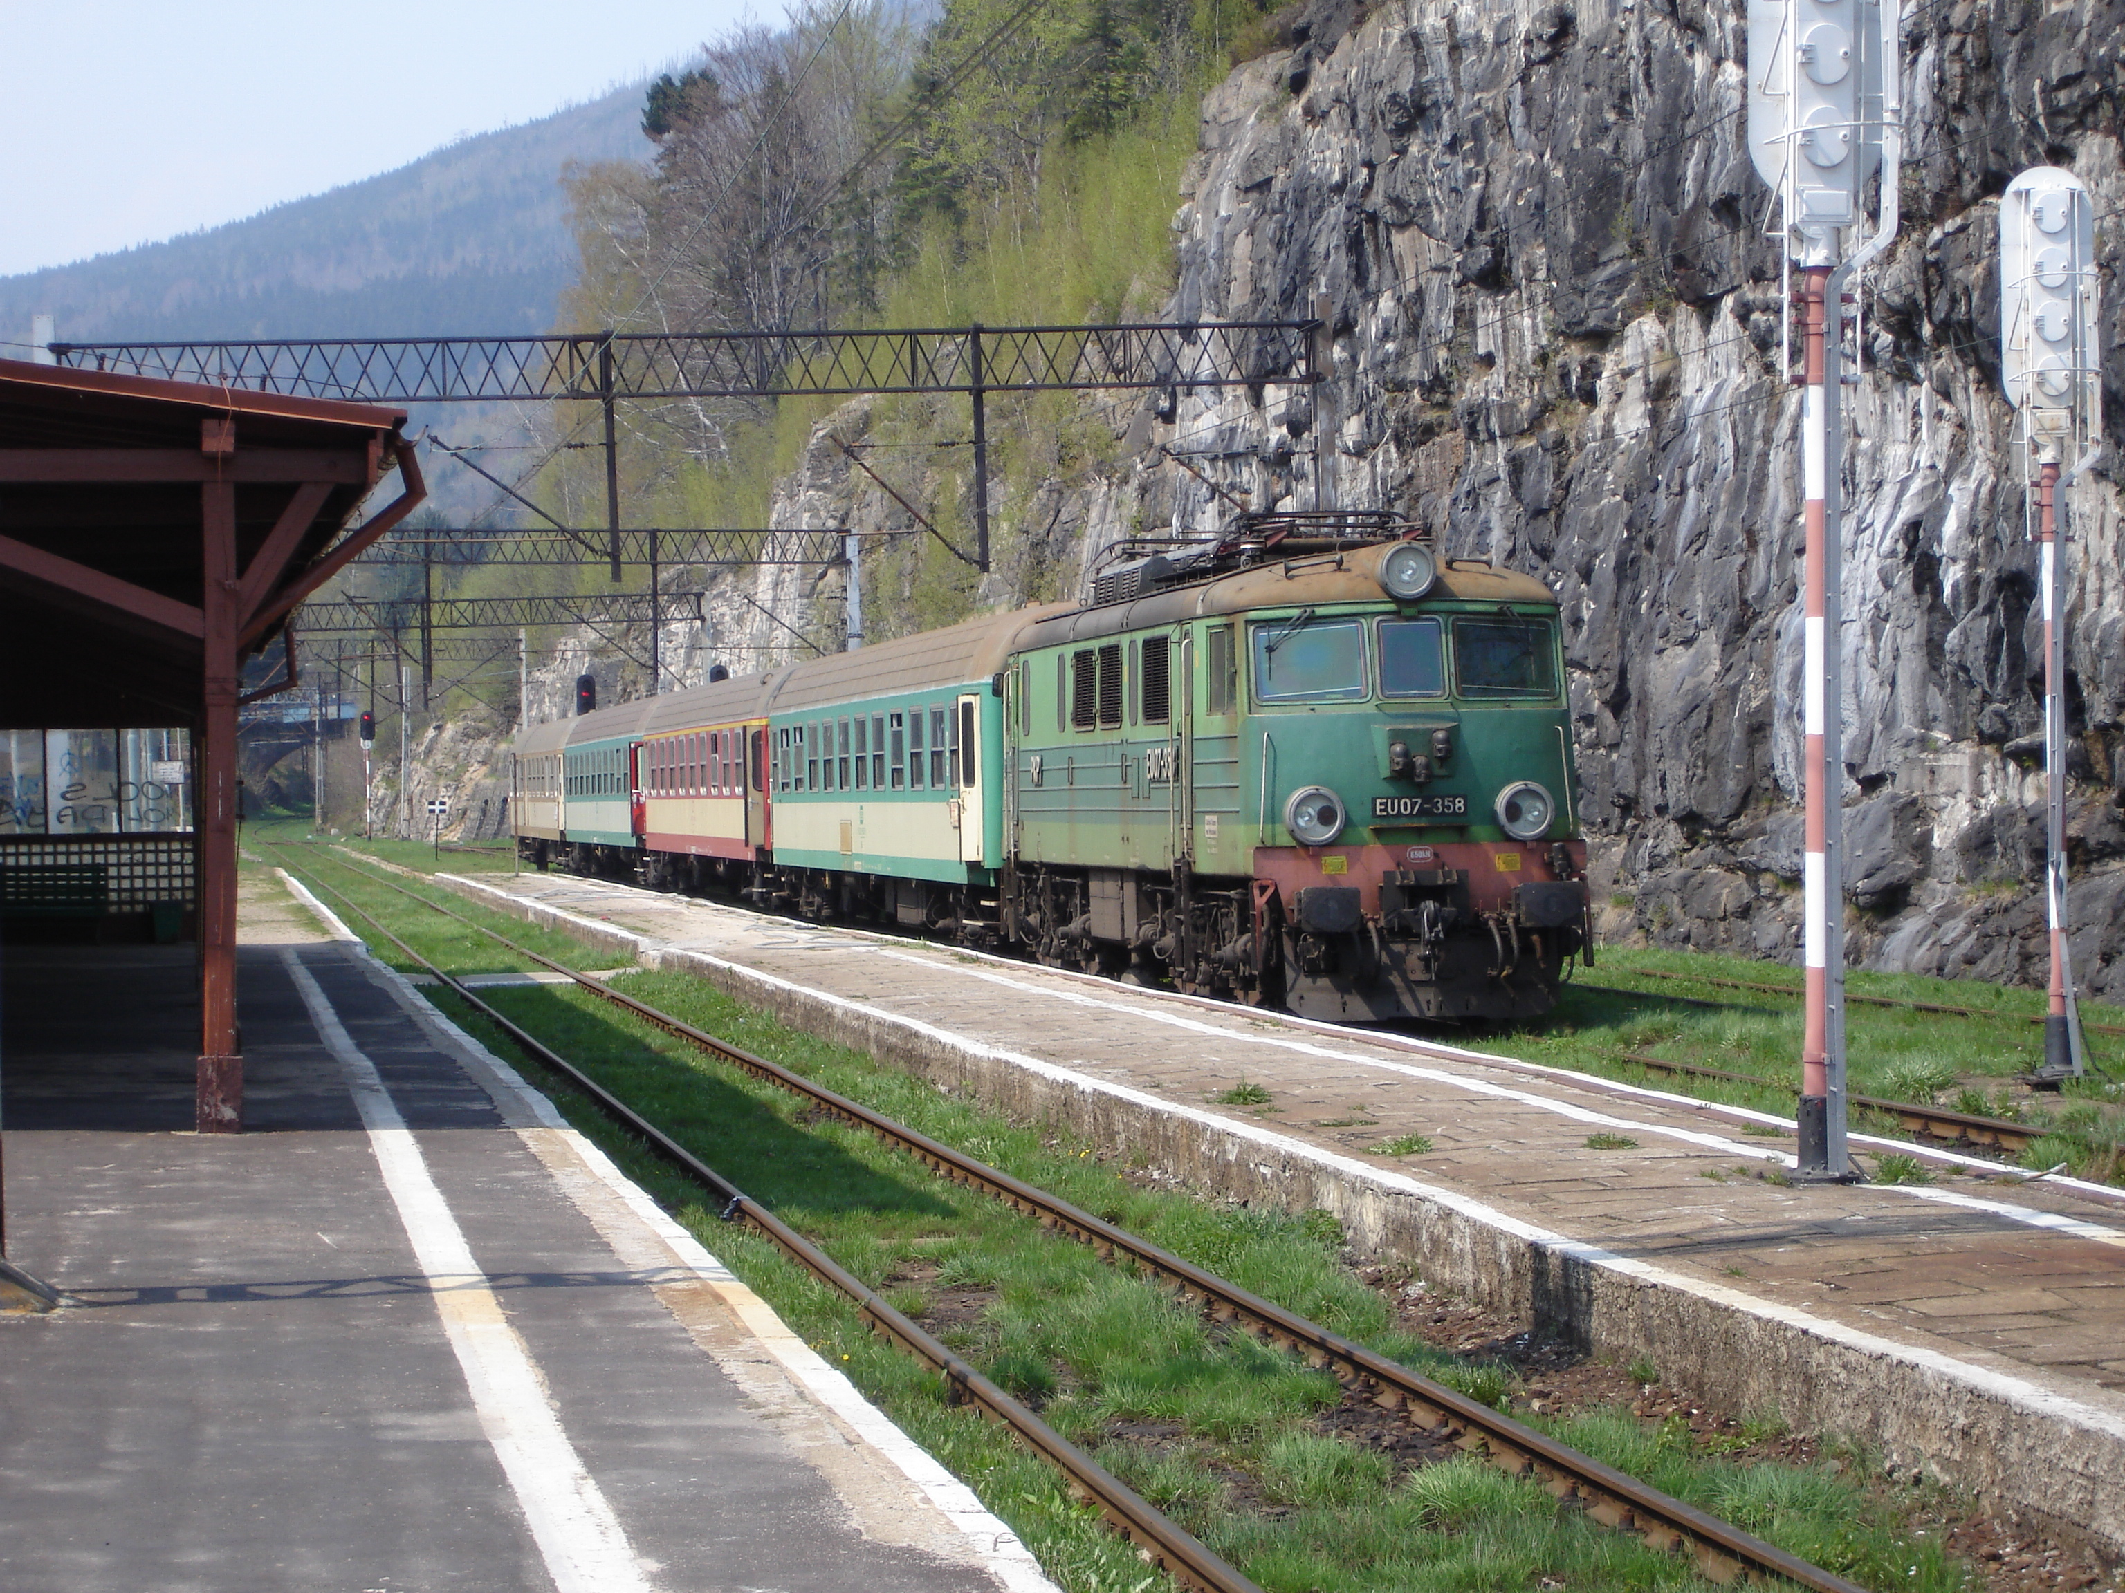
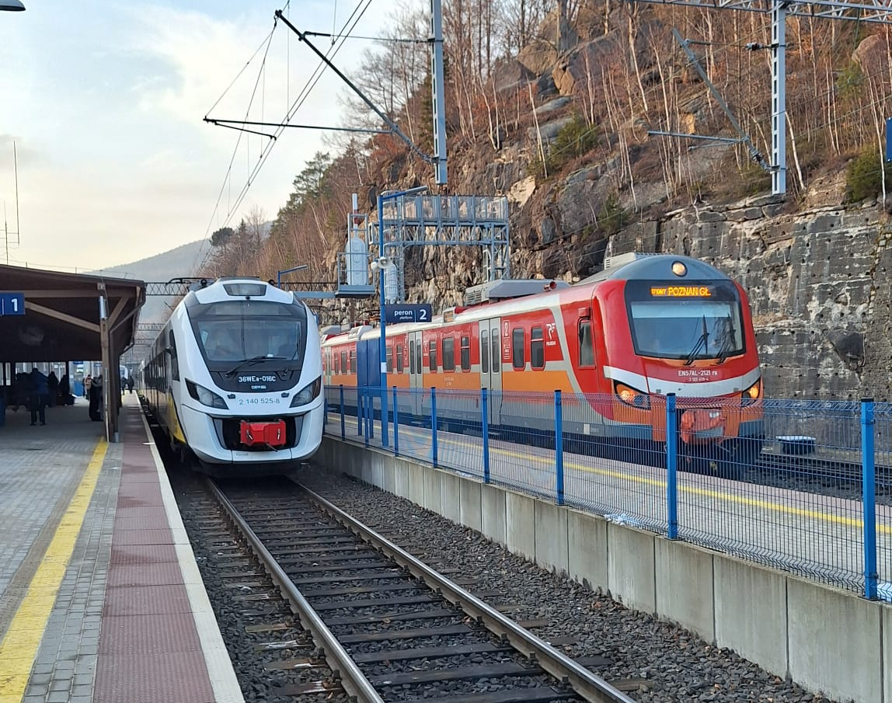
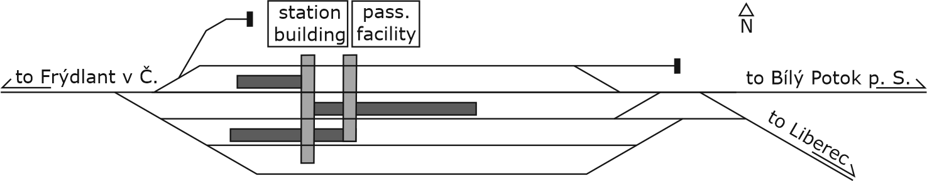
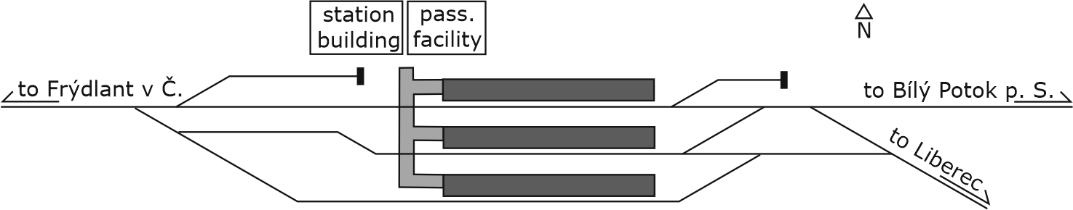
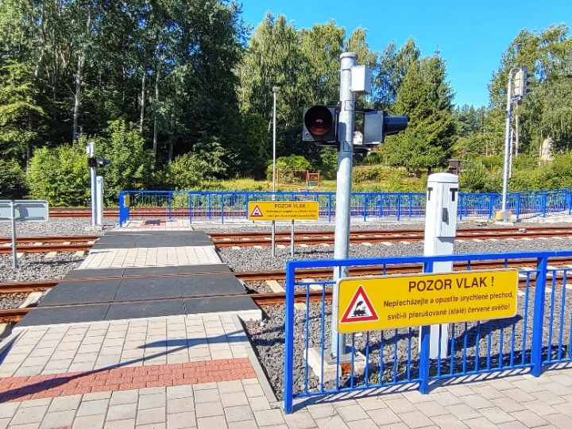
Development of barrier-free solutions for selected railway station platforms in Central European countries
TRANSCOM 2025: 16th International Scientific Conference on Sustainable, Modern and Safe Transport
Jiří Čížek¹, Martin Jacura¹
1 Czech Technical University in Prague, Czech Republic
Introduction
The development of accessibility in the railway environment is an important issue not only in Central Europe. Island platforms with level access allowed its extension to lines of regional importance. [1] | There is currently no decision-making tool to assist the infrastructure manager in planning modifications in the event of a choice between alternative solutions for the configuration of stations with platforms accessible via a crossing. | The aim is to map the current possibilities of this technical solution and to find optimization criteria according to which it will be possible to create a tool for the assessment of such railway stations. It is expected to be used by the infrastructure manager in the project preparation phase.
materials, methods & implementation
Railway stations using island platforms accessible by pedestrian crossing have recently been created during renovations across much of Europe. Czech legislation uses the term "peninsular platform" for this case. At the EU level, this issue is regulated by the Technical Specifications for Interoperability (TSIs), especially the TSI INF subsystem, which deal with line parameters [2], and the TSI PRM, which set out requirements for the movement of people in railway stations [3]. At the level of the Member States, legislation varies not only in content but also in form. [4] | This paper focuses on 5 examples of such stations in European countries: Selb-Plößberg (DE), Freistadt (AT), Raspenava (CZ); Szklarska Poręba Górna (PL); Pilicsaba (HU). These examples are used to describe the specifics of these solutions in terms of their impact on rail traffic and passenger movements.
results
The study of the selected stations showed several positive and negative experiences that are found across all the countries studied. The following specificities of the stations studied were described: The characteristics of the station in terms of position on the network Construction year of the current solution Dimension of platforms - width, height, length, accessibility to tracks Dimensions of access routes – ramp slopes, minimum width Use of the historic station building Platform passenger facilities - roofing, information system, lighting Security of passenger movement - warning devices, fencing | Fig. 1 (left). Station Szklarska Poręba Górna prior to modernization (source: [5]). Fig. 2 (right). The same station using barrier-free solution (source: Martin Jacura).
Fig. 3 & 4. Raspenava station scheme 2015 (above) & 2025 (below) (source: Authors) | Figures 1 and 2 show the main benefits but also the disadvantages of converting stations to a track-level passenger access solution. The safety of passenger movement has been improved. At the same time, however, passengers need to travel a much greater distance to reach more distant platforms, with the only crossing located behind the camera. Fenced platforms can also feel cramped. Figures 3 and 4 show the difference between the track layout with the original low platform solution and the new barrier-free solution. One through track has been completely removed and the track in front of the station building has been divided into two short fragments.
conclusion & implementation path
Several insights emerge from the research to date that will help the authors to establish some optimization criteria for the decision tool. The following areas need to be addressed: Minimizing walking distances and removing barriers, Adequacy and effectiveness of safety measures, Efficient use of space for railway structures including the involvement of historic heritage, Minimizing restrictions on train operations, Minimizing of investment costs. The authors acknowledge the difficulty of comparability of these aspects, and it will be necessary to appropriately set up metrics for evaluating such stations. It will then be possible to compile a database of the track configurations in use and assess their advantages and disadvantages. In the next phase, a tool will be developed to evaluate these configurations. Based on the input conditions it will be possible to assess the suitability of each configuration for specific situations. | Fig. 4. Example of possible safety measures (source: Jiří Čížek).
acknowledgements
[1] Jacura, M., Tyfa L., Hlubucek A., 2015. Poloostrovní nástupiště a jejich přínos pro osobní železniční dopravu. In: “Silnice-železnice”. KONSTRUKCE Media, s.r.o., Dec. 2015 [In Czech] [2] COMMISSION REGULATION (EU) No 1299/2014 of 18 November 2014 on the technical specifications for interoperability relating to the ‘infrastructure’ subsystem of the rail system in the European Union [2014a] OJ L 356 [3] COMMISSION REGULATION (EU) No 1300/2014 of 18 November 2014 on the technical specifications for interoperability relating to accessibility of the Union's rail system for persons with disabilities and persons with reduced mobility [2014b] OJ L 356 [4] Bazar J. 2021. Porovnání návrhových parametrů železničních stanic v ČR a zahraničí. [Master thesis, CTU in Prague] [In Czech] [5] By R.D. - Rolf-Dresden - Own work, CC BY 3.0, https://commons.wikimedia.org/w/index.php?curid=7537014

