Slide 1


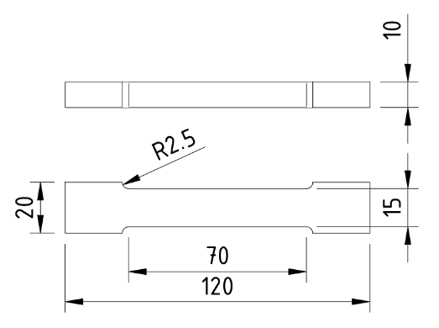
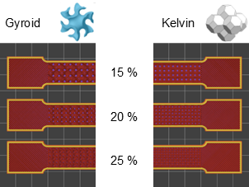
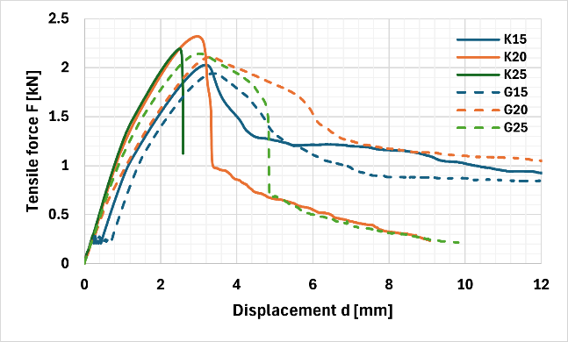
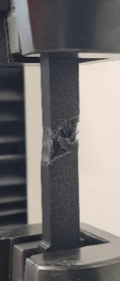
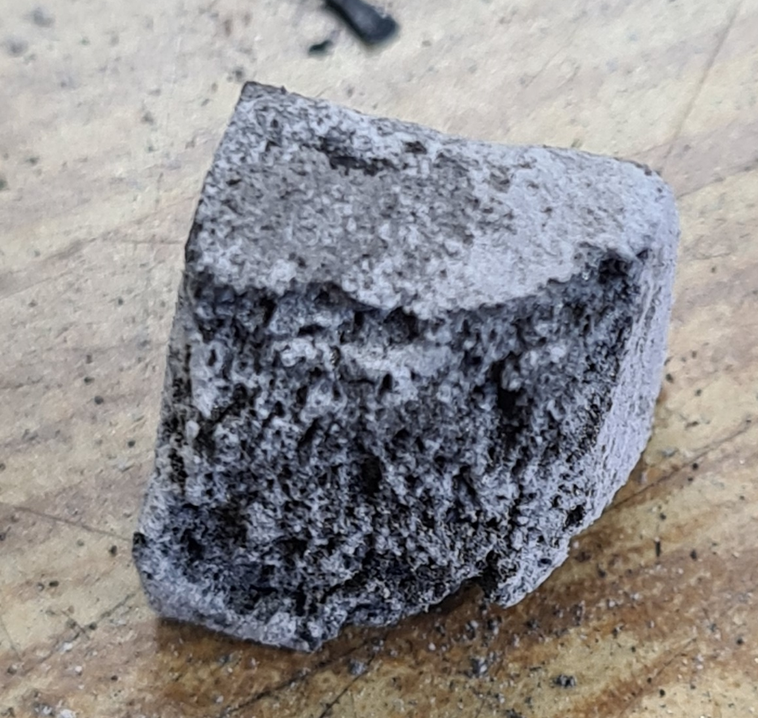
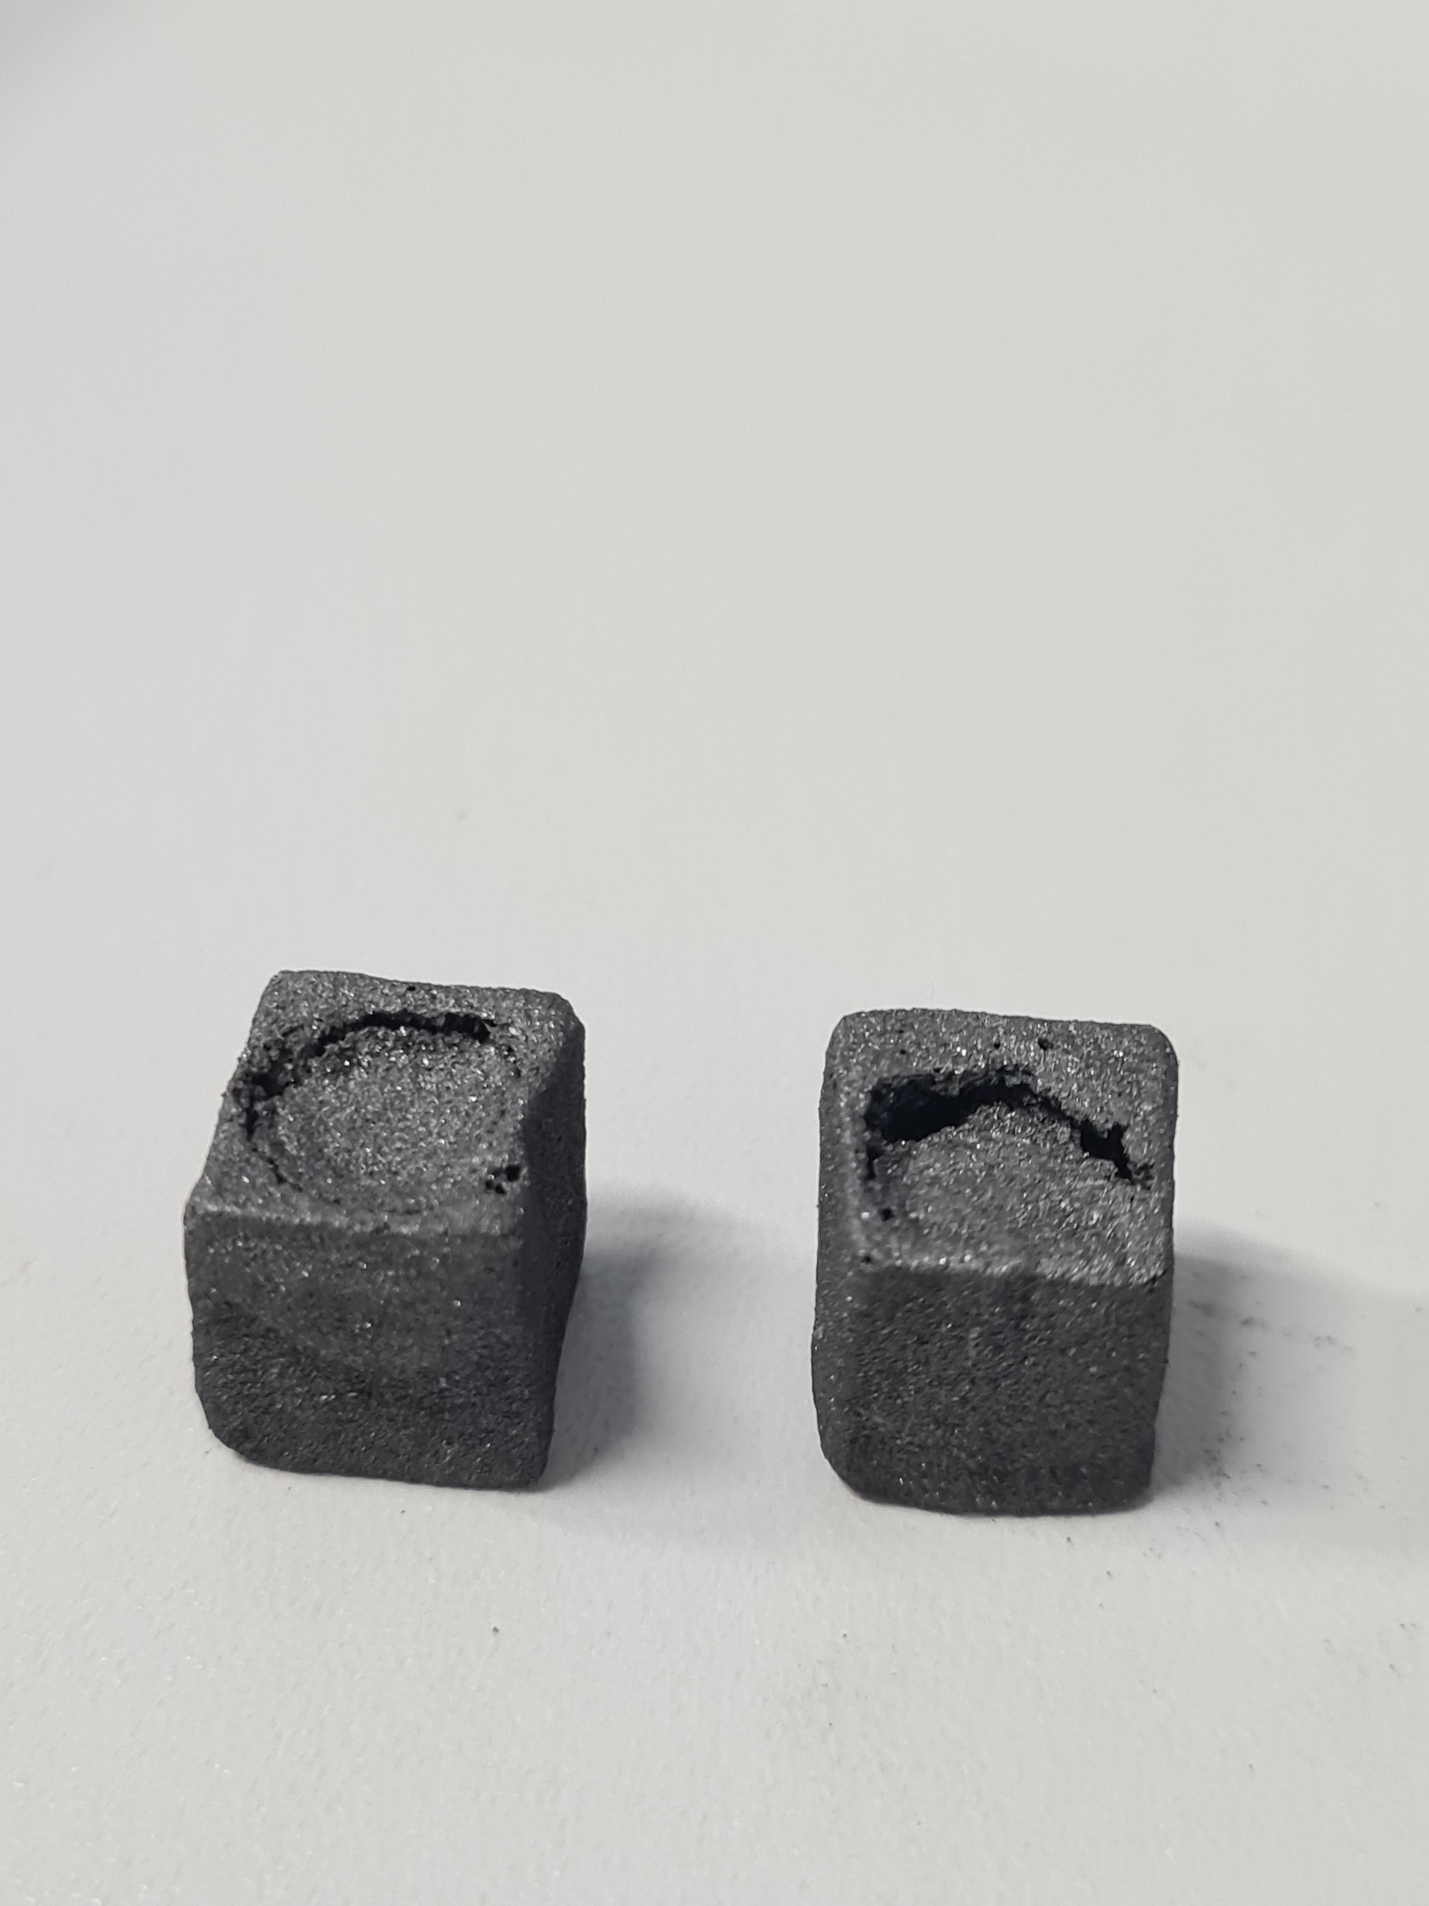
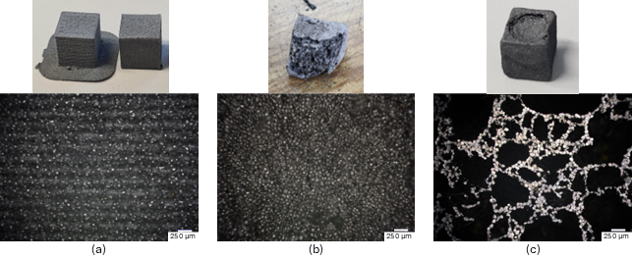
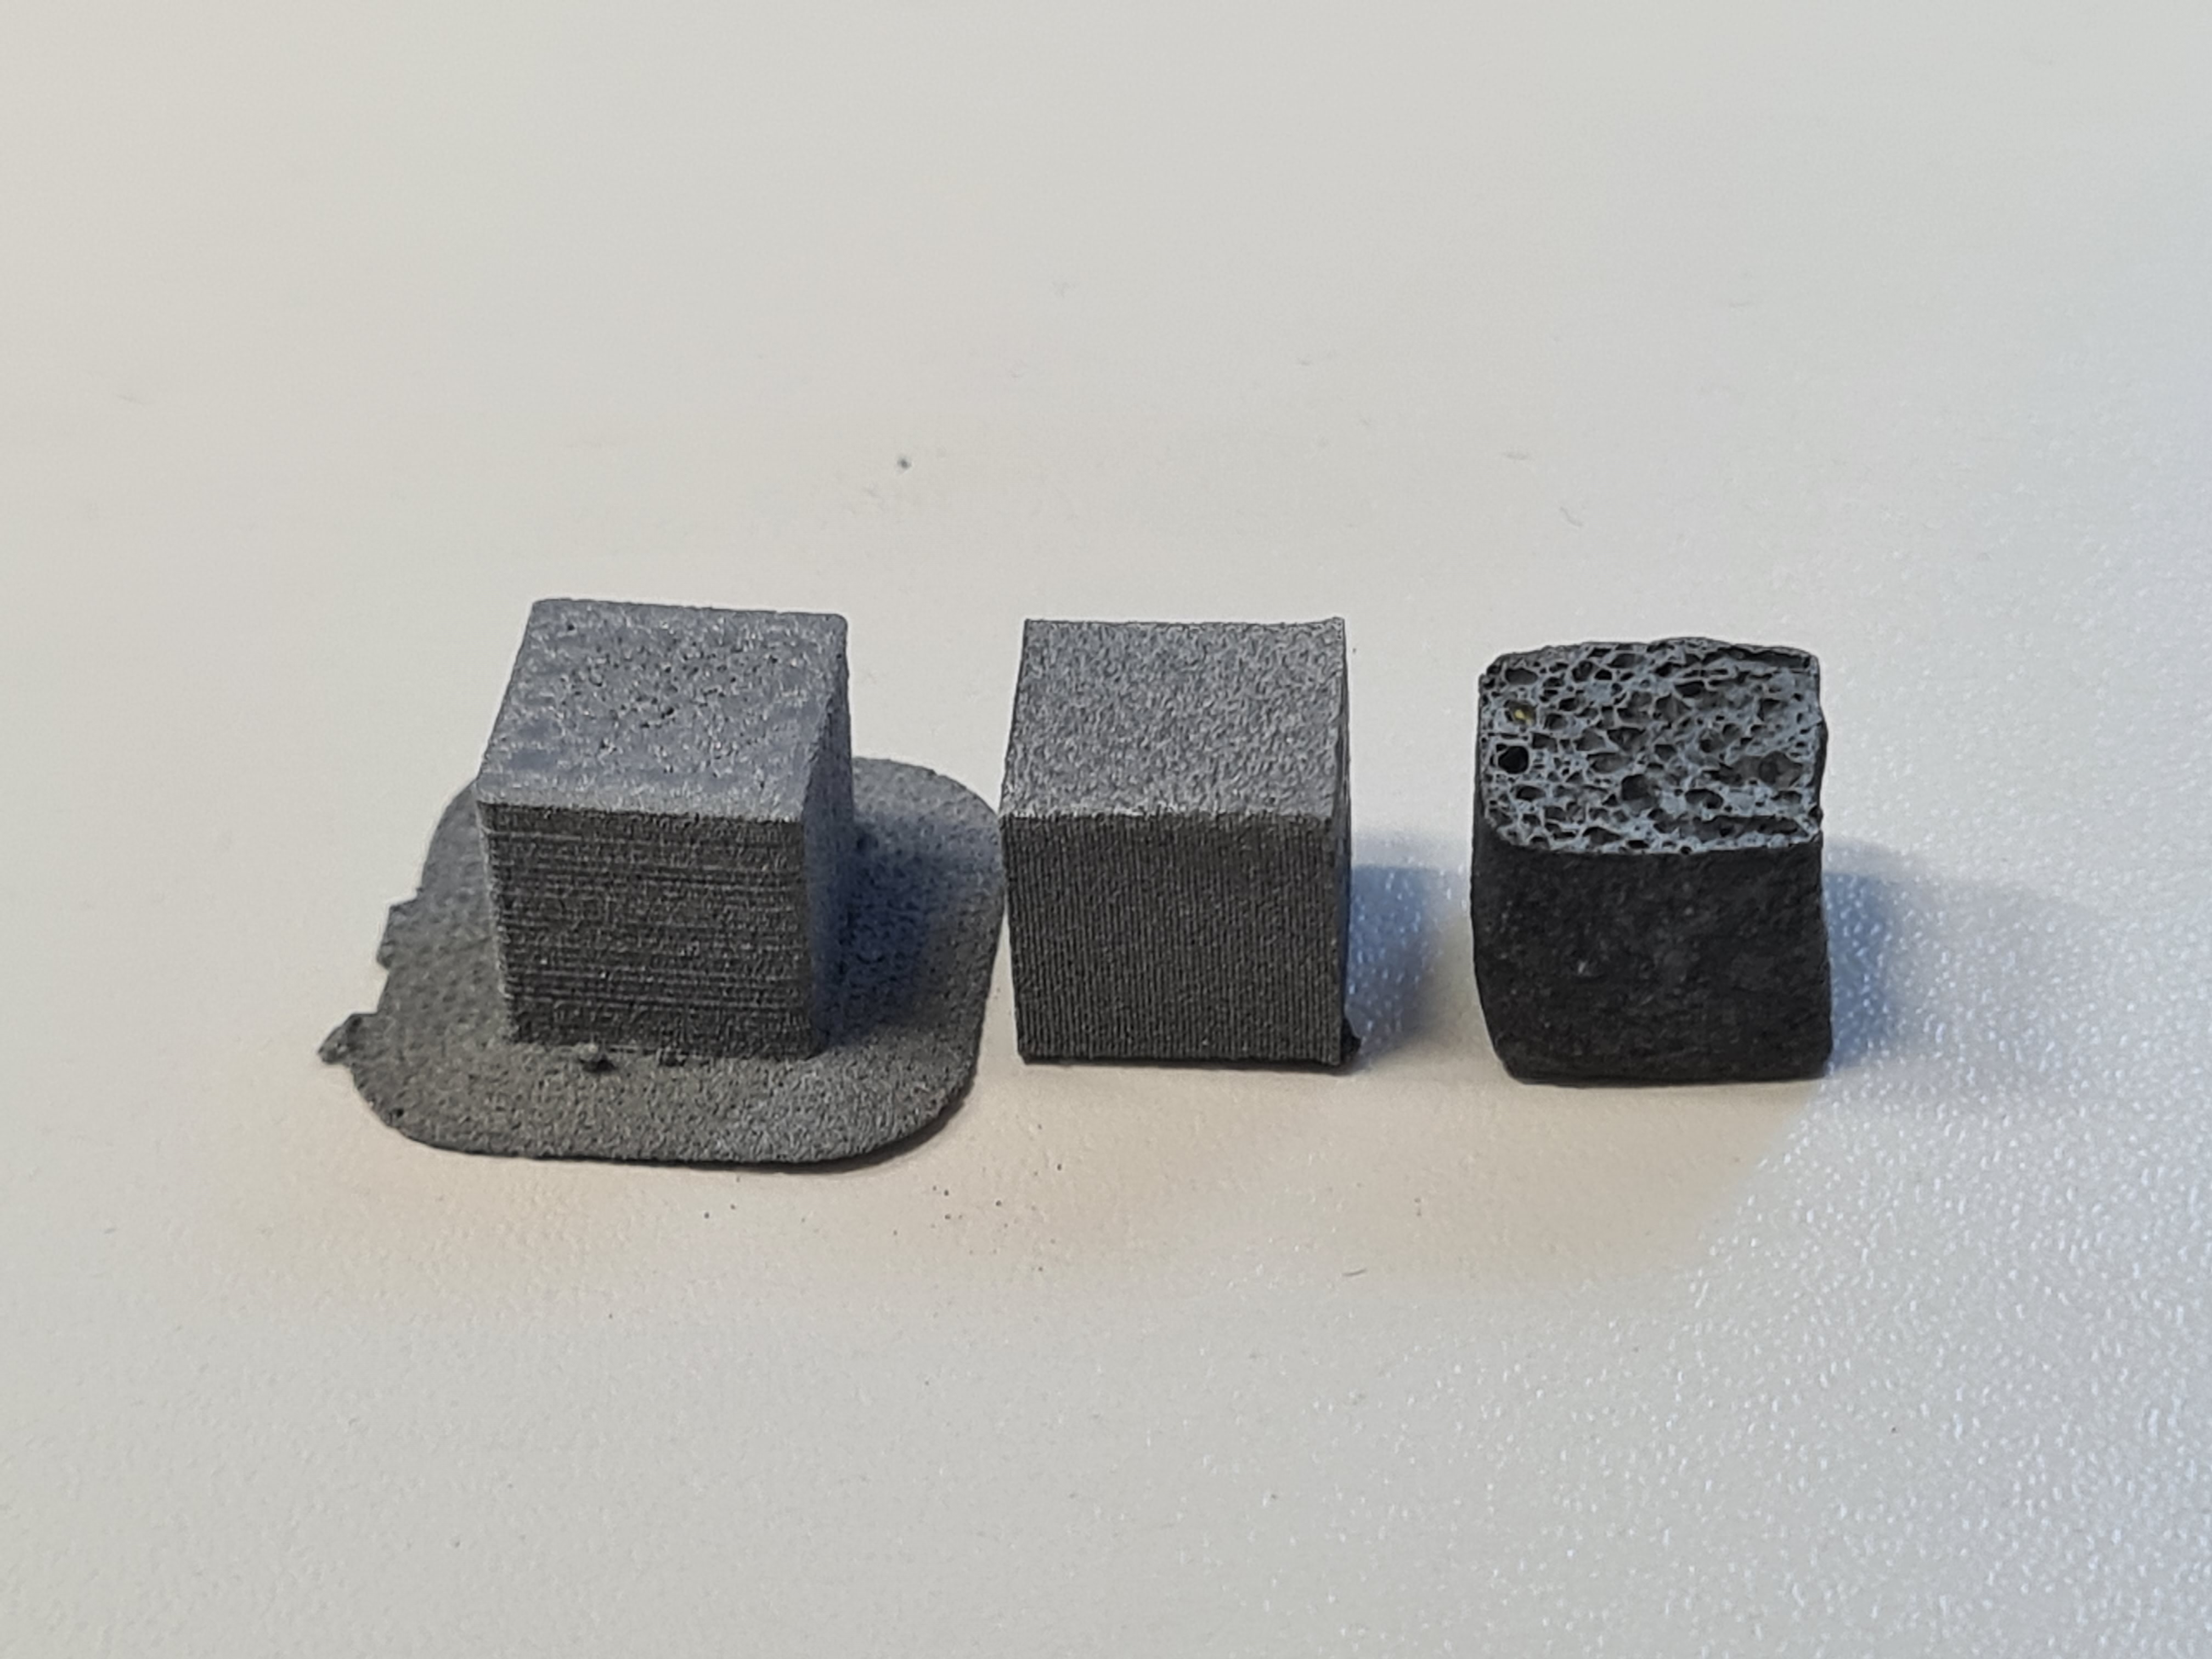
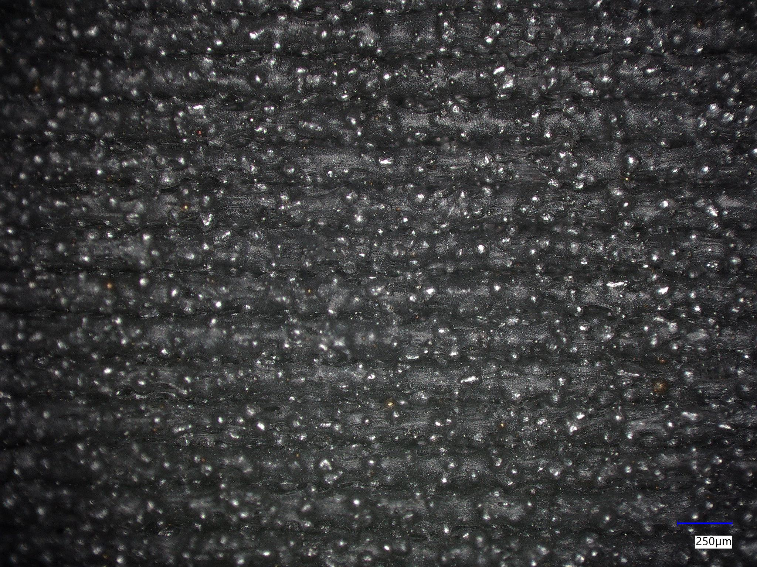
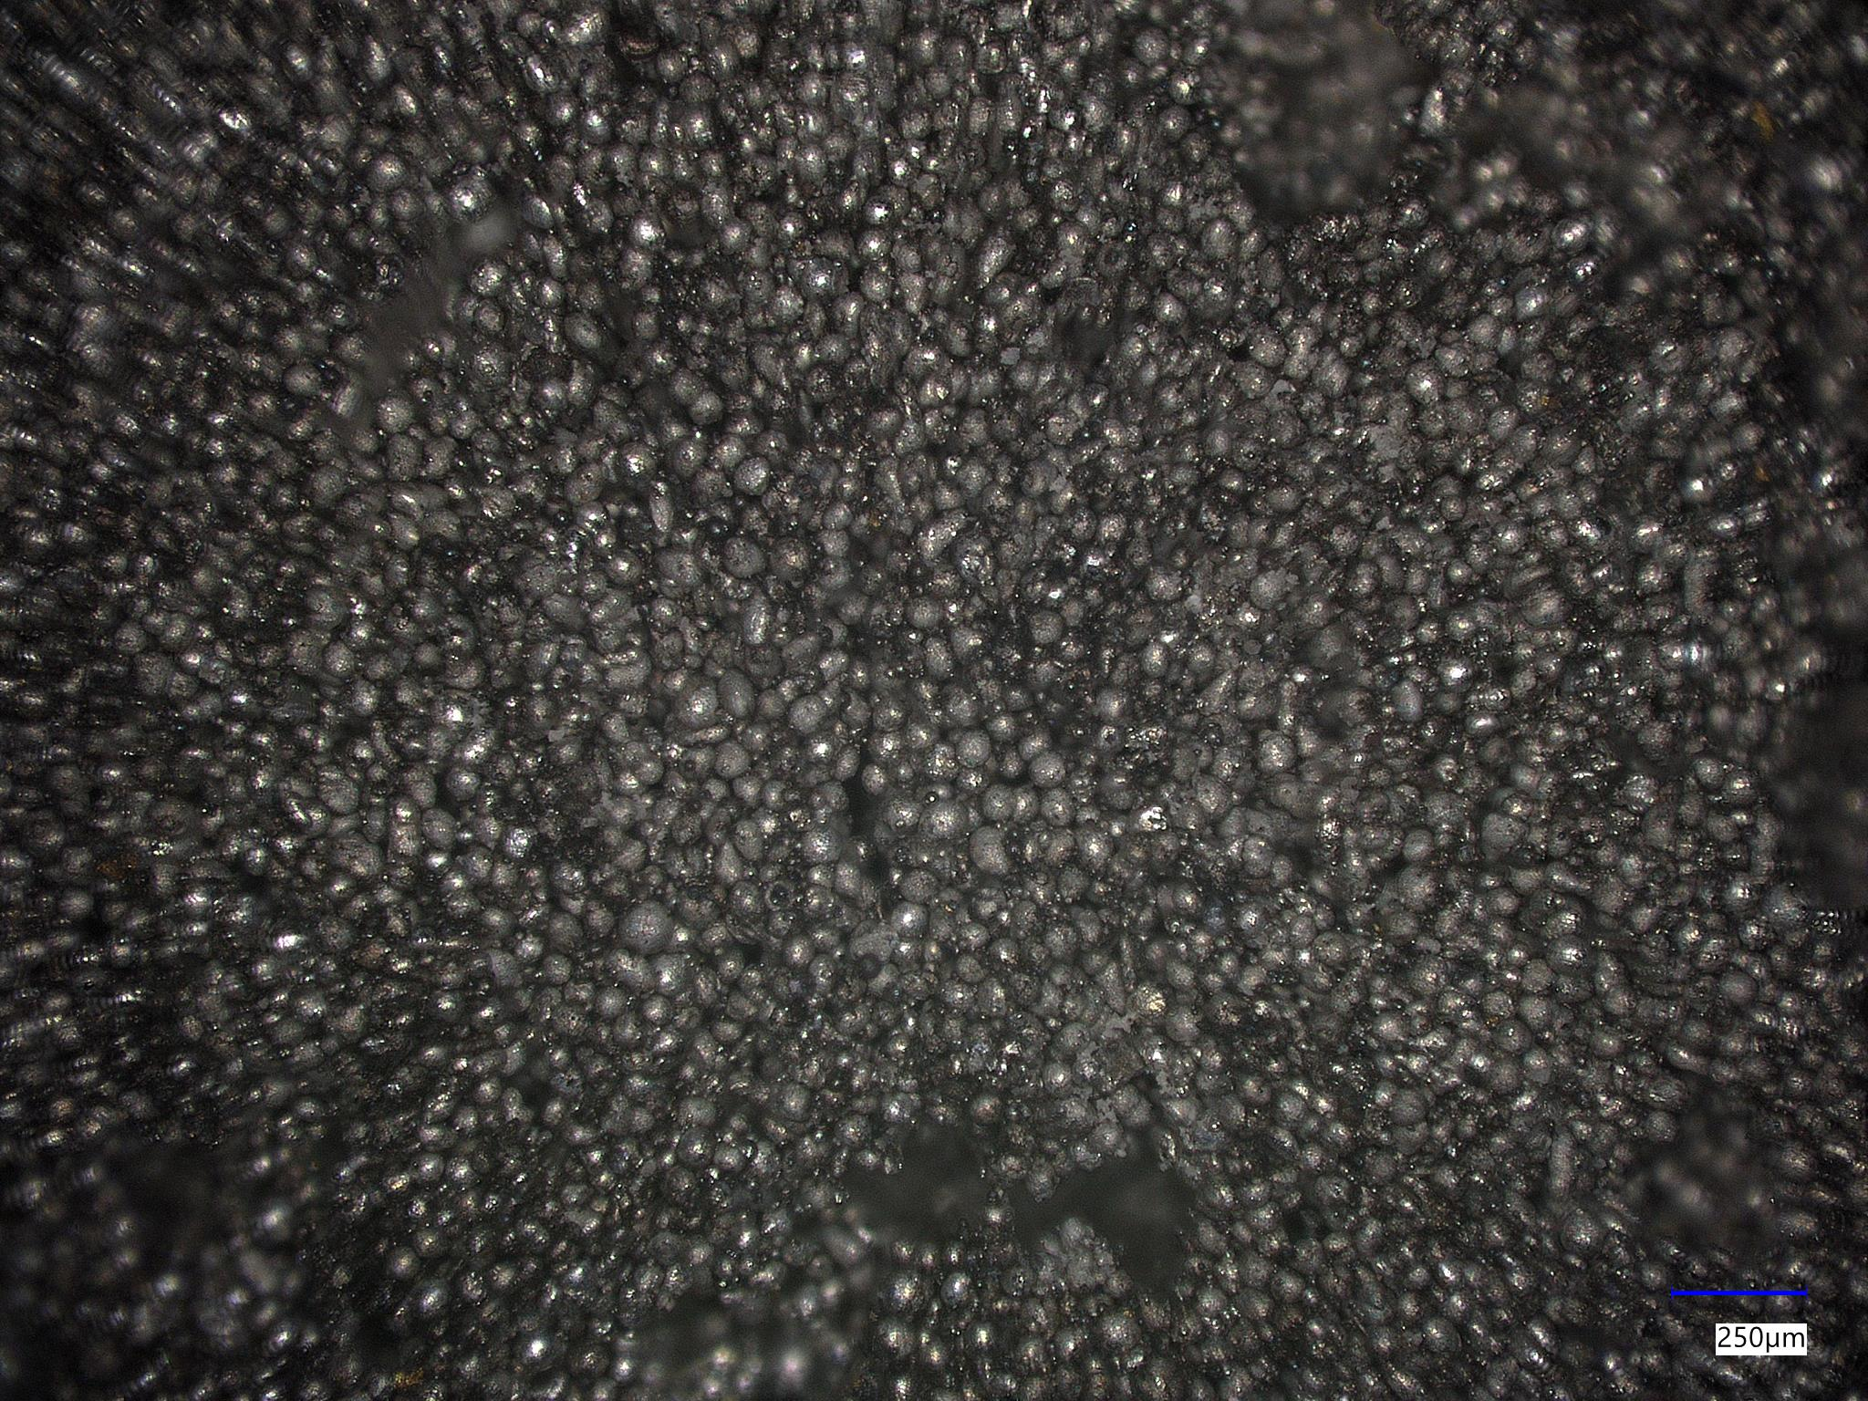
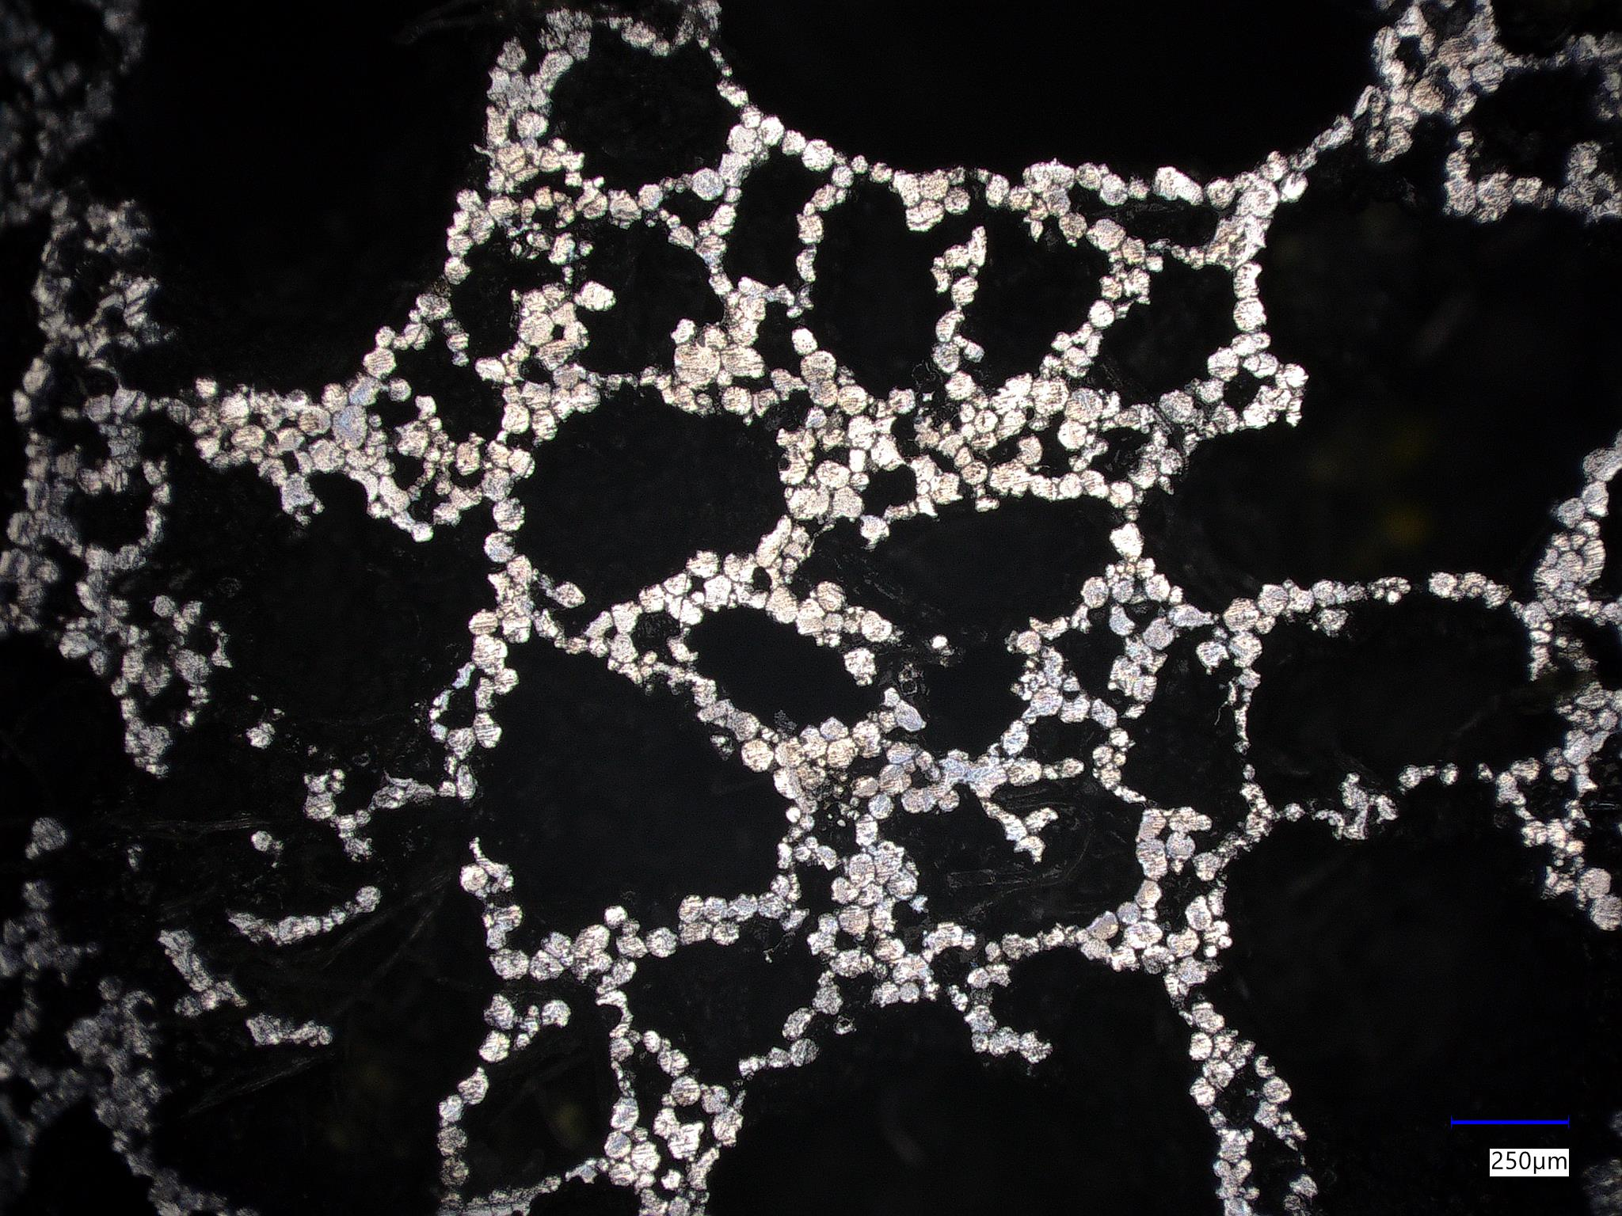
Additive manufacturing of cellular cores for overcasting technology
TRANSCOM 2025: 16th International Scientific Conference on Sustainable, Modern and Safe Transport
Martin Medňanský¹, Marek Brůna¹, Michal Kuriš², Peter Oslanec²
1 Univertity of Žilina, Žilina, Slovak Republic
2 Slovak Academy of Sciences, Žiar nad Hronom, Slovak Republic
Introduction
Backround information & Market Context In an effort to reduce car emissions, resulting in a reduced negative impact on the environment, car manufacturers are being forced to consider innovative ways to reduce the weight of functional body parts and other components. One of these is the overcasting, through which hybrid castings can be created. Hybrid aluminum castings with overcasted porous aluminum cores with lower relative density are proposed in order to achieve improved mechanical properties. | Problem Statement & Stakeholders The most widely adopted AM technology in general, Fused Filament Fabrication (FFF) can be used for metal parts fabrication using highly filled filaments. It promises high cost effectivity with lower initial investments. Highly filled (HF) filaments contain high volume percentage of metal particles (i.e. Aluminium alloy) in polylactic acid (PLA) matrix in the shape of a spooled wire. The 3D-printed part has the polymer binder removed by debinding and sintering process, where the material gains its final mechanical properties. The optimal sintering regime for AL-PLA HF filament is not sufficiently researched. | Research Objectives & Expected Impact - Evaluation of the influence of the infill shape on the resulting tensile strength of polylactic acid preliminary specimens. - Sintering green parts using varying sintering regimes utilizing resistance furnace and inductor. - Microscopic observation of the sintered specimen. Impact – results of much needed research of the sintering regimes for AL-PLA HF filament.
Materials, Methods & Implementation
PLA tensile testing Comparison of Kelvin and Gyroid structures with varying infill (15, 20, 25%, points of contact with tensile testing device: constant 90% linear infill). Specimens were 3D printed using Prusa MK3S+, the uniaxial tensile test was performed at 2 mm.s⁻¹ rate. | 2) AL-PLA HF filament part sintering and observation No attempt to replicate the geometry for tensile testing due to manufacturer‘s limitation of min. 1.8 mm wall thickness. Specimen geometry was 10x10x10 mm cubes. Modified Prusa MK3S+ with hardened steel 0.6 mm nozzle was used. Experimental sintering variants are summarized in the table. Microscopic observation was carried out on Keyence VHX-7000 + VH-Z100 zoom lens.
Sintering parameter | Variant 1 | Variant 2 | Variant 3 („Blast“)
Ballast material | Remasil 48 (Al₂O₃ + SiO₂) | Powdered Graphite | Powdered Graphite
Ballast coverage | 10 g black coal | - | -
Sintering time and temperature | 45 min @ 450 °C then 1.5 hr @ 620 °C | 45 min @ 450 °C then 2 hr @ 620 °C | 2.5 min @ max. inductor power
Results
1) PLA tensile testing: There was no absolute rupture of the material for specimens G15, K15,G20. After elongation >10 mm, the applied force is transmitted primarily through the perimeters, not through the internal structure. G20: sudden drop in applied force @ 3,25 mm elongation. K20: highest transferred force. K25: lowest toughness. | 2) AL-PLA HF filament part sintering and observation: Variant 1: No sintered sample was obtained using V1 mode. It is assumed that the PLA matrix was burnt out without sufficient heating to bind the metal particles. Pre-sintering: Aluminum particles can be observed dispersed in the PLA binder. Variant 2 regime: close to no mechanical properties. Fig: spherical particles of Al powder without interlocking or binding. Variant 3 regime: short and intense high heating temperature melted the oxide layer of Al₂O₃ on the particle surface and the desired interlocking of the particles occurred.
Conclusion & Implementation path
This paper was focused on bringing an attention to potentially cost-effective technology able to create complex aluminum alloy parts, suitable for proposed overcasting technology. Results of the preliminary tensile testing of the PLA specimen with varying cellular infill showed that the chosen structure affects the final tensile characteristics. Tighter closed cell Kelvin structure at 25 % relative density was shown to be able to transfer relatively high forces but provides the least elongation. Relative density of Gyroid variant does not seem to affect the resulting maximal tensile force. Regarding the insufficient knowledgebase of the sintering regimes of high filled AL-PLA filament, experimental regimes were conducted, and the promising results were achieved by utilizing V3 sintering variant using electric induction furnace, labeled “blast sintering” by the authors. There is still much room for improvement of the debinding and sintering system – a furnace with controlled temperature and/or inert atmosphere can be utilized in the future experiments.
Acknowledgements
The article was created as part of the grant agency project: KEGA 029ŽU-4/2023. The authors thank the agency for the support.

