Slide 1


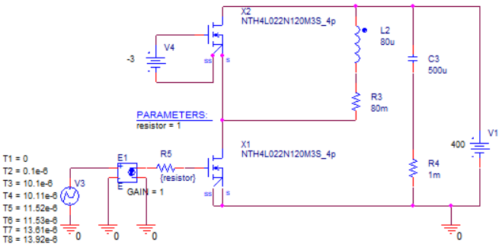
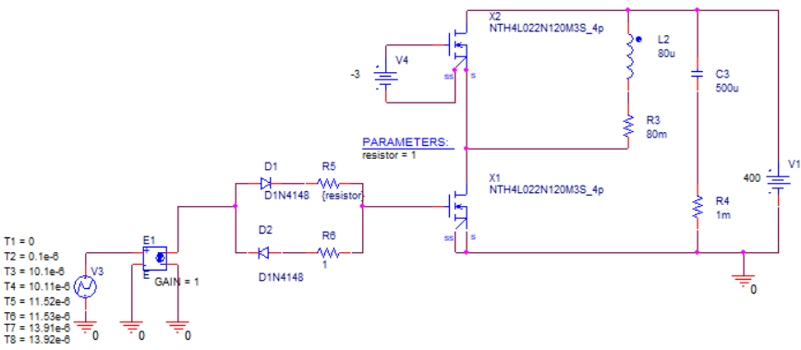
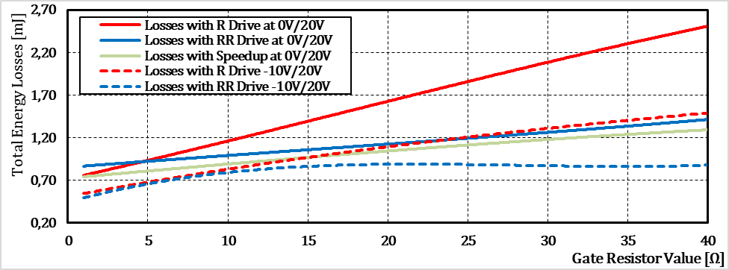
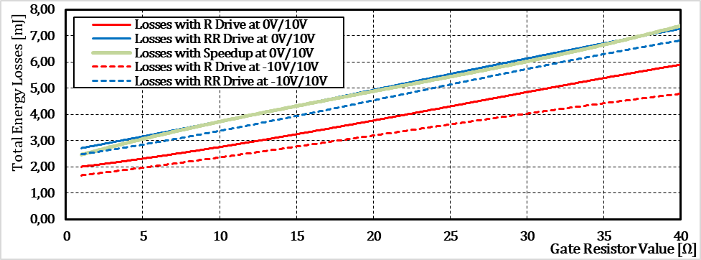
A Comparison of Switching Conditions in SiC MOSFET Driving
TRANSCOM 2025: 16th International Scientific Conference on Sustainable, Modern and Safe Transport
Veronika Švárna¹, Michal Frivaldský¹
1 University of Žilina, Žilina, Slovakia
introduction
SiC MOSFETs offer high efficiency and fast switching, making them vital for modern power electronics. Optimizing their gate drive is essential to reduce energy losses in key applications like electric vehicles and renewables. | The study addresses switching loss reduction in SiC MOSFETs through optimal gate drive design. Stakeholders include engineers and industries focused on efficient power systems. The findings aim to enhance performance, reliability, and energy efficiency in advanced electronic applications. | The objective is to evaluate how different gate driver configurations affect switching losses in SiC MOSFETs using simulation. The expected impact is improved efficiency and thermal performance in power electronic systems, benefiting applications like EVs, renewable energy, and industrial converters.
materials, methods & implementation
Simulation analysis was performed in Cadence OrCAD 17.2 using a modified double pulse test (DPT) to assess switching losses in the SiC MOSFET NTH4L022N120M3S. Three gate driver configurations were compared: Single resistor, Separate turn-on and turn-off resistors, Speed-up element using a PNP transistor Gate voltages varied across positive levels (10V and 20V) and negative levels (0V, -5V, -10V). Gate resistor values ranged from 1Ω to 40Ω to evaluate their effect on energy loss. The setup enabled detailed assessment of switching behavior across different driver configurations and voltage conditions.
Fig. 1 Schematic of the double pulse test with NTH4L022N120M3S and single resistor gate drive
Fig. 2 Schematic of the double pulse test with NTH4L022N120M3S and double resistor gate drive
Fig. 3 Schematic of the double pulse test with NTH4L022N120M3S and the speed-up element
results
Independent control of turn-on and turn-off resistors significantly improved switching efficiency and stability. The two-resistor configuration with a -10V/20V gate drive consistently produced the lowest total energy loss, making it well-suited for high-frequency applications. The speed-up configuration introduced higher switching losses and added design complexity. Lowering the positive gate voltage from 20V to 10V notably increased switching losses, especially in the speed-up configuration. The use of detailed SPICE-based simulations ensured a high level of accuracy, control, and reproducibility. Results emphasize the need for customized gate driver designs tailored to the electrical behavior of SiC MOSFETs.
Fig. 4 The graph of total energy loss for different driver setup within the driver voltage ranges up to 20V
Fig. 5 The graph of total energy loss for different driver setup within the driver voltage ranges up to 20V
conclusion & implementation path
Based on the presented results and graphs the most suitable configuration for controlling the selected MOSFET transistor NTH4L022N120M3S is the one with two resistors using a driving voltage range from -10V to 20V. In contrast, the worst results were achieved by the configuration with the speed-up transistor in both simulated driving voltage ranges. In general, using positive voltages lower than 13V is not recommended for controlling silicon carbide-based MOSFET transistors. This is due to the physical properties of their structure. This behavior was observed in the high losses associated with the driving voltage ranges of -10V/10V, -5V/10V, and 0V/10V, as shown in the tables and graphs. Such control introduces the risk of thermal runaway due to high losses and a significant risk of false turn-on, caused by slower turn-off and the oscillatory voltage waveform during the turn-off process.
acknowledgements
The authors would like to thank for the project funding APVV – 20 – 0500 and for the project funding Vega 1/0274/24.

