Slide 1


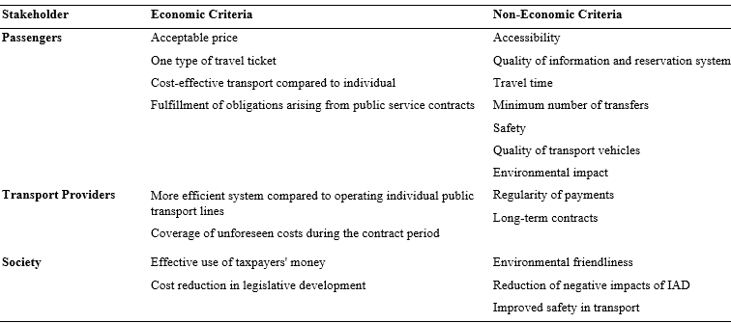
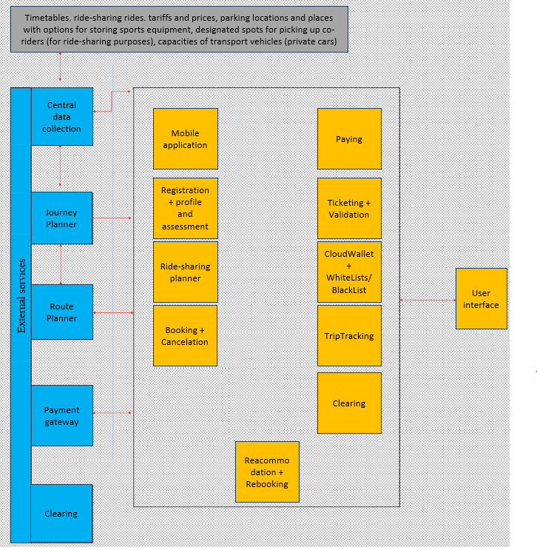
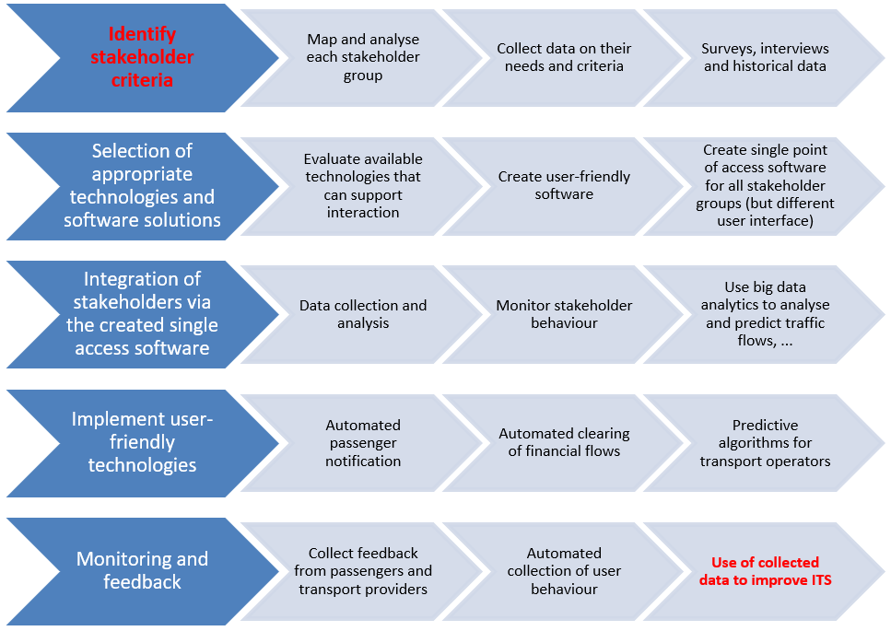
Innovative Integrated Transport Systems: Digital Solutions for Stakeholder Collaboration and Sustainability
TRANSCOM 2025: 16th International Scientific Conference on Sustainable, Modern and Safe Transport
Adriana Pálková¹, Zdenka Bulková¹, Jozef Gašparík¹, Juraj Čamaj¹
1 University of Žilina, Univerzitná 8215/1, 01026 Žilina, Slovakia
introduction
Integrated Transport Systems (ITS) aim to unify various transport modes and operators into a coordinated structure to enhance efficiency and service quality. With rising mobility demands and smart city initiatives, digital tools play a key role in improving planning, resource allocation, and passenger experience. However, many regions still lack fully integrated and user-centric ITS solutions. | Current ITS often suffer from fragmented data and limited stakeholder cooperation. Transport providers, local authorities, planners, and users operate independently, which reduces system efficiency and user trust. A major gap remains in digital platforms that connect all actors for better coordination and real-time decision-making. | This study proposes a digital collaboration framework for ITS stakeholders. Its goal is to improve information exchange, planning, and service delivery through an integrated platform. The solution supports more efficient operations, data-driven decision-making, and higher user satisfaction, contributing to the sustainability and effectiveness of urban transport systems.
materials, methods & implementation
For an ITS to be successful, the elements must be integrated throughout the ITS. A properly designed and implemented ITS, which meets the requirements of passengers and service providers and facilitates their needs, can significantly enhance connectivity and improve the quality and safety of transport across the region. Within stakeholders’ requirements, specific economic and non-economic evaluation criteria are established for each stakeholder. Without adhering to these criteria, it is impossible to create a functional ITS within a given area. Table 1 shows the criteria of ITS stakeholders.
results
To get the best possible interaction, it is necessary to ensure the collection and analysis of data from all stakeholders and thus ensure the necessary interaction. Figure 1 shows the proposed software solution. The central part contains internal services, while services highlighted in blue are called from external environments. The proposed system includes a variety of software components that enable the collection of data on the behavior of individual stakeholders. By integrating modern technologies into data processing, it allows for continuous improvement of ITS. To achieve full collaboration, this proposal will use the data processing approach shown in Figure 2.
Fig. 1. Proposed software solution for Stakeholders collaboration. Fig. 2. Outlined methodology for ITS stakeholder’s integration
conclusion & implementation path
This study presents an outline of a methodology that uses modern technologies and software solutions to meet the criteria of all stakeholders and ensure their interaction. The identification of stakeholder needs, the selection of appropriate technologies, the implementation of automated processes and the continuous monitoring of the system form the basis for building a successful ITS. These tools allow not only the collection and analysis of huge amounts of data, but also the continuous improvement of the system based on feedback from all stakeholders. The proposed methodology provides a practical framework for ITS implementation that can serve as a basis for further research and applications in this area. As technology advances, new opportunities will emerge that need to be exploited to improve mobility, enhance quality of life and promote sustainability in transport.
acknowledgements
Funded by the EU NextGenerationEU throught the Recovery and Resilience Plan for Slovakia under the project No. 09I01-03-V04-00055. The paper is supported by the VEGA Agency by Project 1/0640/23 "Elements of quality in competitive public tendering in railway passenger transport", that is solved at the Faculty of Operations and Economics of Transport and Communication, University of Žilina.

