Slide 1


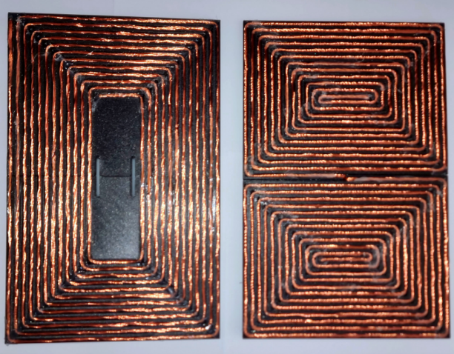
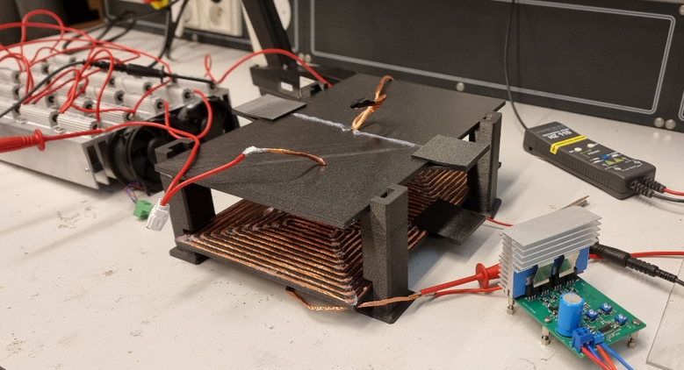
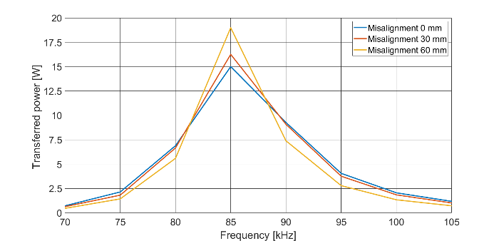
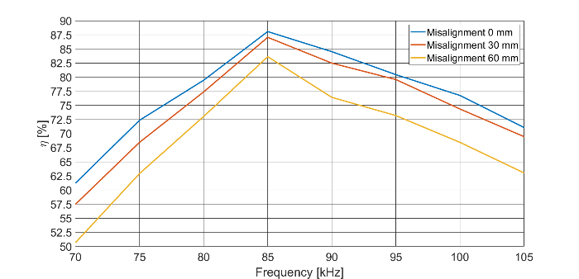
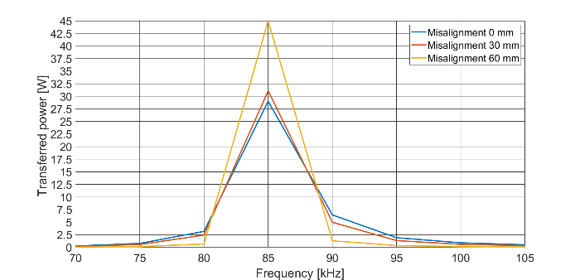
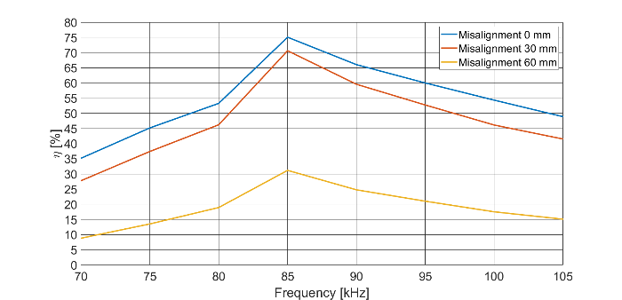
Experimental evaluation of the influence of coupling coils geometry on transmitting performance of wireless power transfer system (WPT)
TRANSCOM 2025: 16th International Scientific Conference on Sustainable, Modern and Safe Transport
Jakub Škorvaga, Michal Frivaldský, Patrik Resutík
University of Zilina, Univerzitna 8215/1, 010 26 Zilina, Slovak republic
introduction
Wireless charging is rapidly replacing cable-based stations in e-mobility and gaining interest in smart city infrastructures due to its advantages like autonomous operation and tolerance to misalignment. | Wireless power transfer faces challenges in dynamic and semi-dynamic charging, particularly with misalignment caused by vehicle movement. This paper explores coil selection to address these issues. | This paper compares flat rectangular and DD coil designs to assess their efficiency and suitability, contributing to the scalability of wireless charging for high-performance applications.
materials, methods & implementation
Coupling coils made from high-frequency wires with 300 strands per winding. Physical coil matrices designed in Fusion 360 and created using 3D printing. Rectangular and DD coils share identical geometry and winding specs. Self and mutual inductance measured using a digital RCL meter at 100 kHz. Coil alignments tested at 0 mm, 30 mm, and 60 mm, alongside compensating capacitors. Voltage adjusted for power transfer experiments within 70 kHz to 105 kHz. Mutual inductance and coupling coefficients assessed under varying alignments. Fig. 1. Experimental models of the coils Transmitted power compared between DD and rectangular coils. Testing involved a 6 V DC input voltage and a 10 Ω resistor as load. Coil spacing maintained at 65 mm. Performance differences analyzed for aligned and offset systems. Fig. 2. Measurement setup
results
Self and Mutual Inductance Measurements Self-Inductance: The self-inductance was higher for the rectangular coil (28.924 μH) compared to the DD coil (24.24 μH). Mutual Inductance: Rectangular coils maintained higher mutual inductance values compared to DD coils across all alignments (0 mm, 30 mm, 60 mm). For example: At 0 mm alignment: 7.777 μH (rectangular) vs. 4.308 μH (DD). At 60 mm misalignment: 6.397 μH (rectangular) vs. 1.733 μH (DD). Power Transfer Characteristics Aligned Coils: DD coil achieved a higher maximum power transfer (29 W) compared to the rectangular coil (15 W). Misaligned Coils: At 30 mm offset: DD coil transferred 31.1 W, while the rectangular coil transferred 16.2 W. At 60 mm offset: DD coil transferred 45 W, while the rectangular coil transferred 18.9 W. Efficiency Analysis The rectangular coil displayed higher efficiency across all misalignments, exceeding 80% at perfect alignment. Efficiency remained stable even under significant misalignment. The DD coil, while superior in power transfer, showed a marked efficiency drop at larger misalignments (e.g., <35% at 60 mm).
Fig 3. Experimentally obtained power frequency characteristics (left) Fig. 4 Experimentally obtained power frequency characteristics (left) and efficiency characteristics (right) of the system with rectangular coil and efficiency characteritics (right) of the system with DD coil
conclusion & implementation path
This study explored the performance of DD coils and rectangular coils in wireless power transfer systems, focusing on their efficiency under varying misalignments. Despite both coil types having identical dimensions and winding specifications, experimental findings revealed distinct differences. Rectangular coils exhibited more stable mutual inductance and higher efficiency levels, particularly under misaligned conditions. Conversely, DD coils demonstrated superior power transfer capability, especially at resonant frequencies, but at the cost of lower efficiency during significant misalignment. These insights highlight the need for precise coil design tailored to specific operational parameters and application requirements.
acknowledgements
The authors would like to thank to national grant agency APVV for project funding APVV-21-0462 and to national grant agency VEGA for project funding 1/0274/24.

