Slide 1


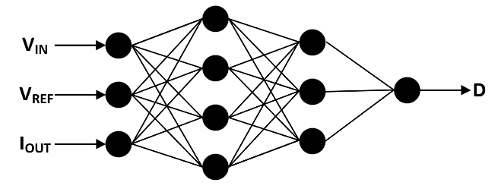
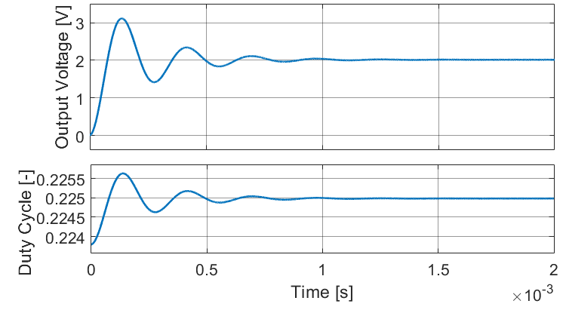
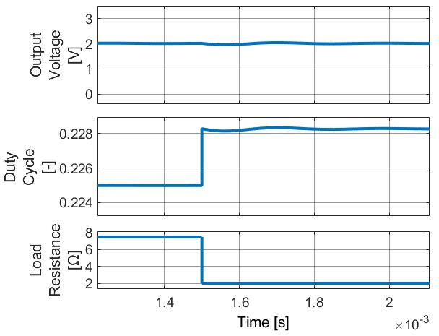
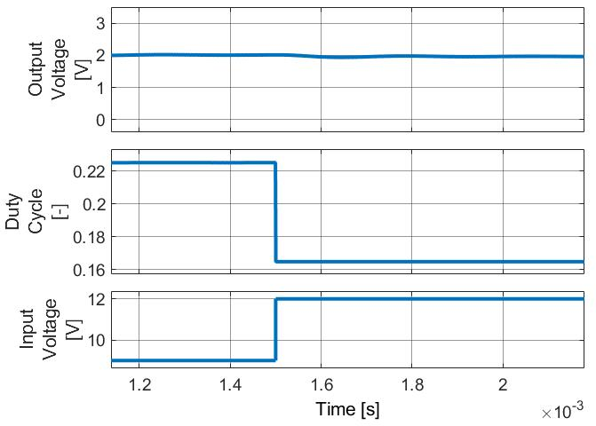
Neural Network-Controlled Buck Converter for Power Management in Electric Vehicles
TRANSCOM 2025: 16th International Scientific Conference on Sustainable, Modern and Safe Transport
Juraj Šimko¹, Michal Praženica¹, Roman Koňarik¹
1 University of Zilina, Univerzitna 1 010 26 Zilina, Slovakia
introduction
Neural networks are increasingly shaping the modern world, seamlessly integrating into various applications. The same applies to power converters. One area where these two sectors can intersect is in the control mechanisms of power semiconductor converters, where neural networks can replace PID controllers. | The primary challenge of this application is that neural networks demand significantly more computing power than PID controllers. Overall, the challenge lies in the entire network design, from obtaining training data to selecting its structure to meet the given requirements, which is quite time-consuming. | Research and experimentation are necessary to determine the optimal network structure for a given application- ensuring it performs as intended. The objective is to create a functional neural network model capable of delivering the required output voltage of a step-down DC-DC converter.
materials, methods & implementation
In this case, a feedforward neural network was chosen. Previous attempts to train a network for controlling the output voltage of a step-down DC-DC converter were based on the converter‘s voltage regulation ratio. The neural network had a single output corresponding to the control signal and two inputs: the input voltage and the reference value. However, this approach proved insufficient, as the network failed to adjust the control signal when the converter load changed. To address this issue, the network structure was modified by introducing a third input- the output current.
results
The proposed neural network structure was validated through simulation. Figure 1 illustrates the output voltage and duty cycle curve under nominal conditions, with an input voltage of 9 V, a load resistance of 7.5 Ω, and a reference voltage of 2 V. As shown, the neural network continuously adjusted the duty cycle during the initial phase of the converter‘s operation. The steady-state output voltage achieved is 2.013 V. Subsequently, simulations were made to evaluate the neural network‘s performance under basic fault scenarios, including a step change in input voltage and load resistance. As shown in Fig. 2, when the load resistance value was reduced to 2 Ω, the neural network successfully achieved the desired output voltage. The steady state voltage value is again 2.013 V. Similarly, in Fig. 3, where the input voltage was adjusted to 12 V, minimal overregulation was observed, with the stabilized output voltage settling at 1.99 V.
Fig.1 Fig.2 Fig.3 Fig.1 The course of the output voltage and duty cycle Fig.2.The course of the output voltage and Fig. 3 The course of the output voltage and at the nominal parameters duty cycle when the change in the load duty cycle when the change in the input resistance from 7.5 Ω to 2 Ω was applied voltage from 9 V to 12 V was applied
conclusion & implementation path
This article focused on designing a neural network structure to regulate the output voltage of a step-down DC-DC converter. As discussed, earlier experiments using only two input parameters revealed limitations, as the network could not adjust the duty cycle when the load resistance changed. To address this, an additional input parameter- output current was used. The redesigned network demonstrated reliable output voltage regulation, as shown in the results. However, the effectiveness of the network heavily depends on the training dataset range. An open question remains whether such a neural network can be successfully implemented to control a converter in real-world applications. Another consideration is whether it can be trained differently, such as using a traditional closed-loop control approach, where the controller input is an error signal- the difference between the actual and reference values- and the output is a control signal. Additionally, a key aspect is the practical implementation of the proposed solutions on real hardware. A challenge is programming it into a standard microprocessor commonly used in power electronics. The question arises: how efficiently can such a microprocessor compute the neural network, and consequently, what will be the control signal‘s refresh rate given the complexity of the system.
acknowledgements
The authors would like to thank for the financial grant support for the projects APVV-22-0330 „Research of a system for active and optimal management of electrical energy using battery storage system“ and VEGA 1/0314/24 „Research of a system for active management of electrical energy using battery storage system“. Špánik, P., Drgoňa, P., Frivaldský, M., 2010. Design and Application of Full Digital Control System for LLC Multiresonant Converter. Electronics and Electrical Engineering, no.10 Valčo, M., Šedo, J., Paškala, M., 2013. Simulation Analysis of DC/AC Inverter Under Nonlinear Load. International Conference Technical Computing Prague Frivaldský, M., Špánik, P., Morgoš, J., Pridala, M., 2018 Control Strategy Proposal for Modular Architecture of Power Supply Utilizing LCCT Converter. Energies 2018 Jarabicová, M., Kaščák, S., 2019. The parametric simulation of the interleaved boost converter for the electric transport vehicle. 13th International Scientific Conference on Sustainable, Modern and Safe Transport (TRANSCOM 2019) Lešo, M., Žilková, J., Pástor, M., 2016. Advanced Control Methods of DC-DC converters. Elektrotechnické listy, vol. 1, no. 1

