Slide 1


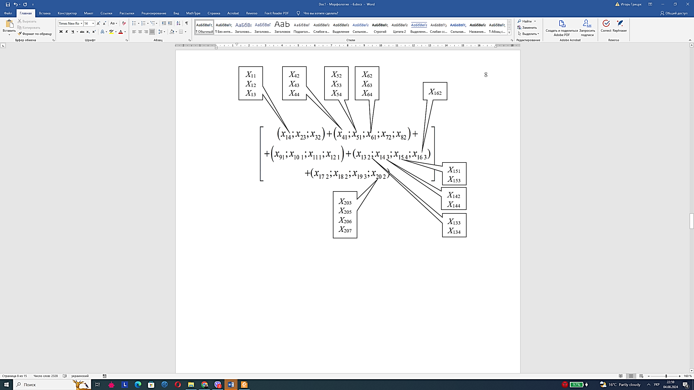
Systematization of Information and Hardware Support for Vehicle Operation Monitoring Systems
TRANSCOM 2025: 16th International Scientific Conference on Sustainable, Modern and Safe Transport
Vasyl Mateichyk^{1,4}, Igor Gritsuk², Miroslaw Smieszek¹, Andrii Holovan³, Olena Volska², Andrii Navrotskyi⁴
1 Rzeszow University of Technology, Rzeszów, Poland
2 Kherson State Maritime Academy, Kherson, Ukraine
3 Odesa National Maritime University, Odesa, Ukraine
4 National Transport University, Kyiv, Ukraine
introduction
For efficient operation of a vehicle in external environment conditions, it is necessary to systematically obtain information about the technical condition of its units and assemblies. Designing a modern vehicle involves the widespread use of electronic (computer, information) systems that manage various operational processes, provide informatization of technical and technological processes, optimize and plan their work, create conditions for tracking the technical parameters of the vehicle in the infrastructure environment. | Transport control (monitoring) is an effective solution to the problem of tracking the location and movement on the ground, the technical condition of the vehicle. Remote monitoring systems allow you to determine the exact coordinates of the location of the vehicle, its speed, fuel consumption; systematize the collection of statistical data to optimize the development of rational route configurations; promote safety; monitor compliance with the vehicle schedule. | For effective remote monitoring, it is necessary to analyze the basic requirements and characteristics of the technical means used to track the technical condition of vehicles during operation. All currently available technological solutions designed for monitoring and managing vehicles have a common goal - to effectively provide accurate data about the vehicle and its location, ensuring their further use in accordance with the business requirements of consumers.
materials, methods & implementation
The purpose of the study is to systematize the schemes for implementing information and hardware support for vehicle operation monitoring systems using a morphological matrix. The method includes a system of information interaction between monitoring components: the vehicle and the operator, the operating conditions of the vehicle, as well as the transport and road infrastructure. The method for carrying out the systematization of schemes is the method of morphological analysis, which is also called the method of the morphological box. The method of morphological analysis integrates both the classification and generalization approaches. It involves decomposing the problem into its fundamental components and identifying the most promising element in this structure for developing an optimal solution to the entire problem.
results
An analysis of the structures and a synthesis of possible implementation schemes for the information and hardware support of information monitoring systems (IMS) of vehicles interacting with the infrastructure environment (technical system “Vehicle – Infrastructure”) have been carried out. The study was conducted based on the types of hardware used for collecting information about both the vehicle and the infrastructure environment at various stages of performing their functions under operational conditions. The technical system “Vehicle – Infrastructure” under study was functionally divided into five elements, each representing a set of specialized hardware components. The resulting schematic structure of the hardware support for the IMS of vehicle operation, with options for component configuration, can be considered an effective method for monitoring vehicles under operational conditions, which today form the basis of the current fleet of passenger and freight vehicles.
conclusion & implementation path
Summary of findings and research: The issues of systematization of monitoring schemes by implementing information and technical support for the IMS of vehicle operation using a morphological matrix have been resolved. A schematic representation of the structure of the hardware of the IMS of vehicle operation has been developed, including various options for the arrangement of components, which can be considered as an effective way to ensure control under operating conditions. Influence and future research: The development of the results of this study is the development of a methodology for structuring schemes for the implementation of information and hardware support for vehicle operation monitoring systems based on the use of a morphological matrix on different types of transport. It is advisable to use the obtained results to improve the efficiency of vehicle operation in an infrastructure environment and to ensure the rational formation of monitoring systems in transport.
acknowledgements
This research was conducted within the collaborative framework of Rzeszow University of Technology (Poland), Kherson State Maritime Academy (Ukraine), Odesa National Maritime University (Ukraine) and the National Transport University (Ukraine). We would like to express our sincere gratitude to all the engineers, data analysts, and operational staff who contributed to the development of the method of systematization of information and hardware for vehicle operation monitoring systems.

