Slide 1


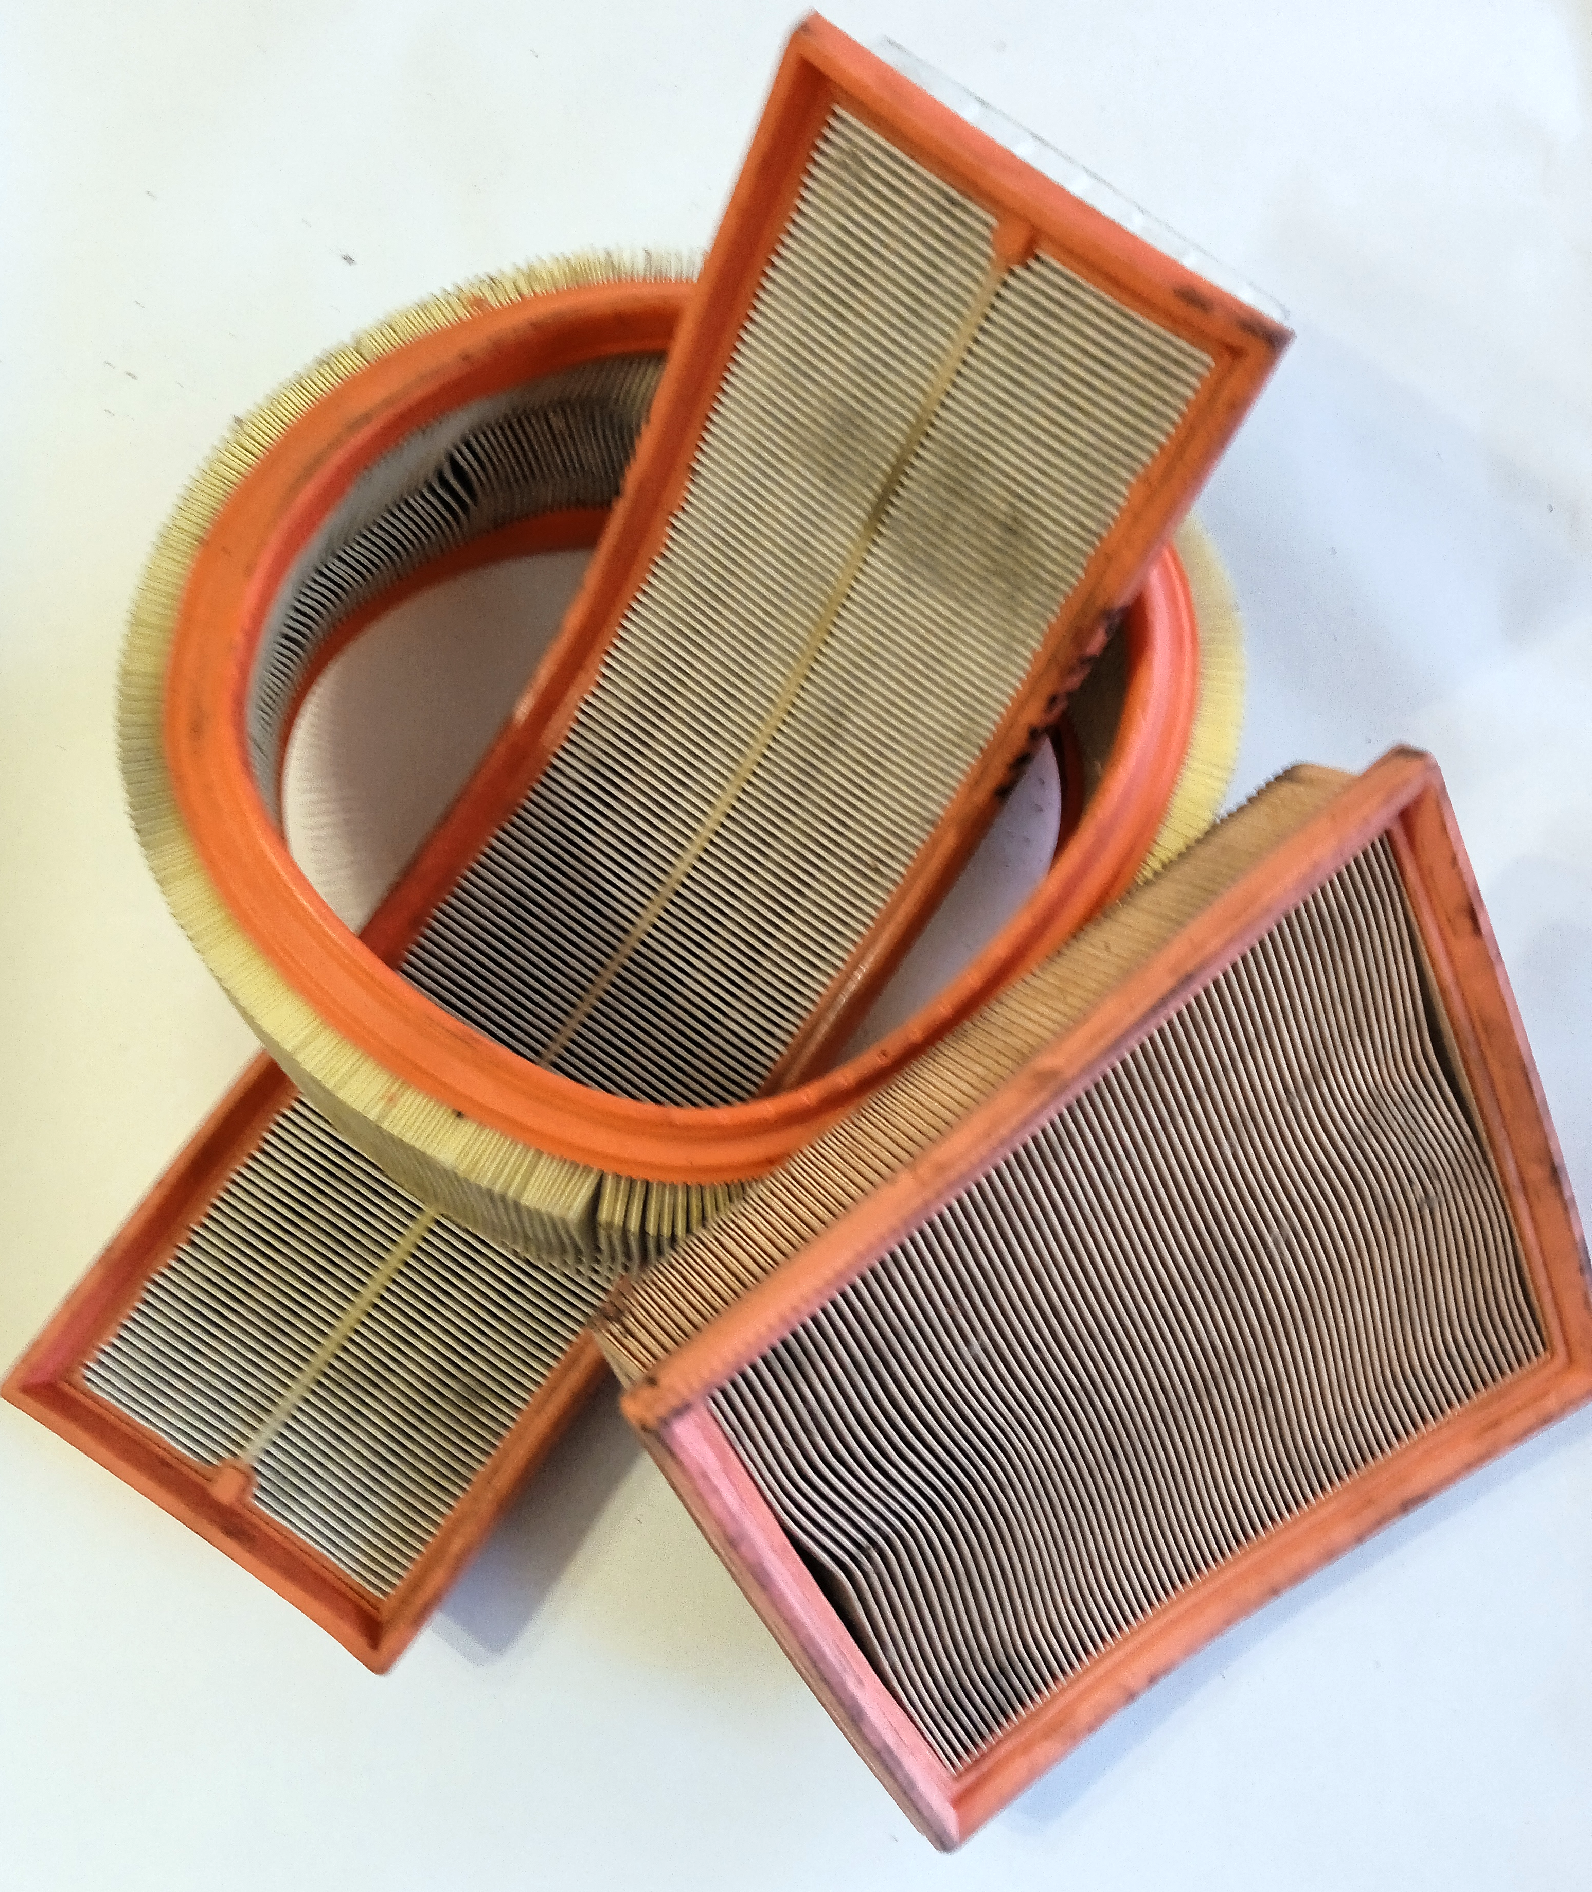
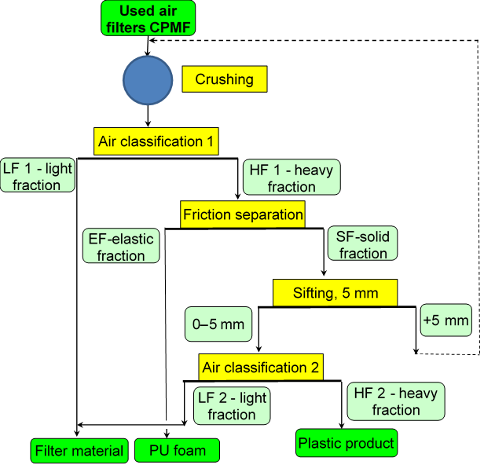
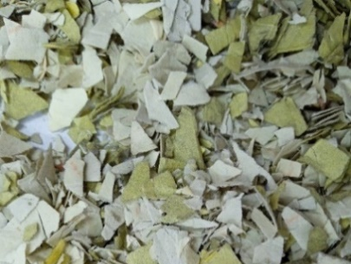
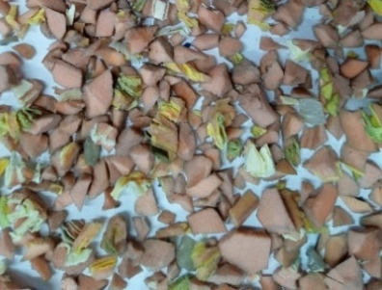
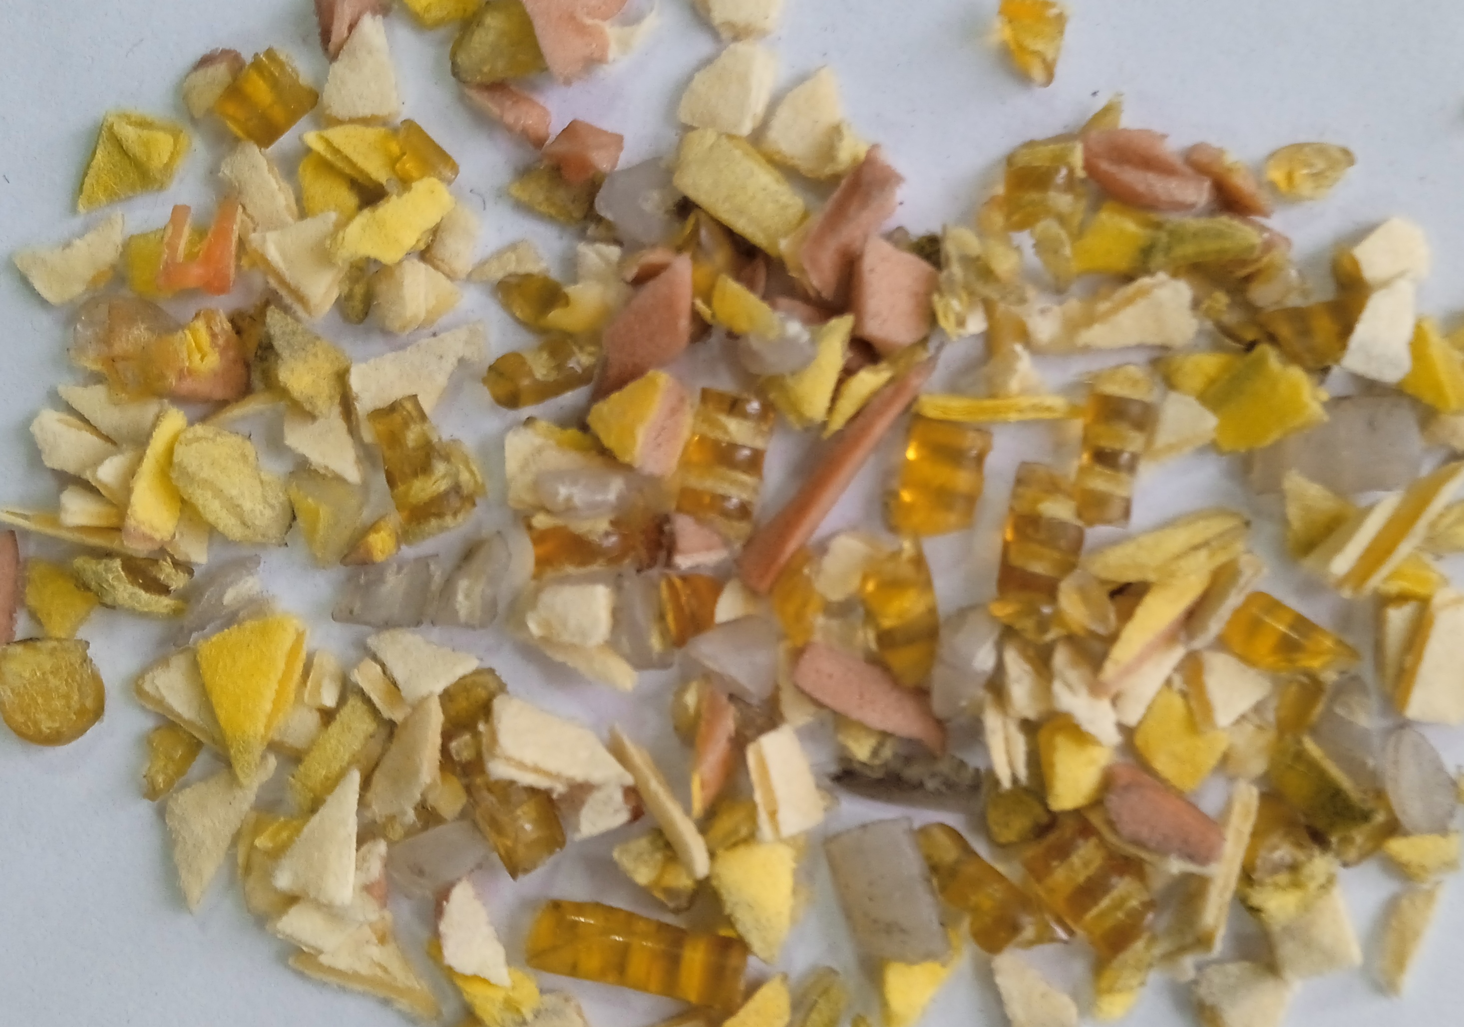
Improving the recycling technology of consumable vehicle components
TRANSCOM 2025: 16th International Scientific Conference on Sustainable, Modern and Safe Transport
Miroslaw Smieszek¹, Oleksandr Stadnyk^{2, 3}, Vasyl Mateichyk¹, Jakub Mosciszewski¹, Roman Ihnatiuk²,
Roman Marchuk²
1 Rzesszow University of Technology, Rzeszow, Poland
3 Scientific and manufacturing firm "Prodecologiya", Rivne, Ukraine
2 National University of Water and Environmental Engineering, Rivne, Ukraine
introduction
Backround information & Market Context According to EU Directives, 95% of the total weight of an end-of-life vehicle is subject to recycling with the reuse of materials. These regulations also apply to consumable vehicle components such as air filters. | Problem Statement & Stakeholders The proposed technology solves the problem of recycling used air filters from vehicle engines. The technology may be of interest to companies involved in recycling end-of-life vehicles and their components. | Research Objectives & Expected Impact The objective of this research is to enhance the existing technological scheme for recycling used vehicle air filters by friction separation and air classification, with the aim of increasing the purity of PU foam and filter material which improves the environmental friendliness of the existing technology.
materials, methods & implementation
Description of research methods and materials For the study, we used vehicle engine air filters with cellulose-paper filter surface (CPMF) obtained at service stations in Rivne (Ukraine). These filters were used on Renault, Volkswagen, and BMW vehicles. The CPMF filters were flat or cylindrical in shape, with a cellulose-paper filter material inside. A sealing element made of porous polyurethane was placed along the contour. The paper filter surface was fixed with strips of EVA or PA plastic. The used CPMF filters were sent for mechanical processing according to the technological scheme, which included crushing on a granulator, air classification 1 to obtain a light fraction LF 1 and a heavy fraction HF 1, friction separation of the heavy fraction to obtain an elastic fraction EF and a solid fraction SF, sieving by size of 5 mm of the solid fraction and subsequent air classification of the undersize product 0-5 mm to obtain a light fraction LF 2 and a heavy fraction HF 2. The products were crushed on a rotary shear granulator MN-300 (Castulik, Slovakia) equipped with a discharge screen, with round holes with a diameter of 10 mm. Air classification was performed on a light fraction separator of the “Zig-Zag” type SLF-5-15/30 (SMF “Prodecologia”, Ukraine) and friction separation was performed on a ST-100 separator (SMF “Prodecologia”, Ukraine).
results
Academic Findings & Innovation Practical Applications
According to the improved technological scheme of recycling used vehicle air filters, which includes crushing, air classification 1, friction separation, sieving and air classification 2, we obtained filter material (LF 1+LF 2) with 89.6 % recovery and 97.4 % purity, PU foam (EF) with 75.9 % recovery and 94.4 % purity, and a plastic product with 80.5 % recovery of plastics, including 48.5 % of plastics. An additional potential to increase the recovery of filter material and PU foam is the oversized separated product (+5 mm), which is recommended to be crushed together with the original product, allowing a better recovery. When conducting research, not enough plastic product was generated to obtain concentrates of the different types of plastic present. Plastic product (HF 2), it can be further purified by electrostatic separation and sorting using the near infrared spectrum. Compared to the process of Wilke et al. (2024), an increase in the purity of the filter material from 96.7% to 97.4% with a partial decrease in the recovery of the filter material from 90.1% to 89.6% and an increase in the purity of the PU foam from 93% to 94.4% with a decrease in the recovery from 90% to 75.9% with a possible potential to increase it up to 84.6% with processing of fraction +5 mm were obtained. The results obtained do not contradict previous studies and correspond to their level. The main advantage is that the improved process scheme using friction separation and air classification is more environmentally friendly, as there is no need to use reagent solutions that require additional regeneration and disposal.
Used air filters
Filter material
PU foam
Plastic product
Fig. Technological scheme for the recycling of used vehicle air filters
conclusion & implementation path
Summary of research conclusions, impact and potential areas of further research in this field The paper proposes an improved technological scheme for the recycling of used vehicle air filters, including crushing, air classification and separation by friction, and sieving. Used vehicle air filters consist of cellulose and paper filter material, polyurethane foam, and plastic. Crushing the used filters on a rotary shear granulator with a 10 mm discharge screen ensures a material degree of liberation to achieve 94.2 %. The use of air classification ensures efficient separation into light fractions LF 1 and LF 2 at average air flow rates of 3.5 and 5.5 m/s of cellulose and paper filter material with a recovery of 89.6 % and a purity of 97.4 %. Friction separation on a glass working surface with a gap between the dividers ensures a recovery of 75.9 % and a purity of 94.4 % of foamed polyurethane with the potential to increase this recovery by a further 8.7 % by additional recovery of the +5 mm oversize product together with the feed material. The plastic recovery to plastic product was 80.5 %. This product requires additional purification and sorting of plastics by type using electrostatic separation and near-infrared separation. The research was carried out on semi-industrial equipment, which allows repeating the technological scheme on an industrial scale. The improved technological scheme for recycling used vehicle air filters is environmentally friendly, as it does not require the use of water and reagent solutions. It is also advisable to perform a similar study for vehicle air filters with polyester filter material.

