Slide 1


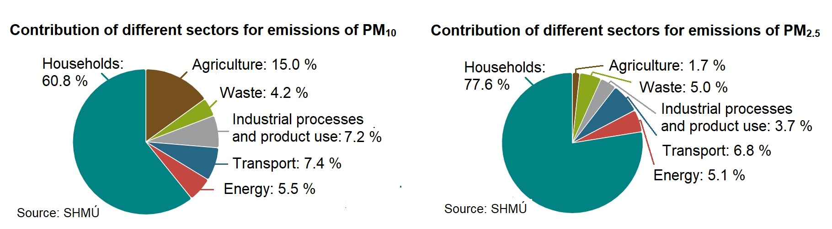
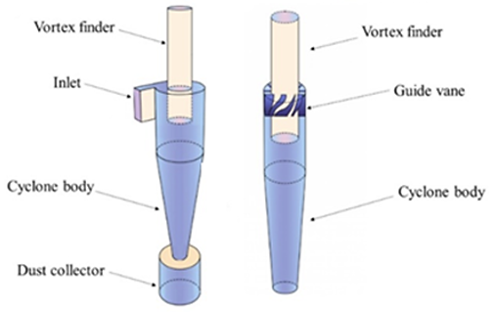
Capturing solid pollutants transported from small heat sources using cyclones
TRANSCOM 2025: 16th International Scientific Conference on Sustainable, Modern and Safe Transport
Katarína Hornická¹, Peter Ďurčanský²
1 University of Zilina, Zilina, Slovakia
2 University of Zilina, Zilina, Slovakia
introduction
Backround information & Market Context Higher concentrations of pollutants are harmful to human health, welfare, plants, and animals. Primary air pollutants are emitted directly into the air. Secondary air pollutants are produced by atmospheric reactions. | Problem Statement & Stakeholders Reference to air pollution from heating and road transport. Reducing emissions by capturing solid pollutants with gas precipitators. | Research Objectives & Expected Impact The characteristics of solid pollutants influence the selection of a specific type of separation device. The influence of geometric factors on increasing the effectiveness of cyclones. Innovative solutions in cyclone design to improve performance in particular.
materials, methods & implementation
Six major air pollutants have been designated by the U.S. Environmental Protection Agency (EPA) are particulate matter (PM), ozone (O₃), carbon monoxide (CO), nitrogen oxides (NO and NO₂), lead (Pb), and sulfur dioxide (SO₂). Heating, especially small heat sources, is the major contributor to air pollution, particularly in winter. The main properties of solid pollutants that most influence the choice of a particular type of separator are concentration, material composition, particle velocity gradient, granulometric composition, particle density, particle electric charge, stickiness, and electrical resistance.
results
From a sectoral perspective, transport accounts for 7.4% of total emissions of PM₁₀ and 6.8% of total emissions of PM_{2.5} in Slovakia in 2022. Households produce 60,8% of PM₁₀ particles and 77.6% of PM_{2.5} particles of total emissions (MoE, 2025). Gas cyclone separators are commonly used in many applications due to low operating and maintenance costs. They are relatively simple to manufacture, adaptable to extremely high pressures and temperatures before being released into the environment. By comparing the small and large cyclones for capturing solid particles, especially the effect of the diameter of the vortex finder on the efficiency of fractional separation at different gas flows, it was proved in a certain numerical analysis that the efficiency of a cyclone with a smaller diameter of the vortex finder achieved a higher efficiency of fractional separation. Innovative solutions for the geometry of the inlet, outlet, cyclone body, and dust collector contribute to maximizing the efficiency of particulate collection and minimizing pressure losses. Two types of the most commonly used cyclones, namely the tangential and axial reverse flow cyclone separators.
conclusion & implementation path
Although air quality is slowly improving, air pollution poses the greatest environmental risk. Such pollution causes reduced quality of life due to diseases and originates mainly from solid fuels used for heating homes, industrial activities, and road transport. The amount of particulate matter emissions produced by households accounts for most of the total amount of PM₁₀ and PM_{2.5}. Therefore, it is necessary to address the issue of reducing emissions, especially in households, and to find solutions to reduce the generation or capture of particulate matter in small heat sources. The capture of solid pollutants is carried out by various types of separators. The absence of moving parts, simple design, and general use make cyclones a suitable alternative for reducing emissions at temperatures as high as those in biomass boilers. Despite the relatively low efficiency of cyclones in terms of separating medium particles (< 2.5 µm), fine particles (< 1 µm), and particles with low density, cyclone separation technology can be highly efficient when supplemented with another type of separator, namely filters or electrostatic precipitators. Filters are very effective in capturing particles and are usually financially viable, but the requirement for frequent maintenance due to filter replacement or regeneration is very high. Although an electrostatic precipitator is usually not as efficient as a filter, its efficiency is generally very high. The problem can be, for example, higher investment costs, and voltage sources.
acknowledgements
This research is supported by the project KEGA—032ŽU-4/2022, "Implementation of knowledge about modern ways of reducing the burden on the environment in the energetic use of solid fuels and waste into the pedagogical process".

