Slide 1


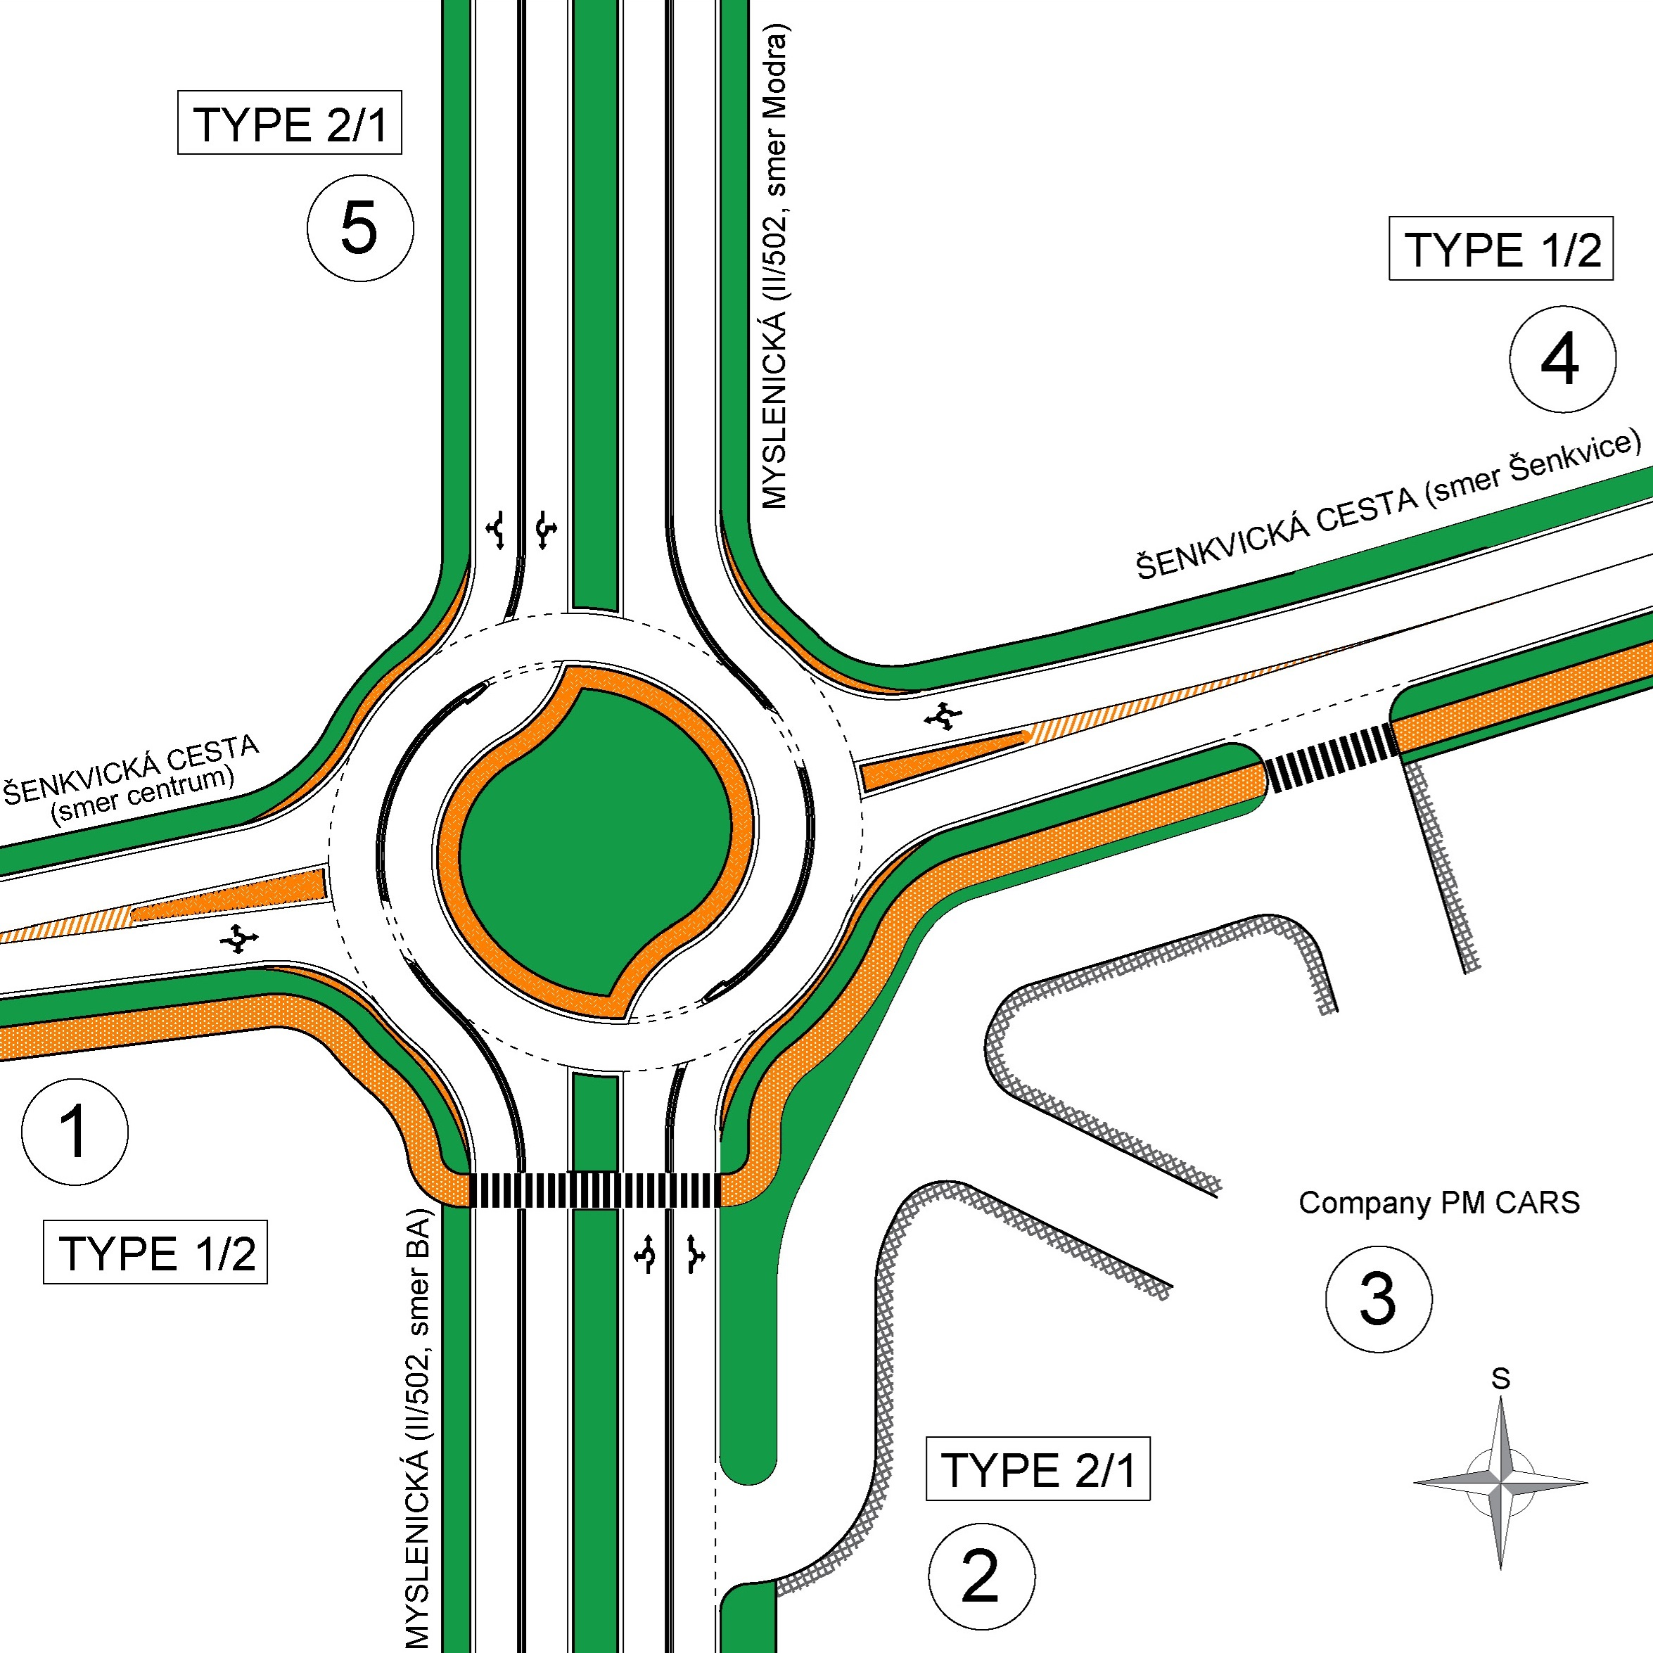
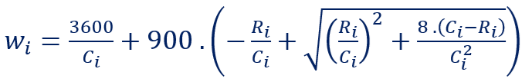
Capacity and safety aspects of turbo-roundabouts
TRANSCOM 2025: 16th International Scientific Conference on Sustainable, Modern and Safe Transport
Kristián Čulík, Alica Kalašová, Peter Fabian
Department of Road and Urban Transport, University of Žilina, Univerzitná 8215/1, 010 26 Žilina, Slovakia
introduction
In recent years, unconventional roundabouts, known as turbo roundabouts (TRs), have gained popularity. TRs are defined in the technical conditions TP 100 and TP 102 (Slovak Road Administration, 2015), are valid in the Slovak Republic, and are used for planning, designing, and capacity assessment of TRs. | According to technical specifications, it can be assumed that a standard turbo roundabout is suitable for a total load of approximately 3,500 PCU/h. An important input parameter, in addition to the geometric arrangement and traffic load distribution. This article verifies the possibility of the correct function of TR under high traffic loads. | This article examines the capacity and safety aspects of TRs, analysing their performance through capacity assessment. The findings confirm that properly designed TRs can effectively manage high traffic intensity, minimize collision points, and optimize traffic flow.
materials, methods & implementation
The research question of this article remains under what conditions it can be claimed that a standard TR can handle a load of 3,500 PCU/h without significant delays (up to 60 seconds). For this purpose, a simulation of capacity calculations was conducted for a standard TR with an even distribution of vehicles between the left and right lanes. The TR was tested with unit vehicles under five scenarios, each varying in the proportion of main direction traffic relative to the total roundabout load. For instance, scenario S70 indicates that only 70% of PCU traversed the roundabout in the main direction, i.e., 35% from arm 4 to arm 2 and 35% from arm 2 to arm 4. An additional 15% of the load was evenly distributed between right and left turns from the main directions. The remaining 15% of the total load was distributed across all directions from arms 1 and 3.
results
The figure on the left illustrates the development of the longest waiting time, regardless of which arm or lane of an arm. Total TR loads below 2,500 PCU/hour are not shown in the graph, as the roundabout can handle such loads with waiting times under 10 seconds, corresponding to the best level of service grade, "A," regardless of load distribution across directions. However, as the roundabout load increases, the distribution of traffic becomes significantly impactful. Naturally, the most significant load on the roundabout is caused by left-turning vehicles and vehicles from secondary arms (1 and 3) with single-lane entries.
The figure on the right shows the design of the examined TR. The following formula was used to calculate the waiting time for each arm.
The research question was whether a standard turbo roundabout could handle a traffic load of 3,500 PCU/hour. It can, but only under tolerable load distribution conditions (ideally at least 70%, or at minimum 60%, of vehicles travelling in the main direction). As shown in the graph, at 2,450 PCU/hour in the main direction and 1,050 PCU/hour in other directions, the roundabout can handle this load with a maximum waiting time of 32 seconds, corresponding to the level of service grade "D." With every further increase in load, the total waiting time rises exponentially.
conclusion & implementation path
In conclusion, it can be stated that turbo roundabouts have many positive and negative aspects, which can be summarized into the following areas: ► High investment costs: Due to the specific shape of the roundabout, numerous specialized construction elements, and the irregular shape of the lanes, TRs are significantly more expensive to construct than other types of at-grade intersections. ► More complex navigation, especially for drivers using the roundabout for the first time. For this reason, it is essential to provide appropriate horizontal and vertical traffic markings. ► Limited flexibility: Unlike signal-controlled intersections, signal plans cannot be adjusted to optimize vehicle flow through the roundabout. ► Inability to prioritize public transport vehicles: This limitation arises from the nature of a roundabout without traffic signal control. While some roundabouts allow public transport vehicles to pass through the central island, such a solution would be dangerous in the case of a TR. ► Pedestrian and cyclist routing: This is a common issue for roundabouts, as they often force pedestrians and cyclists to take longer detours since their paths are routed around the roundabout at an even larger radius than the vehicle lanes. ► Passage of oversized vehicles: Roundabouts can generally be problematic for oversized transport. If oversized transport routes are expected to pass through a given roundabout, appropriate structural modifications can be made.
acknowledgements
Funded by the EU NextGenerationEU through the Recovery and Resilience Plan for Slovakia under the project No. 09I03-03-V05-00002.

