Slide 1


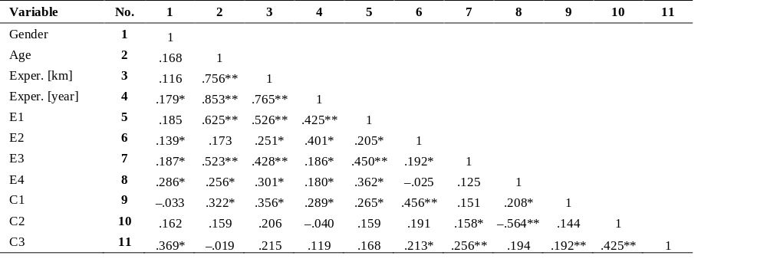
Perception of Intelligent Technologies by Road Users
TRANSCOM 2025: 16th International Scientific Conference on Sustainable, Modern and Safe Transport
Alica Kalašová, Kristián Čulík, Peter Fabian
Department of Road and Urban Transport, University of Žilina, Univerzitná 8215/1, 010 26 Žilina, Slovakia
introduction
Road traffic safety remains a major concern, especially for vulnerable users like pedestrians and cyclists. Intelligent Transportation Systems (ITS) offer new ways to improve safety and efficiency. However, their success depends on user trust and acceptance. In Slovakia, higher accident rates highlight the urgent need for ITS. | Despite technological progress, many road users remain skeptical about ITS benefits. Low adoption rates stem from limited awareness, mistrust, or lack of experience. Key stakeholders include drivers, policymakers, researchers, and ITS developers, all of whom influence are affected by ITS deployment. | This study aims to analyze drivers’ attitudes toward ITS technologies and identify factors influencing their acceptance. By understanding user perceptions, the research supports safer ITS implementation. Results may guide policymakers and developers in designing user-friendly and widely accepted systems.
materials, methods & implementation
The research followed a seven-step process (see figure), starting with problem definition and ending with result analysis. A structured questionnaire was used to gather data from 412 drivers, focusing on demographics, driving experience, and ITS related attitudes using a 5 point Likert scale. Key areas included expectations, control preferences, and social influence. Despite a smaller sample than planned, the results offer relevant insights. Correlation analysis helped uncover relationships between driver characteristics and their views on ITS technologies.
1. Problem definition and research objective
2. Research plan
3. Preparing a questionnaire
6. Data processing and analysis
5. Data collection
4. Questionnaire verification
7. Research results
results
A total of 412 valid responses were collected, primarily from male drivers, most of whom were aged 20 to 30 years. The majority had a driving experience of 25 000 to 100 000 km, which also correlated strongly with years of driving license ownership. These demographic characteristics influenced their expectations and attitudes toward ITS technologies. Statistical analysis revealed several significant relationships. The correlation between age and driving experience was notably strong (r = 0.756 for kilometers driven and r = 0.853 for years of experience, both p < 0.01), confirming expected patterns. When analyzing responses to ITS expectations, older and more experienced drivers expressed greater trust and belief in ITS benefits. These values suggest that older drivers are more likely to value safety oriented functionalities. Similarly, experienced drivers were more positive about ITS improving driving comfort and control, as well as about the superiority of certain automated interventions over human input.
An interesting insight was found in the negative correlation between trust in ITS interventions and the desire to disable the system. This suggests that users who trust ITS are more comfortable with automated control and prefer fewer manual overrides. The survey also explored social influence. Respondents were more likely to consider using ITS if recommended by people close to them (friends, family), rather than by institutions such as police or insurance companies. This underscores the role of peer opinion in technology adoption. The table summarizes key correlation results and their statistical significance.
conclusion & implementation path
In conclusion, the research highlights key findings about user perception of Intelligent Transportation Systems (ITS), as well as practical implications for implementation. These can be summarized into the following areas: Age and experience: Older and more experienced drivers show greater acceptance of ITS, particularly features aimed at improving safety and response time in critical situations. Social influence: Recommendations from friends and family have a stronger impact on ITS adoption than institutional sources like police or insurance companies. Trust affects control preferences: Users who believe in the superiority of automated interventions are less likely to desire manual override options, indicating a connection between trust and control. System design must be intuitive: Respondents expressed a preference for ITS features that are easy to use, with clear communication through sound or vibration alerts, and optional deactivation. Education is essential: Targeted awareness campaigns and training (especially integrated into driver education) can improve understanding and acceptance of ITS functionalities.
acknowledgements
This work was supported by the Slovak Research and Development Agency under the Contract no. SK-CN-23-0009.

