Slide 1


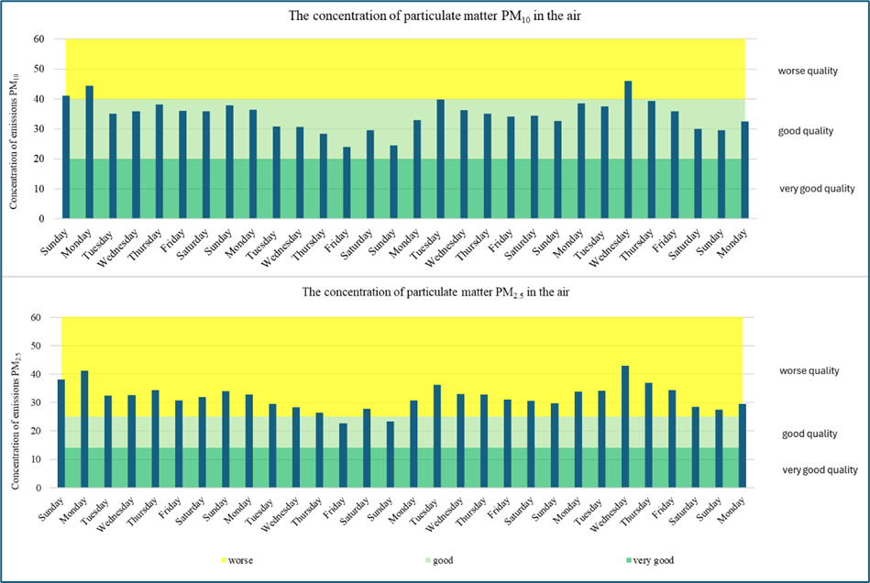
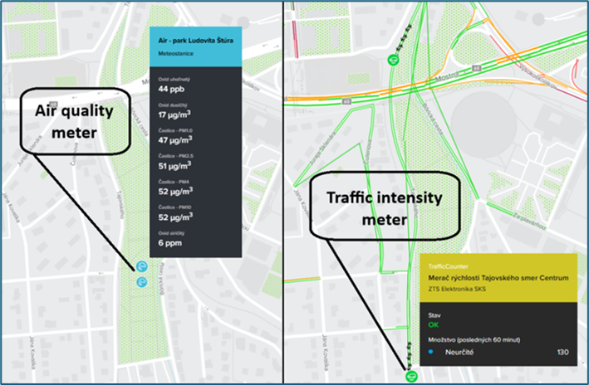
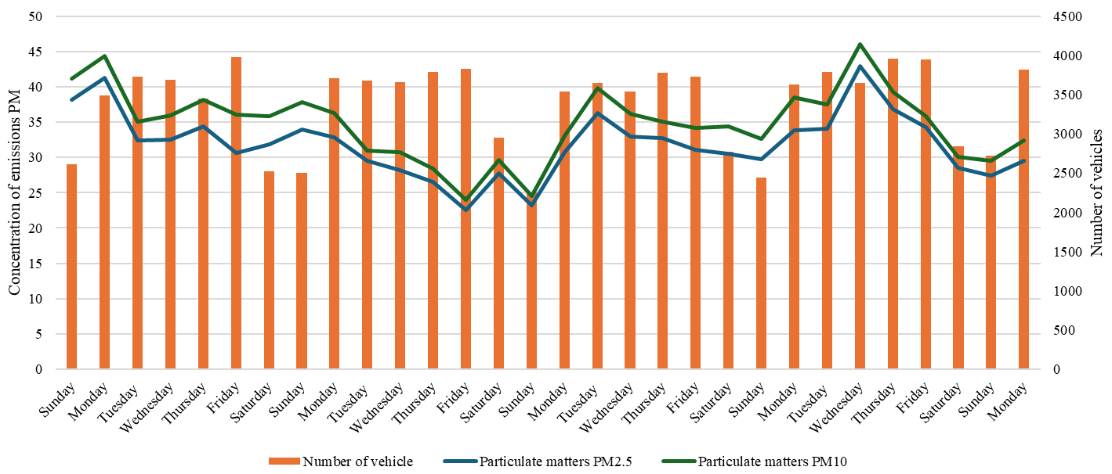
Monitoring the impact of traffic activity in a selected location on air quality
TRANSCOM 2025: 16th International Scientific Conference on Sustainable, Modern and Safe Transport
Branislav Šarkan¹, Michal Loman¹, Dominika Rovňaníková¹
¹ Department of Road and Urban Transport, Univerzitná 8215/1, Žilina 010 26, Slovakia
introduction
Rapid urbanization and the ever-increasing mobility of the population are leading to an increase in the intensity of road traffic, which is one of the primary sources of air pollution. As part of modern life, transport contributes to an increase in emissions of various pollutants, including nitrogen oxide (NOx), carbon monoxide (CO), volatile organic compounds (VOCs), particulate matter (PM10 and PM2,5), and sulfur oxides (SOx). These pollutants have negatively impacted on human health, ecosystems and climate change. Transport is a key factor affecting air quality in urban and municipal environments with dense transport networks.
The increasing global requirements to improve air quality and achieve sustainable development goals compound the importance of this topic. Although many countries are implementing measures to reduce transport emissions, such as the switch to electromobility and the development of public transport, the long-term impact of these strategies still needs to be studied and evaluated in detail.
Identifying the sources and processes contributing most to air pollution is key to effectively designing measures to improve environmental quality. The connection between transport and air quality is significant for urban areas, where high traffic and population densities generate synergistic pollution effects. This research will increase the understanding of local specificities such as traffic volume, geographical and climatic conditions and their impact on the dispersion of pollutants.
materials, methods & implementation
The air quality measurements were based on data collected from the city's infrastructure, which is specializes in air quality monitoring and evaluation. The measurements were carried out in Ľudovita Štúr Park in regional town Žilina, which is located near a major road - Tajovského Street. This park is a strategic location for monitoring the impact of traffic on air quality, as it combines elements of the urban environment and green infrastructure.
Data on the concentration of pollutants such as particulate matter (PM₁₀, PM_{2,5}) were collected through an automated station from AGDATA equipped with sensor technology. The station provided continuous monitoring over several weeks, giving a detailed view of the variation of pollution with time and outdoor conditions. For comparison, the database from a traffic counter located in the immediate area of the roadway was used. This counter provided data on traffic volume and a number of vehicles through. The combination of traffic volume and air pollution data allowed the analysis of correlations between traffic activity and pollutant concentrations. In Figure below it is possible to observe the location of measuring devices in the area of the road - traffic counter (left picture) as well as in the area of the park - air quality meter (left picture). Data collection and processing were performed for September 2024. This is a month when there is a spike in vehicle movement on the roads as well as a spike in pedestrian movement due to the end of the summer holidays and the start of the school year.
results
PM₂.₅ concentration (bottom graph): The highest value was also recorded on Wednesday, 6.9.2024 (approximately 40 µg/m³), close to the boundary between the good quality and worse quality categories. The lowest concentrations occurred on Sunday and Saturday 14.9.2024 and 15.9.2024 (approximately 15-20 µg/m³), which is classified in the very good quality category. The overall range of PM₂.₅ concentration values was between 15 µg/m³ and 40 µg/m³.
In Figure it is possible to observe the location of measuring devices in the area of the road - traffic counter (left picture) as well as in the area of the park - air quality meter (left picture). Data collection and processing were performed for September 2024. This is a month when there is a spike in vehicle movement on the roads as well as a spike in pedestrian movement due to the end of the summer holidays and the start of the school year.
Permanent location of measuring devices
The results of the research showed a clear correlation between traffic intensity and concentrations of pollutants, namely PM₁₀ and PM₂.₅, in the air. On weekdays, when traffic volumes were highest (maximum 4 000 vehicles per day, especially on Fridays), concentrations of PM₁₀ and PM₂.₅ increased to values of approximately 45 µg/m³ and 40 µg/m³, respectively, which are close to the upper limit of the 'good quality' category and, in places, to the 'poorer quality' limit. In contrast, on weekends, when the number of vehicles dropped below 2000 per day, particulate concentrations fell to values in the range of 15-20 µg/m³, representing "very good air quality". These results confirm that increased traffic intensity leads to a decrease in air quality.
Daily averages of particulate matter concentrations (PM10, PM2,5) over the studied period
Figure shows the daily averages of PM₁₀ and PM₂.₅ concentrations in the air during the monitoring period, divided by day of the week. According to the Slovak Hydrometeorological Institute, air quality is visually divided into three categories:
• Very good quality - bottom green zone.
• Good quality - middle light green zone.
• Worse quality - upper yellow zone.
The PM₁₀ concentration (top graph) was highest on Wednesday, 6 September 2024 (approximately 45 µg/m³), close to the upper limit of the good quality category. The lowest concentration was observed on Saturday (approximately 20 µg/m³), which is very good quality category. Overall, the range of PM₁₀ concentration values ranged from approximately 20 µg/m³ to 45 µg/m³.
The influence of traffic activity on air quality in the monitored area
The graph shows the impact of traffic activity on air quality in the monitoring area. It combines data on the number of vehicles (orange bars) and PM₁₀ (green curve) and PM₂.₅ (blue curve) concentrations. This graph links the graphical results of the investigations presented in previous Figures . The examination data indicate a correlation between traffic volume (number of vehicles) and PM₁₀ and PM₂.₅ concentrations in the air. The number of vehicles is highest on weekdays, resulting in elevated levels of particulate matter. In contrast, weekend traffic reduction decreases concentrations of both types of particles. PM₁₀ shows higher values than PM₂.₅, which is in accordance with their physical properties. PM₁₀ is larger and can be produced by mechanical processes such as abrasion of tyres, brake linings or the road surface. PM₂.₅, the smaller particles, are the result of finer pollution and can be affected by secondary atmospheric processes. Peak pollution levels on Wednesdays may be associated with high midweek traffic volumes. The middle of the working week often represents the period of highest traffic activity, which is reflected in the pollution values. However, it is important to add that we do not currently know the traffic flow composition, which can be assessed as a negative feature of the study.
conclusion & implementation path
In this paragraph, it should be emphasized that several factors determine the size and character of solid particles. PM₁₀, the larger particles, are mainly produced by mechanical processes such as tire and roadway abrasion, while PM₂.₅, the smaller particles, are connected to finer pollutant processes and secondary chemical reactions. This diversity of pollution sources requires comprehensive approaches to reduce the impacts of traffic on air quality. Research limitations include the absence of detailed data on the composition of the traffic flow, which could provide a more accurate view of the specific sources of pollution. For example, defining the level of pollution in freight transport compared to passenger transport, these methods could contribute to a better understanding of traffic pollution. Another limitation is the short monitoring period, which may affect the representativeness of the results. Extending the research to a longer period and including different seasonal conditions could provide a more comprehensive view of the issue under study. The results show that the concentration of PM does not only depend on the number of vehicles but also on the category and emission class of the vehicle. These facts have also been confirmed by studies aimed at identifying the biggest polluters by vehicle category and emission class. In (Kontses et al.) , besides the emission class of the vehicle, the type of fuel is also important, e.g., in (Giechaskiel), they found that lower amounts of PM were recorded by diesel engines compared to LNG, CNG. Based on the results of the research, measures such as the implementation of low emission zones in urban areas with high traffic intensity, regulation of traffic activity during peak periods of the working week and, last but not least, the need to expand monitoring networks and implement technologies for continuous monitoring of pollution can be implemented. Further research should focus on analyzing the structure of the traffic flow, examining the impact of secondary processes on pollutant generation, and assessing the impact of long-term measures on air quality. These steps can contribute to effectively designing strategies to reduce emissions and improve environmental quality in urban areas.

