Slide 1


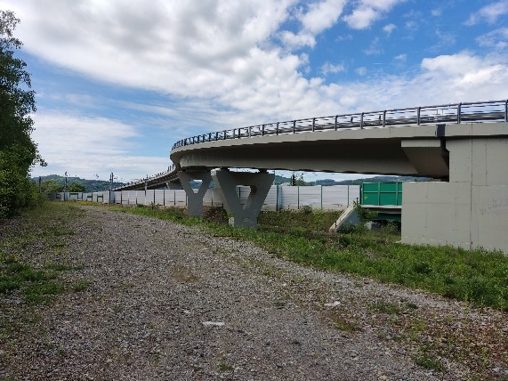
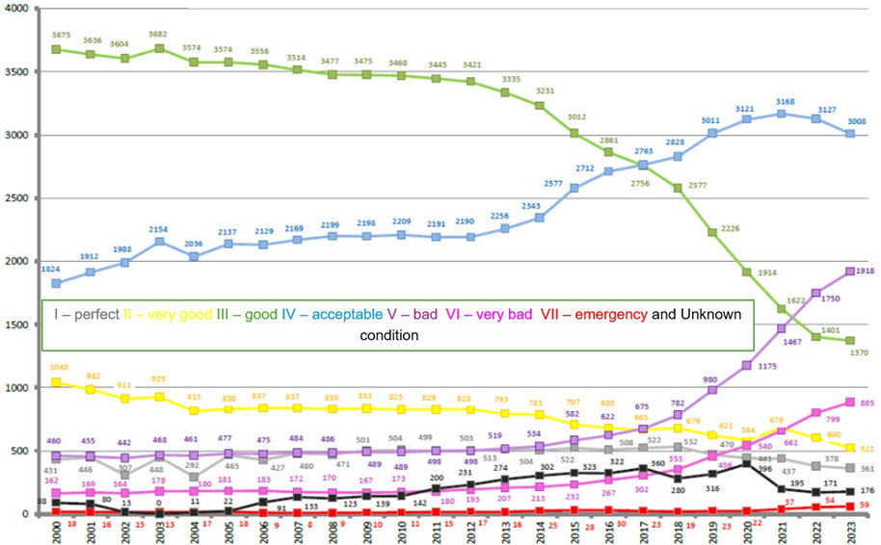
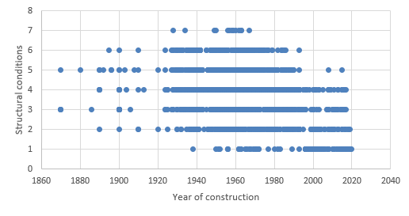
Correlation Between Structural Condition and Age of Bridge: A Statistical Analysis of Road Bridges in Slovakia
TRANSCOM 2025: 16th International Scientific Conference on Sustainable, Modern and Safe Transport
Michal Miške¹, Lucia Figuli¹
1 University of Žilina, Žilina, Slovakia
introduction
Bridges play a crucial role in ensuring the continuity and efficiency in transportation. In Slovakia, there are over 8,000 bridges across all types of roads. These bridges vary not only in size and structural design but also in their technical condition and load capacity. Over last 20 years, the structural conditions of our bridges have decreased significantly, as illustrated in figure. This analysis is focused on correlation between structural condition and age of bridge.
materials, methods & implementation
The application of correlation analysis is thoroughly explored to understand the relationship between the structural and technical condition of bridge structures, which are located on 1st class roads and the year they were designed and built. The primary objective was to investigate whether dependence exists between these two variables, which could indicate that the age of the bridge plays a significant role in determining its current structural and technical state. By analyzing this relationship, we aim to identify potential patterns that could inform maintenance strategies and future construction practices.
Results
The negative correlation found in this analysis underscores the importance of regular inspection and maintenance, especially for older bridge structures. It highlights the need for targeted interventions to address potential weaknesses in older bridges, ensuring their safety and functionality over time. For better illustration there is also graphics between structural conditions and year of construction on the side. As we predicted there is a weak correlation represented by number − 0,287. It means that older the bridge is, the worse condition it has. But that is valid only for 28,7% bridges on 1st class roads.
Correlation analysis of paper provides a foundation for further research, where more variables can be incorporated to better understand the complex dynamics affecting bridge conditions. Future studies could include factors like traffic load, geographical location, environmental exposure, and historical maintenance records to create a more comprehensive assessment of the factors influencing bridge longevity and safety. Factors of interest could theoretically include the owner and operator of the bridge for the future research as well.
conclusion & implementation path
Through correlation analysis, we found a weak negative correlation between these variables, suggesting that older bridges tend to be in worse condition. However, this relationship is not strong enough to be considered a decisive factor influencing the structural and technical condition of bridges. Historically, it has been recognized that proactive measures, such as routine inspections and preventive maintenance, are more cost-effective than reactive responses to structural failures or extraordinary events. This paper should intended to highlight the need for maintenance and necessary improvements in infrastructure monitoring. Then, expected results should be:
increased visibility and transparency of infrastructure,
better understanding of infrastructure operation and vulnerabilities,
ability to simulate various scenarios and test crisis solutions,
capability for forecasting for physical objects and surroundings,
creation of proposals for enhancing the resilience of critical infrastructure objects,
improvement in the efficiency of infrastructure maintenance and repair,
reduction of risk impact and operating costs through timely detection.
acknowledgements
The article was supported by The Ministry of Education, Science, Research and Sport of the Slovak Republic and Slovak research and development agency, grant number APVV-22-0562 Strengthening the REsilience MAnagement of Key infrastructue Elements using advances in 3D modeling.

