Slide 1


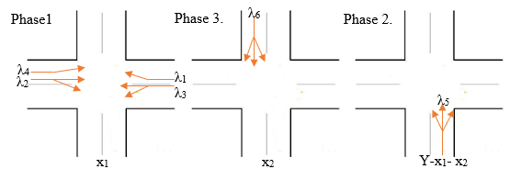
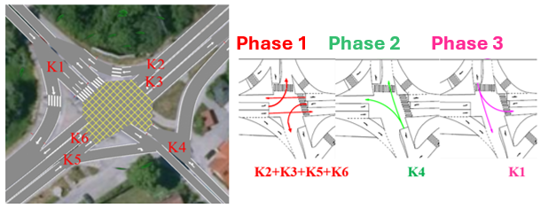
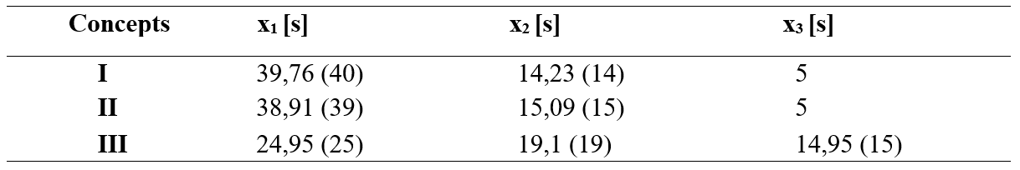
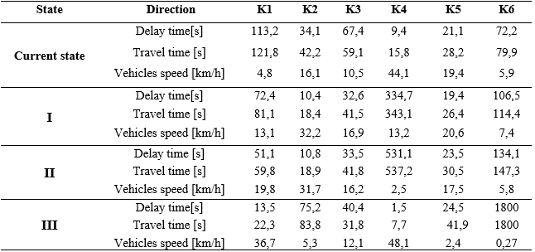
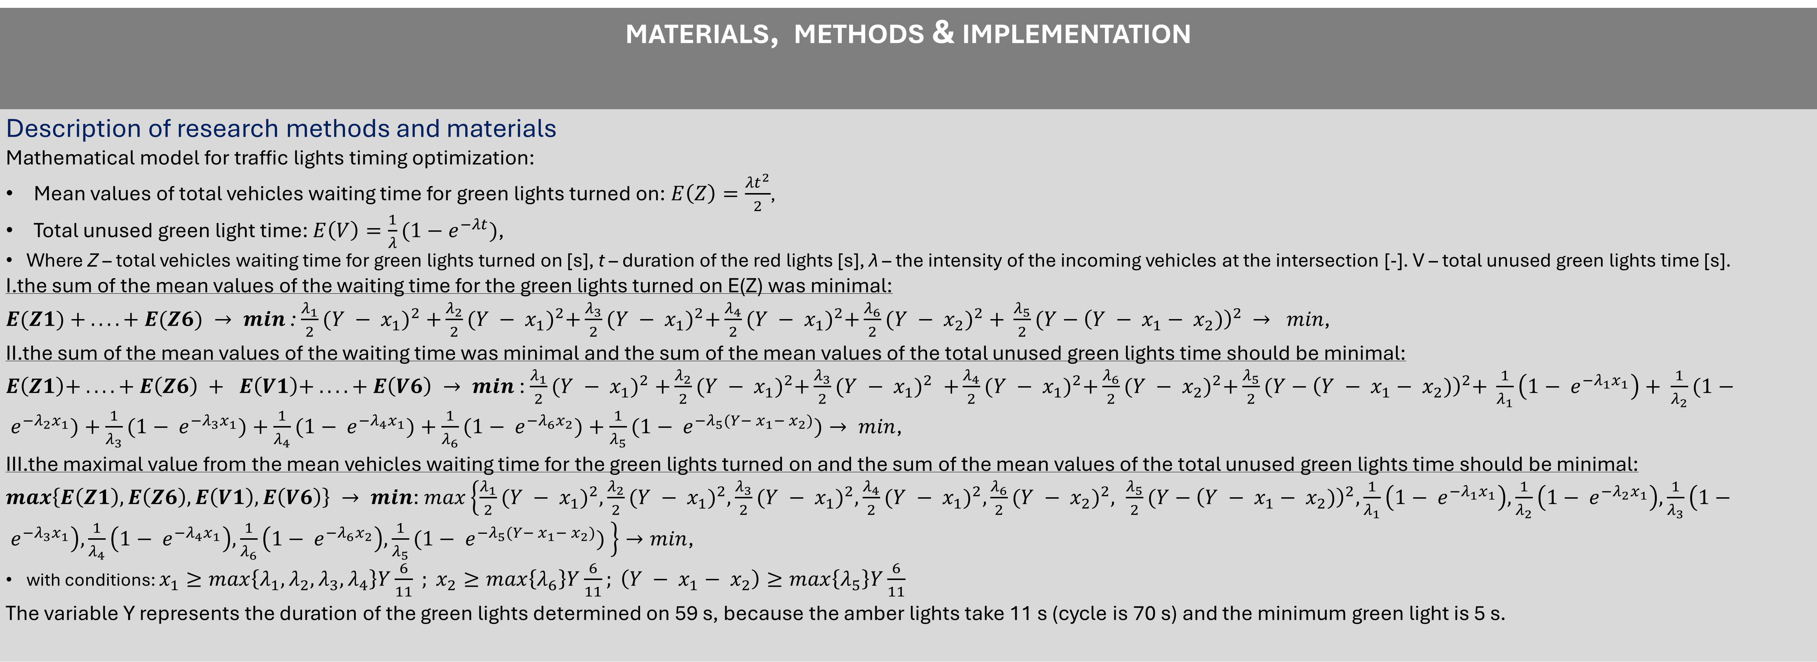
The traffic lights timer optimization model at frequented intersection in small urban area in Slovakia
TRANSCOM 2025: 16th International Scientific Conference on Sustainable, Modern and Safe Transport
Veronika Harantová¹, Kristína Ovary Bulková¹
1 University of Zilina, Faculty of Operation and Economic of Transport and Communications, Univerzitná 8215/1, 010 26 Žilina, Slovakia,
introduction
Backround information & Market Context Optimizing light control systems is crucial for alleviating traffic congestion in Intelligent Transport Systems. Previous research has focused on traffic light optimization as well as simulation-based methods that have led to significant reductions in delays and waiting times. This paper contributes to this field by implementing traffic light timing optimization at an intersection using a mathematical model simulated in AIMSUN software to explore different control scenarios. | Problem Statement & Stakeholders The intersection suffers from significant traffic congestion and long vehicle queues, which highlights the need to optimize the traffic light control system at this intersection. Optimized traffic light timing can significantly reduce average waiting times. Reduced waiting times could benefit for drivers, public transport users, pedestrians. This paper provides valuable data for improving traffic signal control for Traffic Engineers/Planners. | Research Objectives & Expected Impact Objectives: Creating a mathematical model and Simulating various traffic control scenarios in AIMSUN software: I. Minimizing the sum of mean vehicle waiting times. II. Minimizing the sum of mean vehicle waiting times and total unused green light time. III. Minimizing the maximum of mean vehicle waiting time and total unused green light time. Impact: Reduced Traffic Congestion, Increased Intersection Capacity, Improved Travel Time, Enhanced Urban Mobility,...
materials, methods & implementation
Description of research methods and materials Mathematical model for traffic lights timing optimization: Mean values of total vehicles waiting time for green lights turned on:$E\left(Z\right)=\frac{{λt}^{2}}{2}$, Total unused green light time: $E\left(V\right)=\frac{1}{λ}{(1−e}^{−λt})$, Where Z – total vehicles waiting time for green lights turned on [s], t – duration of the red lights [s], λ – the intensity of the incoming vehicles at the intersection [-]. V – total unused green lights time [s]. I.the sum of the mean values of the waiting time for the green lights turned on E(Z) was minimal: $E(Z1) + ....+ E(Z6) → min$ : $\frac{λ_{1}}{2}{(Y − x_{1})}^{2} +\frac{λ_{2}}{2}{(Y − x_{1})}^{2}+\frac{λ_{3}}{2}{(Y − x_{1})}^{2}+\frac{λ_{4}}{2}{(Y − x_{1})}^{2}+\frac{λ_{6}}{2}{(Y − x_{2})}^{2} + \frac{λ_{5}}{2}{(Y−\left(Y − x_{1}− x_{2})\right)}^{2} → min$, II.the sum of the mean values of the waiting time was minimal and the sum of the mean values of the total unused green lights time should be minimal: $E\left(Z1\right)+ ....+ E\left(Z6\right) + E\left(V1\right)+ ....+ E\left(V6\right) → min$ : $\frac{λ_{1}}{2}{(Y − x_{1})}^{2} +\frac{λ_{2}}{2}{(Y − x_{1})}^{2}+\frac{λ_{3}}{2}{(Y − x_{1})}^{2} +\frac{λ_{4}}{2}{(Y − x_{1})}^{2}+\frac{λ_{6}}{2}{(Y − x_{2})}^{2}+\frac{λ_{5}}{2}{(Y−\left(Y − x_{1}− x_{2})\right)}^{2}+ \frac{1}{λ_{1}}\left(1− e^{−λ_{1}x_{1}}\right)+ \frac{1}{λ_{2}}(1− e^{−λ_{2}x_{1}})+\frac{1}{λ_{3}}(1− e^{−λ_{3}x_{1}})+\frac{1}{λ_{4}}(1− e^{−λ_{4}x_{1}})+\frac{1}{λ_{6}}(1− e^{−λ_{6}x_{2}})+\frac{1}{λ_{5}}(1− e^{−λ_{5}(Y− x_{1}− x_{2})})→ min$, III.the maximal value from the mean vehicles waiting time for the green lights turned on and the sum of the mean values of the total unused green lights time should be minimal: $max\left\{E\left(Z1\right), E\left(Z6\right), E\left(V1\right), E\left(V6\right)\right\} → min$: $max\left\{\frac{λ_{1}}{2}{(Y − x_{1})}^{2}, \frac{λ_{2}}{2}{(Y − x_{1})}^{2}, \frac{λ_{3}}{2}{(Y − x_{1})}^{2}, \frac{λ_{4}}{2}{(Y − x_{1})}^{2}, \frac{λ_{6}}{2}{(Y − x_{2})}^{2}, \frac{λ_{5}}{2}{(Y−\left(Y − x_{1}− x_{2})\right)}^{2}, \frac{1}{λ_{1}}\left(1− e^{−λ_{1}x_{1}}\right), \frac{1}{λ_{2}}\left(1− e^{−λ_{2}x_{1}}\right), \frac{1}{λ_{3}}\left(1− e^{−λ_{3}x_{1}}\right), \frac{1}{λ_{4}}\left(1− e^{−λ_{4}x_{1}}\right), \frac{1}{λ_{6}}\left(1− e^{−λ_{6}x_{2}}\right), \frac{1}{λ_{5}}(1− e^{−λ_{5}(Y− x_{1}− x_{2})}) \right\}→min$, with conditions: $x_{1}≥max\left\{λ_{1}, λ_{2}, λ_{3}, λ_{4}\right\}Y\frac{6}{11} ; x_{2}≥max\left\{λ_{6}\right\}Y\frac{6}{11}; \left(Y − x_{1}− x_{2}\right)≥max\left\{λ_{5}\right\}Y\frac{6}{11}$ The variable Y represents the duration of the green lights determined on 59 s, because the amber lights take 11 s (cycle is 70 s) and the minimum green light is 5 s.
results
Academic Findings & Innovation, Practical Applications The optimization of the green lights duration considering expressed concepts (I), (II), (III) was realised by Excel Solver: Observed variables as the simulation output using the optimizing green lights duration mathematical model:
Concept I, (similar to the current situation), resulted in the highest vehicle speeds and the lowest delays.
Concept III proved inefficient, recording extremely high waiting times (over 1800 seconds) and almost zero vehicle speeds.
  This was attributed to the extension of the green light duration in phase 3 (x3).
conclusion & implementation path
Summary of research conclusions, impact and potential areas of further research in this field The aim of this study was to optimize traffic light timing and improve traffic flow using a mathematical model. The model results were simulated using AIMSUN software. The analysis revealed that optimization by minimizing the sum of average waiting times for green lights resulted in the highest average vehicle speed and the lowest waiting times. Other approaches, in particular maximizing unused green light time, proved ineffective and in some directions even worsened traffic flow. The study concluded that mathematical model-based traffic light timing optimization is an effective tool for improving intersection management systems.
acknowledgements
Identify applicable funding agency here, put sponsor acknowledgments and references. The paper was supported by the KEGA Agency, Grant No. 034ŽU-4/2025 „Innovative Project Management Education for Sustainable and Intelligent Transport in the EU in line with Industry 5.0“ at the Faculty of Operation and Economics of Transport and Communications, University of Žilina.

