Slide 1


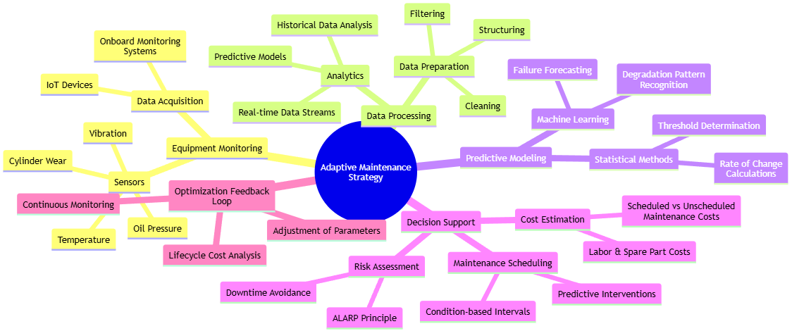
Adaptive Maintenance Strategies for Cargo Ships: Digital Approaches and Cost Optimization
TRANSCOM 2025: 16th International Scientific Conference on Sustainable, Modern and Safe Transport
Andrii Holovan¹, Miroslaw Smieszek², Igor Gritsuk³, Vasyl Mateichyk^{2,4}, Iryna Honcharuk¹, Jakub Mosciszewski²
1 Odesa National Maritime University, Odesa, Ukraine
2 Rzeszow University of Technology, Rzeszów, Poland
3 Kherson State Maritime Academy, Kherson, Ukraine
4 National Transport University, Kyiv, Ukraine
introduction
The maritime sector is under increasing pressure to enhance operational reliability while minimizing costs. Traditional maintenance – scheduled or reactive – fails to fully leverage data-driven insights. | Current systems lack adaptability to dynamic operational conditions. Shipowners, operators, maintenance engineers, and fleet managers seek more efficient, predictive, and cost-effective maintenance strategies. | This study introduces an adaptive maintenance framework using digital technologies (IoT, AI, predictive analytics) to: Reduce downtime Optimize maintenance intervals Lower total lifecycle costs Enhance system reliability
materials, methods & implementation
Methods: IoT-based real-time sensor monitoring (temperature, vibration, oil pressure) Predictive analytics using historical and live data Machine learning models for failure forecasting Cost-benefit analysis incorporating ALARP principles | Implementation: Experimental setup on marine diesel generator Technical condition tracking through wear-rate analysis (oil rings, cylinder bushings) Maintenance scenario modeling (scheduled vs condition-based)
results
Academic Findings & Innovation: Developed dimensionless metrics to track technical degradation Proposed cost functions for adaptive vs scheduled maintenance Quantified effect of condition-based monitoring on failure prevention Practical Applications: Up to 15% cost savings on maintenance per engine Real-time decision-making tools for ship crews and fleet managers Increased operational cycles between cleanings (e.g., from 5500h to 7300h)
conclusion & implementation path
Summary of Research Conclusions: Adaptive strategies outperform traditional maintenance in reliability, efficiency, and cost AI and digital twins offer transformative potential for maritime maintenance Impact & Future Research: Deployment across various vessel types and systems Integration with digital twin platforms Exploration of fleet-wide data aggregation for strategic insights
acknowledgements
This research was conducted within the collaborative framework of Odesa National Maritime University (Ukraine), Rzeszow University of Technology (Poland), Kherson State Maritime Academy (Ukraine), and the National Transport University (Ukraine). We would like to express our sincere gratitude to all the engineers, data analysts, and operational staff who contributed their expertise to the experimental setup and implementation of adaptive maintenance technologies.

