Slide 1


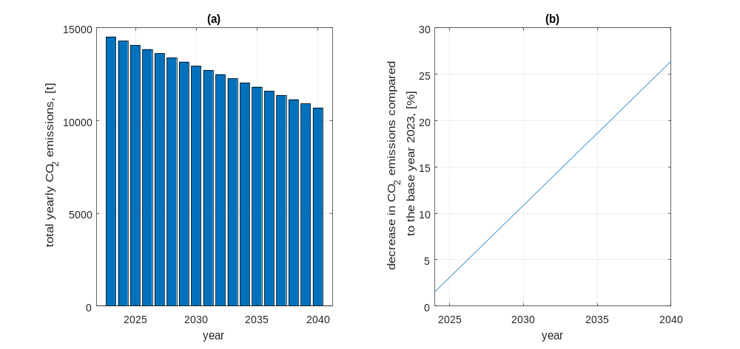
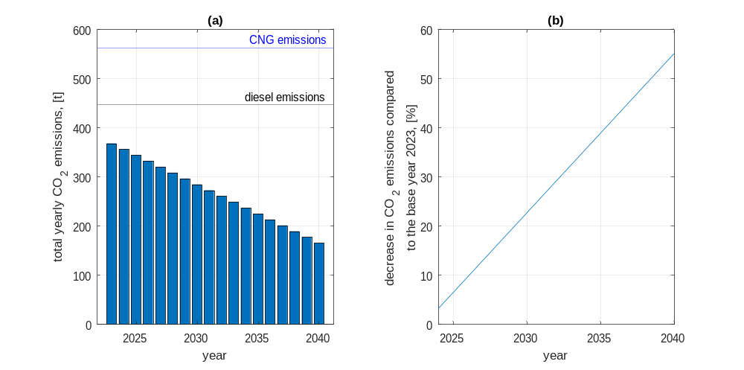
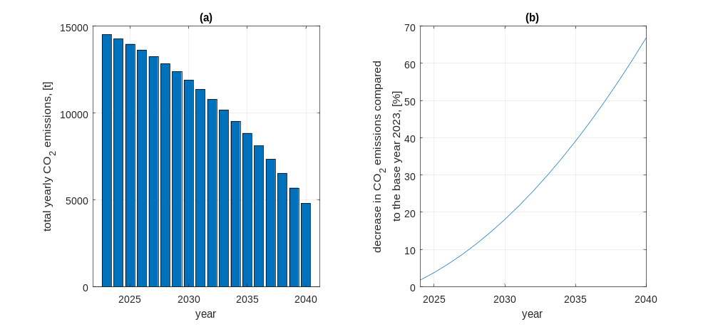
The impact of electrification of public transport on environmental pollution on the example of the city of Rzeszów
TRANSCOM 2025: 16th International Scientific Conference on Sustainable, Modern and Safe Transport
Mirosław Śmieszek¹, Vasyl Mateichyk¹, Jakub Mościszewski¹
1 Rzeszów University of Technology, Rzeszów, Poland
introduction
Sustainable development requires limiting energy consumption and emissions of toxic substances into the atmosphere. In public transport, there is a gradual transition to zero-emission transport means. | The introduction of zero-emission vehicles does not always lead to a significant reduction in emissions of toxic substances into the atmosphere. The decisive factor in the scale of reduction is the method of generating electricity. | Poland has one of the most unfavourable emission rates from electricity generation in the EU. The objective was to analyze potential possibilities of reducing toxic emissions into the atmosphere by replacing public bus fleet.
materials, methods & implementation
Three simulation scenarios were performed. The first scenario included the replacement of conventional buses with electric buses with an unchanged energy mix. The second scenario included a change in the energy mix for electric buses operating on line "0". The third scenario included the replacement of conventional buses with electric buses with a simultaneous change in energy mix. In the first and third scenarios, a constant annual mileage of 12,000,000 km was assumed in the years 2023-2040. In the second scenario, the annual mileage was constant and equal to the mileage on line "0" in 2023. The average values of energy consumption and CO2 emissions characteristic of various fuel types of buses were also constant. The emission factor from electricity generation was assumed to linearly decrease from value of 597 kg CO2/MWh in 2023 to value of 268 kg CO2/MWh in 2040.
results
The first scenario took into account changes in the structure of the bus fleet. It was assumed that conventional buses would be completely eliminated in 2040. In the second scenario, the CO2 emissions resulting from the movement of electric buses on the route "0" were determined. In the third scenario, a simulation was carried out, taking into account the replacement of bus fleet as in the first scenario and additionally a decrease in the CO2 emission factor during the production of electricity as in the second scenario. The entire fleet of city buses was considered. Each simulation scenario showed a decrease in annual CO2 emissions into the atmosphere. In the first scenario, the decrease in annual CO2 emissions of 26% was obtained in 2040. This is mainly due to high CO2 emissions in the electricity generation in Poland. In the second scenario, the decreases in annual CO2 emissions are significant and will reach 55% in 2040. The assumed value of the CO2 emission factor in Poland by 2040 is, however, higher than the current average value for the EU and more than two times higher than the CO2 emission factor for Slovakia. In the third scenario, , the decrease in annual CO2 emissions of almost 67% was obtained in 2040.
Fig. 1. Results of the first scenario Fig. 2. Results of the second scenario Fig. 3. Results of the third scenario
conclusion & implementation path
As the results show, electrification of the bus fleet alone will not bring significant environmental benefits in Poland. The replacement of all conventional buses with electric vehicles in Rzeszów, with an unchanged energy mix, will result in only about a 26% decrease in annual CO2 emissions. The only positive effect is the shift in emissions from the city to the area around the power plant. Analyzing all three scenarios, it can be concluded that, from the point of view of environmental protection, the emission factor for electricity production is the most important. To radically reduce the total emissions from public transport, decisive actions are necessary to force changes in the electricity generation process. Assuming that the predicted value of CO2 emissions in electricity generation in 2040 will occur, the reduction in CO2 emissions from public transport will be radical and will reach a value of more than 66%. The final assumed emission indicator for electricity production in Poland is still higher than the current EU average and definitely higher than the value for Slovakia.
acknowledgements
References Połom, M., Wiśniewski, P., 2021. Assessment of the emission of pollutants from public transport based on the example of diesel buses and trolleybuses in Gdynia and Sopot. International Journal of Environmental Research and Public Health 18, 8379. doi:10.3390/ijerph18168379 Published by Statista Research Department, 10, J., 2024. Electricity production in France by source 2023 [WWW Document]. Statista. URL https://www.statista.com/statistics/768066/electricity-production-france-source/ (accessed 06.01.2025). Dusiło, M.,. Transformacja Energetyczna w Polsce. Edycja 2024 [WWW Document]. Forum Energii. URL https://www.forum-energii.eu/transformacja-edycja-2024 (accessed 06.01.2025). Hebda, W., 2022. Energy Policy Of Poland Until 2040: The Challenges And Threats To Energy Security In The Next Two Decades. Politeja, 79, 167–186. https://www.jstor.org/stable/27193574 Maćkowiak-Pandera, J., Skłodowska, M., Derski, B., Metropolis, Zasuń, R., 2024. Pomysł na transformację energetyczną W polsce czyli jak przeciąć Węgiel Gordyjski [WWW Document]. WysokieNapiecie.pl. URL https://wysokienapiecie.pl/96302-pomysl-na-transformacje-energetyczna-w-polsce-czyli-jak-przeciac-wegiel-gordyjski/ (accessed 06.01.2025). Emissions indicators of CO2, SO2, NOx, CO and total dust for electricity based on information contained in the National Database on Emissions of Greenhouse Gases and Other Substances for 2023, The Institute of Environmental Protection – National Research Institute of Poland, December 2024 EMEP/EEA air pollutant emission inventory guidebook 2023 Engineeringtoolbox, E., 2024. Combustion of fuels - carbon dioxide emission [WWW Document]. Engineering ToolBox. URL https://www.engineeringtoolbox.com/co2-emission-fuels-d_1085.html (accessed 06.01.2025). e funding agency here, put sponsor acknowledgments and references.

