Slide 1


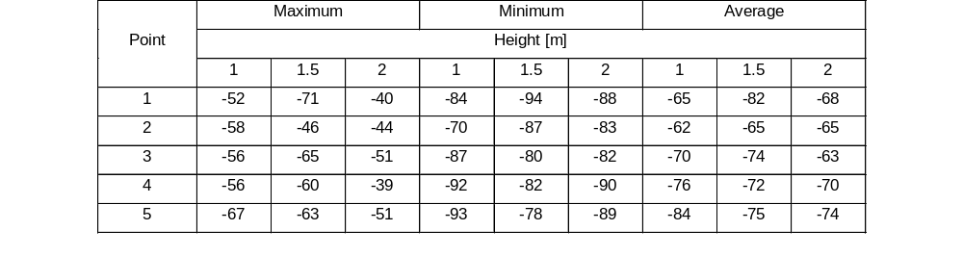

Testing of the Indoor Positioning System Applicable for Healthcare Facilities
TRANSCOM 2025: 16th International Scientific Conference on Sustainable, Modern and Safe Transport
Erika Skýpalová¹, Martin Boroš¹, Eva Sventeková¹, Lukáš Valla¹
1 University of Žilina, Faculty of Security Engineering, Žilina, Slovakia
introduction
The growing interest in practical and effective solutions to everyday problems is related to people's desire to improve their standard of living. Thanks to the accurate real-time localization of users and devices, a number of contextually customized services and protocols have been implemented. As a consequence, intensive research efforts have started in the area of positioning, as GPS systems encounter technical limitations in difficult indoor environments. Based on this, the development of alternative location technologies has been pursued. A network of devices called an indoor positioning system is used to wirelessly locate people or moving objects inside buildings or in places that are partially covered. Indoor positioning systems serve as an alternative to GPS. Compared to GPS, indoor positioning systems are considered to be more complicated, where several factors make them more challenging to implement and require more equipment and infrastructure.
materials, methods & implementation
The aim of the experiment was to investigate the influence of interference from other devices in the electromagnetic radiation spectrum on the quality of the received signal strength. The purpose of this experiment was to find out what impact the normal operation of appliances in the space has on the quality of the signal. For this reason, measurements were made in the kitchen area, since there are several appliances in this area that can affect the signal propagation based on electromagnetic radiation in the form of radio waves (radio), microwaves (microwave) and electronic device emitting infrared radiation, such as refrigerator, kettle and stove. The indoor positioning system consists of transmitting and receiving devices. The transmitting device is a Beacon Gigaset G-Tag Red and the receiving device is a Raspberry Pi Zero 2W microcomputer. The devices communicate with each other via Bluetooth Low Energy technology. The investigated quality of the received signal strength is interpreted by the Received Signal Strength Indicator (RSSI).
results
RSSI values were recorded for 1 minute at each of the determined points, and the maximum, minimum, and average RSSI values for each point were calculated. These appliances were switched on during the measurement to simulate a scene of normal use. 5 measurement points were marked on the floor where the received signal strength was measured at heights of 1 m, 1.5 m and 2 m. The distances of these points from the receiving device ranged from 0.69 m to 1.46 m. The points were placed close to the appliances to maximise the effect of interference on the measurement. The signal receiving device was placed on the refrigerator at a height of 2 m. At each of the 5 measurement points, the measured values were recorded at constant intervals for 1 minute. Figure interprets the measured RSSI values at each point at a height of the transmitting device of 1 m. At point 1, a maximum value of -52 dBm, which also represents the highest measured value, a minimum value of -84 dBm and an average value of -65 dBm were obtained. At point 2, the average value reached -62 dBm, the minimum value reached -70 dBm and the maximum value reached -58 dBm. The measured maximum values of -56 dBm are the same for points 3 and 4. At point 5, the lowest measured RSSI value of -93 dBm can be seen. Consequently, at point 4 the minimum RSSI value reached -92 dBm. The measured average value reached -70 dBm at point 3 and at point 4 it reached -76 dBm. At point 5, the average RSSI value was -84 dBm.
conclusion & implementation path
The difference of RSSI values at points 1-5 can be observed to be significantly different. In this type of testing, the RSSI values are influenced by the presence of switched on appliances in addition to height and distance. The influence of appliances is significant at point 1, where there is a decreasing and then increasing difference in average values depending on the height of the transmitting device. The average RSSI value at point 2 has only decreased by -3 dBm. At point 3, the lowest average RSSI value was -74 dBm. At points 3, 4 and 5 there is an increase in values from 1 m height to 2 m height. Based on these results, it can be concluded that the presence of switched on appliances can have a significant effect on the propagation of radio signals between the devices forming the indoor positioning system. It can also be concluded that the height of the transmitting device also has an influence on the quality of the received signal strength. The results obtained show that at points 3, 4 and 5, there was an increase in RSSI values as the height of the transmitting device increased. It is assumed that this phenomenon occurred because the transmitting and receiving devices were at the same height level. However, for points 1 and 2, this phenomenon did not occur; on the contrary, the RSSI values decreased as the height of the transmitting device increased. In both cases, however, these are not significant differences that would ultimately have a significant impact on the actual positioning in space.
acknowledgements
The article was created with the support of the project of the University of Žilina KEGA 041ŽU-4/2023 An education and training module expanding the knowledge, skills and competencies of students on the emergency services programme.

