Slide 1


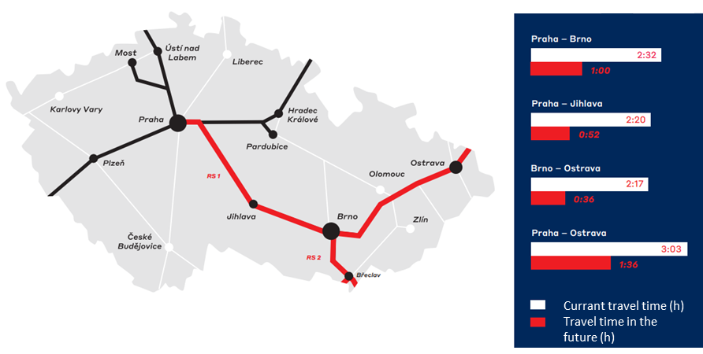
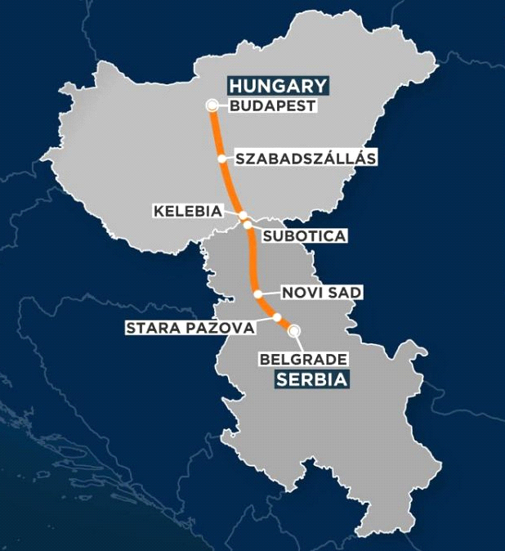
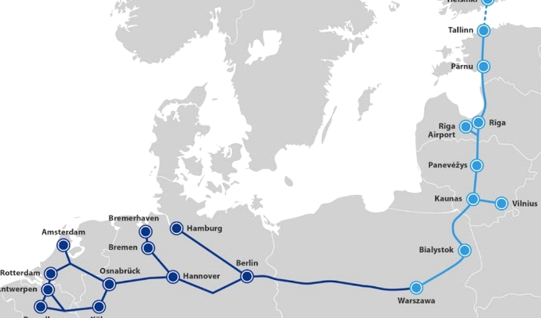
Railways in Slovakia: Current State and Perspectives of High-Speed Lines
TRANSCOM 2025: 16th International Scientific Conference on Sustainable, Modern and Safe Transport
Jana Fabianova¹, Jan Palinsky^{1,2}, Ladislav Rigo¹, Peter Michalik³
1 Technical University of Kosice, Košice, Slovakia
2 Slovak Railway Company, Košice, Slovakia
3 Technical University of Košice with seat in Prešov, Slovakia
introduction
High-speed railways (HSR) represent a significant part of the modernization of transport infrastructure, with which countries respond to the need for an efficient, sustainable, and ecological mode of transport. HSR is a railway subsystem with a commercial speed of 250 km/h. | The implementation of high-speed railways in the Slovak Republic brings specific challenges associated with geographical, economic, and technological conditions. | The aim of the paper is to examine the current status, possibilities, and perspectives of the development of high-speed railways in Slovakia and their connection with the V4 countries.
materials, methods & implementation
Slovakia has a relatively dense railway network with a total length of over 3,600 km of tracks. The main corridors include the Bratislava central station – Košice and Kúty state border – Štúrovo state border, which are part of the TEN-T corridor. Railway infrastructure currently includes 196 km of tracks with a maximum speed of 160 km/h. However, Slovakia´s Railway faces several challenges that affect the efficiency, reliability, and economic operation of railway transport. The railway infrastructure is outdated and requires modernization. Many sections of the main lines do not have sufficient capacity to handle high-speed trains, and speeds are often limited to 60-80 km/h. Currently, the main corridor is being modernized to increase its speed to 160 km/h. The modernization of many selected sections is also underway. The primary research is conducted to explore the state of the railways of the V4 countries in the context of HSR.
results
The state of the railways in Czech Republic
The Czech Republic has the densest railway network in Central Europe. The length of state lines is a total of 9,365 km, of which 7,337 km are single-track and only 1,981 km are double-track (21%) and 58 km are multi-track. In the Czech Republic, 700 km of HSR are being prepared and should be implemented by 2050. In the future, HSR should connect Prague with Dresden, Prague with Brno, and the corridor between Ostrava and Prosenice.
The main objectives of the HSR project: increasing the competitiveness of rail transport, connect the leading centres in the Czech Republic, increase the use of rail transport, shortening travel times between the Czech Republic's main economic centres, increasing the speed to 160-200 km/h.
The state of the railways in Hungary
The main corridors lead from it to Austria, Slovakia, Romania, and Serbia. Most of the corridors have a maximum speed of 120 km/h, with sections with a speed of 160 km/h between the Tata and Hegyeshalom stations. At the moment, reconstruction is underway on the line from Budapest to Kelebia to increase speed and connect to the high-speed line Belgrade - Novi Sad – Subotica. However, freight trains will reach a maximum speed of 120 km/h, while the maximum speed on the section from Belgrade to the state border with Hungary is 200 km/h. The line Budapest-Belgrade is planned to be extended by 1,500 km so trains can run to Athens.
The state of the railways in Poland and the Baltics
Poland has the longest railway network among the V4 countries, with a length of over 19,000 km, of which approximately 60% is electrified. Poland is investing significantly in modernizing its railway infrastructure, with some main corridors allowing a maximum speed of 200 km/h. ne of the most important transport projects at present is the CPK (Centralny Port Komunikacyjny) a transport hub that will be located between Warsaw and Łódź. Rail Baltica is one of the important transport projects in the eastern part of the European Union. The project aims to connect the Baltic capitals Tallinn, Riga and Vilnius with Warsaw. The high-speed Rail Baltica line will be designed with a maximum speed of up to 250 km/h for passenger transport.
Risks of implementing HSR
Low investment return, technically challenging in mountainous or geologically complex areas, legislative and administrative obstacles, environmental and social impacts.
conclusion & implementation path
High-speed railways represent an opportunity for Slovakia to modernize its transport infrastructure. Slovakia faces significant barriers, such as outdated infrastructure, financial constraints, and legislative complexities, the potential benefits of high-speed railways are substantial. These include improved mobility, environmental sustainability, economic growth, and increased competitiveness on a regional and international scale. Furthermore, learning from the experiences of V4 neighbors—such as the Czech Republic’s advanced planning, Hungary’s international collaborations, and Poland’s ambitious investment in high-speed rail—provides valuable insights for Slovakia's strategic planning. High-speed railways have the potential to significantly contribute to the sustainable development of Slovakia.
acknowledgements
This paper was developed within the project implementations KEGA 010ŽU-4/2023, VEGA 1/0674/24, VEGA 1/0488/23, APVV-21-0195, and SK-SRB-23-0054.

