Slide 1


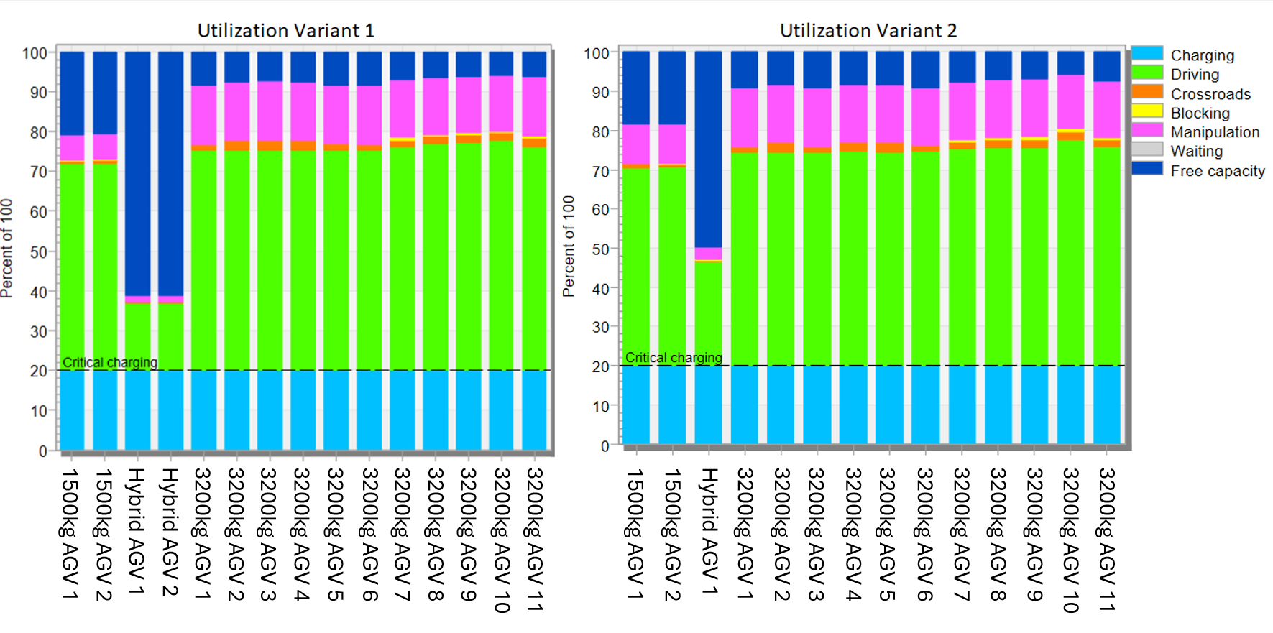
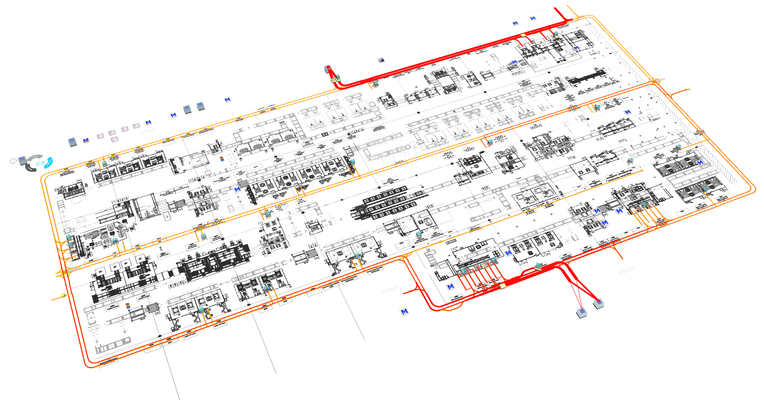
Design and simulation of the AGV logistics system: Case study
TRANSCOM 2025: 16th International Scientific Conference on Sustainable, Modern and Safe Transport
Milan Marčan¹, Patrik Grznár², Ladislav Papánek³, Dávid Komačka⁴
1 University of Žilina, Žilina, Slovakia
2 University of Žilina, Žilina, Slovakia
3 University of Žilina, Žilina, Slovakia
4 University of Žilina, Žilina, Slovakia
introduction
This study focuses on the design and simulation of an Automated Guided Vehicle (AGV) logistics system for a newly constructed battery manufacturing facility. | The aim was to address challenges in supplying production lines, handling empty pallets, and transporting finished goods. | Using simulation tools, the logistics system was designed to optimize throughput and operational efficiency, with findings providing key insights into AGV utilization, pathway design, and system flexibility.
materials, methods & implementation
This study used simulation-based design to develop an AGV logistics system for a new battery production facility. Three types of VDA5050-compliant AGVs were deployed to handle various pallet weights and tasks. Two layout and fleet variants were tested in 14-day simulations, focusing on AGV utilization, charging schedules, and route efficiency. The chosen solution used synchronized AGV pairs and a mix of fixed and flexible routes to optimize material flow and minimize downtime.
results
Two system variants were tested through 20 simulation runs, each covering 14 days of continuous production. The simulations focused on AGV utilization, charging efficiency, waiting times, and route optimization. Variant 1, with 15 AGVs (including 2 hybrid AGVs), demonstrated a higher overall efficiency, especially in synchronized pallet exchange, despite lower utilization of the hybrid AGVs. Variant 2 reduced the number of hybrid AGVs to one, improving its utilization but increasing pallet exchange times due to the lack of synchronization. Simulation outputs included AGV utilization graphs, Sankey diagrams, and bottleneck visualizations, allowing in-depth analysis of system behavior. The average utilization of 3200 kg and 1500 kg AGVs remained above 79% in both variants, confirming their sufficient workload capacity. Variant 1 was ultimately chosen due to better performance in minimizing idle times and ensuring smoother material flow between warehouse and production lines.
conclusion & implementation path
The proposed AGV system, combining fixed and flexible routes with synchronized vehicle pairs, achieved a strong balance between efficiency and adaptability. Despite the lower utilization of hybrid AGVs, Variant 1 was selected for implementation due to faster pallet exchange and smoother material flow. The use of VDA5050-compliant devices ensures long-term system flexibility and compatibility with future upgrades. Simulation proved essential for optimizing design decisions before real-world deployment. The implementation will follow a phased approach, beginning with infrastructure setup, AGV fleet deployment, and gradual system integration, allowing for testing, fine-tuning, and full-scale operation without disrupting production.
acknowledgements
This research was funded by Slovak Research and Development Agency, grant number APVV-21-0308, grant agency VEGA under the contract No. 1/0150/24, and grant agency KEGA under the contract No. 017ŽU-4/2025.

